Slide 1
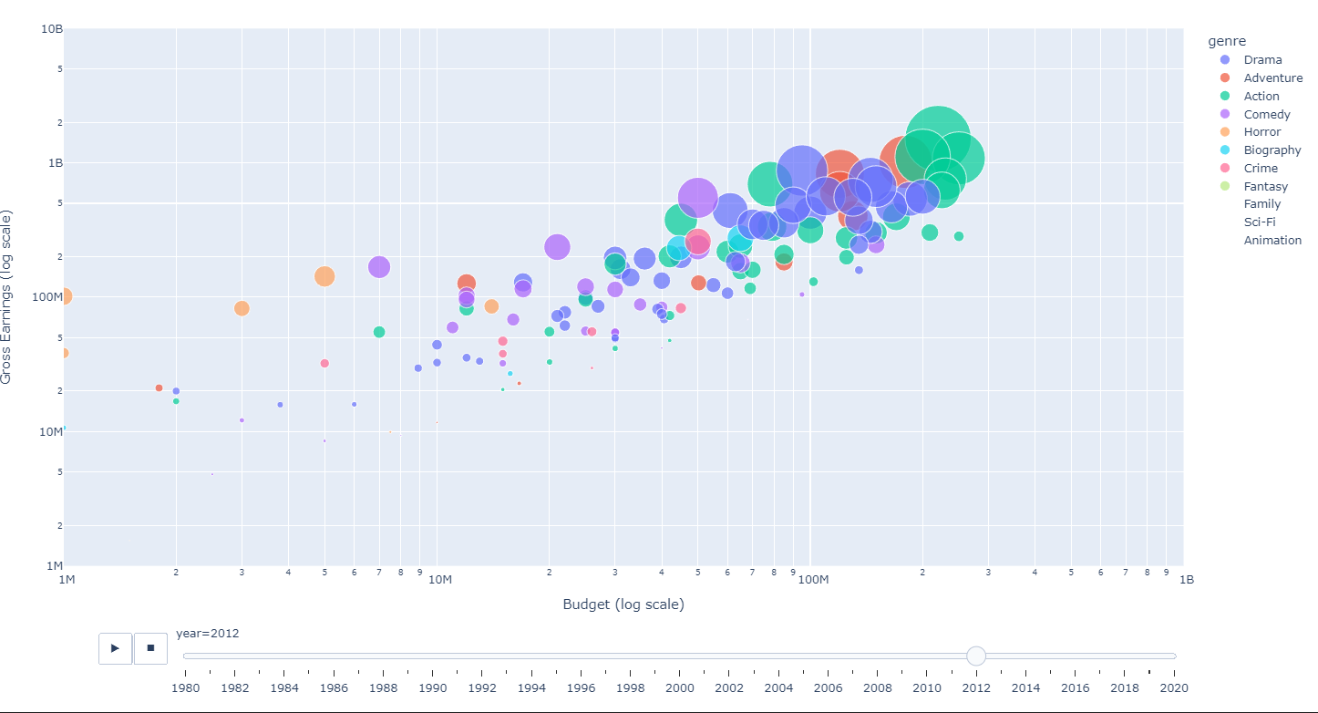
PHASE ONE PROJECT
By. Robinson Mumo

Slide 2
PROJECT GOALS
The EDA process was directed by the following questions:
1. What are the highest grossing film genres Microsoft can invest in?
2. What are the best combinations (if any) of the highest grossing films by genre
3. Who are the best directors for that job?
4. BONUS: An animated visualization of trends of movies since 1980

Slide 3
DATA
SQL Database: There is a im.db relational database. The SQL file was provided in the instructions. It contains a comprehensive collection of movie-related data, including information on genres, directors, and more.
TSV Files: Two TSV (Tab-Separated Values) files were used, presumably containing supplementary data for the analysis. One has reviews
CSV Files: Two CSV (Comma-Separated Values) files were included, likely containing additional information about movies.n one of the files was downloaded from Kaggle. https://www.kaggle.com/datasets/danielgrijalvas/movies

Slide 4
EDA PROCEDURES
Importing all necessary packages i.e
numpy,
pandas,
sqlite3,
matplotlib.plotly & pyplot
Loading the data into dataframes
Cleaning the data
This process entailed
Handling missing values
Handling duplicates
Data transformation as needed (to strings or floats where applicable)
Outlier handling i.e. one dataset contained data from year 2115

Slide 5
EDA METHODS
Added relevant columns as needed
New columns were created to aid in analysis. For example, the to calculate profit, you create a new column from gross profit and budget
Data cleaning following this process since the created column of profit contained negative figures. The negative values were converted to 0
Combined DataFrames
A mask was applied to one DataFrame i.e sql_df and filtered then combined with data from movies_df. Movies DF was inner joined. The aim was to calculate the gross revenue per genre. One DF contained most genres and they were inner joined with movies_df which had the earnings data

Slide 6
RESULTS – Question 1
What are the highest grossing film genres Microsoft can invest in?
The top 3 highest grossing genres are Action, Comedy and Animation
Most Movies do not fall into a single genre. They have multiple genres.

Slide 7
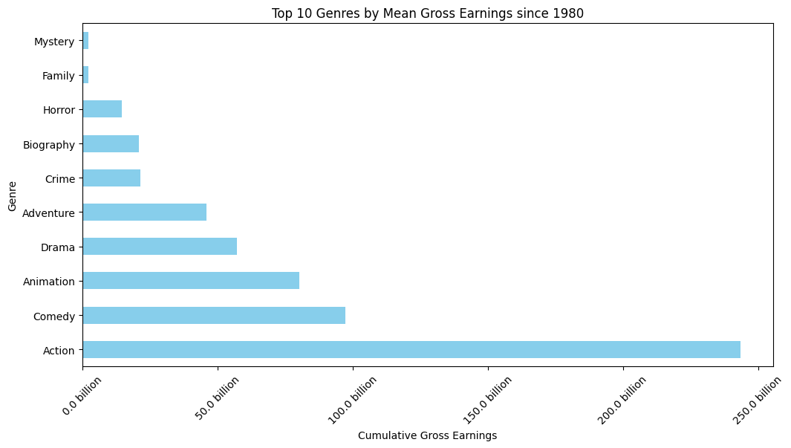

Slide 8
RESULTS: Question 2
What are the best combinations (if any) of the highest grossing films by genre
The most common genre combinations are Comedy and Drama
So we'd advise Microsoft to create a movie on comedy and or drama

Slide 9
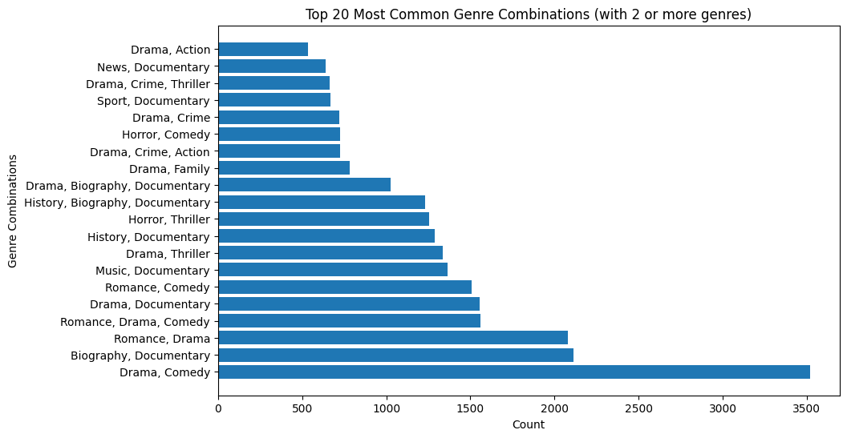

Slide 10
RESULTS – Question 3
Who are the best directors for that job?
Since we understand that the best genres are Animation, Comedy and Drama,
The directors with highest experience (by number of movies) and most successful by their gross income in these areas are:
Comedy - Garry Marshall, Woody Allen
Drama - Barry Levinson
Animation – ‘Directors’
NB: Under animation, there are assorted directors who have created the best animated movies. But if it is a name, Robert Zemeckis and Richard Linklater. Each has 4 and 2 animated movies respectively

Slide 11
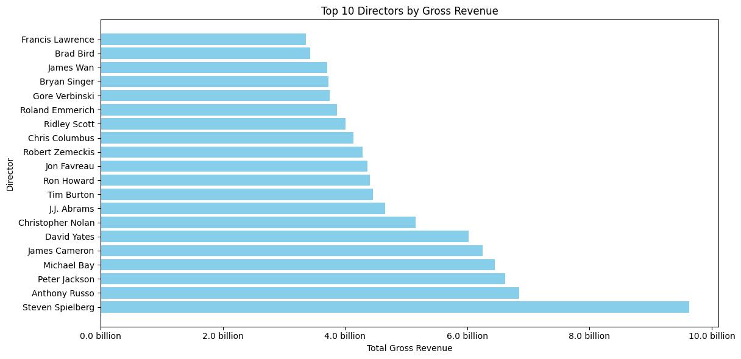

Slide 12
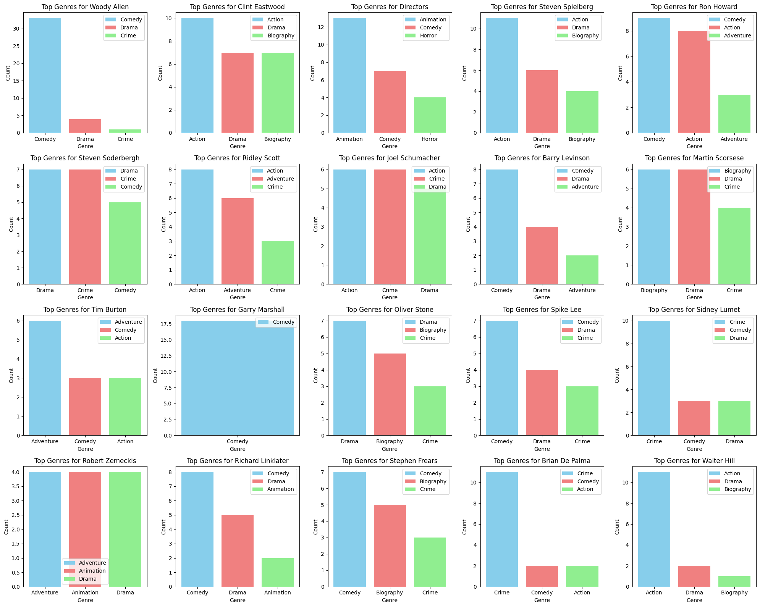

Slide 13
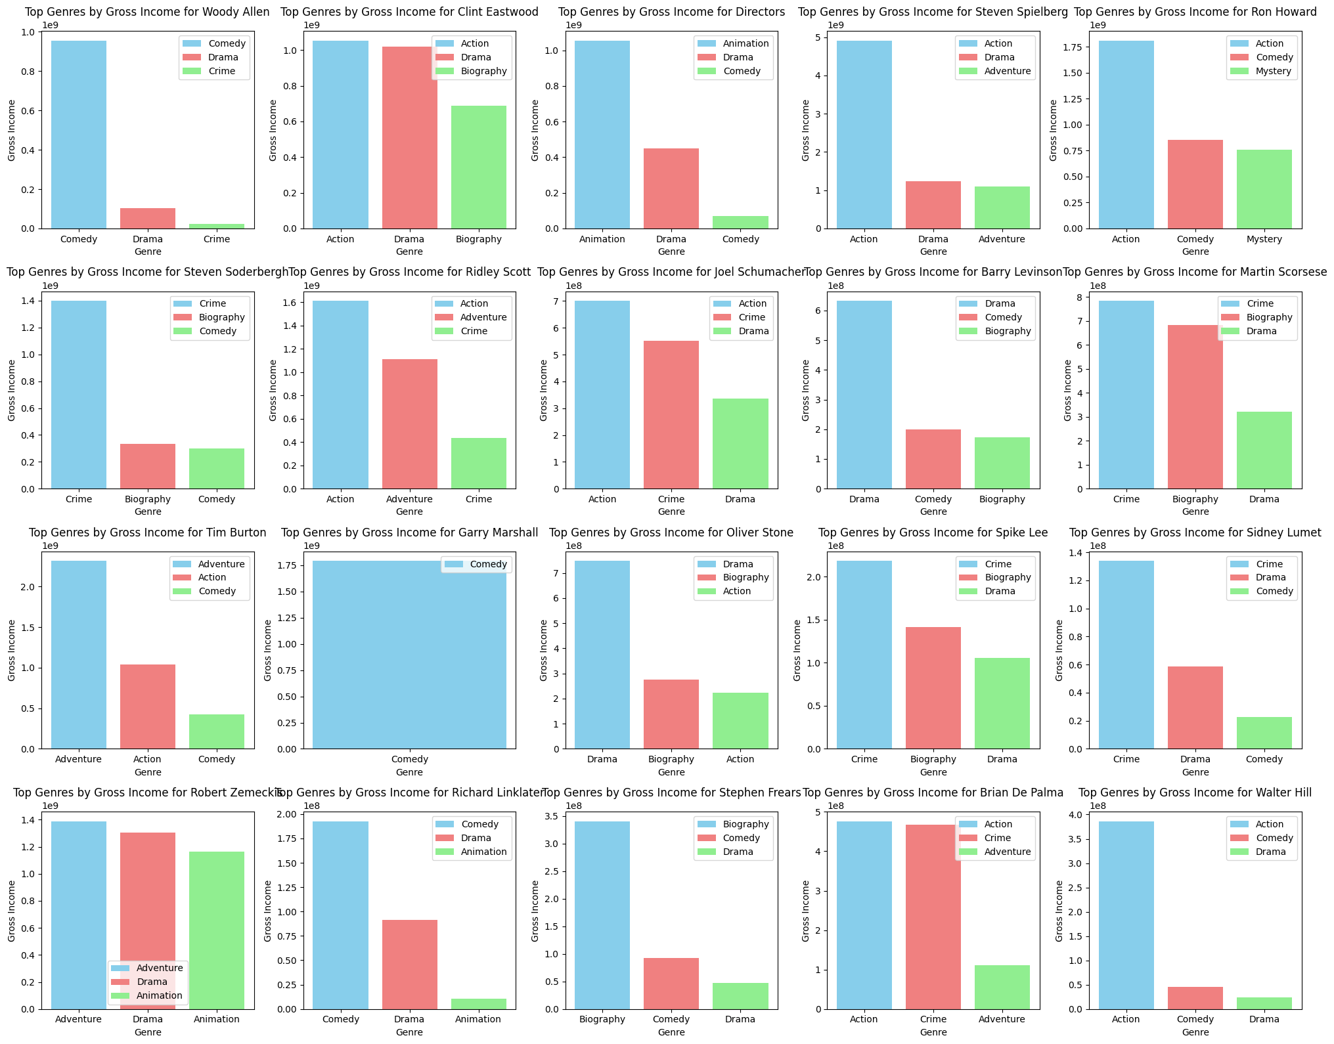

Slide 14
BONUS
This animation shows that there has been an increase in Budget and Earnings from each movie since 1980s
There is a general trend in increase in cost of producing the movies
Animations and comedy seems to be some of the highest grossing movies since 2010
Please Note that this is an animation from the .ipynb

