Slide 1
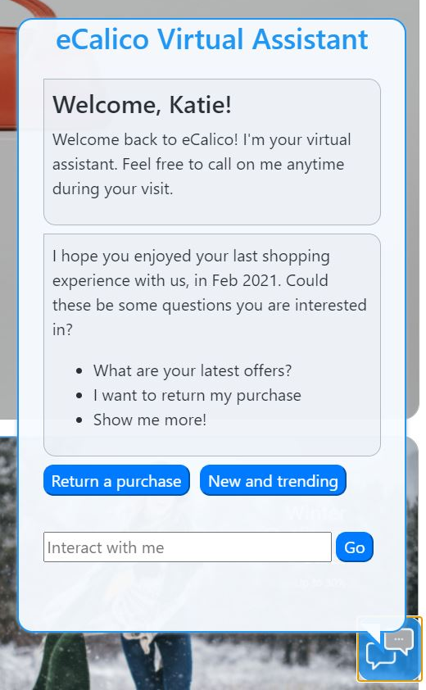
Frictionless customer experiences, across all customer journeys, lead to better Customer Satisfaction & Loyalty
Frictionless customer journeys @ eCalico
Key Points
Faster time to value, through a conversational interface
Multiple Decisions orchestrated
Multi-disciplinary AI

