Slide 1
Supercritical Fluid Chromatography
Or SFC for short

Slide 2
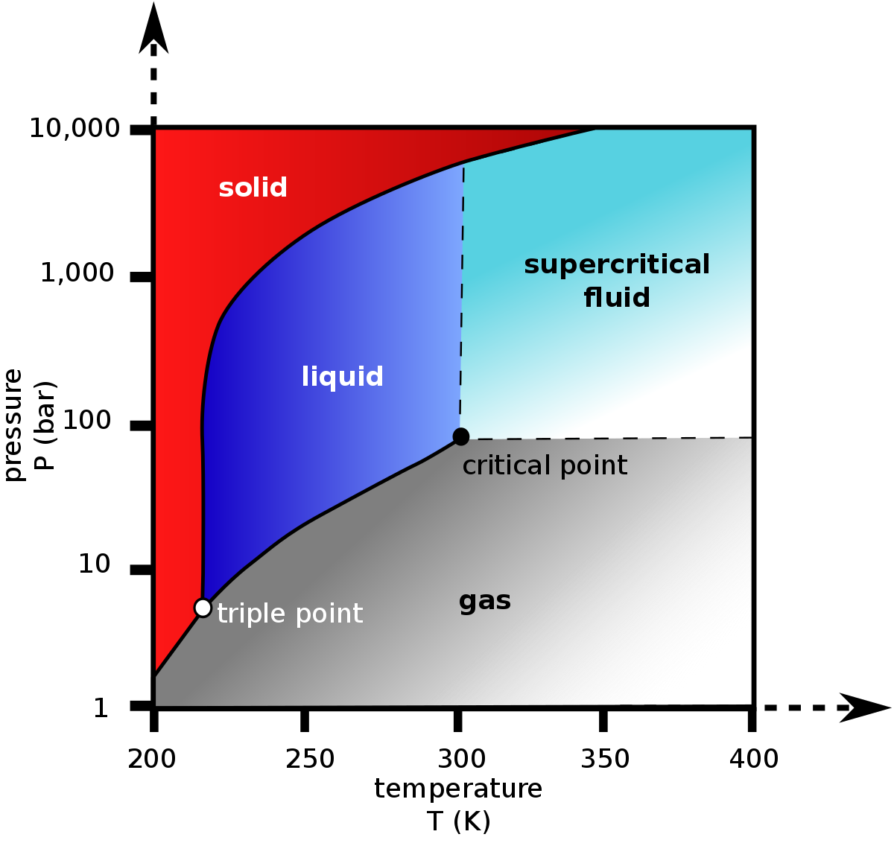
Fig 1. Diagram of a carbon dioxide pressure-temperature
Source: https://upload.wikimedia.org/wikipedia/commons/thumb/1/13/Carbon_dioxide_pressure-temperature_phase_diagram.svg/1200px-Carbon_dioxide_pressure-temperature_phase_diagram.svg.png

Slide 3
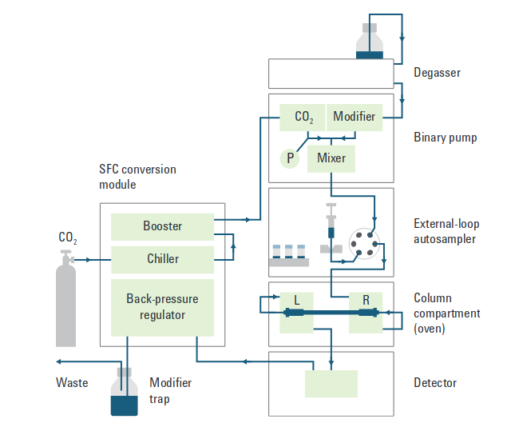
Fig 2. Diagram of a Agilent analytical SFC system.
Source: https://www.agilent.com/cs/library/primers/public/5991-5509EN.pdf

Slide 4
Questions?

