Slide 1
Financial News Sentiment Analysis
Can a computer classify headlines like a human?

Slide 2
The problem
Problem Statement
Context
Criteria for Success
Goldman and Sachs is an investment bank and they want to improve their current trading strategies by using NLP to correctly classify financial news as either positive, negative or neutral sentiment with over 80 % accuracy.
The Data Science team has access to over 4,000 labeled news headlines
Kaggle Dataset
Over 80 % total accuracy
Over 75% precision and recall for positive and negative sentiments

Slide 3
NLP - Approaches
Bag of Words
RNN
Sentence Transformers
Word Counts
Using word counts and probabilities to make a prediction
Visualize Keywords that indicate sentiment
GLOVE-Embeddings
Improve Prediction with word embeddings and RNNs
Hugging-face
Utilize state of the art transformers to improve prediction accuracy

Slide 4
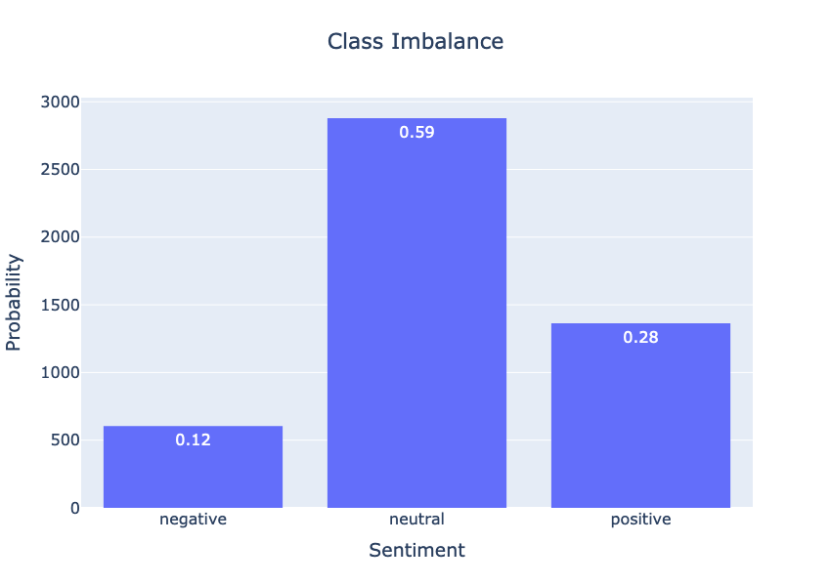
Our Data
4846 Labeled Headlines
Class Imbalance
Negative: 12 %
Neutral: 59 %
Positive: 28 %
This is our Prior Probability

Slide 5
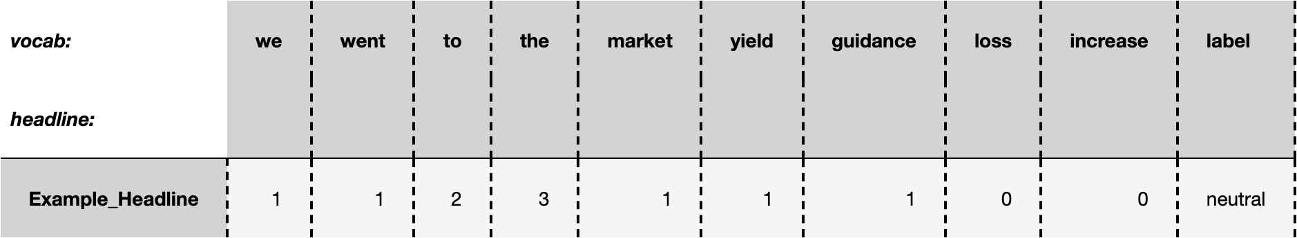
Bag of Words Example
Headline:
“We went to the market with yield guidance of the 7.25 % area , which gave us the flexibility to go up or down by 1-8th.”

Slide 6
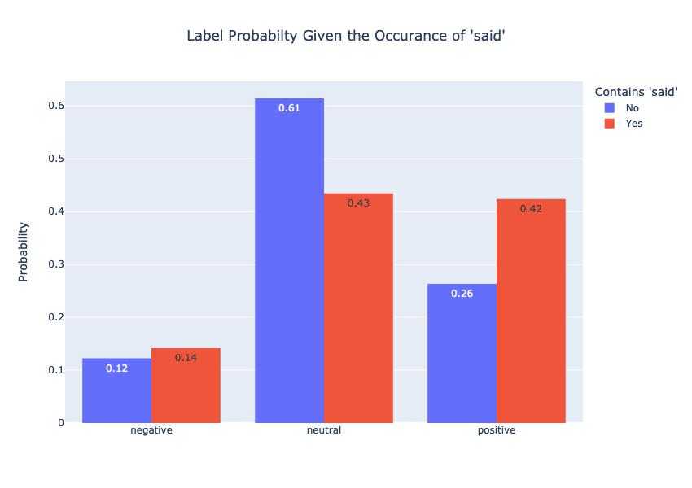
Sentiment Probablity Given the word “said”
Steakholders Insights
Quote Headlines
i.e()
18% less likely to have a neutral sentiment if the headline contains the word “said”
16 % more likely to have a positive sentiment if the article contains the word “said”

Slide 7
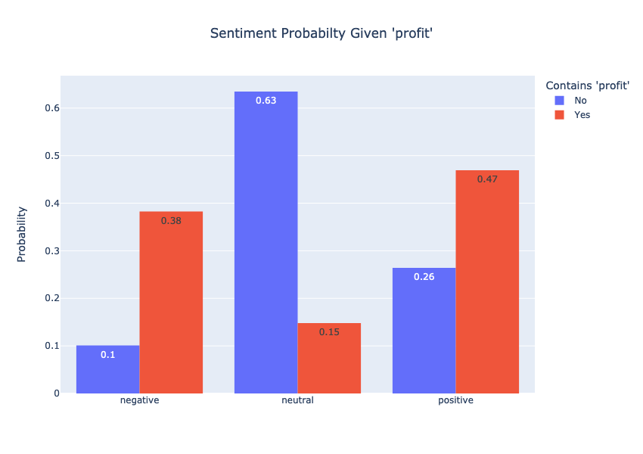

Slide 8
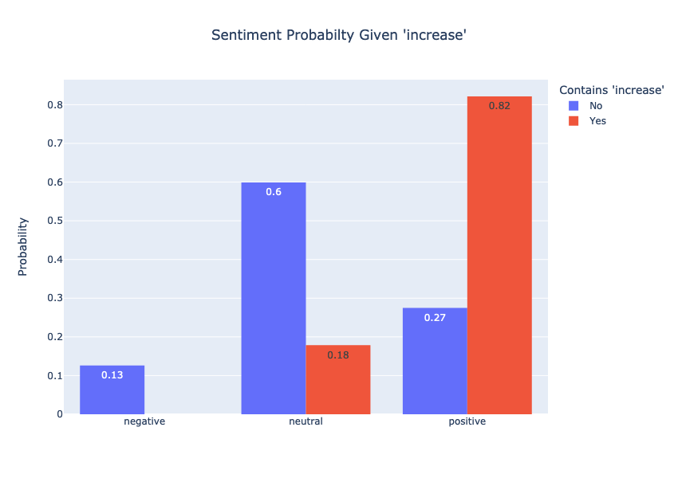
Sentiment Probability Given “increase”

Slide 9
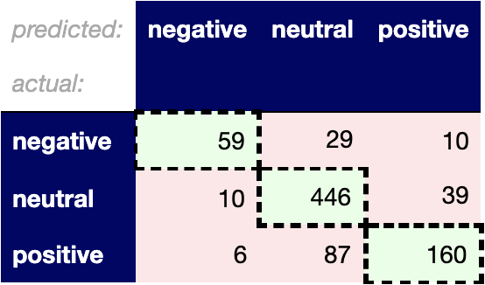
BOW Model Performance
Accuracy: 78%
Positive:
Precision: 60.2 %
Recall: 78.7 %
Negative:
Precision: 63.2 %
Recall: 76.6%

Slide 10
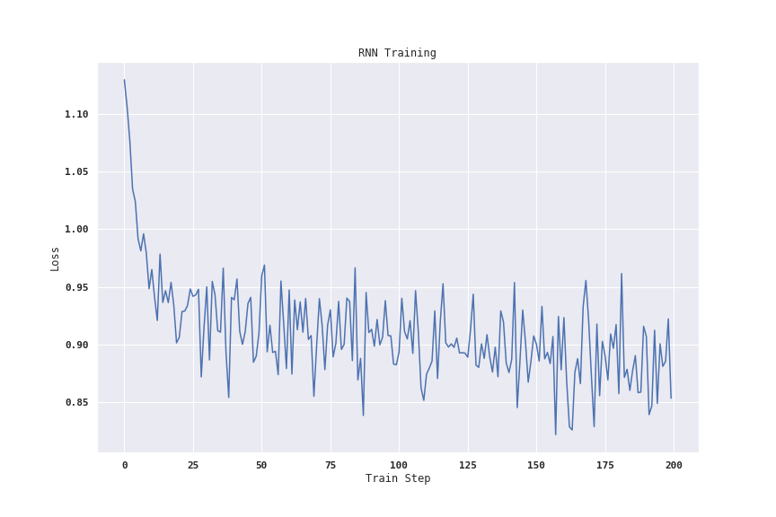
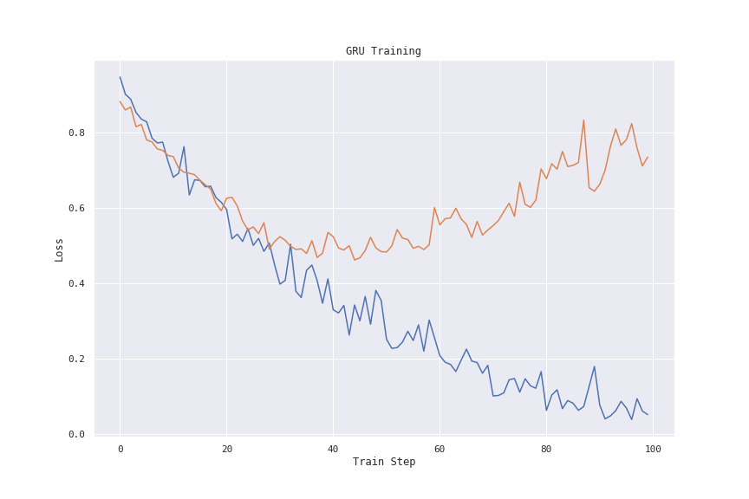
RNN Training vs GRU Training

Slide 11

RNN Model Performance
Accuracy: 80%
Positive:
Precision: 69.1 %
Recall: 77.3 %
Negative:
Precision: 70.1 %
Recall: 73.9 %

Slide 12

Sentence Transformers Results
Accuracy: 85 %
Positive:
Precision: 77.5 %
Recall: 81 %
Negative:
Precision: 79 %
Recall: 83 %

Slide 13
Future Work
Classify Unlabeled Financial News Articles around a certain stock ticker as Positive, Negative, or Neutral
Predict change on the day based on the news classification and prior days.
Support online learning, so the model continues to learn as its fed new news articles
NLP will always have an impact on financial markets

Slide 14
Sources
Sinha, Ankur. “Sentiment Analysis for Financial News.” Kaggle, 27 May 2020, https://www.kaggle.com/ankurzing/sentiment-analysis-for-financial-news.

