Slide 1
Big Mountain Ski Resort
Data Science Guided Capstone

Slide 2
Problem Statement
Big Mountain Ski resort is not confident in their current ticket pricing strategy. The executives at Big Mountain Ski resort wants to know their relative position in the ski resort market and a data driven plan for increasing revenue by 2 % over the next year.
Criteria For Success:
MAE

Slide 3
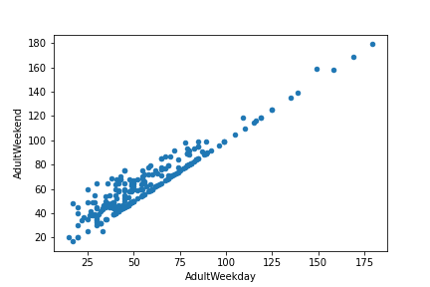
Target Variable and Data Cleaning
Adult Weekend: 4 Missing Values
Adult Weekday: 7 Missing Values
Very Highly Correlated

Slide 4
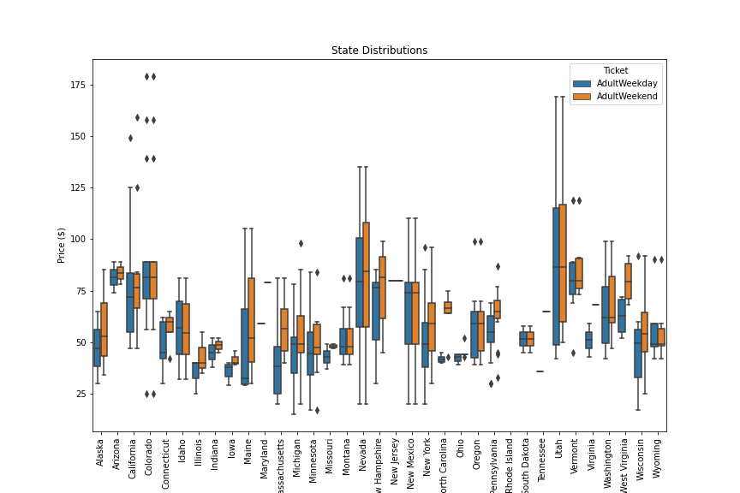
Distribution of Price By State
Price Distribution in Montana:
Montana 25th Percentile: $ 44.0
Montana Median: $ 48.0
Montana 75th Percentile: $ 56.5
Our Weekend Price: $ 81.00

Slide 5
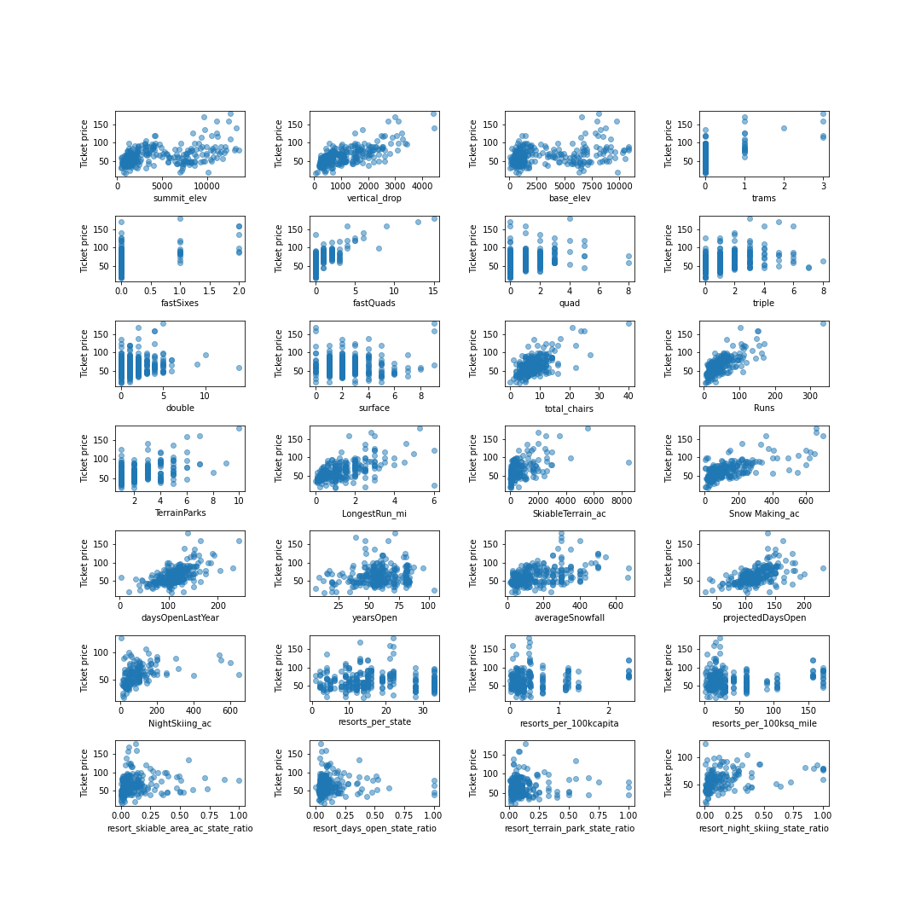

Slide 6
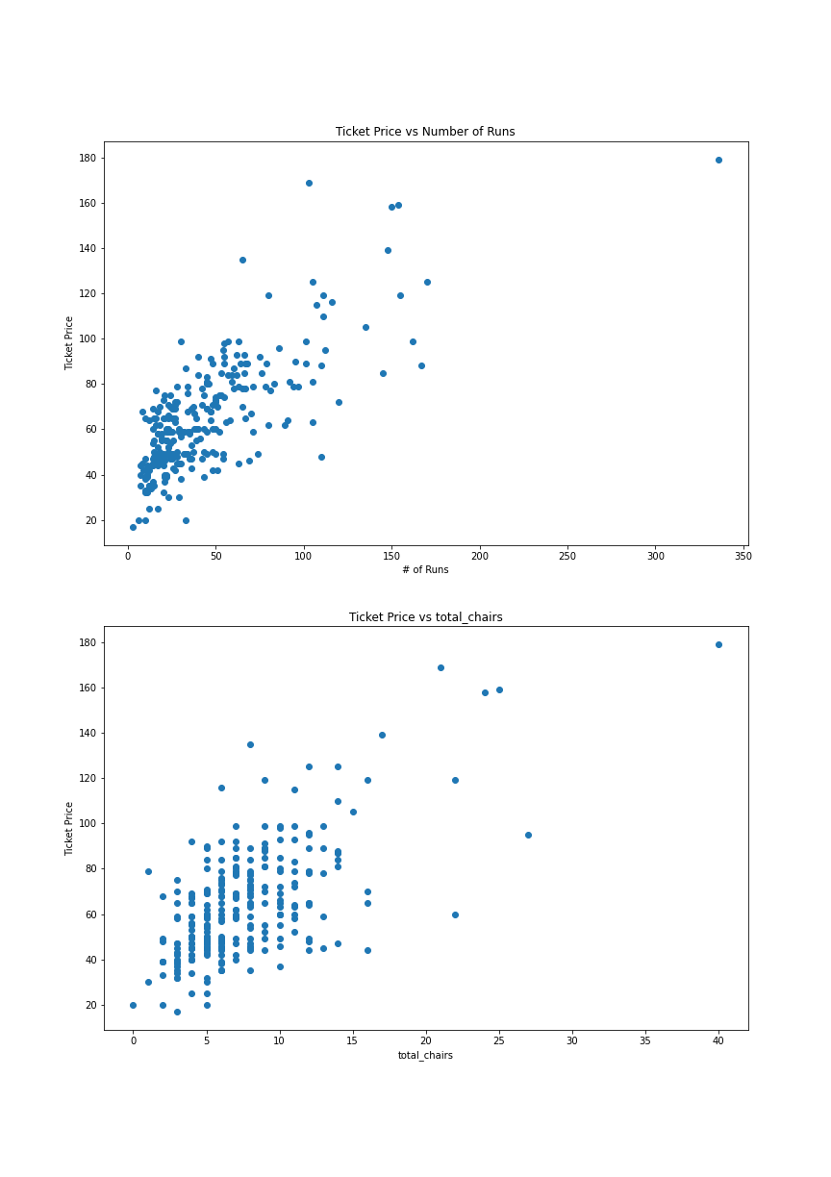
Total Runs and Chairs
Total Runs are highly correlated with Ticket Price
Total Chairs are also highly correlated with Ticket Price
Both worth considering to improve revenues

Slide 7
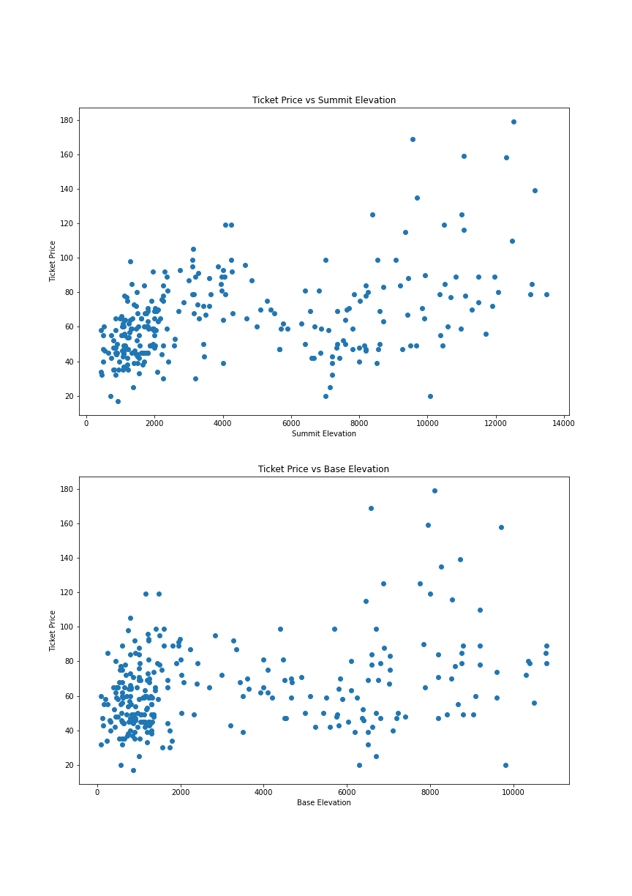
Feature Engineering
Feature Engineering Ideas:
‘Summit_elev’ > 6000
‘Base_elev’ > 4000
Np.polyfit(‘base_elev’, price, deg=3)
Could only use training data!

Slide 8
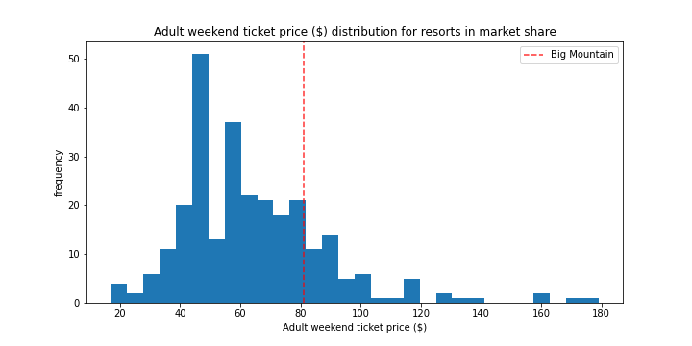

Slide 9
Model Selection and Metrics
Random Forest Regressor
MAE: $10.39
Big Mountain Resort Predicted Value: $95.87
Actual Value: $81.00

Slide 10
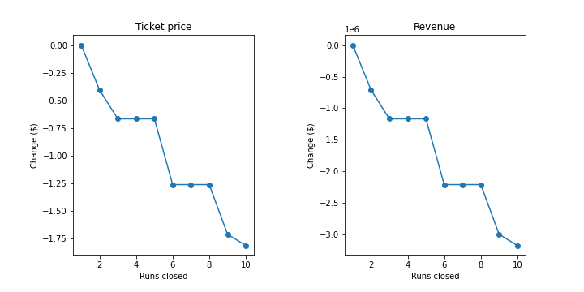
Suggested Changes
adding a run, increasing the vertical drop by 150 feet, and installing an additional chair lift
Increased projected ticket price by $1.99
Projected Revenue increased by $3474638
Adding acres of snow making
No Change
increasing the longest run
No Change

