Slide 1
Python in a Day
Session #2

Slide 2
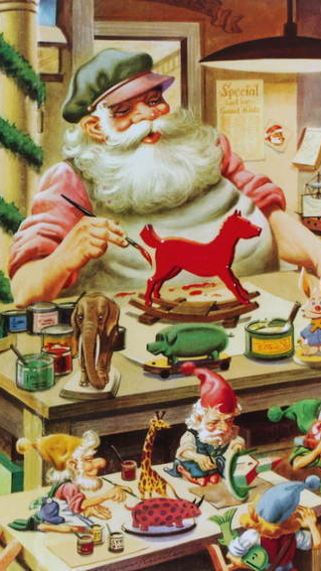
Functions
Defining your own

Slide 3

Defining a Function
Reusable chunk of code

Slide 4
Defining a Function
Reusable chunk of code
Build action from basic functions

Slide 5
Defining A Function
def double(my_name):
answer = my_name + my_name
return answer

Slide 6
Defining A Function
def double(my_name):
answer = my_name + my_name
return answer

Slide 7
Defining A Function
def double(my_name):
answer = my_name + my_name
return answer

Slide 8
Defining A Function
def double(my_name):
answer = my_name + my_name
return answer
arbitrary label for input

Slide 9
Defining A Function
colon
def double(my_name):
answer = my_name + my_name
return answer

Slide 10
Defining A Function
def double(my_name):
answer = my_name + my_name
return answer

Slide 11
Defining A Function
def double(my_name):
answer = my_name + my_name
return answer
indented block

Slide 12
Defining A Function
def double(my_name):
answer = my_name + my_name
return answer

Slide 13
Calling A Function
double(“Rob”)

Slide 14
Calling A Function
double(“Rob”)
no space

Slide 15
Calling A Function
double(“Rob”)
“RobRob”

Slide 16
Exercises

Slide 17
List
Ordered
No set length or data type

Slide 18
List: Basic usage
my_list = [1, “two”, 3.0]

Slide 19
List: Basic usage
my_list = [1, “two”, 3.0]
list literal

Slide 20
Append
my_list.append(“new thing”)

Slide 21
Append
my_list.append(“new thing”)
_______

Slide 22
List
Mutable
Some methods return no value!

Slide 23
Strings
Immutable
Methods always return new string

Slide 24
Numbers
Immutable
Methods always return new string

Slide 25
List: Basic usage
my_list.append(“new thing”)
print(my_list)

Slide 26
List: Basic usage
my_list.append(“new thing”)
print(my_list)
[1, “two”, 3.0, “new thing”]

Slide 27
Assigning to an index
my_list[0] = “new thing”

Slide 28
Assigning to an Index
my_list[0] = “new thing”
_______

Slide 29
Assigning to an Index
my_string[0] = “?”

Slide 30
Assigning to an Index
my_string[0] = “?”
No! Immutable!

Slide 31
List: Basic usage
last_item = my_list.pop()

Slide 32
List: Basic usage
last_item = my_list.pop()
“new thing”

Slide 33
List: Basic usage
last_item = my_list.pop()
print(my_list)
[1, “two”, 3.0]

Slide 34
List: Basic usage
first_item = my_list.pop(0)

Slide 35
List: Basic usage
first_item = my_list.pop(0)
1

Slide 36
Concepts covered so Far
Lists
Mutability
No return value

Slide 37
Exercises

Slide 38
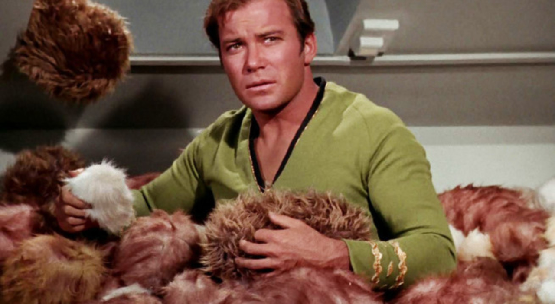
Trouble with Lists
Hard to manage lots of data

Slide 39
Trouble with Lists
Was it my_list[8] or my_list[9]?
Hard to manage lots of data

Slide 40


Slide 41
Dictionary
Store data under a label (“key”)
Fetch value later by key

Slide 42
Dictionary
my_dict = { “name”: “Rob” }

Slide 43
Dictionary
my_dict = { “name”: “Rob” }
dictionary
literal

Slide 44
Dictionary
my_dict = {“name”: “Rob”,
“hair”: “brown”}

Slide 45
Dictionary
my_dict[“hair”]
“brown”

Slide 46
Dictionary
my_dict[“hair”] = “blonde”

Slide 47
Exercises

