Slide 1
Bootcamp
Python for Data Science

Slide 2
Concepts covered so Far
Lists
Zero-indexing
Slicing
Sequence

Slide 3
Values: What kinds are there?
Int
Float
String
?

Slide 4
Equals
“this str” == “that str”

Slide 5
Booleans
100 > 0
“this str” == “that str”

Slide 6
Booleans
100 > 0
“this str” == “that str”
True
False

Slide 7
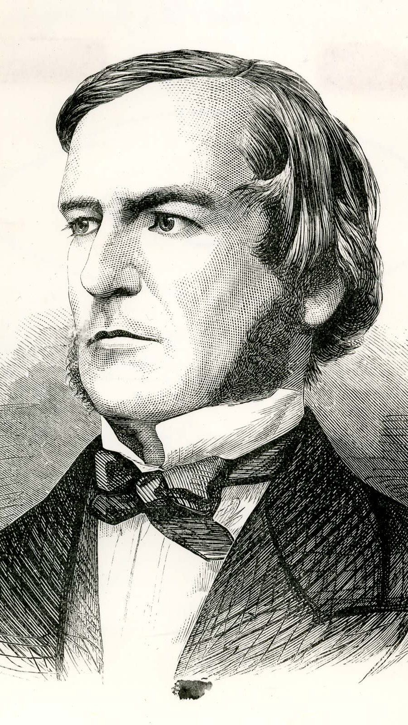
“universal laws of thought which are …mathematical as to their form”
George Boole

Slide 8
Boolean Operators?
True + False
True * False
True / True

Slide 9
Boolean Operators?
True + False
True * False
True / True

Slide 10
Boolean Operators
or
and
not

Slide 11
Boolean Operators
True or False
True and False
not True

Slide 12
Boolean Operators
True or False
True and False
not True
True

Slide 13
Boolean Operators
True or False
True and False
not True
True
False

Slide 14
Boolean Operators
True or False
True and False
not True
True
False
False

Slide 15
Values: What kinds ARE THERE?
Int
Float
String
Bool

Slide 16
Mixing data types
1 + 7.2 = 8.2

Slide 17
Mixing data types
1 + 7.2 = 8.2
1 + “7.2” = error

Slide 18
Mixing data types
1 + 7.2 = 8.2
1 + int(“7.2”) = 8.2

Slide 19
Casting between Data types
int()
float()
str()
bool()

Slide 20
Concepts covered so Far
Boolean values (True/False)
Boolean operators (or, and, not)
Casting between data types

Slide 21
Exercises

Slide 22
Concepts covered so Far
Boolean values (True/False)
Boolean operators (or, and, not)
Casting between data types

Slide 23
What’s missing?

Slide 24
Flow Diagram
Start
Finish

Slide 25


Slide 26

Conditional Statements
Directs route taken by program
Hinges on Boolean expressions

Slide 27
Examples of conditions
my_name == “Rob”
age > 21
name in list_of_guests

Slide 28
if Statement
if condition_is_true:
print(“extra code runs!”)

Slide 29
Flow Diagram
Extra!
Yes
Start
If
No
Finish

Slide 30
if-Else Statement
if condition_is_true:
print(“path #1 runs”)
else:
print(“path #2 runs”)

Slide 31
Flow Diagram
Path 1
Yes
Start
If
Finish
No
Path 2

Slide 32
if-elif-Else Statement
if condition_is_true:
print(“path #1 runs”)
elif second_condition_is_true:
print(“path #2 runs”)
else:
print(“path #3 runs”)

Slide 33
Flow Diagram

Slide 34
Flow Diagram

Slide 35
Conditional Statements
Directs route taken by program
Hinges on Boolean expressions

Slide 36
Exercises

Slide 37
For-Loops
Repeats a chunk of code
Hands in different item each time

Slide 38
For-loops
pets = [“dog”, “cat”, “fish”]
for pet in pets:
print(pet)

Slide 39
For-loops
pets = [“dog”, “cat”, “fish”]
for pet in pets:
if pet == “dog”:
print(“Man’s best friend!”)
else:
print(“whatever”)

Slide 40
Range function
Generates range of numbers
Parameters match slice syntax

Slide 41
Range function
range(3)

Slide 42
Range function
range(3)
0, 1, 2

Slide 43
Range function
range(1,4)

Slide 44
Range function
range(1,4)
1, 2, 3

Slide 45
Range function
range(3,0,-1)
3, 2, 1

Slide 46
Range is Not A List
Returns a “lazy” list
Numbers are generated one-by-one to save memory

Slide 47
Convert Range to list
list(range(3))
[0, 1, 2]

Slide 48
For-Loops
Repeats a chunk of code
Hands in different item each time

Slide 49
Exercises

