Slide 1
Bootcamp
Python for Data Science

Slide 2
Rob Carrington
4 years as a Python developer
Worked in FinTech (@Q2eBanking)

Slide 3



Q2

Slide 4
Projects
Recommendation System
Audience Segmentation
Predicting Overdrafts

Slide 5
Why Python?

Slide 6
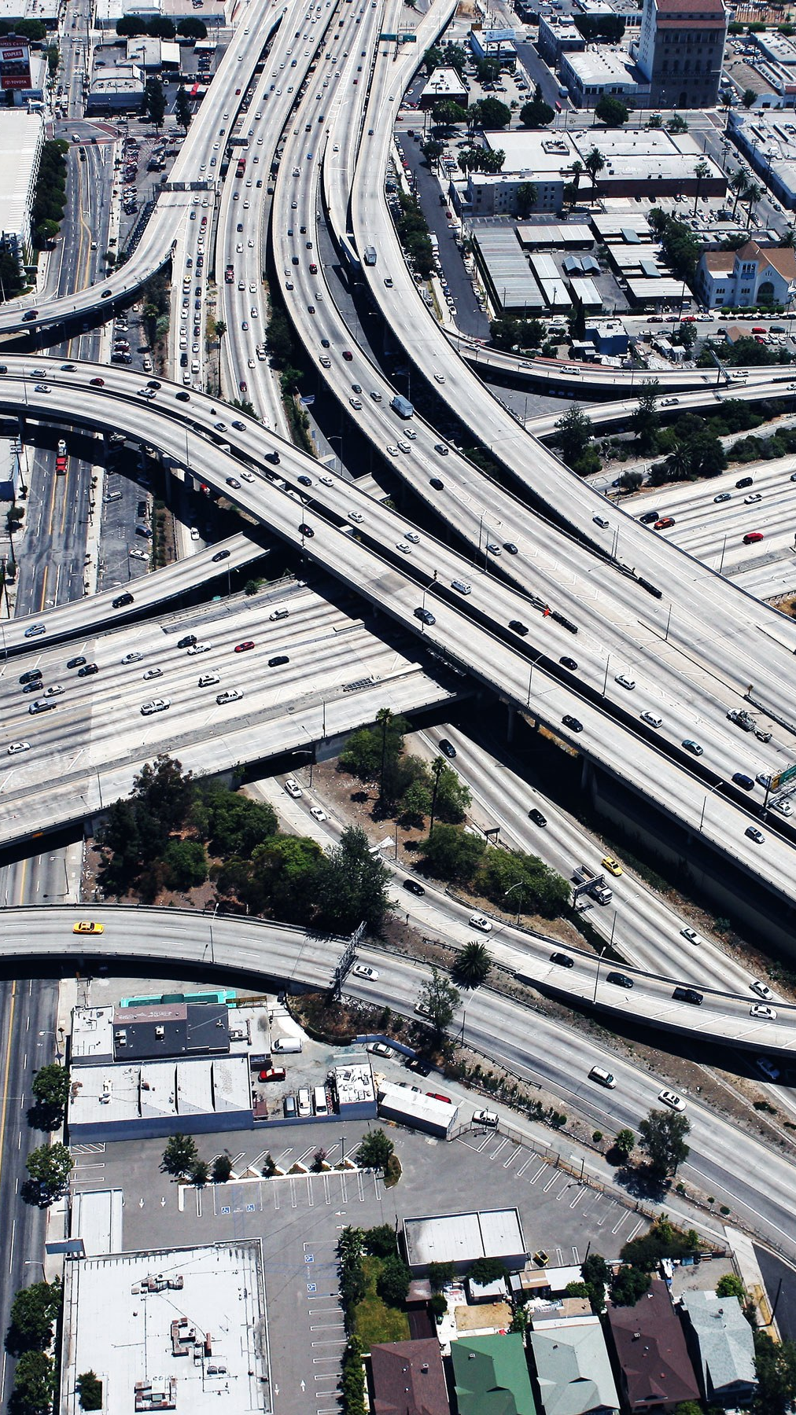
Infrastructure
Modern Software

Slide 7

Community
broad Open-Source

Slide 8
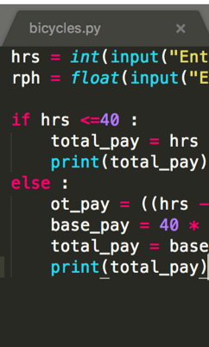
Code
Short, Readable

Slide 9

ME
What’s in it for

Slide 10
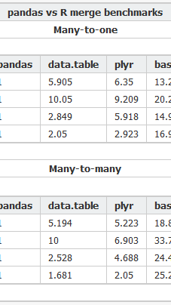
Csv
Analysis of a

Slide 11
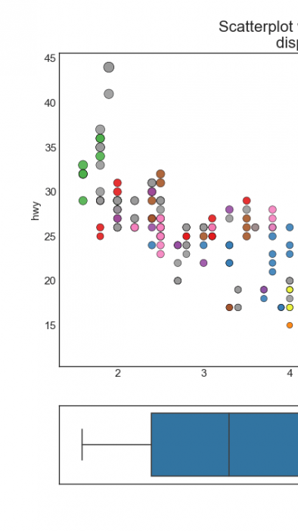
Visualizations
Creating Data

Slide 12
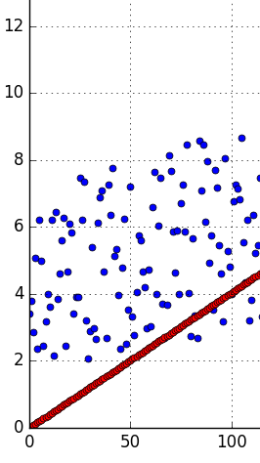
Regression
using Linear

Slide 13
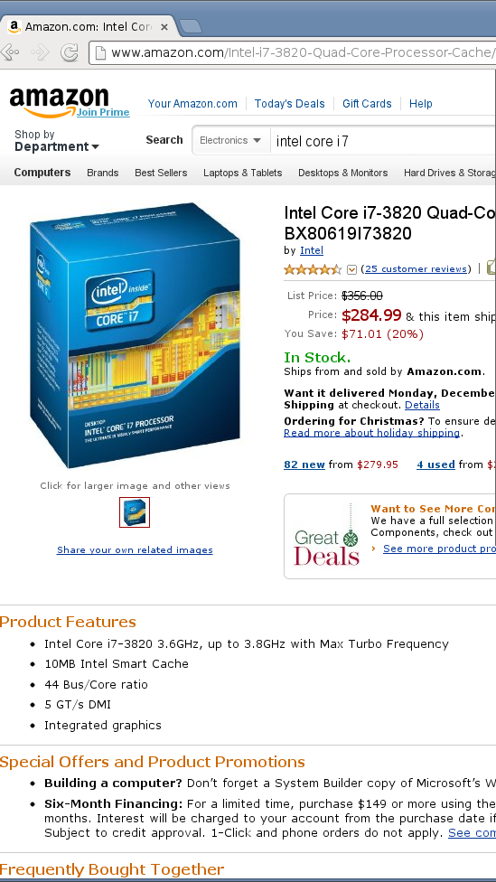
Webscraping
Gathering Data by

Slide 14
Class format

Slide 15
Class format

Slide 16

Class format
15 minutes for lesson & demo
15 minutes for exercise
Pause to review & ask questions
Rinse and repeat

Slide 17
Fundamentals

Slide 18
How to think about Python
You are giving orders to your computer
Each order is called a “statement”

Slide 19
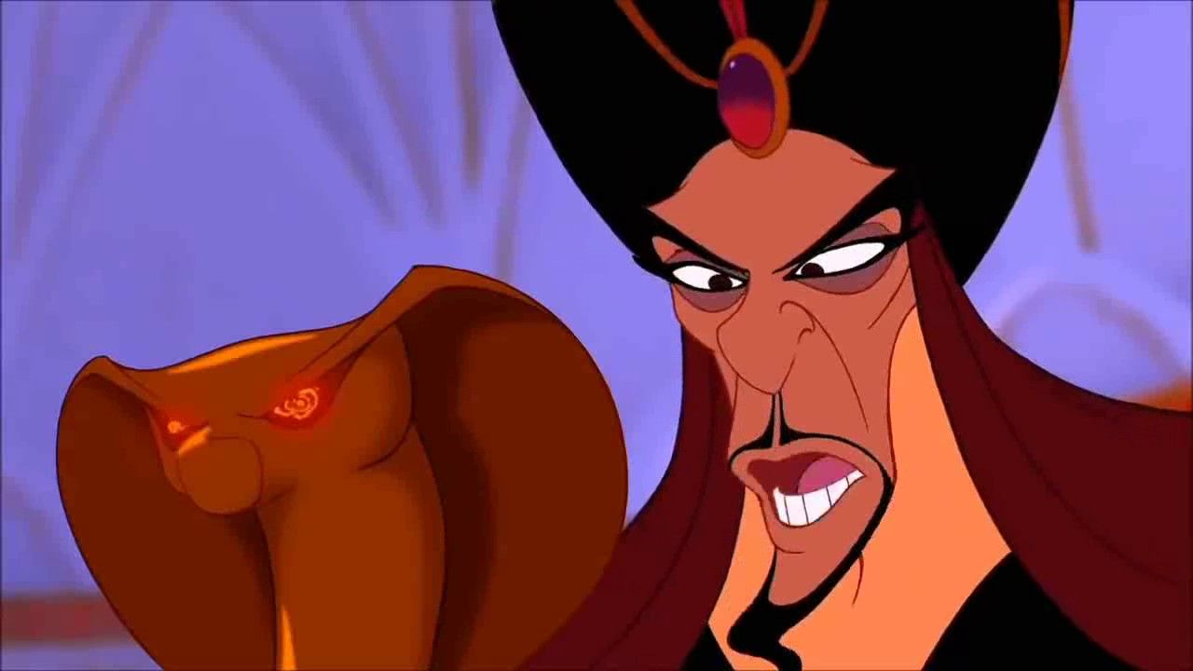
You
Python

Slide 20

Your Computer

Slide 21
ASSIgnment Statement
English:
remember “fav_number” means 3
Notes:
Emphasize that fav_number is an ARBITRARY name
Call it labelling things

Slide 22
ASSIgnment Statement
English:
remember “fav_number” means 3
arbitrary label

Slide 23
Assignment Statement
fav_number = 3

Slide 24
ASSIgnment Statement
fav_number = 3
variable

Slide 25
ASSIgnment Statement
fav_number = 3
value
variable

Slide 26
ASSIgnment Statement
fav_number = 3
variable
(integer literal)

Slide 27
Rules for Variables
Must start with a letter or underscore
Cannot start with a number
Only letters, numbers and underscores allowed
Variable names are case-sensitive

Slide 28
Variables
my_number

Slide 29
Variables
my_number
Notes:
good to note: Snake case. Cannot have spaces in variable names

Slide 30
Variables
my_number
3amigos

Slide 31
Variables
my_number
3amigos

Slide 32
Variables
my_number
3amigos
left-handed

Slide 33
Variables
my_number
3amigos
left-handed

Slide 34
ExpressionS
An expression is part of a statement
Noun without a verb

Slide 35
Expression Examples
Variables (like fav_number)
Values (like 3)

Slide 36

Python thinks like your calculator
If you enter 7 + 9, this is still an expression.
Equivalent to 16.

Slide 37
Expression Vs Statement
Equal to a single value —> expression

Slide 38
Expression Vs Statement
Equal to a single value —> expression
Important to know when you’re giving an order vs noun

Slide 39
Why Do I care about calculators?
Compare to Excel formulas
Find compound interest, etc

Slide 40
Old Friends
Integers (called “int”)
Decimals (called “float”)

Slide 41
Old Friends
Addition (+)
Multiplication (*)
Division (/)
Exponents (**)

Slide 42
A New Friend
Modulo (%)
Finds the remainder

Slide 43
Concepts covered so Far
Statement
Expression
Variable
Int, Float

Slide 44
Exercises

Slide 45
New Data Type: String
Text wrapped in quotes
Only meaningful to humans

Slide 46
String Example
greeting = “hello world!”

Slide 47
String Example
greeting = “hello world!”
value

Slide 48
String Example
greeting = “hello world!”
(string literal)

Slide 49
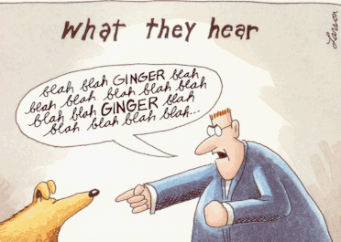

Slide 50
F-Strings
Text with variables injected
Normal string but with an “f” before the quotes

Slide 51
F-strings
my_name = “rob”

Slide 52
F-strings
f“Hello, {my_name}!”

Slide 53
F-strings
f“Hello, {my_name}!”
“Hello, Rob”

Slide 54
Print Statement
English:
Print my_name on the screen
Notes:
Related because strings are for HUMANS. How do you show humans? PRINT

Slide 55
Print Statement
English:
Print my_name on the screen
(Useful for peeking into variables)

Slide 56
print Statement
print(my_name)

Slide 57
print Statement
print(my_name)
function

Slide 58
print Statement
print(my_name)
function
input (aka argument)

Slide 59
Function
Performs an action
Action in example: print to screen

Slide 60
Function vs method
Same: performs an “action” with input
Different: where input comes from

Slide 61
method Example
“Rob”.replace(“R”,“B”)

Slide 62
method Example
“Rob”.replace(“R”,“B”)
“Bob”
Notes:
OBJECTIVE comes first, show how that works, then explain

Slide 63
method Example
“Rob”.replace(“R”,“B”)
method on string
Notes:
OBJECTIVE comes first, show how that works, then explain

Slide 64
Function vs method
Input between parentheses
print(“Rob”)
“Rob”.replace(“R”,“B”)

Slide 65
Function vs method
Input between parentheses
print(“Rob”)
Main input before dot
“Rob”.replace(“R”,“B”)

Slide 66
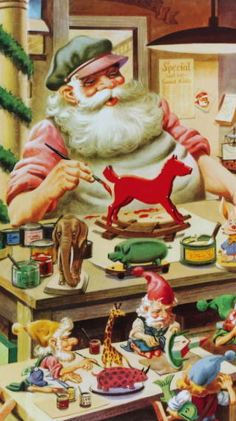
Functions
Defining your own

Slide 67
Defining a Function
Reusable chunk of code

Slide 68
Defining a Function
Reusable chunk of code
Build action from basic functions

Slide 69
Defining A Function
def double(my_name):
return my_name + my_name

Slide 70
Defining A Function
def double(my_name):
return my_name + my_name

Slide 71
Defining A Function
def double(my_name):
return my_name + my_name

Slide 72
Defining A Function
def double(my_name):
return my_name + my_name

Slide 73
Defining A Function
def double(my_name):
return my_name + my_name

Slide 74
Concepts covered so Far
String
Print statement
Function
Method

Slide 75
Exercises

Slide 76
List
Ordered
No set length or data type

Slide 77
List: Basic usage
my_list = [1, “two”, 3.0]

Slide 78
List: Basic usage
my_list.append(4)

Slide 79
List: Basic usage
my_list.append(4)
Method

Slide 80
List: Basic usage
last_item = my_list.pop()

Slide 81
List: Basic usage
first_item = my_list.pop(0)

Slide 82
List: Basic usage
first_item = my_list.pop(0)
Beware of zero-indexing!

Slide 83
Indexing Syntax
English:
get the first element in my_list

Slide 84
Indexing Syntax
my_list[0]

Slide 85
Indexing Syntax
my_list[0]

Slide 86
Indexing Syntax
English translation:
get the seventh element in my_list

Slide 87
Indexing Syntax
my_list[6]

Slide 88
Indexing Syntax
English:
get the last element in my_list

Slide 89
Indexing Syntax
my_list[-1]

Slide 90
Slice Syntax
English:
get the first four elements of my_list

Slide 91
SLICE Syntax
my_string[0:4]

Slide 92
SLICE Syntax
my_string[0:4]
not included!

Slide 93
Slice Syntax
English:
get all the elements up to the third

Slide 94
SLICE Syntax
my_string[:3]

Slide 95
Slice Syntax
English:
grab from the third element through until the end

Slide 96
SLICE Syntax
my_string[2:]

Slide 97
Sequences
Strings
Lists

Slide 98
StringS: Same
Same index and slice syntax!

Slide 99
StringS: but Different
Cannot add or remove characters

Slide 100
Concepts covered so Far
Lists
Zero-indexing
Slicing
Sequence

