Slide 1
Bootcamp
Python for Data Science

Slide 2
Concepts covered so Far
Lists
Zero-indexing
Slicing
Sequence

Slide 3
Values: What kinds are there?
Int
Float
String
?

Slide 4
Equals
“this str” == “that str”

Slide 5
Booleans
100 > 0
“this str” == “that str”

Slide 6
Booleans
100 > 0
“this str” == “that str”
True
False

Slide 7
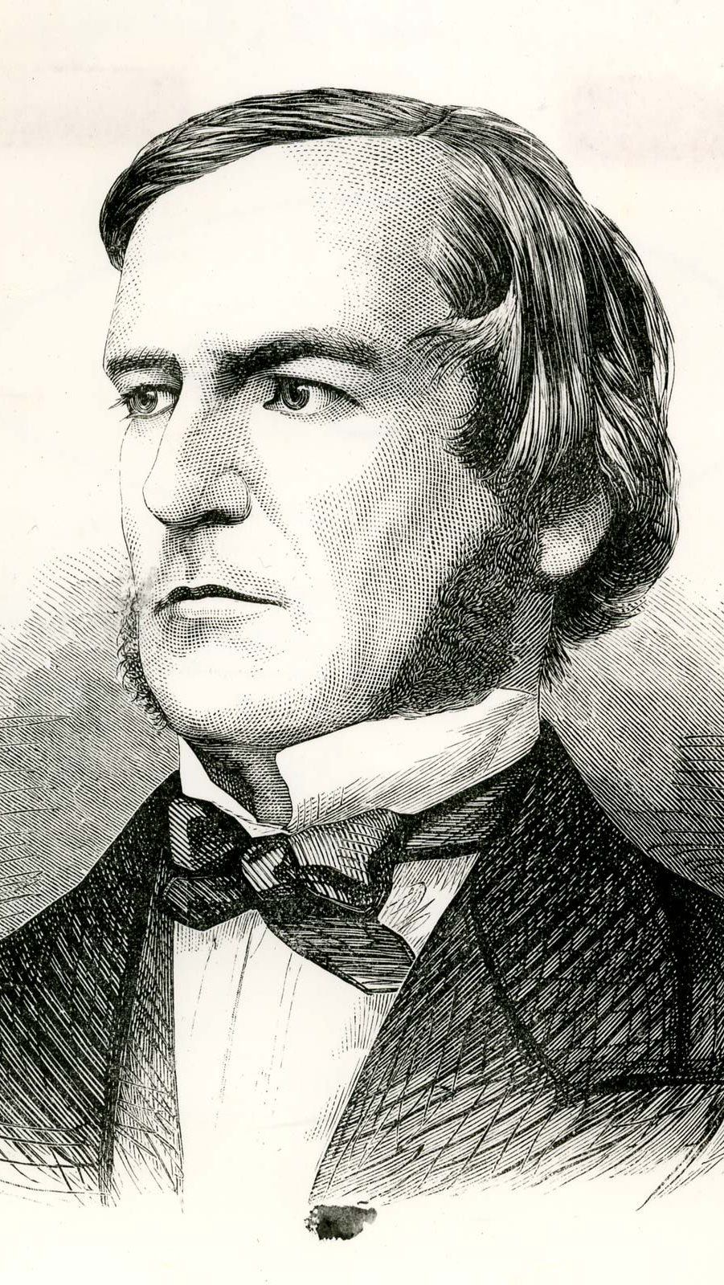
“universal laws of thought which are …mathematical as to their form”
George Boole

Slide 8
Boolean Operators?
True + False
True * False
True / True

Slide 9
Boolean Operators?
True + False
True * False
True / True

Slide 10
Boolean Operators
or
and
not

Slide 11
Boolean Operators
True or False
True and False
not True

Slide 12
Boolean Operators
True or False
True and False
not True
True

Slide 13
Boolean Operators
True or False
True and False
not True
True
False

Slide 14
Boolean Operators
True or False
True and False
not True
True
False
False

Slide 15
Values: What kinds ARE THERE?
Int
Float
String
Bool

Slide 16
Mixing data types
1 + 7.2 = 8.2

Slide 17
Mixing data types
1 + 7.2 = 8.2
1 + “7.2” = error

Slide 18
Mixing data types
1 + 7.2 = 8.2
1 + int(“7.2”) = 8.2

Slide 19
Casting between Data types
int()
float()
str()
bool()

Slide 20
Concepts covered so Far
Boolean values (True/False)
Boolean operators (or, and, not)
Casting between data types

Slide 21
Exercises

Slide 22
Concepts covered so Far
Boolean values (True/False)
Boolean operators (or, and, not)
Casting between data types

Slide 23
What’s missing?

Slide 24
Flow Diagram
Start
Finish

Slide 25


Slide 26

Conditional Statements
Directs route taken by program
Hinges on Boolean expressions

Slide 27
if Statement
if condition_is_true:
print(“extra code runs!”)

Slide 28
Flow Diagram
Extra!
Yes
Start
If
No
Finish

Slide 29
if-Else Statement
if condition_is_true:
print(“path #1 runs”)
else:
print(“path #2 runs”)

Slide 30
Flow Diagram
Path 1
Yes
Start
If
Finish
No
Path 2

Slide 31
if-elif-Else Statement
if condition_is_true:
print(“path #1 runs”)
elif second_condition_is_true:
print(“path #2 runs”)
else:
print(“path #3 runs”)

Slide 32
Flow Diagram

Slide 33
Flow Diagram

Slide 34
Conditional Statements
Directs route taken by program
Hinges on Boolean expressions

Slide 35
Exercises

Slide 36
For-Loops
Repeats a chunk of code
Hands in different item each time

Slide 37
For-loops
pets = [“dog”, “cat”, “fish”]
for pet in pets:
print(pet)

Slide 38
For-loops
pets = [“dog”, “cat”, “fish”]
for pet in pets:
if pet == “dog”:
print(“Man’s best friend!”)
else:
print(“whatever”)

Slide 39
For-Loops
Repeats a chunk of code
Hands in different item each time

Slide 40
Exercises

Slide 41
Values: what kinds are there?
data types: int, float, string, bool
lists of the above

Slide 42
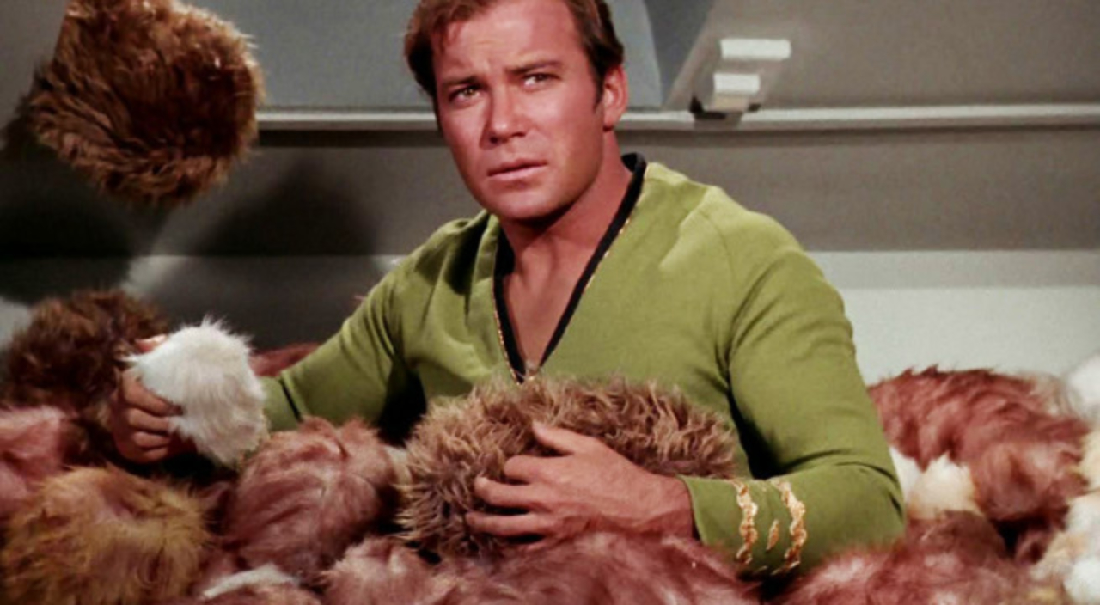
Trouble with Lists
Hard to manage lots of data

Slide 43
Trouble with Lists
Was it my_list[8] or my_list[9]?
Hard to manage lots of data

Slide 44


Slide 45
Dictionary
Store a value under a name (“key”)
Fetch value later by key

Slide 46
Dictionary
my_dict = { “name”: “Rob” }

Slide 47
Dictionary
my_dict = {“name”: “Rob”,
“hair”: “brown”}

Slide 48
Dictionary
my_dict[“key1] = “new_value”

Slide 49
Dictionary
for key in my_dict:
print(f“look at this {key}!”)

Slide 50
Dictionary
for value in my_dict.values():
print(f“look at this {value}”)

Slide 51
Dictionary
for key, value in my_dict.items():
print(f“look at this {key}!”)
print(f“look at this {value}”)

Slide 52
Exercises

