Slide 1
Bootcamp
Python for Data Science

Slide 2

List
Ordered
No set length or data type

Slide 3
List: Basic usage
my_list = [1, “two”, 3.0]

Slide 4
List: Basic usage
my_list = [1, “two”, 3.0]
list literal

Slide 5
Append
my_list.append(“new thing”)

Slide 6
Append
my_list.append(“new thing”)
_______

Slide 7
List
Mutable
Some methods return no value!

Slide 8
Strings
Immutable
Methods always return new string

Slide 9
Numbers
Immutable
Methods always return new string

Slide 10
List: Basic usage
my_list.append(“new thing”)
print(my_list)

Slide 11
List: Basic usage
my_list.append(“new thing”)
print(my_list)
[1, “two”, 3.0, “new thing”]

Slide 12
Assigning to an index
my_list[0] = “new thing”

Slide 13
Assigning to an Index
my_list[0] = “new thing”
_______

Slide 14
Assigning to an Index
my_string[0] = “?”

Slide 15
Assigning to an Index
my_string[0] = “?”
No! Immutable!

Slide 16
List: Basic usage
last_item = my_list.pop()

Slide 17
List: Basic usage
last_item = my_list.pop()
“new thing”

Slide 18
List: Basic usage
last_item = my_list.pop()
print(my_list)
[1, “two”, 3.0]

Slide 19
List: Basic usage
first_item = my_list.pop(0)

Slide 20
List: Basic usage
first_item = my_list.pop(0)
1

Slide 21
Concepts covered so Far
Lists
Mutability
No return value

Slide 22
Slice: step
[start_index:end_index]

Slide 23
Slice: step
[start_index:end_index:step]

Slide 24
Slice: step
my_list[::2]

Slide 25
Slice: step
my_list[::2]
even # items in list

Slide 26
Slice: step
my_list[1::2]

Slide 27
Slice: step
my_list[1::2]
odd # items in list

Slide 28
Slice: step
my_list[::-1]

Slide 29
Slice: step
my_list[::-1]
reverse list

Slide 30
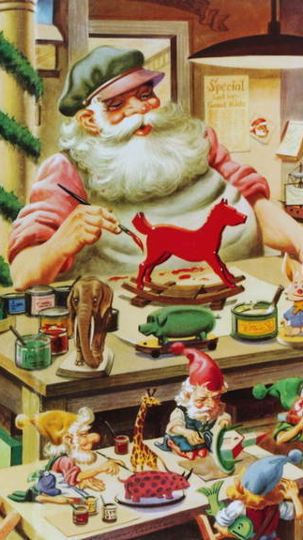
Functions
Defining your own

Slide 31
Defining a Function
Reusable chunk of code

Slide 32
Defining a Function
Reusable chunk of code
Build action from basic functions

Slide 33
Defining A Function
def double(my_name):
answer = my_name + my_name
return answer

Slide 34
Defining A Function
def double(my_name):
answer = my_name + my_name
return answer

Slide 35
Defining A Function
def double(my_name):
answer = my_name + my_name
return answer

Slide 36
Defining A Function
def double(my_name):
answer = my_name + my_name
return answer
arbitrary label for input

Slide 37
Defining A Function
colon
def double(my_name):
answer = my_name + my_name
return answer

Slide 38
Defining A Function
def double(my_name):
answer = my_name + my_name
return answer

Slide 39
Defining A Function
def double(my_name):
answer = my_name + my_name
return answer
indented block

Slide 40
Defining A Function
def double(my_name):
answer = my_name + my_name
return answer

Slide 41
Calling A Function
double(“Rob”)

Slide 42
Calling A Function
double(“Rob”)
no space

Slide 43
Calling A Function
double(“Rob”)
“RobRob”

Slide 44
Exercises

