Slide 1
Bootcamp
Python for Data Science

Slide 2
Rob Carrington
4 years as a Python developer
Worked in FinTech (@Q2eBanking)

Slide 3



Q2

Slide 4
Projects
Recommendation System
Audience Segmentation
Predicting Overdrafts

Slide 5
Why Python?

Slide 6
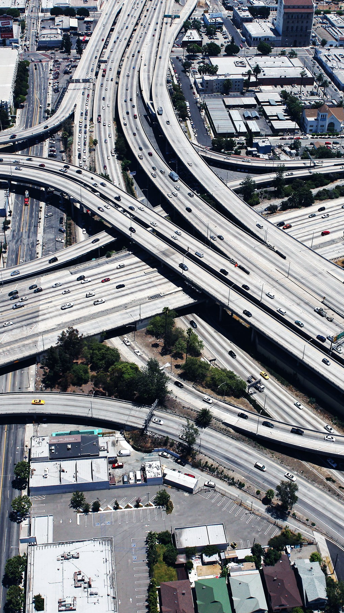
Infrastructure
Modern Software

Slide 7

Community
broad Open-Source

Slide 8
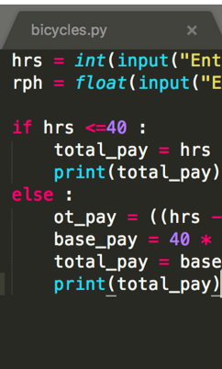
Code
Short, Readable

Slide 9

ME
What’s in it for

Slide 10
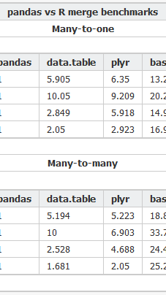
Csv
Analysis of a

Slide 11
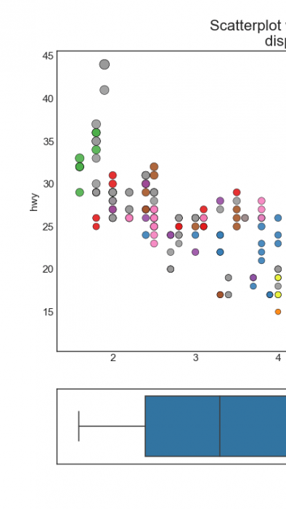
Visualizations
Creating Data

Slide 12
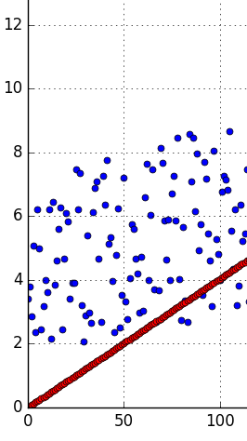
Regression
using Linear

Slide 13
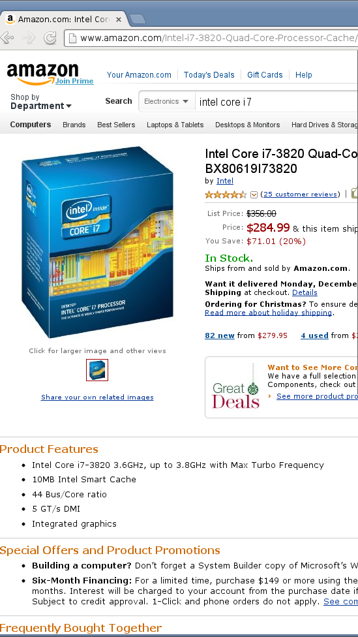
Webscraping
Gathering Data by

Slide 14
Class format

Slide 15
Class format

Slide 16

Class format
10 minutes for lesson & demo
15 minutes for exercise
Pause to review & ask questions
Rinse and repeat

Slide 17
Fundamentals

Slide 18
How to think about Python
You are giving orders to your computer
Each order is called a “statement”

Slide 19
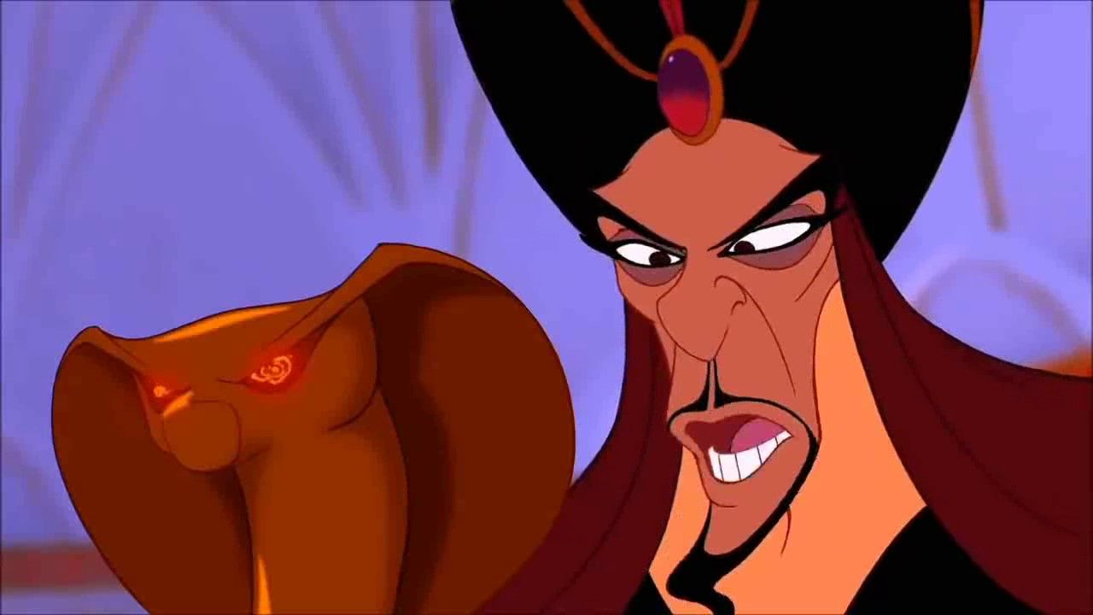
You
Python

Slide 20

Your Computer

Slide 21
ASSIgnment Statement
English:
remember “fav_number” means 3

Slide 22
ASSIgnment Statement
English:
remember “fav_number” means 3
arbitrary label

Slide 23
Assignment Statement
fav_number = 3

Slide 24
ASSIgnment Statement
fav_number = 3
variable

Slide 25
ASSIgnment Statement
fav_number = 3
value
variable

Slide 26
ASSIgnment Statement
fav_number = 3
variable
(integer literal)

Slide 27
Rules for Variables
Must start with a letter or underscore
Cannot start with a number
Only letters, numbers and underscores allowed
Variable names are case-sensitive

Slide 28
Variables
my_number

Slide 29
Variables
my_number

Slide 30
Variables
my_number
3amigos

Slide 31
Variables
my_number
3amigos

Slide 32
Variables
my_number
3amigos
left-handed

Slide 33
Variables
my_number
3amigos
left-handed

Slide 34
ExpressionS
An expression is part of a statement
Noun without a verb

Slide 35
Expression Examples
Variables (like fav_number)
Values (like 3)

Slide 36
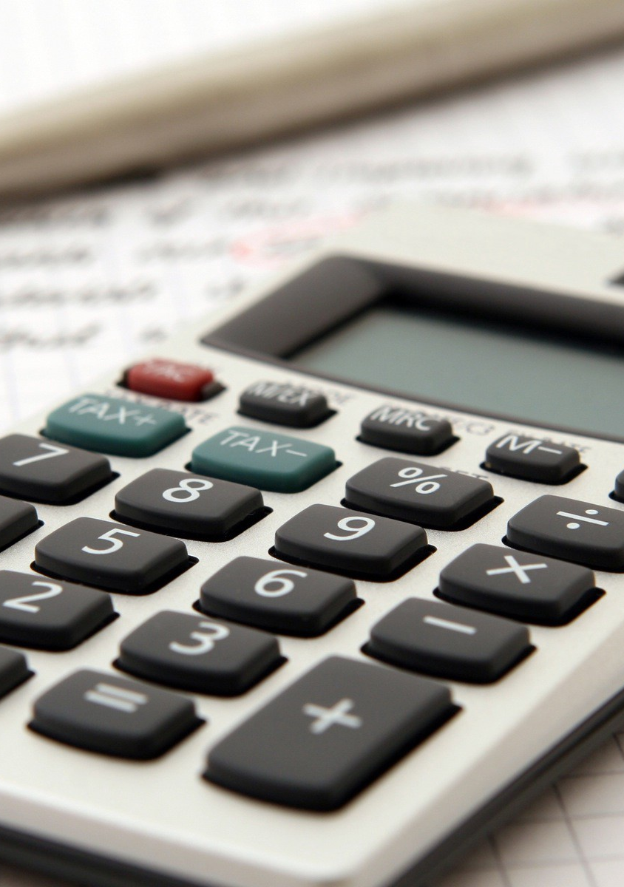
Python thinks like your calculator
If you enter 7 + 9, this is still an expression.
Equivalent to 16.

Slide 37
Expression Vs Statement
Equal to a single value —> expression

Slide 38
Expression Vs Statement
Equal to a single value —> expression
Important to know when you’re giving an order vs noun

Slide 39
Why Do I care about calculators?
Compare to Excel formulas
Find compound interest, etc

Slide 40
Old Friends
Integers (called “int”)
Decimals (called “float”)

Slide 41
Old Friends
Addition (+)
Multiplication (*)
Division (/)
Exponents (**)

Slide 42
A New Friend
Modulo (%)
Finds the remainder

Slide 43
Concepts covered so Far
Statement
Expression
Variable
Int, Float

Slide 44
Exercises

Slide 45
New Data Type: String
Text wrapped in quotes
Only meaningful to humans

Slide 46
String Example
greeting = “hello world!”

Slide 47
String Example
greeting = “hello world!”
value

Slide 48
String Example
greeting = “hello world!”
(string literal)

Slide 49
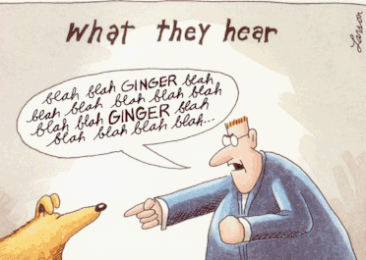

Slide 50
Indexing Syntax
English:
get the first letter in my_string

Slide 51
Indexing Syntax
my_string[0]

Slide 52
Indexing Syntax
English translation:
get the seventh letter in my_string

Slide 53
Indexing Syntax
my_string[6]

Slide 54
Indexing Syntax
English:
get the last letter in my_string

Slide 55
Indexing Syntax
my_string[-1]

Slide 56
Slice Syntax
English:
get the first four letters of my_string

Slide 57
SLICE Syntax
my_string[0:4]

Slide 58
SLICE Syntax
my_string[0:4]
not included!

Slide 59
Slice Syntax
English:
get all the letters up to the third

Slide 60
SLICE Syntax
my_string[:3]

Slide 61
Slice Syntax
English:
grab from the third element through until the end

Slide 62
SLICE Syntax
my_string[2:]

Slide 63
Slice: step
[start_index:end_index]

Slide 64
Slice: step
[start_index:end_index:step]

Slide 65
Slice: step
my_list[::2]

Slide 66
Slice: step
my_list[::2]
even # items in list

Slide 67
Slice: step
my_list[1::2]

Slide 68
Slice: step
my_list[1::2]
odd # items in list

Slide 69
Slice: step
my_list[::-1]

Slide 70
Slice: step
my_list[::-1]
reverse list

Slide 71
Exercises

Slide 72
F-Strings
Text with variables injected
Normal string but with an “f” before the quotes

Slide 73
F-strings
my_name = “rob”

Slide 74
F-strings
f“Hello, {my_name}!”

Slide 75
F-strings
f“Hello, {my_name}!”
“Hello, Rob”

Slide 76
Print Statement
English:
Print my_name on the screen

Slide 77
Print Statement
English:
Print my_name on the screen
(Useful for peeking into variables)

Slide 78
print Statement
print(my_name)

Slide 79
print Statement
print(my_name)
function

Slide 80
print Statement
print(my_name)
function
input (aka argument)

Slide 81
Function
Performs an action
Action in example: print to screen

Slide 82
Function vs method
Same: performs an “action” with input
Different: where input comes from

Slide 83
method Example
“Rob”.replace(“R”,“B”)

Slide 84
method Example
“Rob”.replace(“R”,“B”)
“Bob”

Slide 85
method Example
“Rob”.replace(“R”,“B”)
method on string

Slide 86
Function vs method
Input between parentheses
print(“Rob”)
“Rob”.replace(“R”,“B”)

Slide 87
Function vs method
Input between parentheses
print(“Rob”)
Main input before dot
“Rob”.replace(“R”,“B”)

Slide 88
Values: What kinds ARE THERE?
Int
Float
String

Slide 89
Mixing data types
1 + 7.2 = 8.2

Slide 90
Mixing data types
1 + 7.2 = 8.2
1 + “7.2” = error

Slide 91
Mixing data types
1 + 7.2 = 8.2
1 + int(“7.2”) = 8.2

Slide 92
Casting between Data types
int()
float()
str()

Slide 93
Concepts covered so Far
Print statement
Function
Method
Casting

Slide 94
Exercises

Slide 95
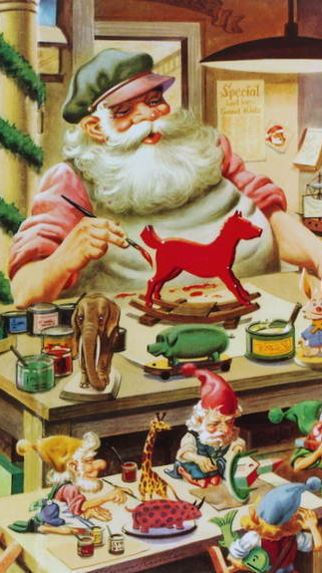
Functions
Defining your own

Slide 96
Defining a Function
Reusable chunk of code

Slide 97
Defining a Function
Reusable chunk of code
Build action from basic functions

Slide 98
Defining A Function
def double(my_name):
answer = my_name + my_name
return answer

Slide 99
Defining A Function
def double(my_name):
answer = my_name + my_name
return answer

Slide 100
Defining A Function
def double(my_name):
answer = my_name + my_name
return answer

Slide 101
Defining A Function
def double(my_name):
answer = my_name + my_name
return answer
arbitrary label for input

Slide 102
Defining A Function
colon
def double(my_name):
answer = my_name + my_name
return answer

Slide 103
Defining A Function
def double(my_name):
answer = my_name + my_name
return answer

Slide 104
Defining A Function
def double(my_name):
answer = my_name + my_name
return answer
indented block

Slide 105
Defining A Function
def double(my_name):
answer = my_name + my_name
return answer

Slide 106
Calling A Function
double(“Rob”)

Slide 107
Calling A Function
double(“Rob”)
no space

Slide 108
Calling A Function
double(“Rob”)
“RobRob”

Slide 109
Exercises

