Slide 1
Bootcamp
Python for Data Science

Slide 2

List
Ordered
No set length or data type

Slide 3
List: Basic usage
my_list = [1, “two”, 3.0]

Slide 4
List: Basic usage
my_list = [1, “two”, 3.0]
list literal

Slide 5
Append
my_list.append(“new thing”)

Slide 6
Append
my_list.append(“new thing”)
_______

Slide 7
List
Mutable
Some methods return no value!

Slide 8
Strings
Immutable
Methods always return new string

Slide 9
Numbers
Immutable
Methods always return new string

Slide 10
List: Basic usage
my_list.append(“new thing”)
print(my_list)

Slide 11
List: Basic usage
my_list.append(“new thing”)
print(my_list)
[1, “two”, 3.0, “new thing”]

Slide 12
Assigning to an index
my_list[0] = “new thing”

Slide 13
Assigning to an Index
my_list[0] = “new thing”
_______

Slide 14
Assigning to an Index
my_string[0] = “?”

Slide 15
Assigning to an Index
my_string[0] = “?”
No! Immutable!

Slide 16
List: Basic usage
last_item = my_list.pop()

Slide 17
List: Basic usage
last_item = my_list.pop()
“new thing”

Slide 18
List: Basic usage
last_item = my_list.pop()
print(my_list)
[1, “two”, 3.0]

Slide 19
List: Basic usage
first_item = my_list.pop(0)

Slide 20
List: Basic usage
first_item = my_list.pop(0)
1

Slide 21
Concepts covered so Far
Lists
Mutability
No return value

Slide 22
Exercises

Slide 23
Sequences
Strings
Lists

Slide 24
StringS: Same
Same index and slice syntax!

Slide 25
StringS: but Different
Cannot add or remove characters

Slide 26
String methods: Split & join
Translate between list/string
Use a string as glue/delimiter

Slide 27
Split
“a new string”.split()

Slide 28
Split
“a new string”.split()
[“a”, “new”, “string”]

Slide 29
Split
“id, name, date”.split(“,”)

Slide 30
Split
“id, name, date”.split(“,”)
[“id”, “name”, “date”]

Slide 31
Join
“,”.join([“id”, “name”, “date”])
“id, name, date”

Slide 32
Join
“|”.join([“id”, “name”, “date”])
“id|name|date”

Slide 33
Split & join methods
Translate between list/string
Use a string as glue/delimiter

Slide 34
Two more methods
len() —> find length of sequence
sorted() —> return sorted version

Slide 35
Concepts covered so Far
.split() method
.join() method
len() function
sorted() function

Slide 36
Exercises

Slide 37
Values: What kinds are there?
Int
Float
String
?

Slide 38
Equals
“this str” == “that str”

Slide 39
Booleans
100 > 0
“this str” == “that str”

Slide 40
Booleans
100 > 0
“this str” == “that str”
True
False

Slide 41
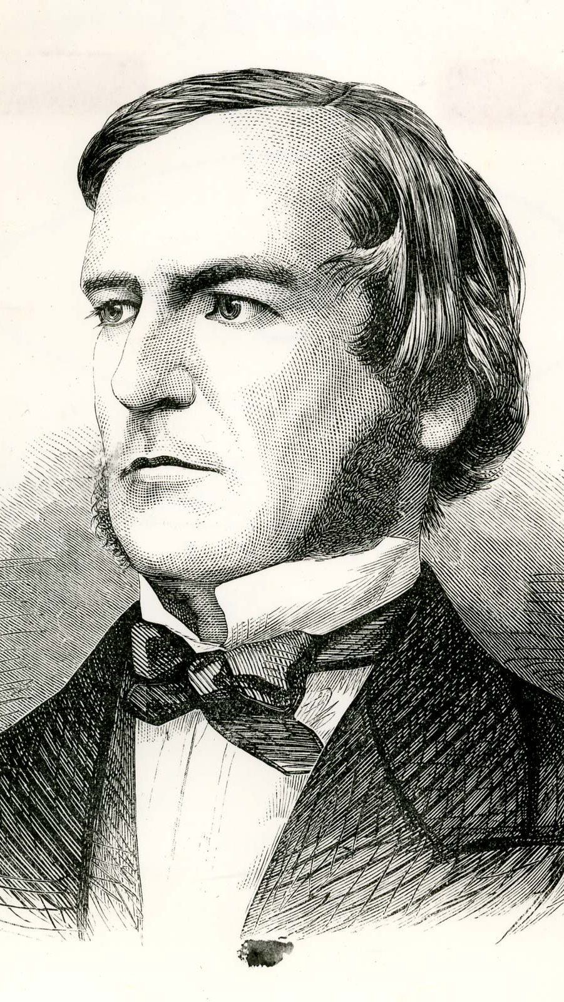
“universal laws of thought which are …mathematical as to their form”
George Boole

Slide 42
Boolean Operators?
True + False
True * False
True / True

Slide 43
Boolean Operators?
True + False
True * False
True / True

Slide 44
Boolean Operators
or
and
not

Slide 45
Boolean Operators
True or False
True and False
not True

Slide 46
Boolean Operators
True or False
True and False
not True
True

Slide 47
Boolean Operators
True or False
True and False
not True
True
False

Slide 48
Boolean Operators
True or False
True and False
not True
True
False
False

Slide 49
Values: What kinds ARE THERE?
Int
Float
String
Bool

Slide 50
Casting between Data types
int()
float()
str()
bool()

Slide 51
Concepts covered so Far
Boolean values (True/False)
Boolean operators (or, and, not)
Casting between data types

Slide 52
Exercises

Slide 53
Concepts covered so Far
Boolean values (True/False)
Boolean operators (or, and, not)
Casting between data types

Slide 54
What’s missing?

Slide 55
Flow Diagram
Start
Finish

Slide 56


Slide 57
Conditional Statements
Directs route taken by program
Hinges on Boolean expressions

Slide 58
Examples of conditions
my_name == “Rob”
age > 21
name in list_of_guests

Slide 59
if Statement
if condition_is_true:
print(“extra code runs!”)

Slide 60
Flow Diagram
Extra!
Yes
Start
If
No
Finish

Slide 61
if-Else Statement
if condition_is_true:
print(“path #1 runs”)
else:
print(“path #2 runs”)

Slide 62
Flow Diagram
Path 1
Yes
Start
If
Finish
No
Path 2

Slide 63
if-elif-Else Statement
if condition_is_true:
print(“path #1 runs”)
elif second_condition_is_true:
print(“path #2 runs”)
else:
print(“path #3 runs”)

Slide 64
Flow Diagram

Slide 65
Flow Diagram

Slide 66
Conditional Statements
Directs route taken by program
Hinges on Boolean expressions

Slide 67
Exercises

Slide 68
For-Loops
Repeats a chunk of code
Hands in different item each time

Slide 69
For-loops
pets = [“dog”, “cat”, “fish”]
for pet in pets:
print(pet)

Slide 70
For-loops
pets = [“dog”, “cat”, “fish”]
for pet in pets:
if pet == “dog”:
print(“Man’s best friend!”)
else:
print(“whatever”)

Slide 71
Range function
Generates range of numbers
Parameters match slice syntax

Slide 72
Range function
range(3)

Slide 73
Range function
range(3)
0, 1, 2

Slide 74
Range function
range(1,4)

Slide 75
Range function
range(1,4)
1, 2, 3

Slide 76
Range function
range(3,0,-1)
3, 2, 1

Slide 77
Range is Not A List
Returns a “lazy” list
Numbers are generated one-by-one to save memory

Slide 78
Convert Range to list
list(range(3))
[0, 1, 2]

Slide 79
For-Loops
Repeats a chunk of code
Hands in different item each time

Slide 80
Exercises

