Slide 1
Bootcamp
Python for Data Science

Slide 2

List
Ordered
No set length or data type

Slide 3
List: Basic usage
my_list = [1, “two”, 3.0]

Slide 4
List: Basic usage
my_list = [1, “two”, 3.0]
list literal

Slide 5
Append
my_list.append(“new thing”)

Slide 6
Append
my_list.append(“new thing”)
_______

Slide 7
List
Mutable
Some methods return no value!

Slide 8
Strings
Immutable
Methods always return new string

Slide 9
Numbers
Immutable
Methods always return new string

Slide 10
List: Basic usage
my_list.append(“new thing”)
print(my_list)

Slide 11
List: Basic usage
my_list.append(“new thing”)
print(my_list)
[1, “two”, 3.0, “new thing”]

Slide 12
Assigning to an index
my_list[0] = “new thing”

Slide 13
Assigning to an Index
my_list[0] = “new thing”
_______

Slide 14
Assigning to an Index
my_string[0] = “?”

Slide 15
Assigning to an Index
my_string[0] = “?”
No! Immutable!

Slide 16
List: Basic usage
last_item = my_list.pop()

Slide 17
List: Basic usage
last_item = my_list.pop()
“new thing”

Slide 18
List: Basic usage
last_item = my_list.pop()
print(my_list)
[1, “two”, 3.0]

Slide 19
List: Basic usage
first_item = my_list.pop(0)

Slide 20
List: Basic usage
first_item = my_list.pop(0)
1

Slide 21
Exercises

Slide 22
Sequences
Strings
Lists

Slide 23
StringS: Same
Same index and slice syntax!

Slide 24
StringS: but Different
Cannot add or remove characters

Slide 25
Concepts covered so Far
Lists
Mutability
No return value
Sequences

Slide 26
Exercises

Slide 27
String methods: Split & join
Translate between list/string
Use a string as glue/delimiter

Slide 28
Split
“a new string”.split()

Slide 29
Split
“a new string”.split()
[“a”, “new”, “string”]

Slide 30
Split
“id, name, date”.split(“,”)

Slide 31
Split
“id, name, date”.split(“,”)
[“id”, “name”, “date”]

Slide 32
Join
“,”.join([“id”, “name”, “date”])
“id, name, date”

Slide 33
Join
“|”.join([“id”, “name”, “date”])
“id|name|date”

Slide 34
Split & join methods
Translate between list/string
Use a string as glue/delimiter

Slide 35
Two more methods
len() —> find length of sequence
sorted() —> return sorted version

Slide 36
Concepts covered so Far
.split() method
.join() method
len() function
sorted() function

Slide 37
Exercises

Slide 38
Values: What kinds are there?
Int
Float
String
?

Slide 39
Equals
“this str” == “that str”

Slide 40
Booleans
100 > 0
“this str” == “that str”

Slide 41
Booleans
100 > 0
“this str” == “that str”
True
False

Slide 42
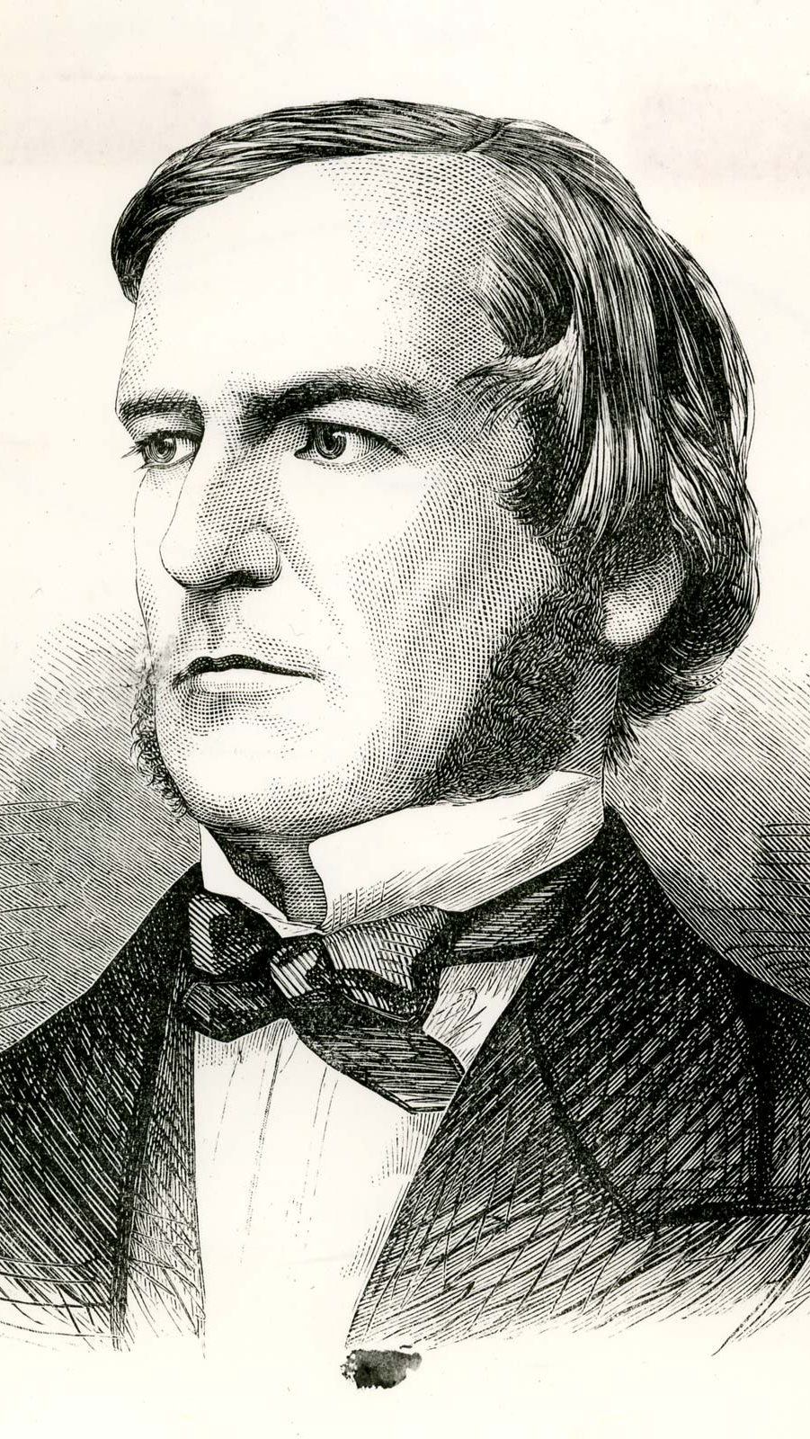
“universal laws of thought which are …mathematical as to their form”
George Boole

Slide 43
Boolean Operators?
True + False
True * False
True / True

Slide 44
Boolean Operators?
True + False
True * False
True / True

Slide 45
Boolean Operators
or
and
not

Slide 46
Boolean Operators
True or False
True and False
not True

Slide 47
Boolean Operators
True or False
True and False
not True
True

Slide 48
Boolean Operators
True or False
True and False
not True
True
False

Slide 49
Boolean Operators
True or False
True and False
not True
True
False
False

Slide 50
Values: What kinds ARE THERE?
Int
Float
String
Bool

Slide 51
Mixing data types
1 + 7.2 = 8.2

Slide 52
Mixing data types
1 + 7.2 = 8.2
1 + “7.2” = error

Slide 53
Mixing data types
1 + 7.2 = 8.2
1 + int(“7.2”) = 8.2

Slide 54
Casting between Data types
int()
float()
str()
bool()

Slide 55
Concepts covered so Far
Boolean values (True/False)
Boolean operators (or, and, not)
Casting between data types

Slide 56
Exercises

Slide 57
Concepts covered so Far
Boolean values (True/False)
Boolean operators (or, and, not)
Casting between data types

Slide 58
What’s missing?

Slide 59
Flow Diagram
Start
Finish

Slide 60


Slide 61
Conditional Statements
Directs route taken by program
Hinges on Boolean expressions

Slide 62
Examples of conditions
my_name == “Rob”
age > 21
name in list_of_guests

Slide 63
if Statement
if condition_is_true:
print(“extra code runs!”)

Slide 64
Flow Diagram
Extra!
Yes
Start
If
No
Finish

Slide 65
if-Else Statement
if condition_is_true:
print(“path #1 runs”)
else:
print(“path #2 runs”)

Slide 66
Flow Diagram
Path 1
Yes
Start
If
Finish
No
Path 2

Slide 67
if-elif-Else Statement
if condition_is_true:
print(“path #1 runs”)
elif second_condition_is_true:
print(“path #2 runs”)
else:
print(“path #3 runs”)

Slide 68
Flow Diagram

Slide 69
Flow Diagram

Slide 70
Conditional Statements
Directs route taken by program
Hinges on Boolean expressions

Slide 71
Exercises

Slide 72
For-Loops
Repeats a chunk of code
Hands in different item each time

Slide 73
For-loops
pets = [“dog”, “cat”, “fish”]
for pet in pets:
print(pet)

Slide 74
For-loops
pets = [“dog”, “cat”, “fish”]
for pet in pets:
if pet == “dog”:
print(“Man’s best friend!”)
else:
print(“whatever”)

Slide 75
Range function
Generates range of numbers
Parameters match slice syntax

Slide 76
Range function
range(3)

Slide 77
Range function
range(3)
0, 1, 2

Slide 78
Range function
range(1,4)

Slide 79
Range function
range(1,4)
1, 2, 3

Slide 80
Range function
range(3,0,-1)
3, 2, 1

Slide 81
Range is Not A List
Returns a “lazy” list
Numbers are generated one-by-one to save memory

Slide 82
Convert Range to list
list(range(3))
[0, 1, 2]

Slide 83
For-Loops
Repeats a chunk of code
Hands in different item each time

Slide 84
Exercises

