Slide 1
Bootcamp
Python for Data Science

Slide 2
Week 1 Review

Slide 3

Booleans and conditionals

Slide 4
Booleans
100 > 0
“this str” == “that str”
True
False

Slide 5
Boolean Operators
or
and
not

Slide 6
Boolean Operators
True or False
True and False
not True
True
False
False

Slide 7
if-Else Statement
if condition_is_true:
print(“path #1 runs”)
else:
print(“path #2 runs”)

Slide 8
Lists and slicing

Slide 9
Fetching from an index
my_list[0]

Slide 10
Fetching from an index
my_list[0]
“first element”

Slide 11
Assigning to an index
my_list[0] = “new thing”

Slide 12
Append
my_list.append(“new thing”)
_______

Slide 13
Slice: step
[start_index:end_index:step]

Slide 14
Slice: step
my_list[::-1]
reverse list

Slide 15
Split
“id, name, date”.split(“,”)
[“id”, “name”, “date”]

Slide 16
Functions and for-loops

Slide 17
Function vs method
Input between parentheses
print(“Rob”)
Main input before dot
“Rob”.replace(“R”,“B”)

Slide 18
Defining A Function
def double(my_name):
answer = my_name + my_name
return answer

Slide 19
Defining A Function
def double(my_name):
answer = my_name + my_name
return answer
arbitrary label for input

Slide 20
Calling A Function
double(“Rob”)

Slide 21
Defining A Function
def double(“Rob”):
answer = “Rob” + “Rob”
return answer

Slide 22
For-loops
pets = [“dog”, “cat”, “fish”]
for pet in pets:
print(pet)

Slide 23
For-loops
pets = [“dog”, “cat”, “fish”]
for pet in pets:
print(“dog”)

Slide 24
For-loops
pets = [“dog”, “cat”, “fish”]
for pet in pets:
print(“cat”)

Slide 25
Range function
range(1,4)
1, 2, 3

Slide 26
Week 2

Slide 27
Values: what kinds are there?
data types: int, float, string, bool
lists of the above

Slide 28
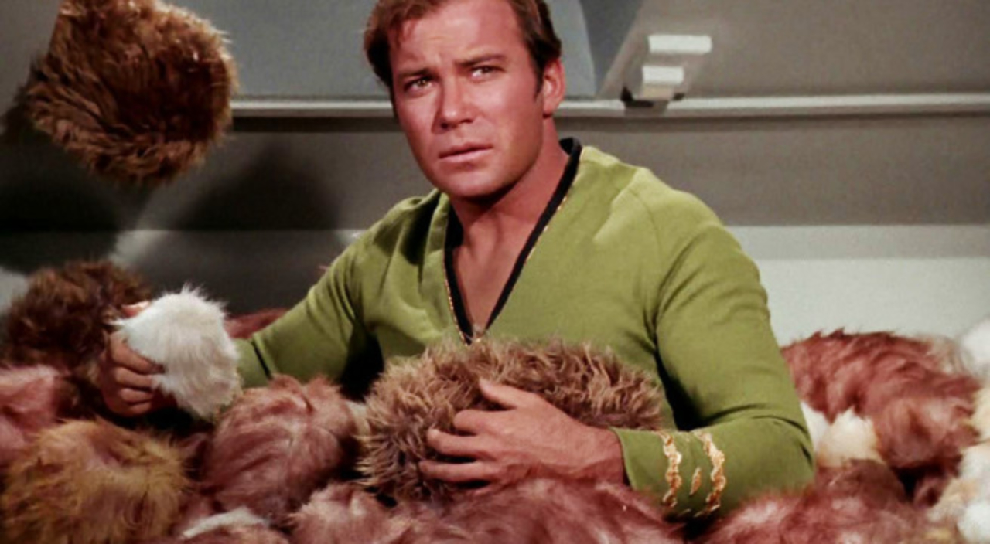
Trouble with Lists
Hard to manage lots of data

Slide 29
Trouble with Lists
Was it my_list[8] or my_list[9]?
Hard to manage lots of data

Slide 30


Slide 31

Dictionary
Store data under a label (“key”)
Fetch value later by key

Slide 32
Dictionary
my_dict = { “name”: “Rob” }

Slide 33
Dictionary
my_dict = { “name”: “Rob” }
dictionary
literal

Slide 34
Dictionary
my_dict = {“name”: “Rob”,
“hair”: “brown”}

Slide 35
Dictionary
my_dict[“hair”]
“brown”

Slide 36
Dictionary
my_dict[“hair”] = “blonde”

Slide 37
Dictionary
for key in my_dict:
print(“look at this”+ key)

Slide 38
Dictionary
for value in my_dict.values():
print(“look at this ”+value)

Slide 39
Dictionary
for key, value in my_dict.items():
print(“look at this ”+key)
print(“look at this ”+value)

Slide 40
Exercises

Slide 41

Classes and Objects

Slide 42
Class vs object
class is a “blueprint” with empty slots
object is one occurrence, slots filled

Slide 43
Why do we need classes?
Like dictionary with guaranteed keys
Can create methods

Slide 44
Using a Class
rob = Person(“Rob”)
rob.name
>>> “Rob”

Slide 45
Using a Class
rob = Person(“Rob”)
rob.say_name()
>>> “Hi I’m Rob”

Slide 46
Why do we need classes?
Store data and methods together
Can make code more intuitive

Slide 47
Class
class Person():
def __init__(self, name):
self.name = name

Slide 48
Class
class Person():
def __init__(self, name):
self.name = name

Slide 49
Class
class Person():
def __init__(self, name):
self.name = name

Slide 50
What is “self”??
Class is the cookie-cutter, self is the cookie
First argument in any method

Slide 51
Class
class Person():
def __init__(self, name):
self.name = name

Slide 52
Class
constructor
class Person():
def __init__(self, name):
self.name = name

Slide 53
Class
*magic*
class Person():
def __init__(self, name):
self.name = name

Slide 54
Class
instance
class Person():
def __init__(self, name):
self.name = name

Slide 55
Class
*magic*
class Person():
def __init__(self, name):
self.name = name

Slide 56
Class
class Person():
def __init__(self, name):
self.name = name

Slide 57
Class
class Person():
def __init__(self, name):
self.name = name
attribute

Slide 58
Class
class Person():
def __init__(self, name):
self.name = name
self[“name”] = name

Slide 59
Class
class Person():
…
def say_name(self):
print(self.name)

Slide 60
Class
rob = Person(“Rob”)
rob.name
>>> “Rob”

Slide 61
Class
rob = Person(“Rob”)
rob.name
>>> “Rob”
attribute

Slide 62
Class
rob = Person(“Rob”)
rob.say_name()
>>> “Rob”

Slide 63
Class
rob = Person(“Rob”)
rob.say_name()
>>> “Rob”
method

Slide 64
Exercises

Slide 65
Importing packages
Use pre-made classes and functions
Save a ton of time!

Slide 66


Slide 67
Importing packages
Core Libraries: “batteries included”
3rd Party: have to be downloaded

Slide 68
Import Statements
import numpy
from numpy import ndarray

Slide 69
Import Statements
import numpy as np

Slide 70
Concepts covered so Far
Dictionary
Class
Packages
Imports

Slide 71
Guided Exercise

Slide 72
Why numpy?
import numpy
from numpy import array

Slide 73
Flexible is slow

Slide 74
Nothing comes for free
List & dictionary hold any value
Also grow to any length
Numbers have no fixed size

Slide 75
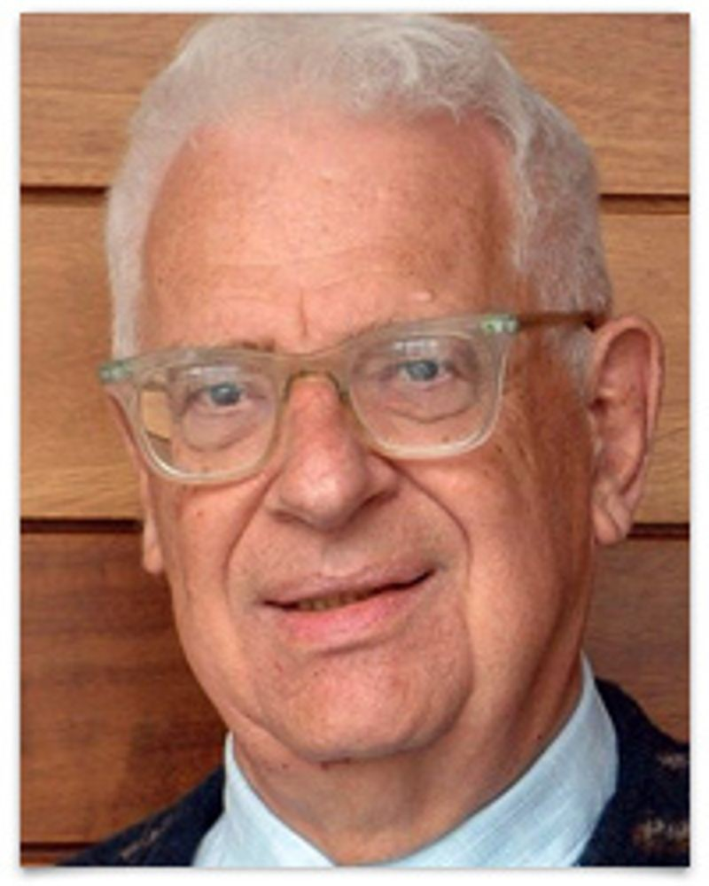
Every problem in computer science can be solved by another layer of indirection
- David Wheeler

Slide 76
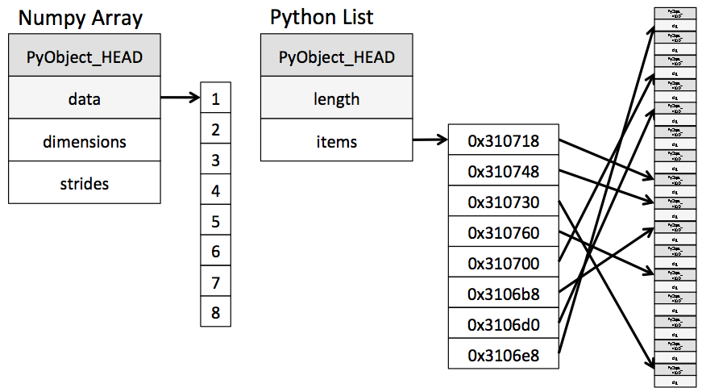

Slide 77
Numpy
Short for “numerical python”
Has array that is faster for math

