Slide 1
Bootcamp
Python for Data Science

Slide 2
Review

Slide 3
Concepts covered so Far
For-loops
Dictionary
Class

Slide 4
Dictionary
my_dict = {“name”: “Rob”,
“hair”: “brown”}

Slide 5
Dictionary
my_dict[“hair”] = “blonde”

Slide 6
Dictionary
my_dict[“hair”]

Slide 7
Dictionary
my_dict[“hair”]
“brown”

Slide 8
Dictionary
for key in my_dict:
print(f“look at this {key}!”)

Slide 9
Dictionary
for key, value in my_dict.items():
print(f“look at this {key}!”)
print(f“look at this {value}”)

Slide 10
Class
class Person():
def __init__(self, name):
self.name = name

Slide 11
Class
rob = Person(“Rob”)
rob.name

Slide 12
Class
rob = Person(“Rob”)
rob.name
“Rob”

Slide 13
open Source tools

Slide 14

Packages
Code designed for re-use
Must be installed before use

Slide 15
First Package: Numpy
Short for “numerical python”
Has array that is faster for math

Slide 16
Flexible is slow

Slide 17
Nothing comes for free
List & dictionary hold any value
Also grow to any length
Numbers have no fixed size

Slide 18
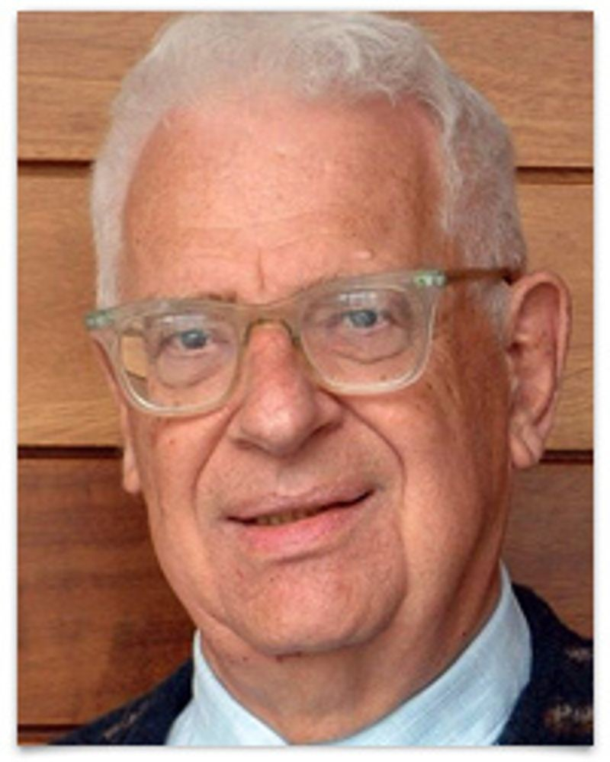
Every problem in computer science can be solved by another layer of indirection
- David Wheeler

Slide 19
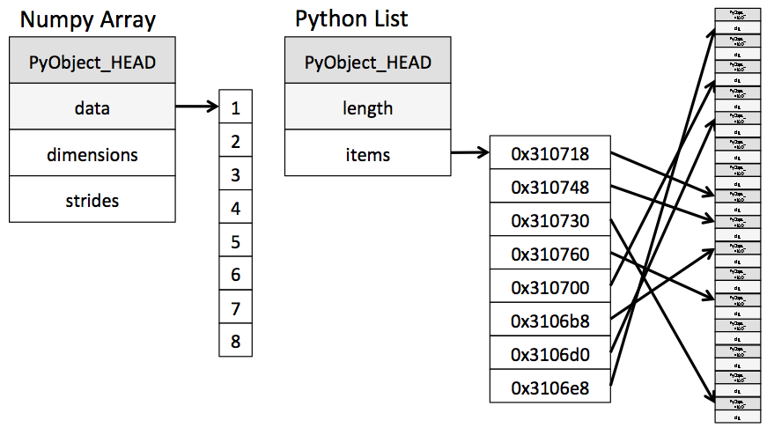

Slide 20
First Package: Numpy
Short for “numerical python”
Has array that is faster for math

Slide 21
importing numpy
import numpy
from numpy import array

Slide 22
importing numpy
import numpy as np

Slide 23
importing numpy
import numpy as np
alias

Slide 24
NDarray
short for “n-dimensional array”
one dimension will be enough

Slide 25
creating an array
np.array([1, 2, 3])

Slide 26
Concepts covered so Far
Package
Import statement
Numpy
Array

Slide 27
Exercises

Slide 28
creating an array
np.array([1, 2, 3])

Slide 29
Ufunc
short for “universal functions”
take arrays as input/output

Slide 31
ufunc
np.add (+)
np.multiply (*)
np.divide (/)
np.power (**)

Slide 32
Element-wise addition
np.array([1, 2]) + np.array([1, 2])

Slide 33
Element-wise addition
np.array([1, 2]) + np.array([1, 2])
array([2, 4])

Slide 34
Broadcasting
np.array([1, 2]) + 2

Slide 35
broaDcasting
np.array([1, 2]) + 2
array([3, 4])

Slide 36
broaDcasting
np.array([1, 2]) * 3

Slide 37
broaDcasting
np.array([1, 2]) * 3
array([3, 9])

Slide 38
Slices: View vs Copy
Slice on list creates a new copy
Slice on array creates a “view”

Slide 39
Slice as view
original = np.array([1, 2, 3])
new_one = original[:1]

Slide 40
Slice as view
original = np.array([1, 2, 3])
new_one = original[1:]
new_one[0] = 0

Slide 41
Slice as view
original = np.array([1, 2, 3])
new_one = original[1:]
new_one[0] = 0
original: [0, 2, 3]

Slide 42
solution
original = np.array([1, 2, 3])
new_one = original[1:].copy()
new_one[0] = 0

Slide 43
solution
original = np.array([1, 2, 3])
new_one = original[1:].copy()
new_one[0] = 0
original: [1, 2, 3]

Slide 44
Concepts covered so Far
Ufunc
Element-wise operations
Broadcasting
View vs Copy

Slide 45
Exercises

Slide 46
Boolean ufuncs
take arrays as input/output

Slide 47
Boolean ufunc
np.equal (==)
np.less (<)
np.greater (>)

Slide 48
Element-wise
np.array([1, 2]) == np.array([1, 2])

Slide 49
Element-wise
np.array([1, 2]) + np.array([1, 2])
array([True, True])

Slide 50
Broadcasting
np.array([1, 2]) < 2

Slide 51
broaDcasting
np.array([1, 2]) < 2
array([True, False])

Slide 52
broaDcasting
np.array([1, 2, 3]) == 3

Slide 53
broaDcasting
np.array([1, 2, 3]) == 3
array([False, False, True])

Slide 54
Boolean INdexing
my_array = np.array([1, 2, 3])
my_array[[True, False, True]]

Slide 55
Boolean INdexing
my_array = np.array([1, 2, 3])
my_array[[False, False, True]]
array([3])

Slide 56
Boolean INdexing
my_array = np.array([1, 2, 3])
my_array[[False, False, True]]
boolean mask

Slide 57
Boolean INdexing
my_array = np.array([1, 2, 3])
my_array[my_array > 2]
boolean mask

Slide 58
Boolean INdexing
my_array = np.array([1, 2, 3])
my_array[my_array > 2]
array([3])

Slide 59
Boolean INdexing
ones = (my_array == 1)
evens = (my_array % 2 == 0)

Slide 60
Boolean INdexing
my_array[ones | evens]

Slide 61
Boolean INdexing
my_array[ones | evens]
works like “or”

Slide 62
Boolean INdexing
my_array[ones & evens]

Slide 63
Boolean INdexing
my_array[ones & evens]
works like “and”

Slide 64
Concepts covered so Far
Boolean ufunc
Element-wise Boolean operations
Broadcasting Boolean operations
Boolean mask

Slide 65
Exercises

