Slide 1
Bootcamp
Python for Data Science

Slide 2
Week 1 Review

Slide 3
Concepts covered so Far
Statement
Expression
Variable
Int, Float

Slide 4
Concepts covered so Far
String
Zero-indexing
Slicing
List

Slide 5
Slice: step
[start_index:end_index:step]

Slide 6
Concepts covered so Far
Function
Method
Mutable/Immutable
No return value

Slide 7
Defining A Function
def double(my_name):
answer = my_name + my_name
return answer

Slide 8
Defining A Function
def double(my_name):
answer = my_name + my_name
return answer
arbitrary label for input

Slide 9
Append
my_list.append(“new thing”)
_______

Slide 10
Concepts covered so Far
Booleans
Casting between data types
Conditional Statements
For-loops

Slide 11
Boolean Operators
True or False
True and False
not True
True
False
False

Slide 12
if-Else Statement
if condition_is_true:
print(“path #1 runs”)
else:
print(“path #2 runs”)

Slide 13
Concepts covered so Far
.split() method
.join() method
len() function
sorted() function

Slide 14
Split
“id, name, date”.split(“,”)
[“id”, “name”, “date”]

Slide 15
Join
“,”.join([“id”, “name”, “date”])
“id, name, date”

Slide 16
Range function
range(1,4)
1, 2, 3

Slide 17
Week 2

Slide 18
Values: what kinds are there?
data types: int, float, string, bool
lists of the above

Slide 19

Trouble with Lists
Hard to manage lots of data

Slide 20
Trouble with Lists
Was it my_list[8] or my_list[9]?
Hard to manage lots of data

Slide 21


Slide 22

Dictionary
Store data under a label (“key”)
Fetch value later by key

Slide 23
Dictionary
my_dict = { “name”: “Rob” }

Slide 24
Dictionary
my_dict = { “name”: “Rob” }
dictionary
literal

Slide 25
Dictionary
my_dict = {“name”: “Rob”,
“hair”: “brown”}

Slide 26
Dictionary
my_dict[“hair”] = “blonde”

Slide 27
Dictionary
my_dict[“hair”]
“brown”

Slide 28
Dictionary
for key in my_dict:
print(f“look at this {key}!”)

Slide 29
Dictionary
for value in my_dict.values():
print(f“look at this {value}”)

Slide 30
Dictionary
for key, value in my_dict.items():
print(f“look at this {key}!”)
print(f“look at this {value}”)

Slide 31
Exercises

Slide 32

Classes and Objects

Slide 33
Class vs object
class is a “blueprint” with empty slots
object is one occurrence, slots filled

Slide 34
Why do we need classes?
Like dictionary with guaranteed keys
Can create methods

Slide 35
Using a Class
rob = Person(“Rob”)
rob.name
>>> “Rob”

Slide 36
Using a Class
rob = Person(“Rob”)
rob.say_name()
>>> “Hi I’m Rob”

Slide 37
Why do we need classes?
Store data and methods together
Can make code more intuitive

Slide 38
Class
class Person():
def __init__(self, name):
self.name = name

Slide 39
Class
class Person():
def __init__(self, name):
self.name = name

Slide 40
Class
class Person():
def __init__(self, name):
self.name = name

Slide 41
What is “self”??
Class is the cookie-cutter, self is the cookie
First argument in any method

Slide 42
Class
class Person():
def __init__(self, name):
self.name = name

Slide 43
Class
constructor
class Person():
def __init__(self, name):
self.name = name

Slide 44
Class
*magic*
class Person():
def __init__(self, name):
self.name = name

Slide 45
Class
instance
class Person():
def __init__(self, name):
self.name = name

Slide 46
Class
*magic*
class Person():
def __init__(self, name):
self.name = name

Slide 47
Class
class Person():
def __init__(self, name):
self.name = name

Slide 48
Class
class Person():
def __init__(self, name):
self.name = name
attribute

Slide 49
Class
class Person():
def __init__(self, name):
self.name = name
self[“name”] = name

Slide 50
Class
class Person():
…
def say_name(self):
print(self.name)

Slide 51
Class
rob = Person(“Rob”)
rob.name
>>> “Rob”

Slide 52
Class
rob = Person(“Rob”)
rob.name
>>> “Rob”
attribute

Slide 53
Class
rob = Person(“Rob”)
rob.say_name()
>>> “Rob”

Slide 54
Class
rob = Person(“Rob”)
rob.say_name()
>>> “Rob”
method

Slide 55
Exercises

Slide 56
Importing packages
Use pre-made classes and functions
Save a ton of time!

Slide 57
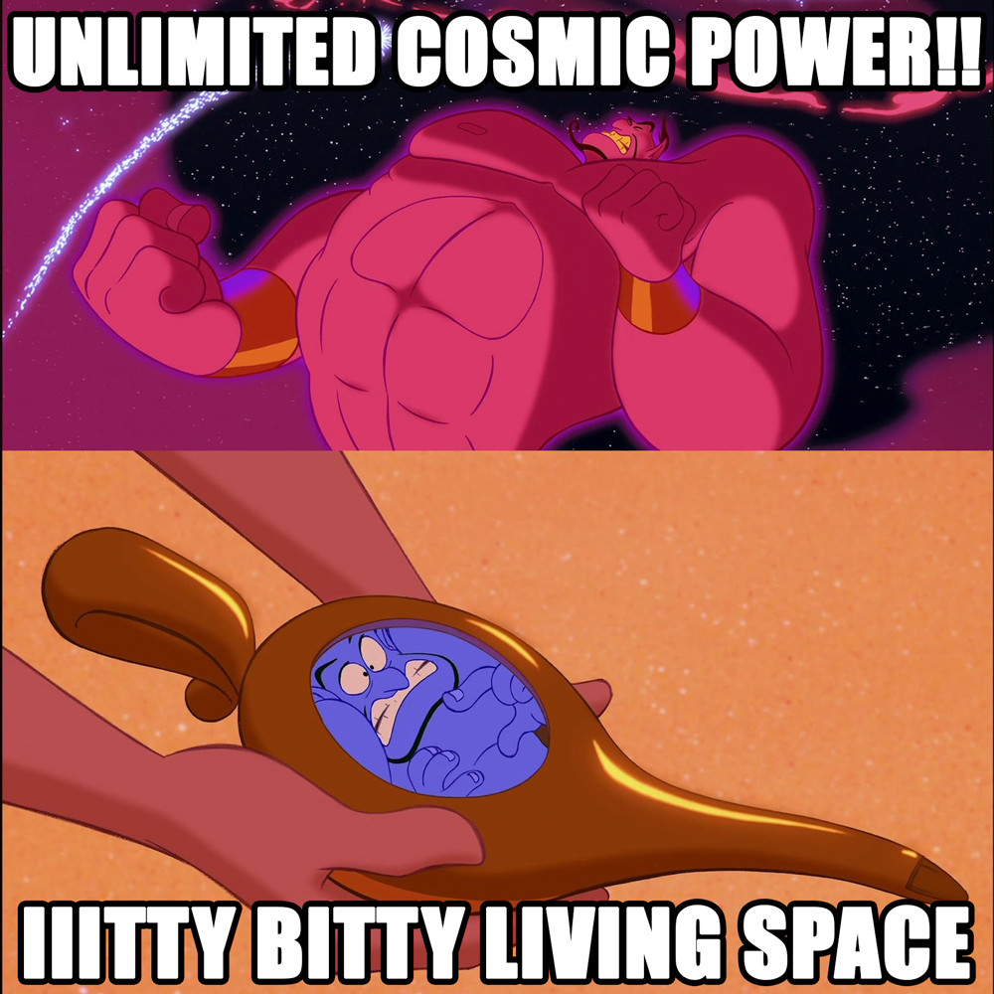

Slide 58
Importing packages
Core Libraries: “batteries included”
3rd Party: have to be downloaded

Slide 59
Import Statements
import numpy
from numpy import ndarray

Slide 60
Import Statements
import numpy as np

Slide 61
Concepts covered so Far
Dictionary
Class
Packages
Imports

Slide 62
Guided Exercise

Slide 63
Why numpy?
import numpy
from numpy import array

Slide 64
Flexible is slow

Slide 65
Nothing comes for free
List & dictionary hold any value
Also grow to any length
Numbers have no fixed size

Slide 66
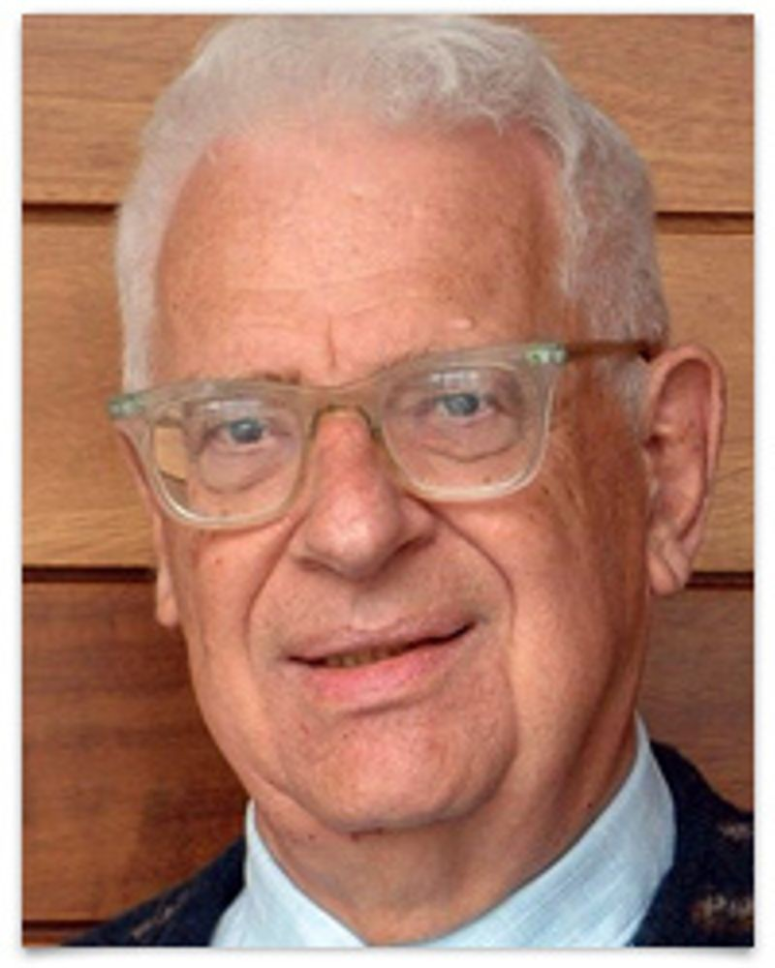
Every problem in computer science can be solved by another layer of indirection
- David Wheeler

Slide 67
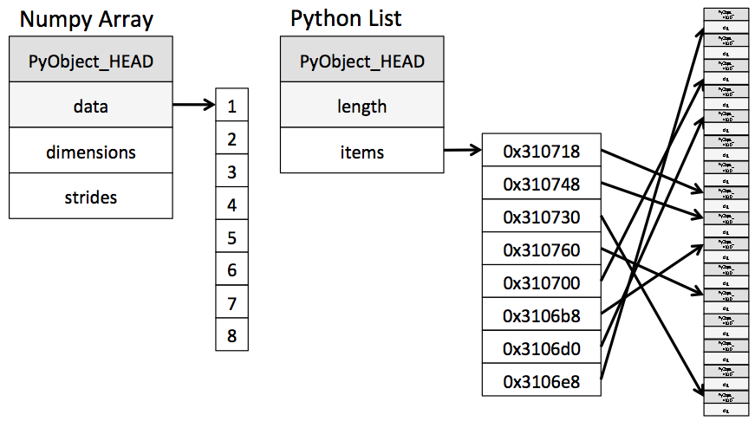

Slide 68
Numpy
Short for “numerical python”
Has array that is faster for math

