Slide 1
Bootcamp
Python for Data Science

Slide 2
Matplotlib
Intro to Data Visualization with

Slide 3
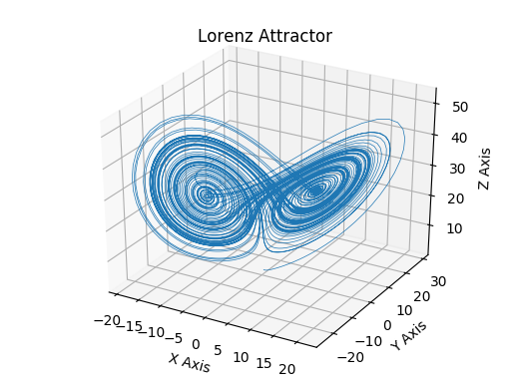

Slide 4
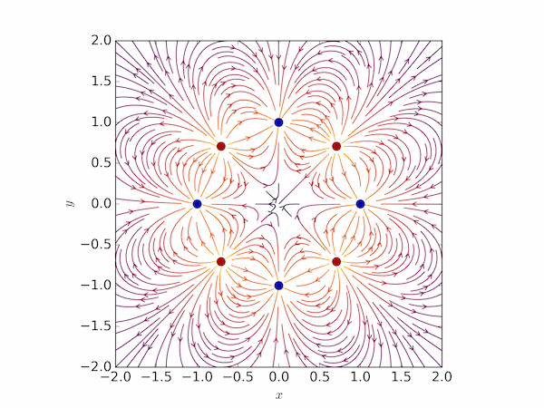

Slide 5
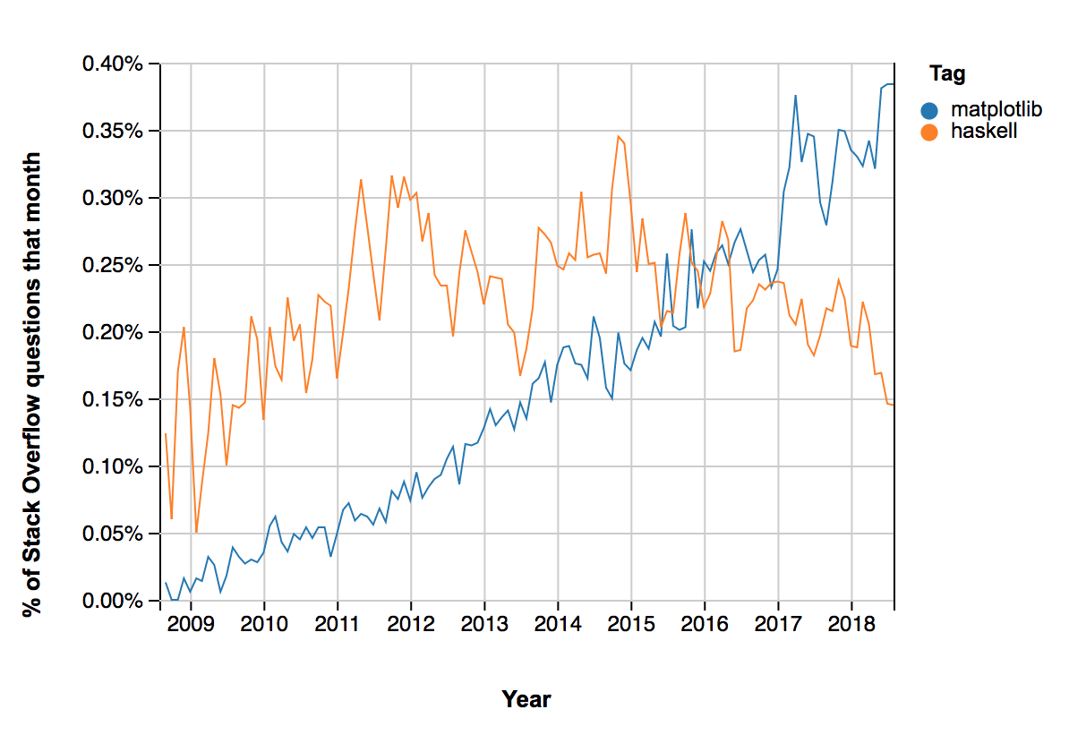

Slide 6
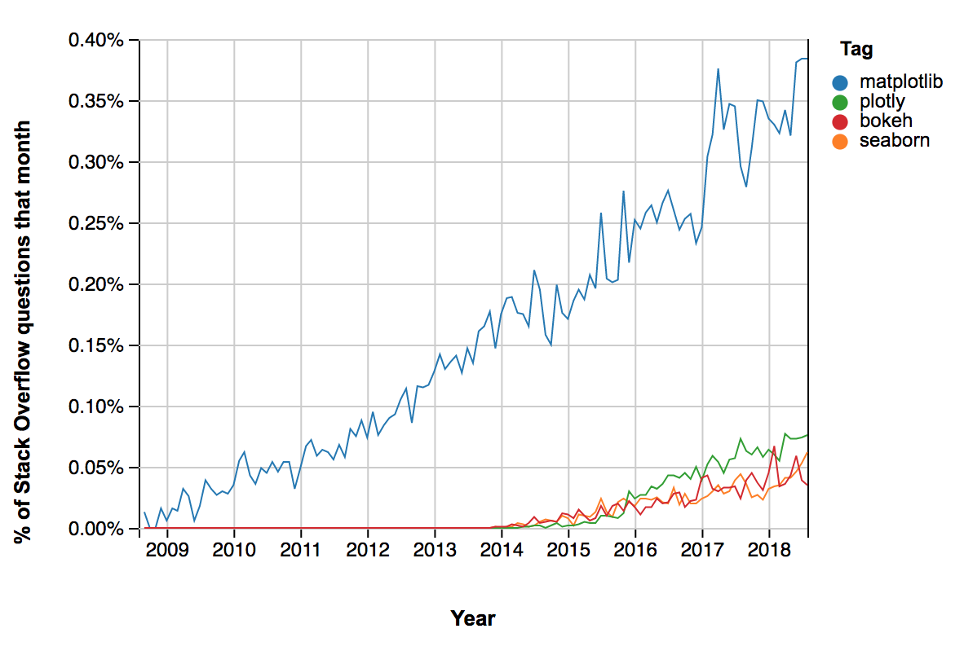

Slide 7
Goal for Today’s lesson

Slide 8

Graphs
Bar charts
Scatter plots
Histograms

Slide 9
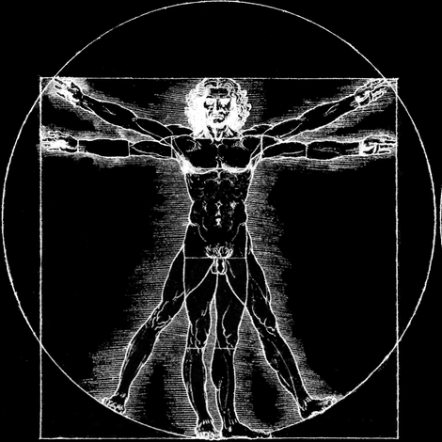
Anatomy of a Graph

Slide 10
The importance of terminology
Foundation
Precise terminology now —> less confusion later
Autonomy
Ability to search documentation or google

Slide 11
Painfully obvious
Vs
Utterly Bizarre

Slide 12
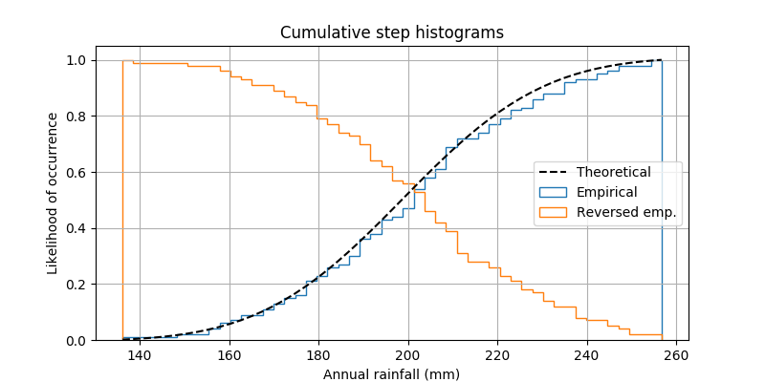
Painfully obvious
Title
Axis
Label
Legend
Grid
Bound

Slide 13
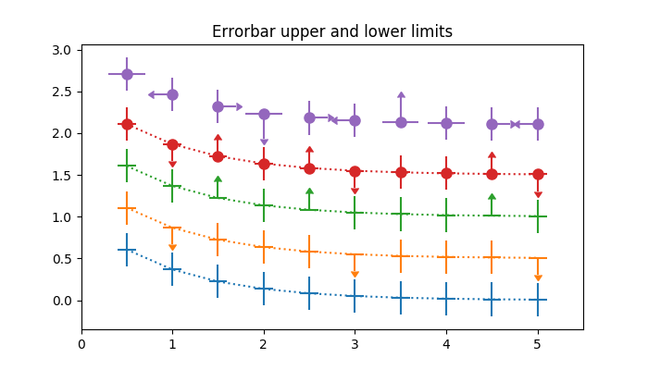
Utterly Bizarre
Pyplot
Figure
Axes
Line
Marker
Facecolor

Slide 14
matplotlib.Pyplot
Imported as plt
Stores global state
Use for setting global style

Slide 15
matplotlib.Pyplot
plt.style.use('seaborn')

Slide 16
matplotlib.Pyplot
plt.gcf()

Slide 17
matplotlib.Pyplot
plt.gcf()
“Grab current figure”

Slide 18
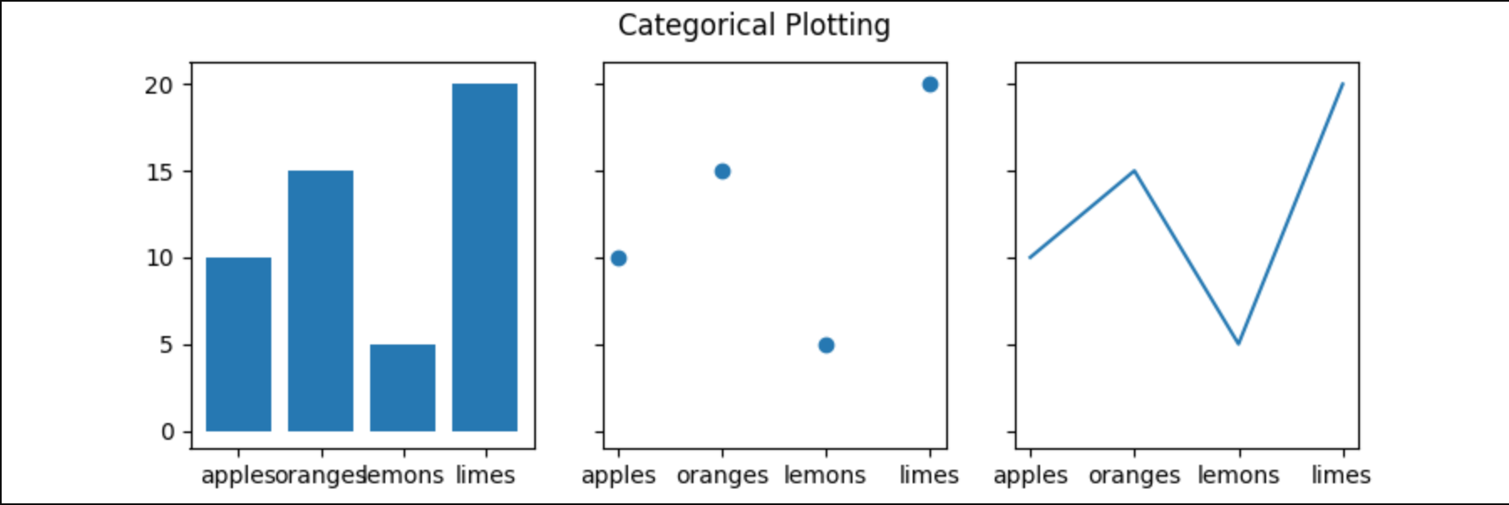
Figure
The entire image output by your code
matplotlib.figure.Figure

Slide 19
Figure
Set overall graph size
Store graph while modifying it
Save graph to disk

Slide 20
Axes
One particular graph within a figure
matplotlib.axes.Axes

Slide 21
Axes
Add title for graph
Change labels or ticks
Change background color/grid

Slide 22
Concepts covered so Far
PyPlot
Figure
Axes
Bar Chart

Slide 23
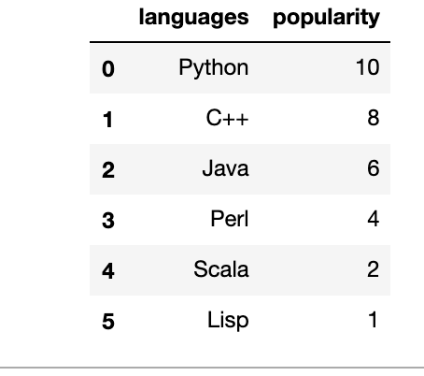

Slide 24
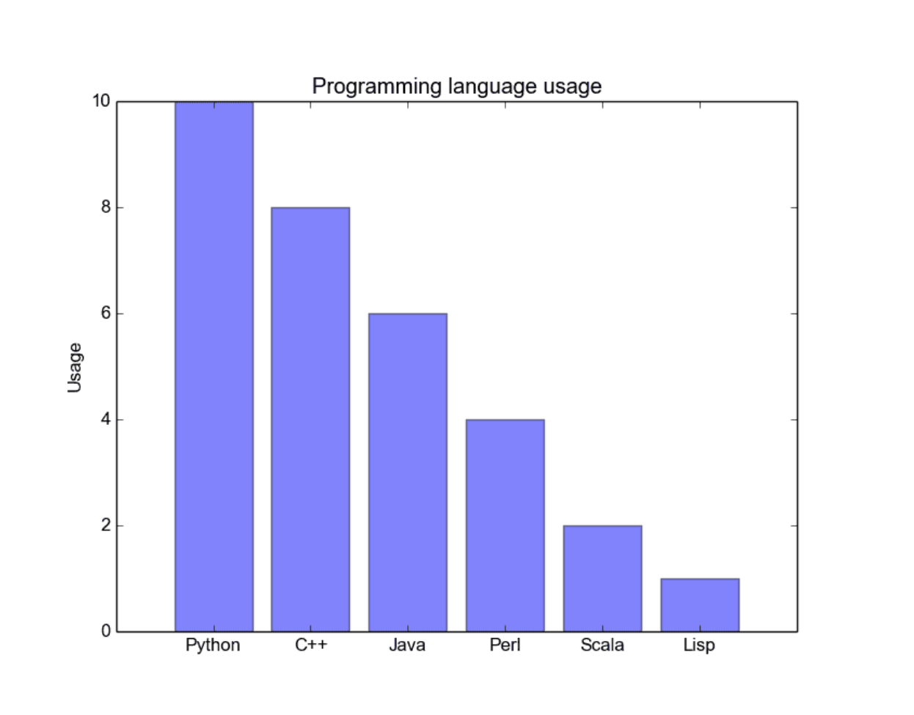
Text

Slide 25
Exercises

Slide 26
Utterly Bizarre
Pyplot
Figure
Axes
Line
Marker
Facecolor

Slide 27
Line
Unlike in math, this can be any curve
matplotlib.lines

Slide 28
Marker
Dot or other symbol centered on a specific point
matplotlib.markers

Slide 29
faceColor
Background color to the data
matplotlib.axes.Axes

Slide 30
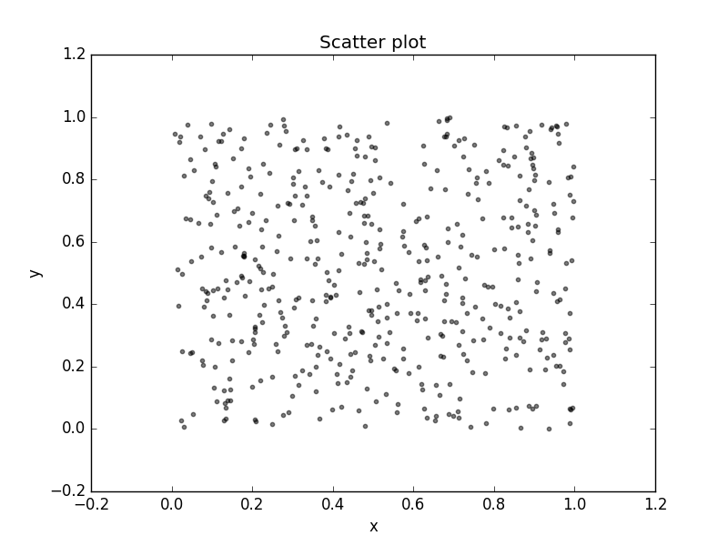

Slide 31
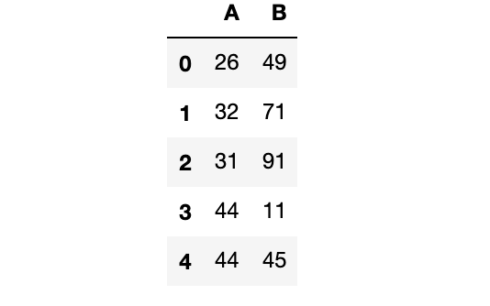
Text

Slide 32
Exercises

Slide 33
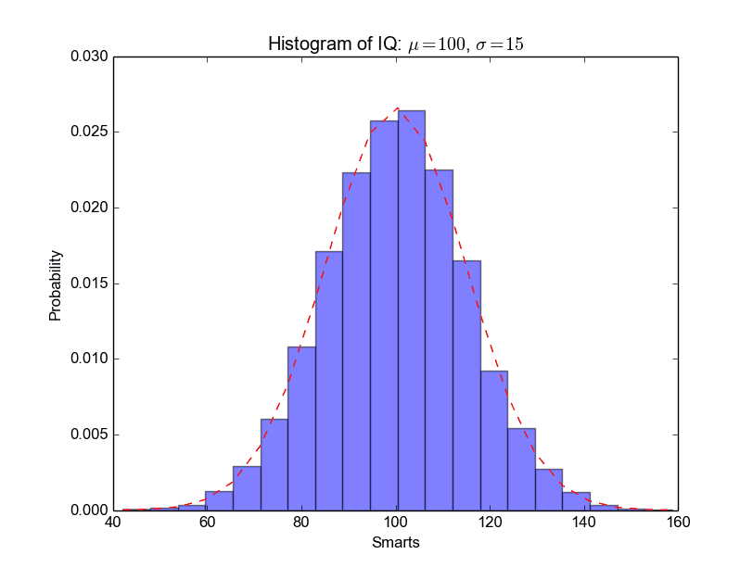

Slide 34
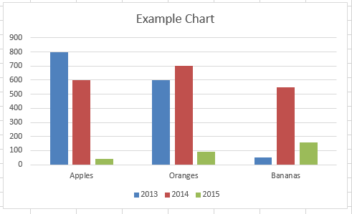
Text

Slide 35
Text

Slide 36
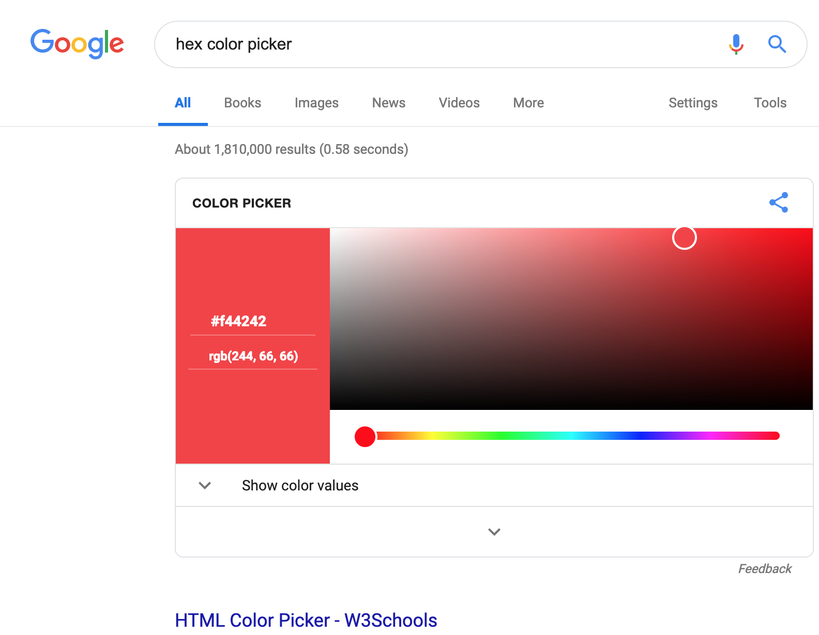
Text

