Slide 1
Bootcamp
Python for Data Science

Slide 2

Sci-Kit Learn
All-in-one machine learning package
Built on Numpy and matplotlib

Slide 3
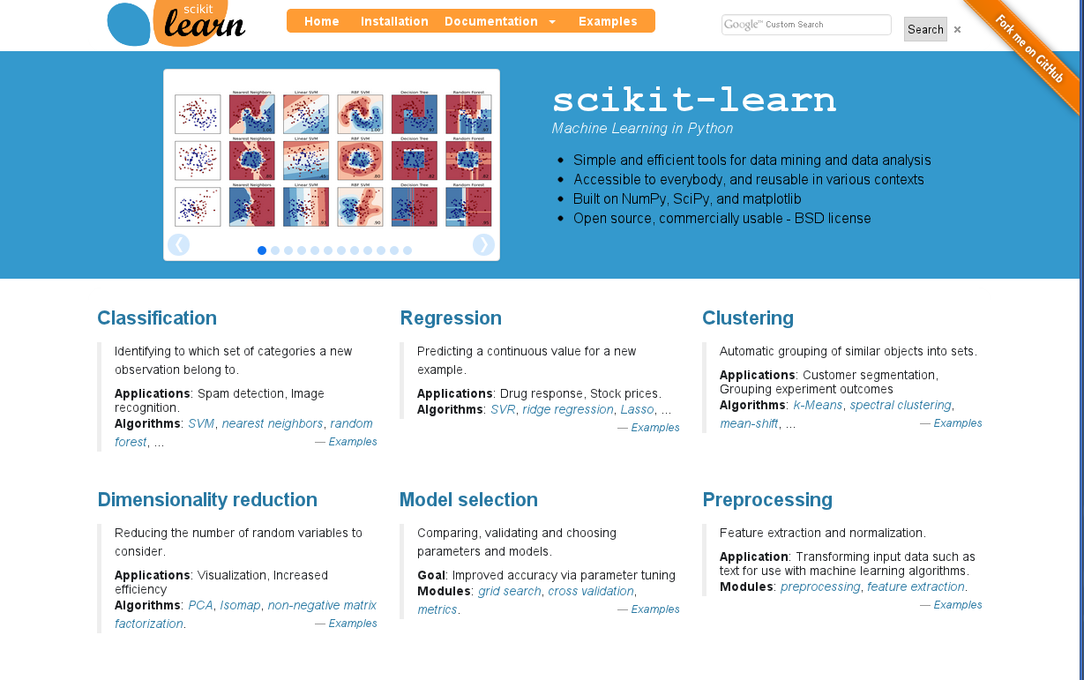
Text

Slide 4
Imported as sklearn
import sklearn

Slide 5
Imported as sklearn
from sklearn.linear_model \
import LinearRegression

Slide 6
Linear Regression

Slide 7
Code is not the hard part
model = LinearRegression()
model.fit(data_df, target)

Slide 8
Code is not the hard part
model.predict(new_df)
target

Slide 9
Linear Regression
Outputs line of best fit
“Best fit” is a function of error

Slide 10
single-variable
y = 2x + 1

Slide 11
single-variable
y = 2x + 1
coefficient AKA slope

Slide 12
single-variable
y = 2x + 1
intercept

Slide 13
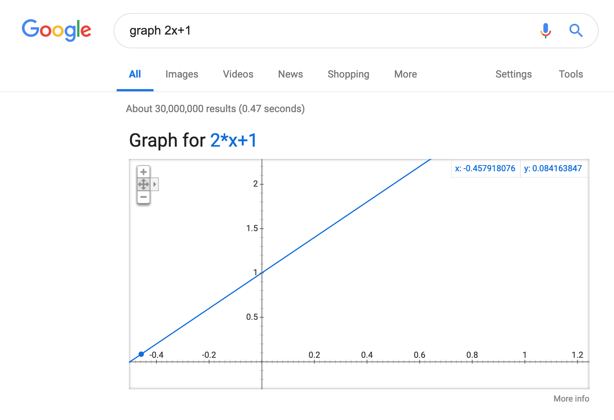
Text

Slide 14
single-variable
y = 2x + 1
1 —> 3
2 —> 5
3 —> 7

Slide 15
Python Equivalent
model = LinearRegression()
model.coef_ = np.array([2.0])
model.intercept_ = 1.0

Slide 16
single-variable
y = model.predict(x)
1 —> 3
2 —> 5
3 —> 7

Slide 17
single-variable Linear models
No magic!
2 dials: coefficient and intercept

Slide 18
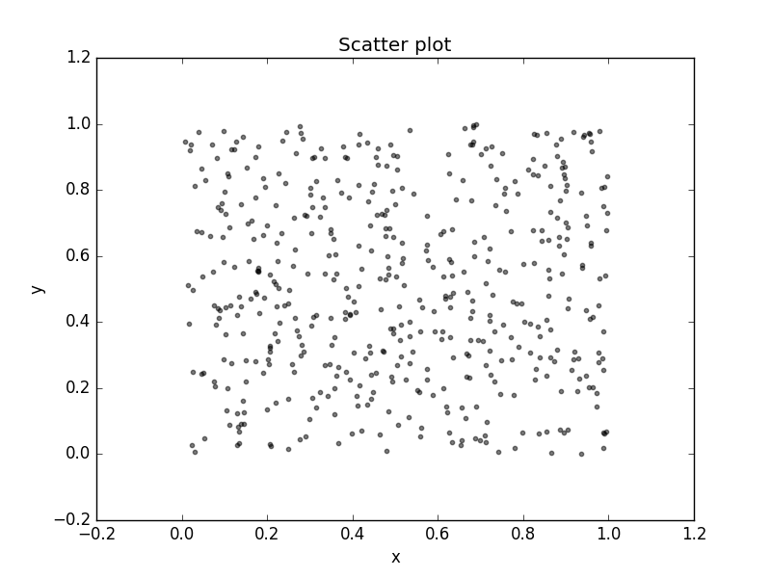
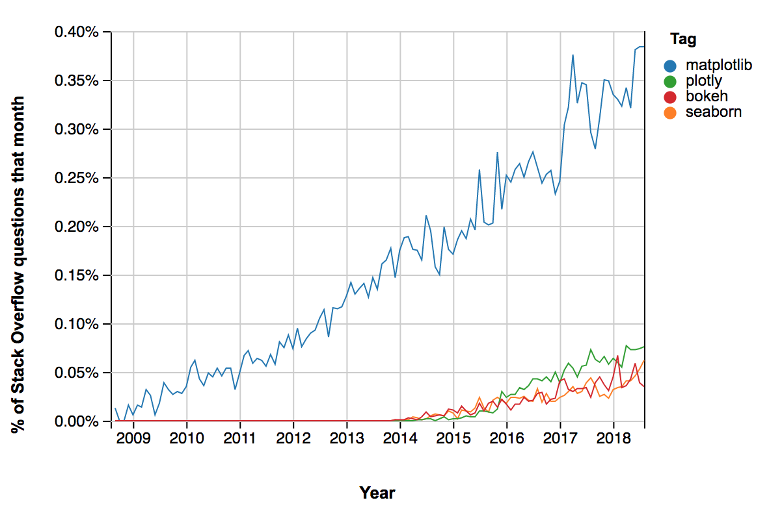
Scatter and Line Plots

Slide 19
Overlaying graphs
axes = df.plot(kind=‘scatter’,
x='avg_num_rooms', y='median_price', color='black')

Slide 20
Overlaying graphs
axes = df.plot(kind=‘scatter’,
x='avg_num_rooms', y='median_price')

Slide 21
Overlaying graphs
axes = data.plot(kind=‘scatter’,
x='avg_num_rooms', y='median_price')
df.plot(
x='avg_num_rooms', y=‘predicted_price’
ax = axes)

Slide 22
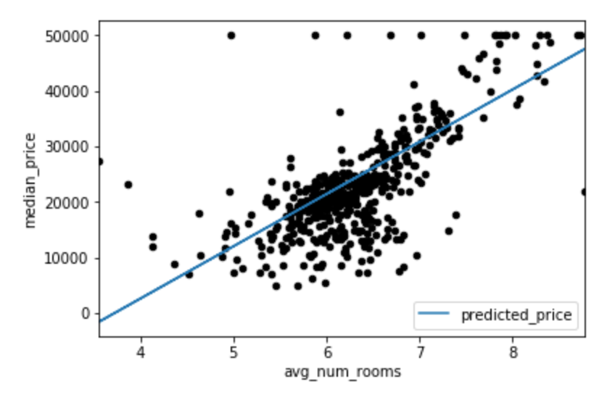

Slide 23
Exercises

Slide 24
Why Least squares?
Math is much simpler
Maximum likelihood estimator, when data is normal

Slide 25
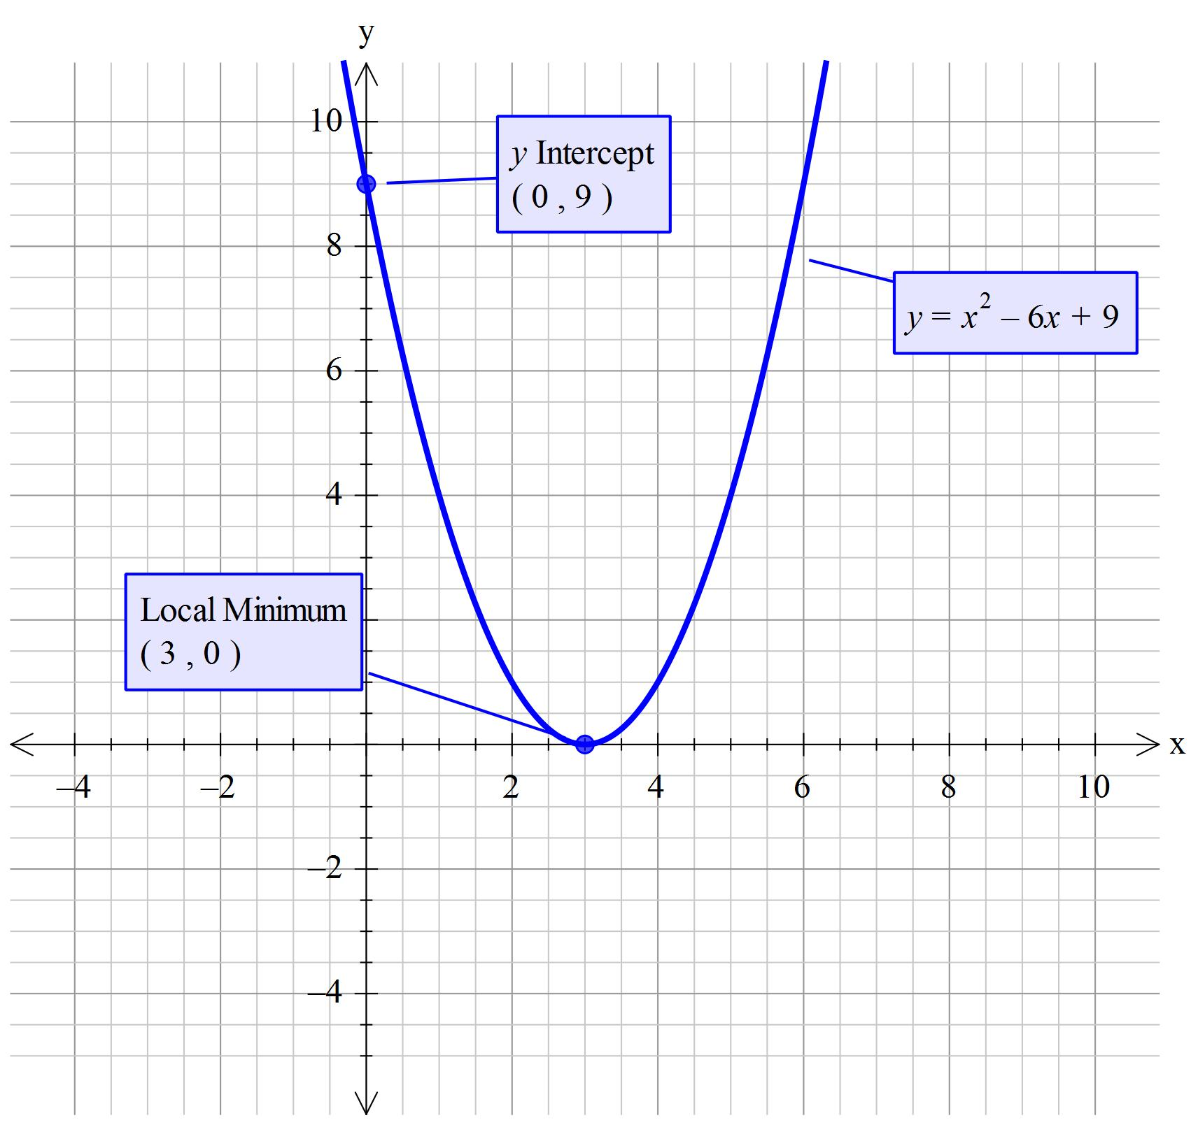
Text

Slide 26
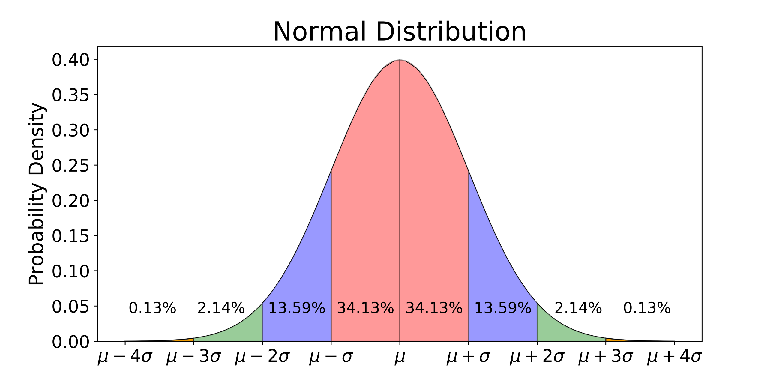

Slide 27
Multi-variable
y = 2x0 + 3x1 + 1

Slide 28
Mean Squared Error
Squared error just like least squares, but average vs total

Slide 29
R2 Score
Proportion of variance that is explained by your model
1.0 is a perfect model

Slide 30
Interpreting Linear models
model.coef_

Slide 31
Interpreting Linear models
model.coef_
[-1.840,4.24, …, -9.96])

Slide 32
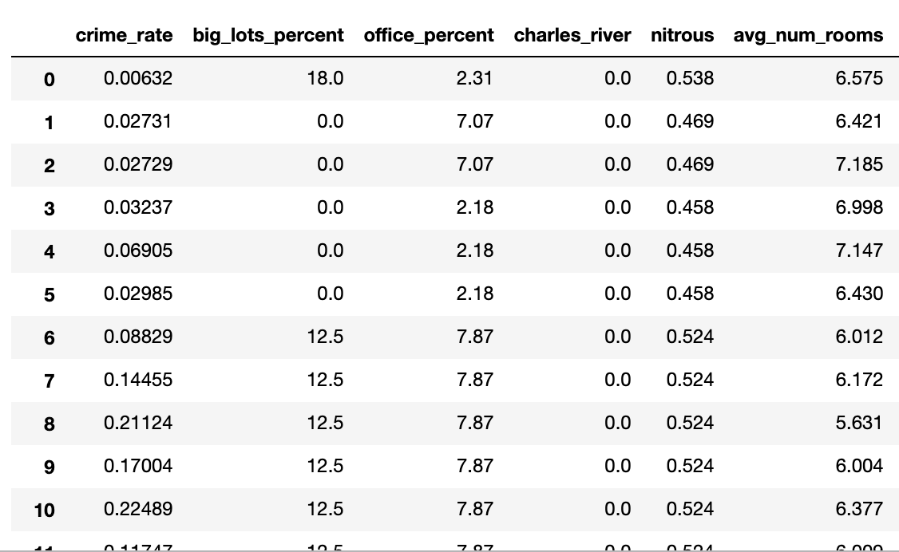
Interpreting Linear models
model.coef_
[-1.840,4.24, …, -9.96])

Slide 33
Exercises

Slide 34
Linear model assumptions
Linear relationship
Independence
Normality
Equal Variance

Slide 35
Testing methods
Quick and qualitative
Protects against major errors

Slide 36
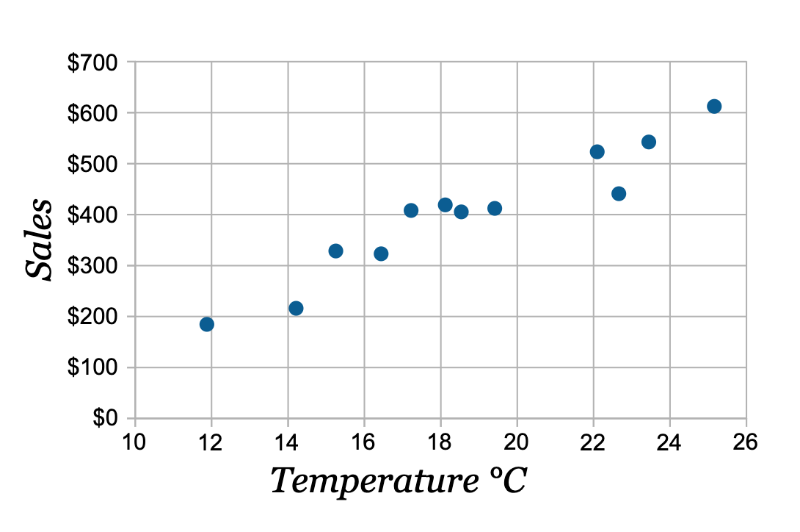
Linear relationship
Can check with a scatter plot

Slide 37
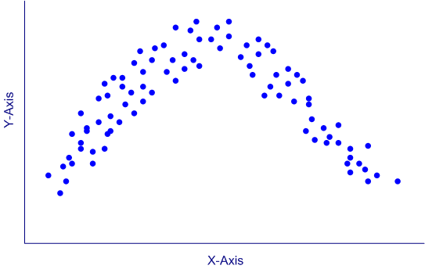
Linear relationship
Can check with a scatter plot

Slide 38
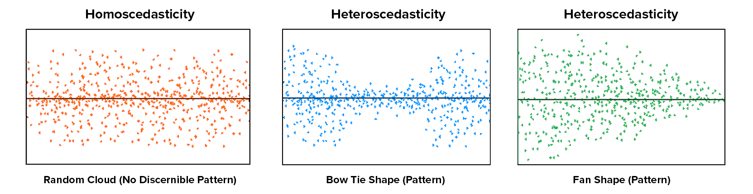
Equal Variance
Can check with a scatter plot

Slide 39
equal Variance
Can check with a scatter plot

Slide 40
equal Variance
Can check with a scatter plot

Slide 41
Linear model assumptions
Linear relationship
Independence
Normality
Equal Variance

Slide 42
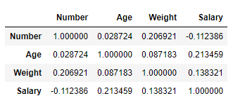
Independence
Check the correlation matrix df.corr()

Slide 43
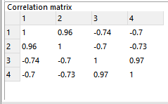
Independence
Check the correlation matrix df.corr()

Slide 44
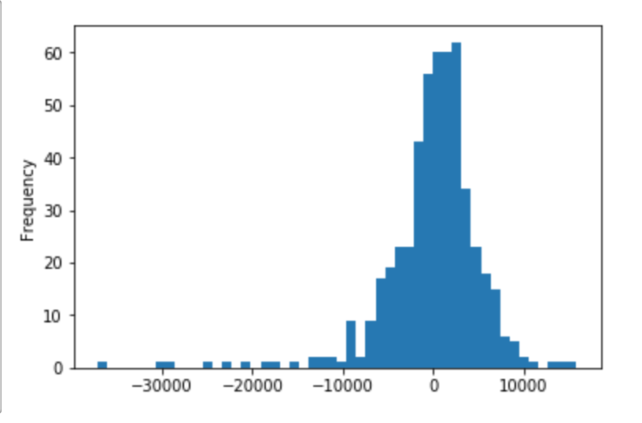
Normality of errors
Can check with a histogram

Slide 45
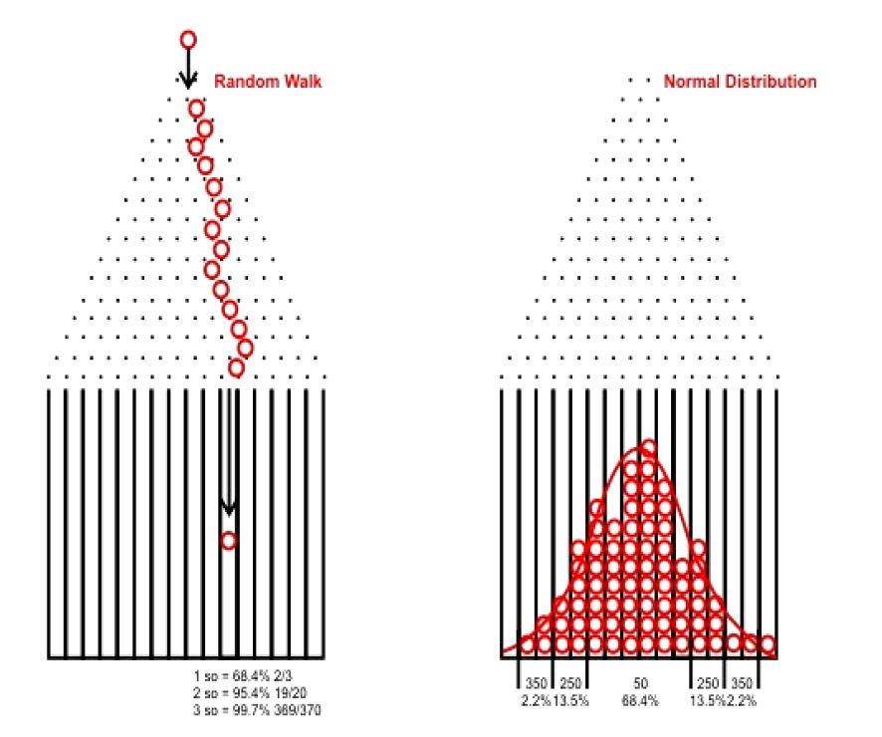

Slide 46
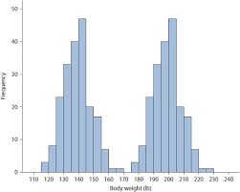
Normality of errors
Can check with a histogram

Slide 47
Exercises

