Slide 1
Bootcamp
Python for Data Science

Slide 2
Review

Slide 3
Fetching a Column
df[‘revenue’]

Slide 4
Creating a new Column
df[‘profit’] =
df[‘revenue’] - df[‘expenses’]

Slide 5
Dataframe from columns
df[[‘revenue’, ‘profit’]]

Slide 6

Group By
Buckets rows by column value
Combines buckets using a ufunc

Slide 8
.loc vs .iloc
.loc grabs via explicit index (e.g. Date)
.iloc grabs via normal, list-like index

Slide 9
Clear notation
my_awesome_df.loc[“2012-02”]

Slide 10
Clear notation
my_awesome_df.iloc[-1]

Slide 11
Plotting with Matplotlib
axes = my_df.plot(kind='bar')
fig = plt.gcf()

Slide 12
Exercises

Slide 13
Pivot Tables

Slide 14
Pivot table
Similar to groupby
Segments data along multiple axes

Slide 17
Pivot table syntax
sales_df.pivot_table(
values=[“quantity”,”price”],
index=“name”
)

Slide 18
Pivot table syntax
sales_df.pivot_table(
values=[“quantity”,”price”],
index=“name”
)
takes AVG by default

Slide 21
Pivot table syntax
sales_df.pivot_table(
values=[“quantity”,”price”],
index=“name”,
aggfunc=“sum”
)

Slide 22
Beyond Groupby

Slide 23
Columns
Columns segment values, just like index
Will form bins from unique values in column you specify

Slide 24
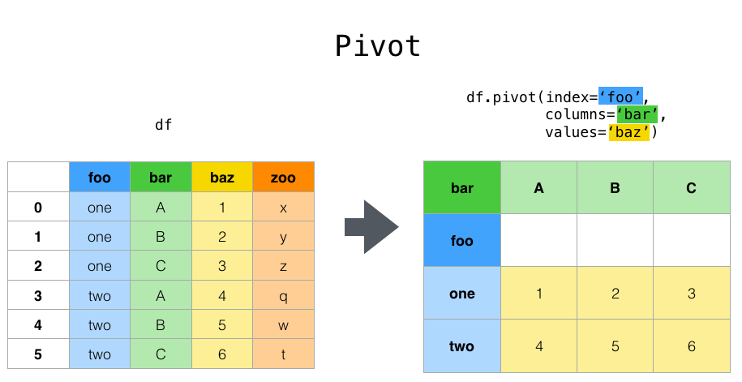

Slide 25
Pivot table syntax
sales_df.pivot_table(
values=[“quantity”,”price”],
index=“name”,
columns=“ABC”)

Slide 26
Concepts covered so Far
Pivot tables
Values
Index
Columns

Slide 27
Exercises

Slide 28
What about continuous data?
Ex: age, salary, etc
Count distinct values? Too many!

Slide 29
Cut and Qcut
Break continuous data into intervals
Cut divides by interval, eg. [0, 10]
Qcut finds intervals with equal # items

Slide 30
Cut
age_bins = pd.cut(titanic_df['age'],
[0, 18, 80])
titanic_df.pivot_table("survived", index=age_bins, columns="class")

Slide 31
QCut
bins=pd.qcut(titanic_df[‘age’], 3)
titanic_df.pivot_table("survived", index=bins, columns="class")

Slide 32
Intervals are bad labels
Fetch using “(0, 18]”?
Possible but difficult
Better to provide labels yourself

Slide 33
QCut
bins=pd.qcut(titanic_df[‘age’], 3, labels=[‘child’,’teen’,'adult'])

