Slide 1
Data Science
Getting Started in Python

Slide 2
What makes Python different?

Slide 3
Python’s data Science Toolset

Slide 4
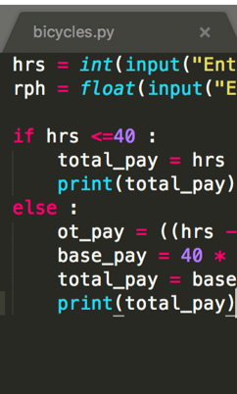
Code
Short, Readable

Slide 5

Code vs UI
Harder for beginners
Easier for complex projects

Slide 6
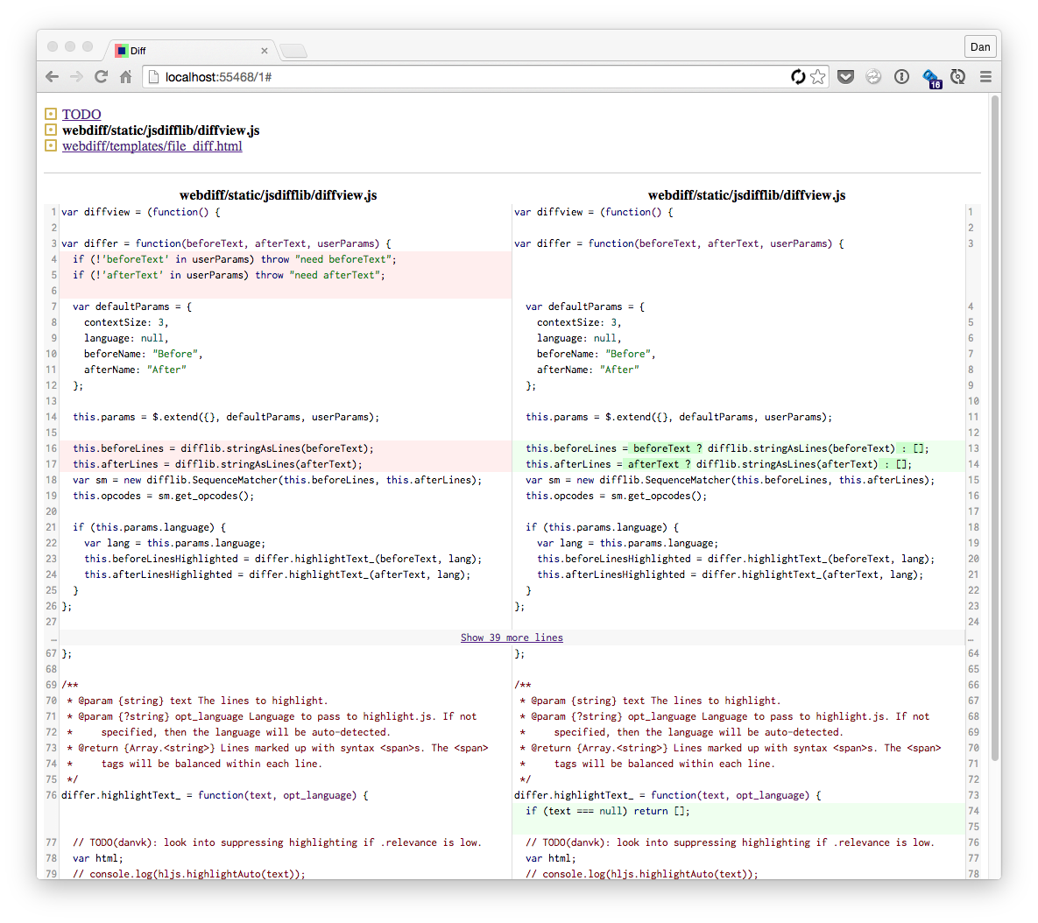

Slide 7
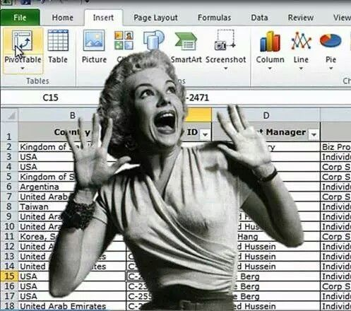

Slide 8
Short and Readable
Human productivity > computer speed
We read code 10X more than we write it

Slide 9

Open Source
Broad community in

Slide 10
Open Source
Contributors all over the world
Now faster than proprietary software!

Slide 11
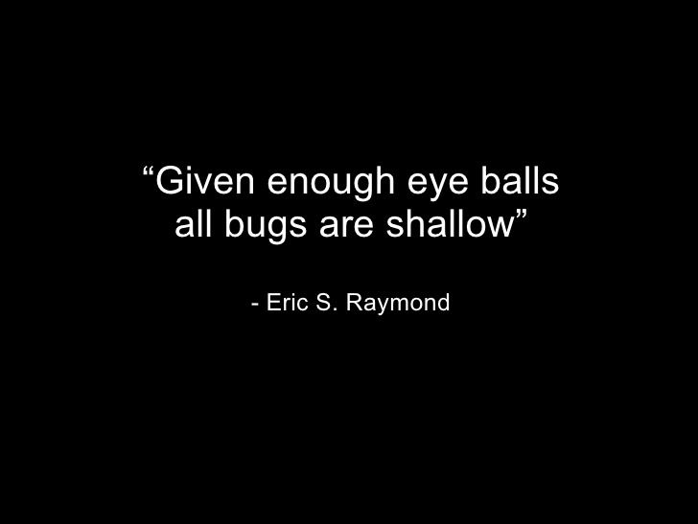

Slide 12
Cross-pollination
Web development
Data science
Automation
Information Security

Slide 13

Data Science
Growth of

Slide 14
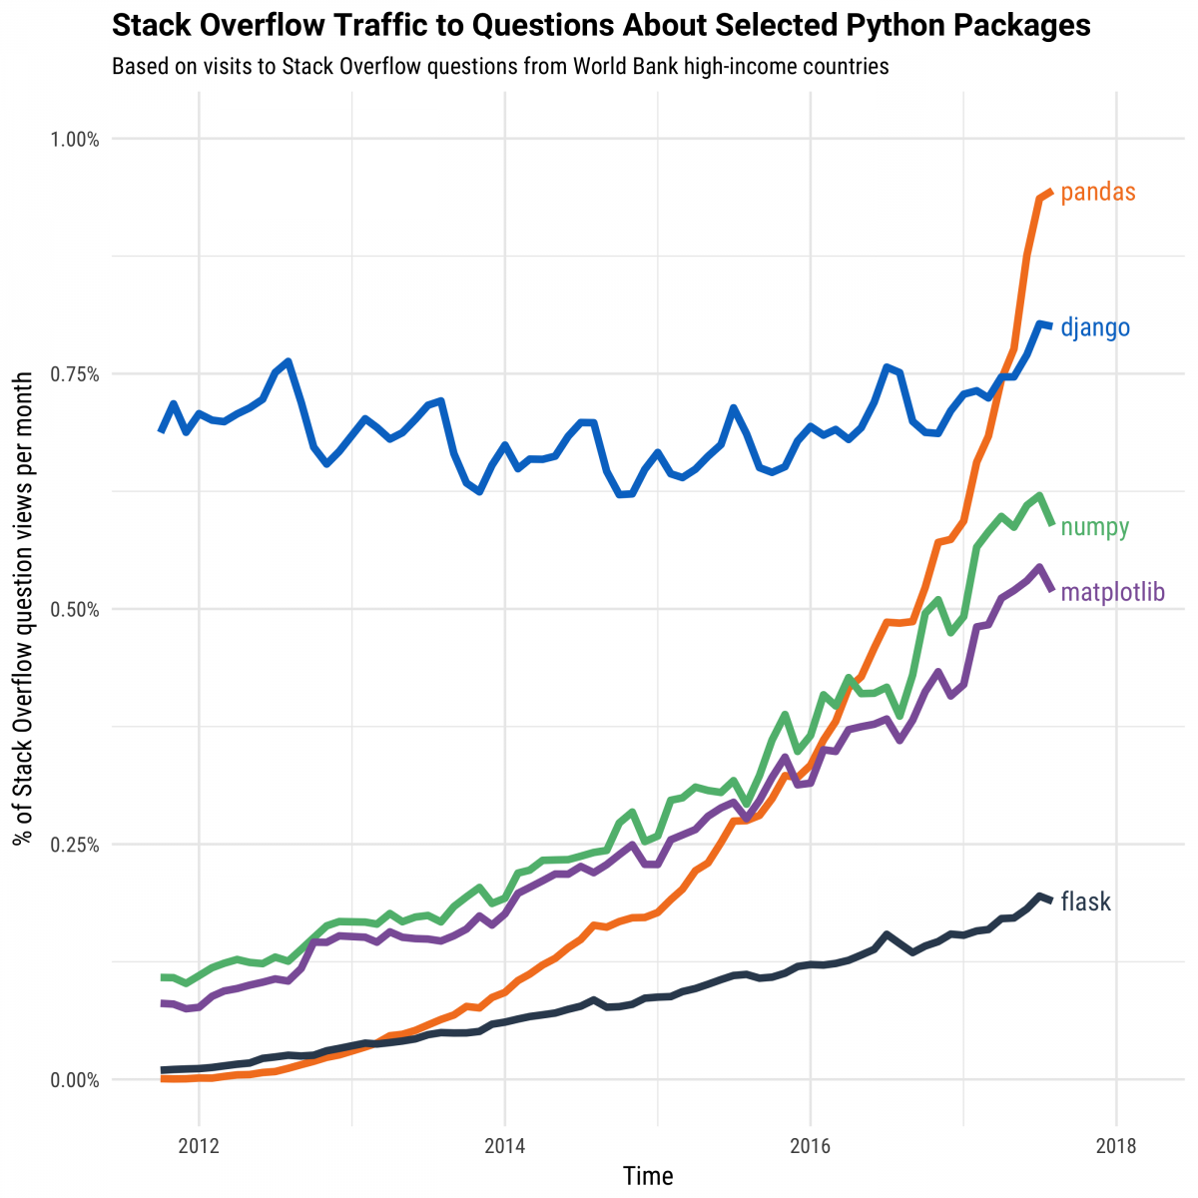

Slide 15
Python’s data Science Toolset

Slide 16
JupYter NotebookS

Slide 17
Jupyter Notebook
Name comes from Julia/Python/R
Standard format for sharing data analysis

Slide 18
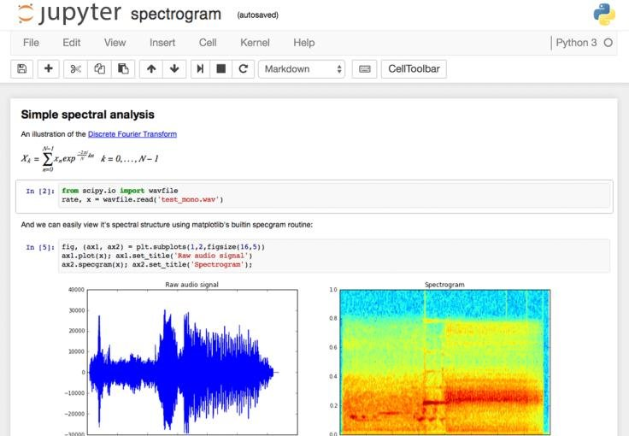


Slide 19
Pandas

Slide 20
Pandas
Short for “panel data”
Similar to spreadsheet
DataFrame concept from R

Slide 21
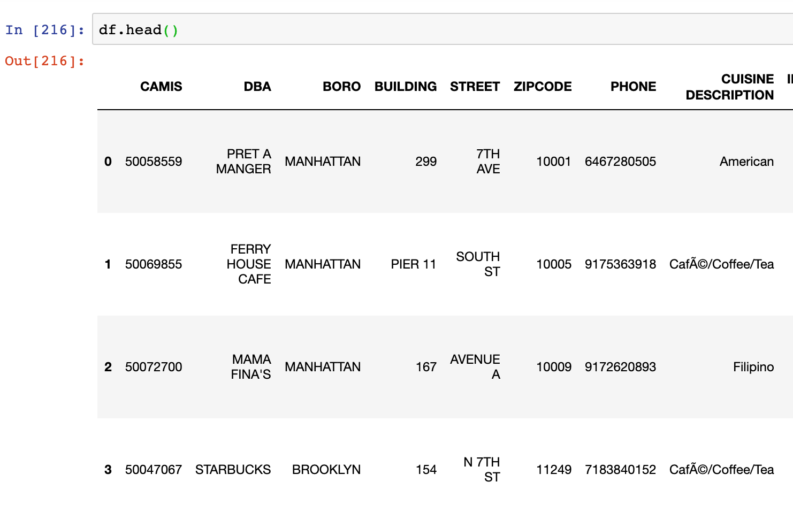
Text

Slide 22
Pandas
Handles (low) millions of rows
Column-oriented workflow
Huge community

Slide 23

Data Analysis
exploration and

Slide 24

Cleaning Data

Slide 25

we can be Fast
When it matters

Slide 26
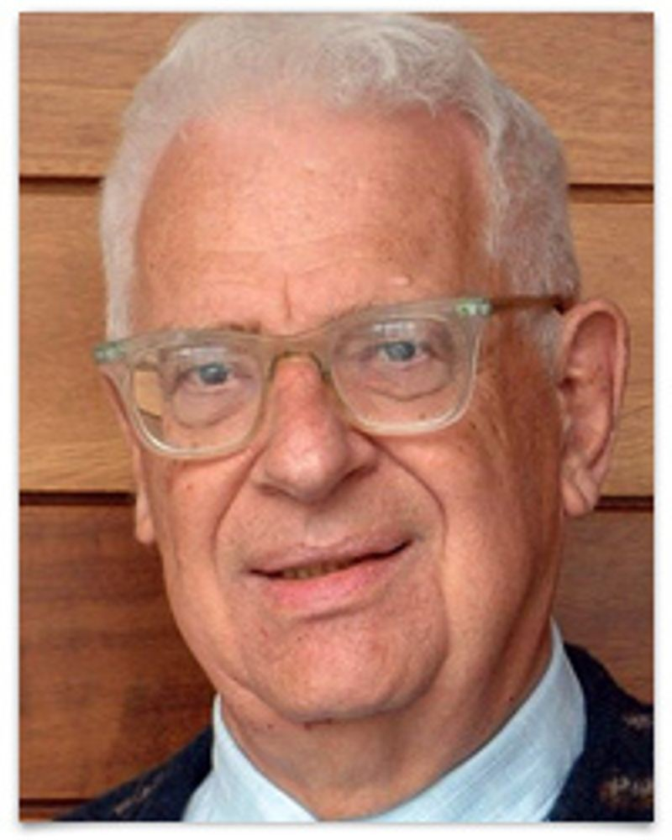
Every problem in computer science can be solved by another layer of indirection
- David Wheeler

Slide 27
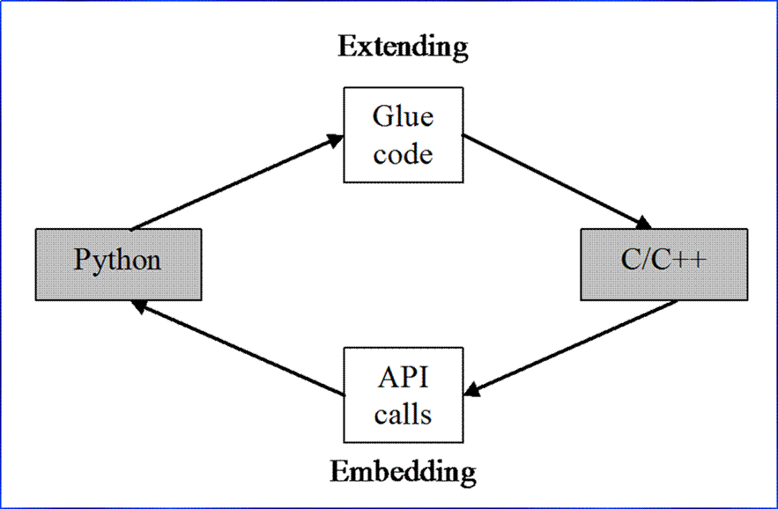

Slide 28
MatPlotLib

Slide 29
MatPlotlib
Originally a copy from MATLAB
Oldest, most popular graphing library

Slide 30
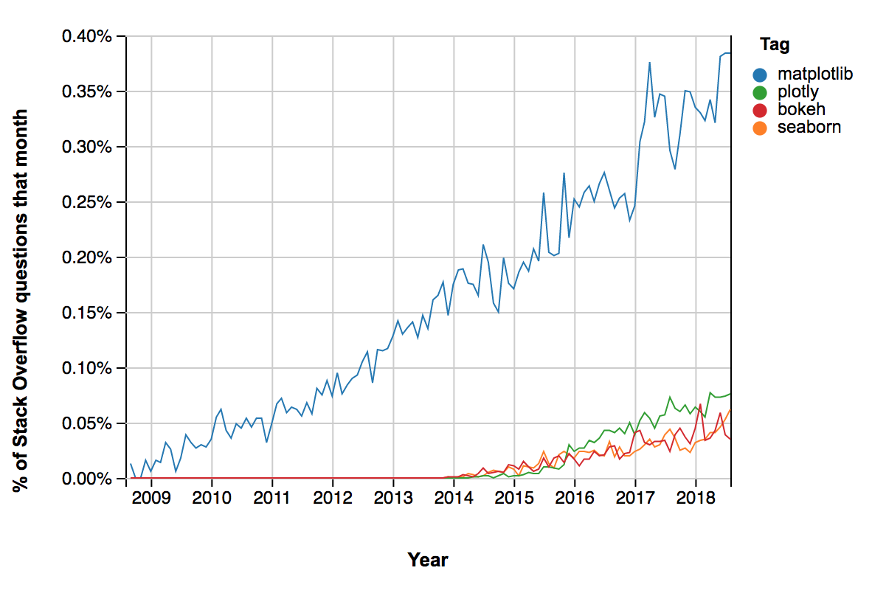

Slide 31
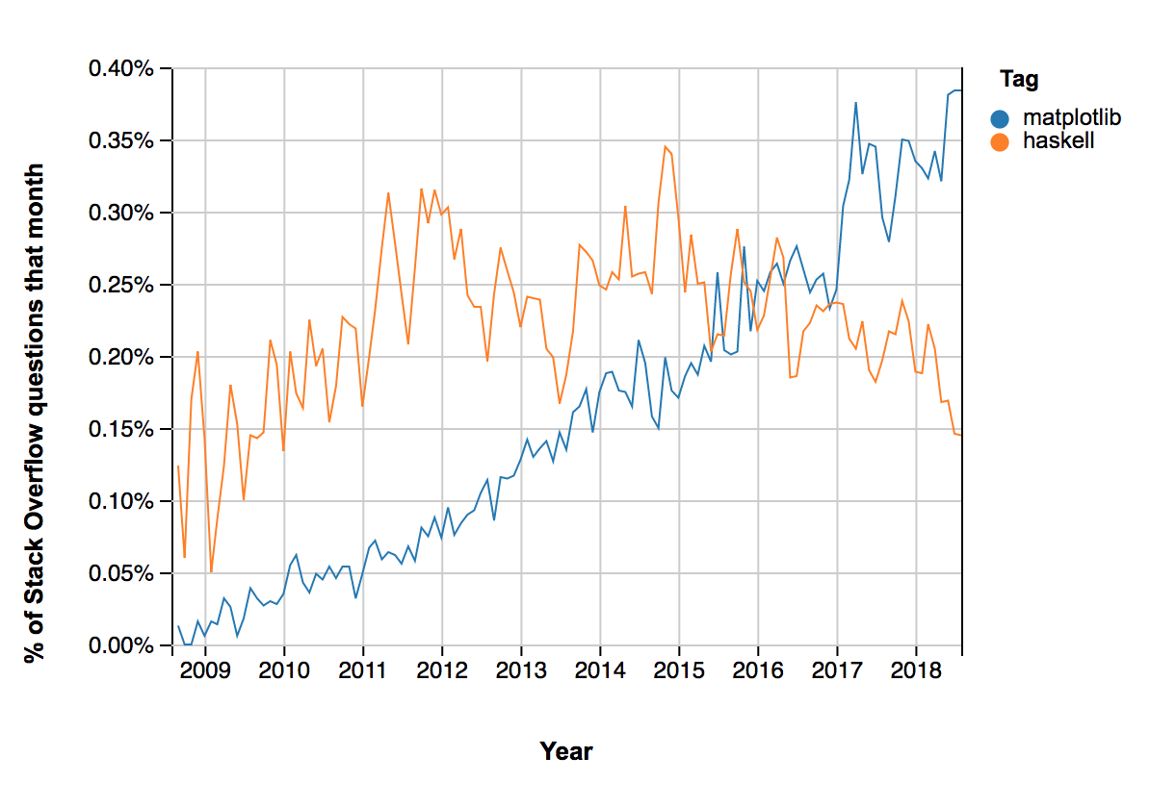

Slide 32
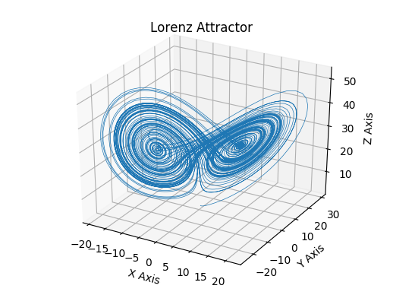

Slide 33
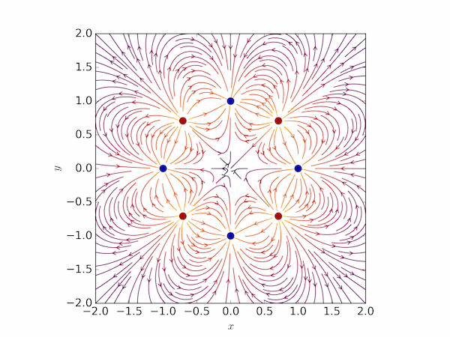

Slide 34
Sci-Kit Learn

Slide 35
Sci-Kit Learn
All-in-one machine learning package
Beginner-friendly and well-documented

Slide 36
Training a Model
model = LinearRegression()
columns = [‘crime_rate’, ‘tax_rate’]
model.fit(df[columns],df[‘price])

Slide 37
Using a Model
model.predict(df[columns])

Slide 38
