Slide 1
Bootcamp
Machine Learning

Slide 2
Rob Carrington
4 years as a Python developer
Worked in FinTech (@Q2eBanking)

Slide 3



Q2

Slide 4
Projects
Recommendation System
Audience Segmentation
Predicting Overdrafts

Slide 5

Class Goals
Intro to essential ML concepts
Hands-on practice building models from clean data

Slide 6
Class format
10 minutes for lesson & demo
15 minutes for exercise
Pause to review & ask questions
Rinse and repeat

Slide 7
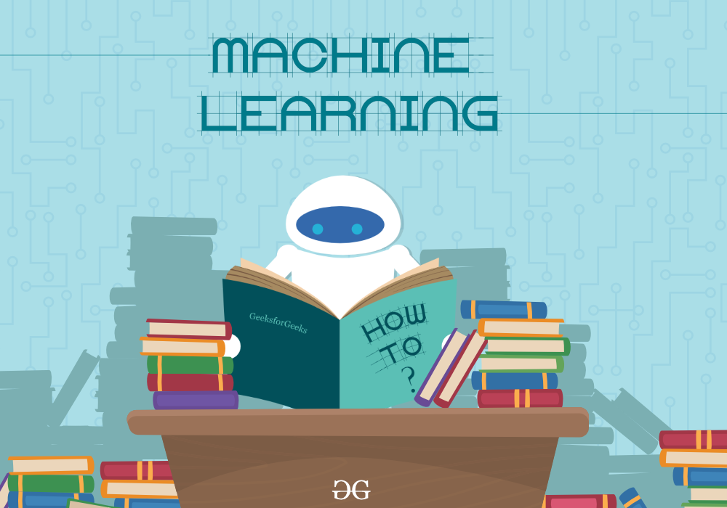

Slide 8
Class format

Slide 9
Class format

Slide 10
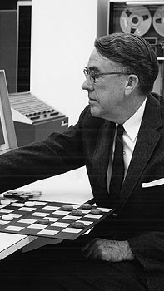
“The field of study that gives computers the ability to learn without being explicitly programmed”
- Arthur Samuel, 1959

Slide 11
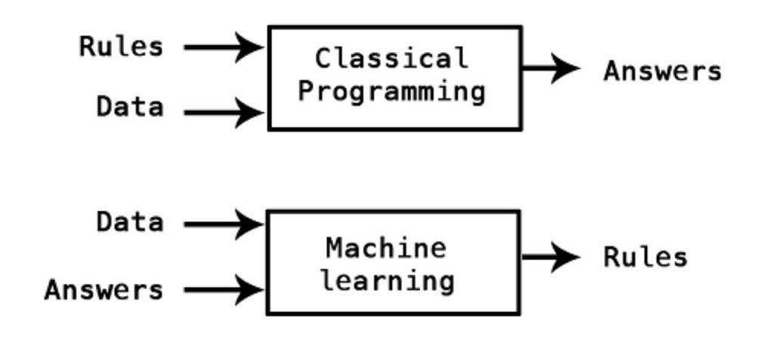

Slide 12
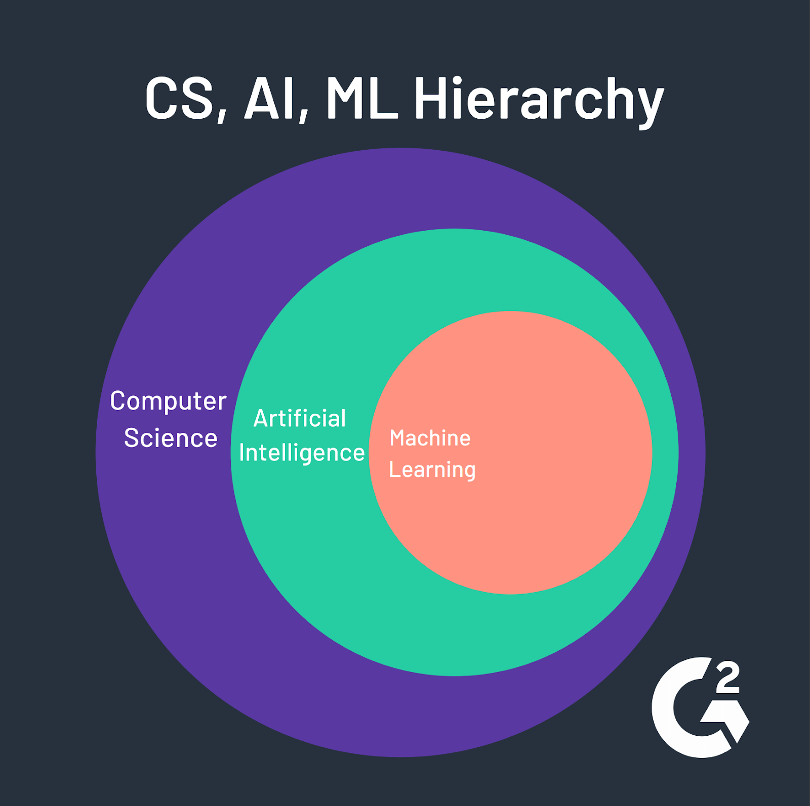

Slide 13
What machine learning isn't

Slide 14
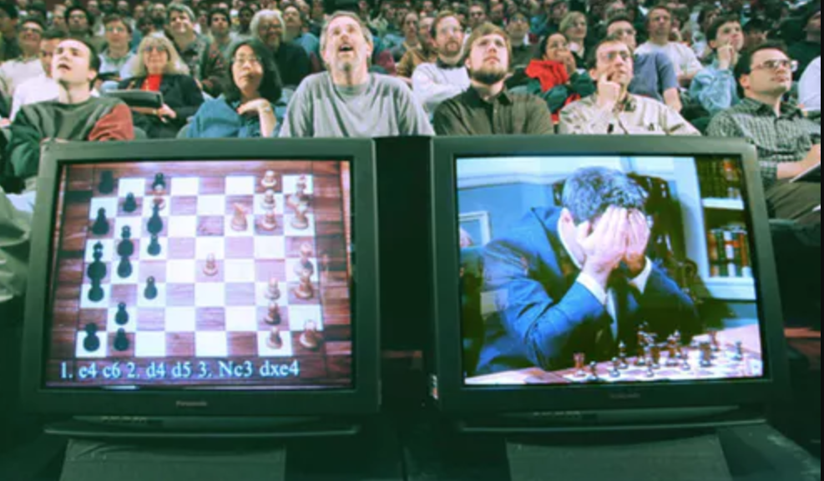
Intelligence = search algorithm (1956 - 1974)

Slide 15
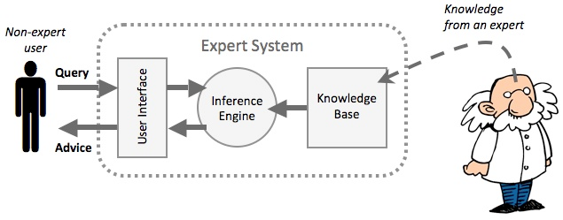
https://www.google.com/url?sa=i&source=images&cd=&ved=2ahUKEwi-kIfs_cHkAhWQxVkKHYNjDYQQjRx6BAgBEAQ&url=https%3A%2F%2Fwww.itgsnews.com%2Fcreating-expert-system-with-clips%2F&psig=AOvVaw2rT1XziARmYSMHLyhFbWN6&ust=1568058074270738
Intelligence = Rules + Deductive Logic (1980 - 1987)

Slide 16
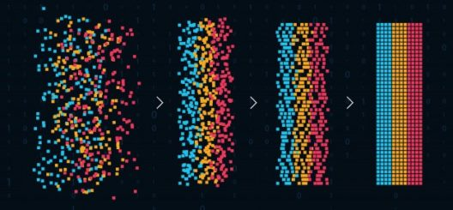
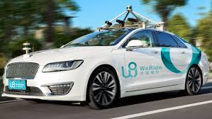
https://www.google.com/url?sa=i&source=images&cd=&ved=2ahUKEwi-kIfs_cHkAhWQxVkKHYNjDYQQjRx6BAgBEAQ&url=https%3A%2F%2Fwww.itgsnews.com%2Fcreating-expert-system-with-clips%2F&psig=AOvVaw2rT1XziARmYSMHLyhFbWN6&ust=1568058074270738
Intelligence = Pattern Recognition (1993 - today)

Slide 17
Machine Learning: Why Now?
Ideas are not new! Started in 1950s
Computers have gotten fast and cheap enough for Big Data
A few new concepts (e.g. back-propagation)

Slide 18
What’s it good for?

Slide 19
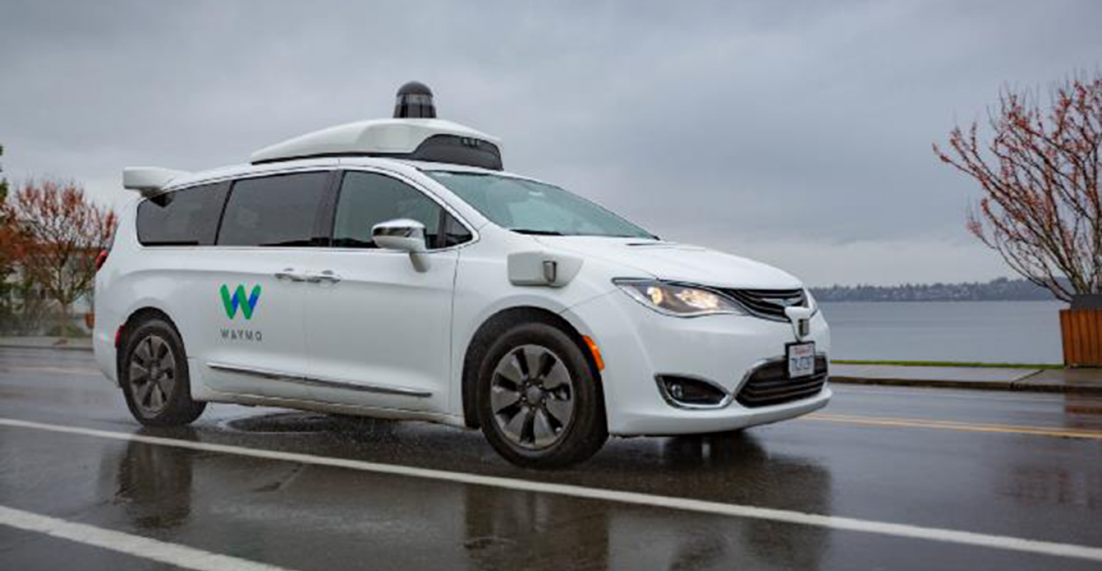
https://www.google.com/url?sa=i&source=images&cd=&ved=2ahUKEwi-kIfs_cHkAhWQxVkKHYNjDYQQjRx6BAgBEAQ&url=https%3A%2F%2Fwww.itgsnews.com%2Fcreating-expert-system-with-clips%2F&psig=AOvVaw2rT1XziARmYSMHLyhFbWN6&ust=1568058074270738
Self-Driving Cars

Slide 20

https://www.google.com/url?sa=i&source=images&cd=&ved=2ahUKEwi-kIfs_cHkAhWQxVkKHYNjDYQQjRx6BAgBEAQ&url=https%3A%2F%2Fwww.itgsnews.com%2Fcreating-expert-system-with-clips%2F&psig=AOvVaw2rT1XziARmYSMHLyhFbWN6&ust=1568058074270738

Slide 21
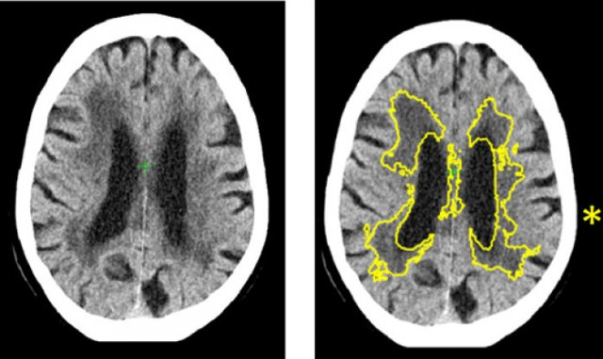
Medical Diagnostics

Slide 22
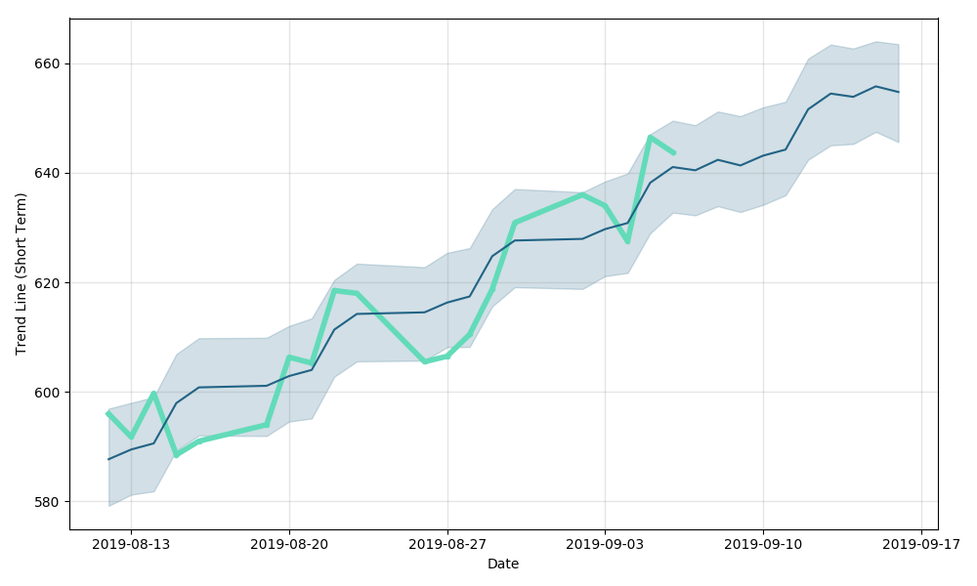
Models for Predictions

Slide 23
Concepts

Slide 24
Supervised vs Unsupervised
Supervised: model trained and evaluated based on previous “right answers”
Unsupervised: Finds patterns, with no right/wrong answers

Slide 25
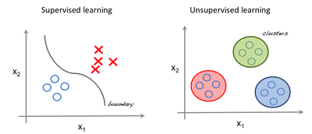

Slide 26
Regressions vs Classification
Regression outputs a number
Classification outputs a label

Slide 27
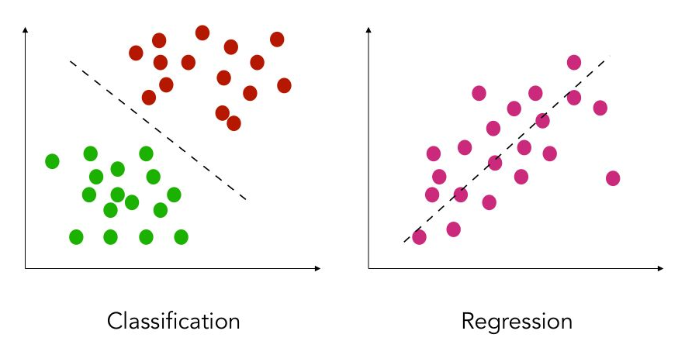

Slide 28
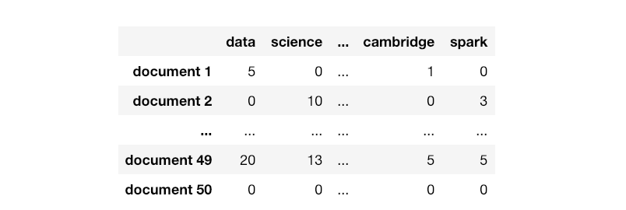

Slide 29
samples

Slide 30
features
samples

Slide 31
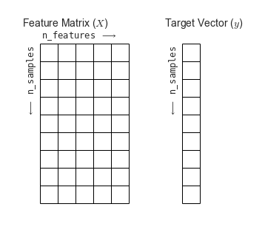

Slide 33

Wait! How do we test?

Slide 34
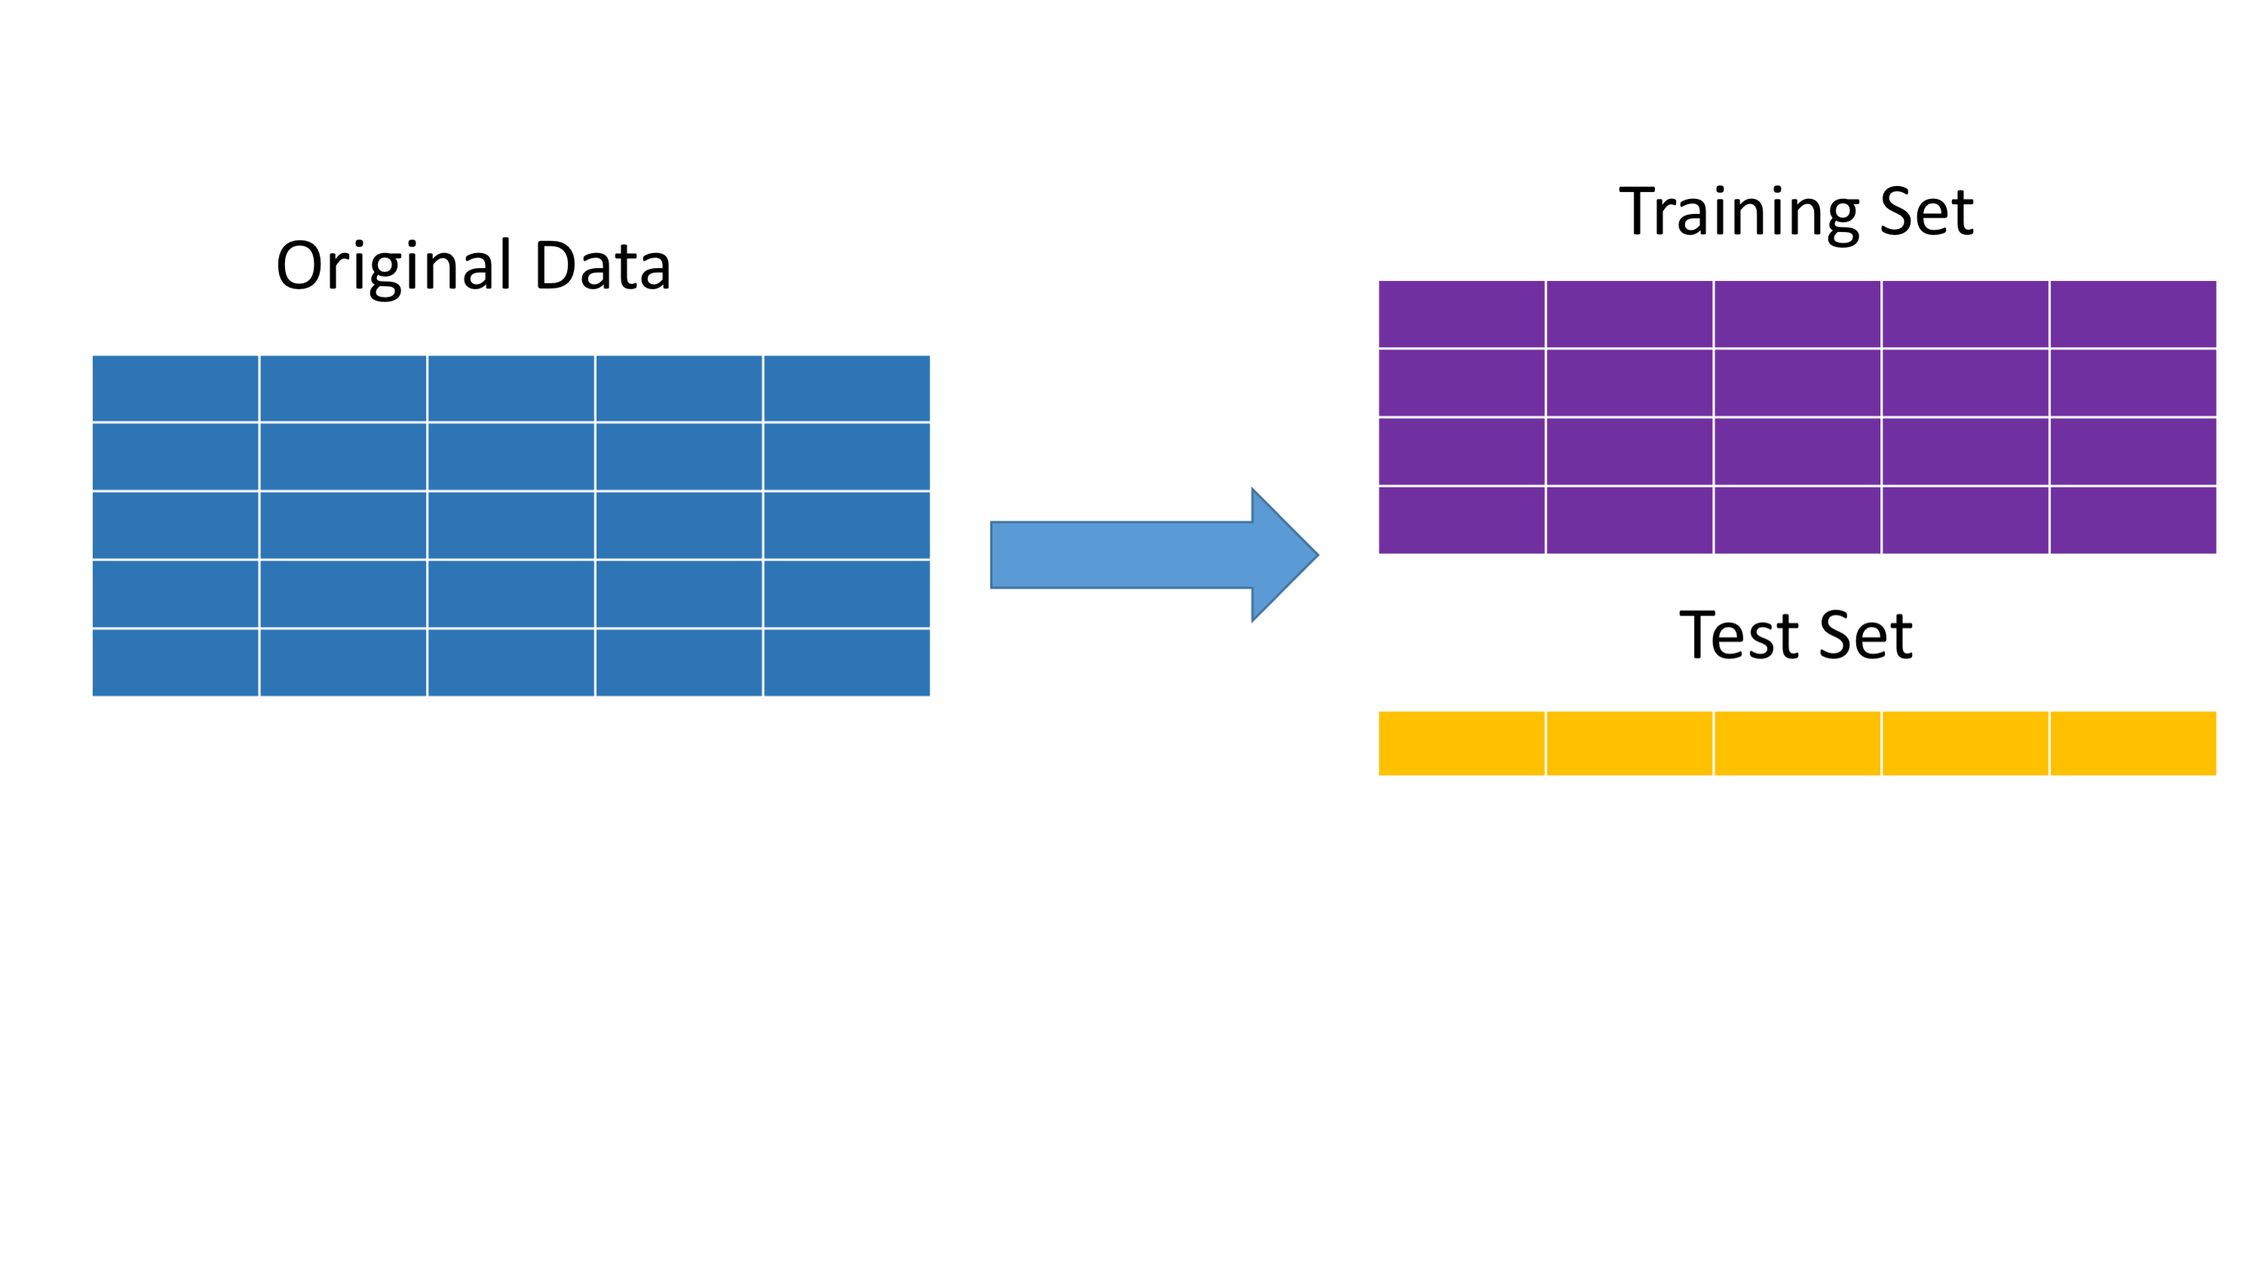
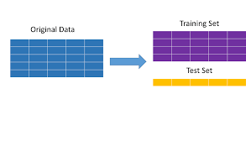

Slide 35
Quiz

Slide 36
Hands on
with Python

Slide 37
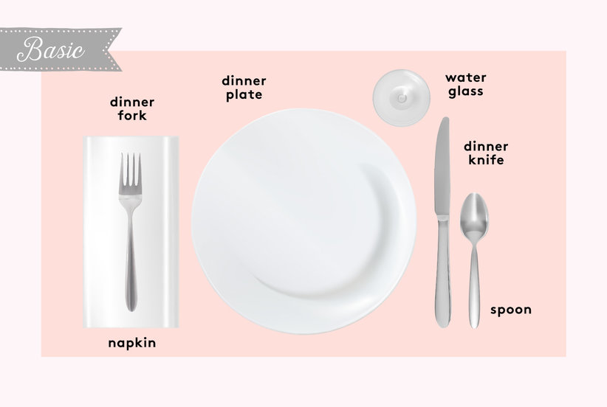
Setting the table

Slide 38
Pandas
Short for “panel data”
DataFrame concept from R

Slide 39
Dataframe
Similar to a spreadsheet
Columns are Numpy arrays with special index

Slide 40
importing Pandas
import pandas as pd

Slide 41
creating a Dataframe
df = pd.read_csv(“file_name”)

Slide 42
Grabbing a Column
df[‘profit’]

Slide 43
Dataframe from columns
columns = [‘revenue’, ‘profit’]
df[columns]

Slide 44
Dropping Columns
df.drop([‘revenue’], axis=1)

Slide 45
Dividing your data
from sklearn.model_selection import train_test_split

Slide 48
Dividing your data
X_train, X_test, y_train, y_test = train_test_split(X, y)

Slide 49
Exercises

Slide 50
Sci-Kit Learn
All-in-one machine learning package
Built on Numpy and matplotlib

Slide 51
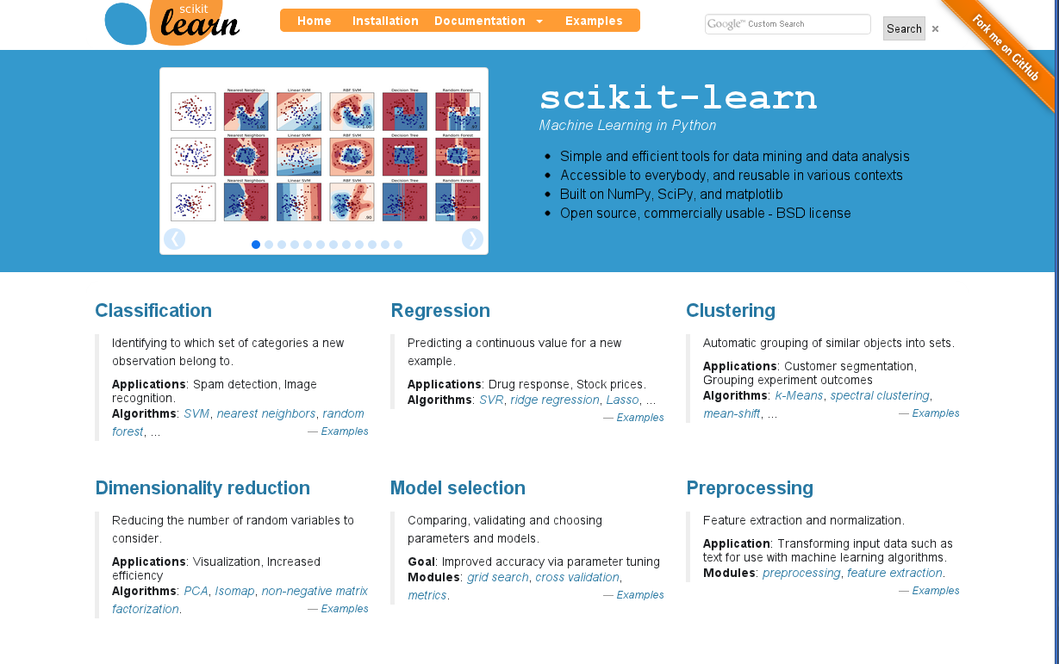
Text

Slide 52
Imported as sklearn
import sklearn

Slide 53
Imported as sklearn
from sklearn.linear_model
import LinearRegression

Slide 54
Linear Regression
y = 2x0 + 3x1 + … + 1

Slide 55
Training a Model
model = LinearRegression()
model.fit(X_train,y_train)

Slide 56
Using a Model
y_predicted = model.predict(X_test)

Slide 57
Evaluating a Model
model.score(X_test, y_test)

Slide 58
Mean absolute error
from sklearn.metrics \
import mean_absolute_error
mean_absolute_error(y_predicted, y_test)

Slide 59
R2 Score
How much error does your model have vs “just guess the mean”?
1.0 is a perfect model, 0.0 is exactly as bad as “just guess the mean”

Slide 60
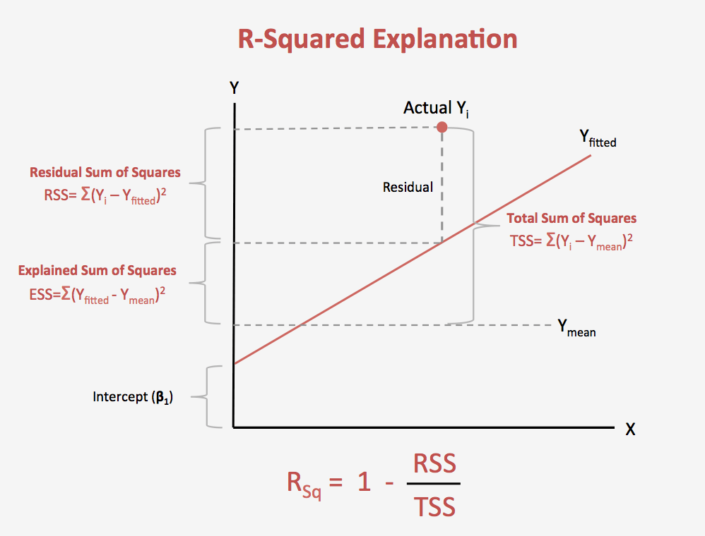
Text

Slide 61
Exercises

Slide 62
One-Hot Encoding

Slide 63
The Problem
Linear models use multiplication (with coefficient)
We can’t multiply categorical data :(

Slide 64
Simple Encoding Doesn’t work
What if we re-label each category as 0,1, 2, .. etc?
Model thinks we’re adding more and more of same thing!

Slide 65
One-hot encoding
Creates a 1-or-0 column for each unique value in categorical
Per row, only one of the new columns will have a 1, hence 1-hot

Slide 66
How the math works:
y = … + 3xn + ..

Slide 67
How the math works:
y = … + 3(1) + ..

Slide 68
How the math works:
y = … + 3(0) + ..

Slide 69
How the math works:
y = … + 3(0) + ..
Adds a fixed amount, or doesn’t!

Slide 70
Exercises

