Slide 1
Data Science
Getting Started in

Slide 2
Why Python?

Slide 3
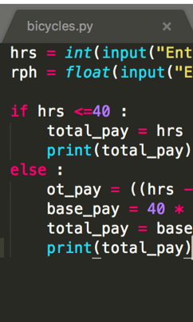
Code
Short, Readable

Slide 4

Code vs UI
Harder for beginners
Easier for complex projects

Slide 5
Short and Readable
Human productivity > computer speed
We read code 10X more than we write it

Slide 6

Community
broad Open-Source

Slide 7
Open Source
Contributors all over the world
Now faster than proprietary software!

Slide 8
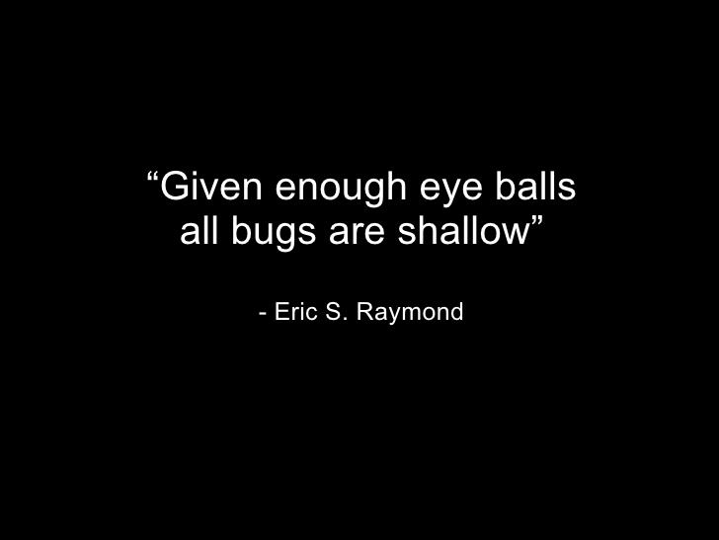

Slide 9
Cross-pollination
Web development
Data science
Automation
Information Security

Slide 10

Data Science
Growth of

Slide 11
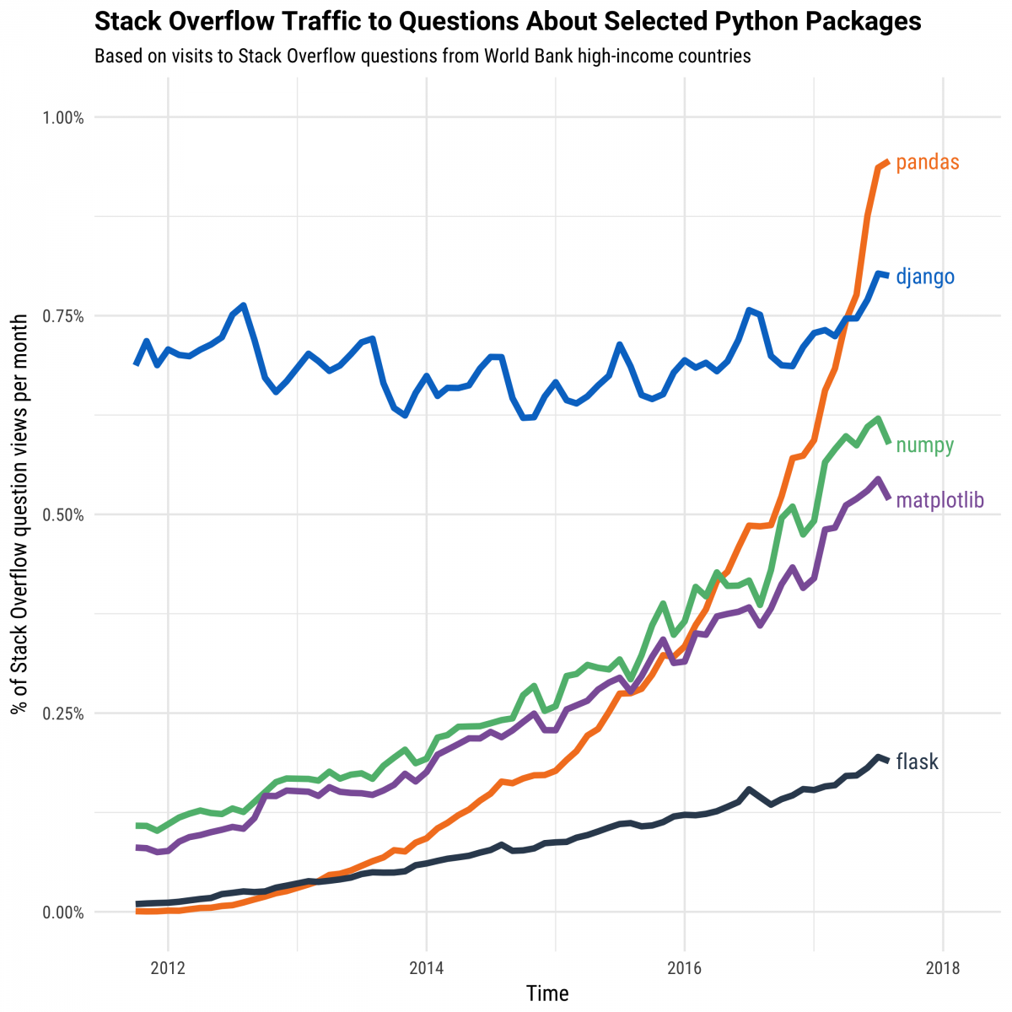

Slide 12
JupYter NotebookS

Slide 13
Jupyter Notebook
Name comes from Julia/Python/R
Standard format for sharing data analysis

Slide 14
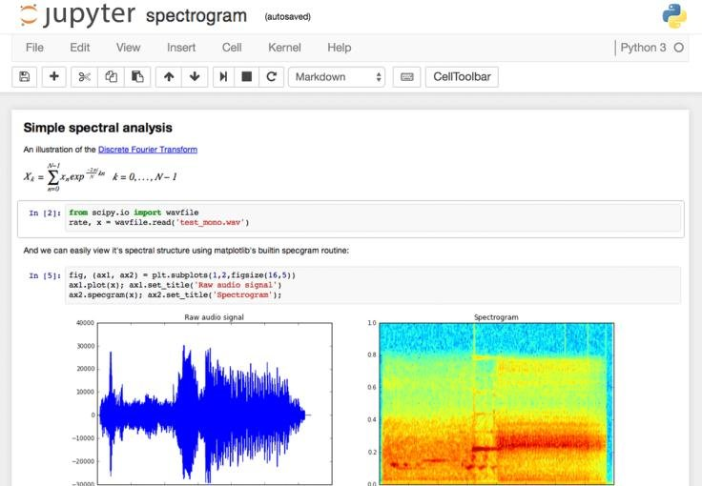


Slide 15
Pandas

Slide 16
Pandas
Short for “panel data”
Similar to spreadsheet
DataFrame concept from R

Slide 17
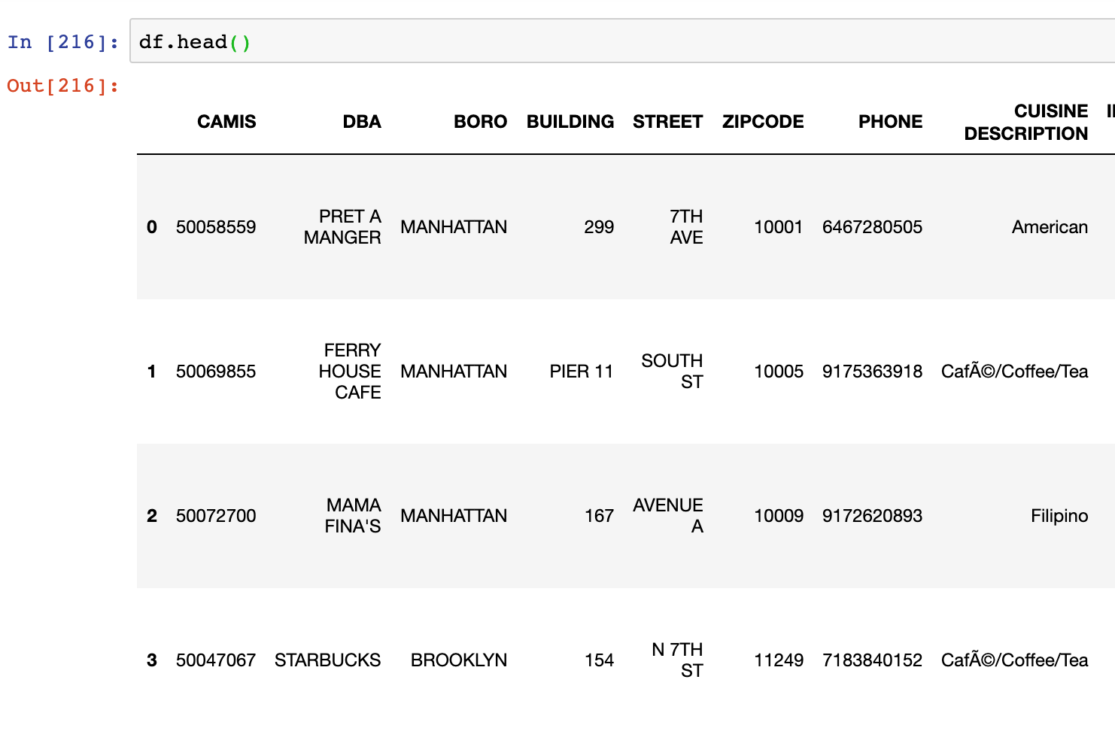
Text

Slide 18
Pandas
Handles (low) millions of rows
Column-oriented workflow
Huge community

Slide 19

Data Analysis
exploration and

Slide 20

Cleaning Data

Slide 21

we can be Fast
When it matters

Slide 22
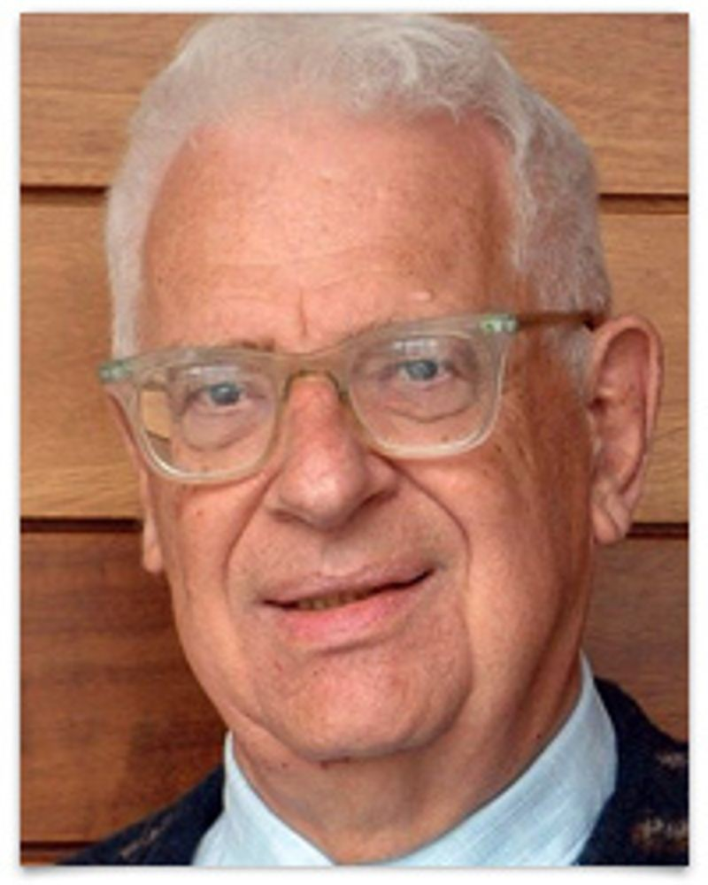
Every problem in computer science can be solved by another layer of indirection
- David Wheeler

Slide 23
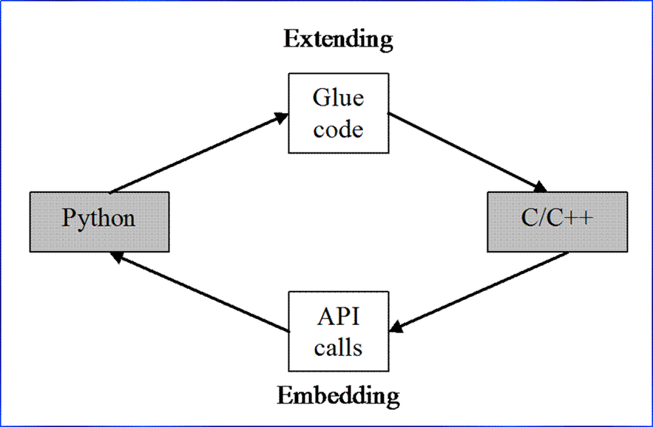

Slide 24
MatPlotLib

Slide 25
MatPlotlib
Originally a copy from MATLAB
Oldest, most popular graphing library

Slide 26
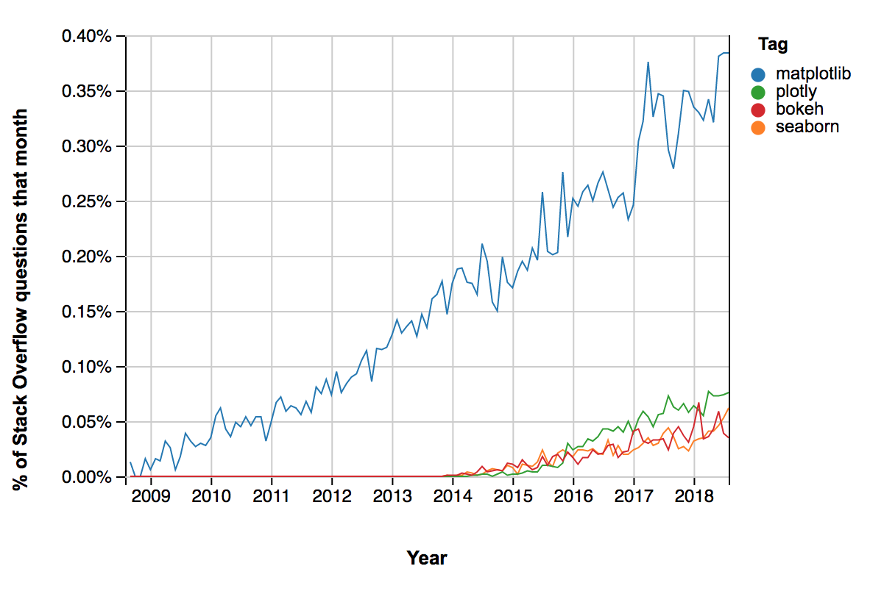

Slide 27
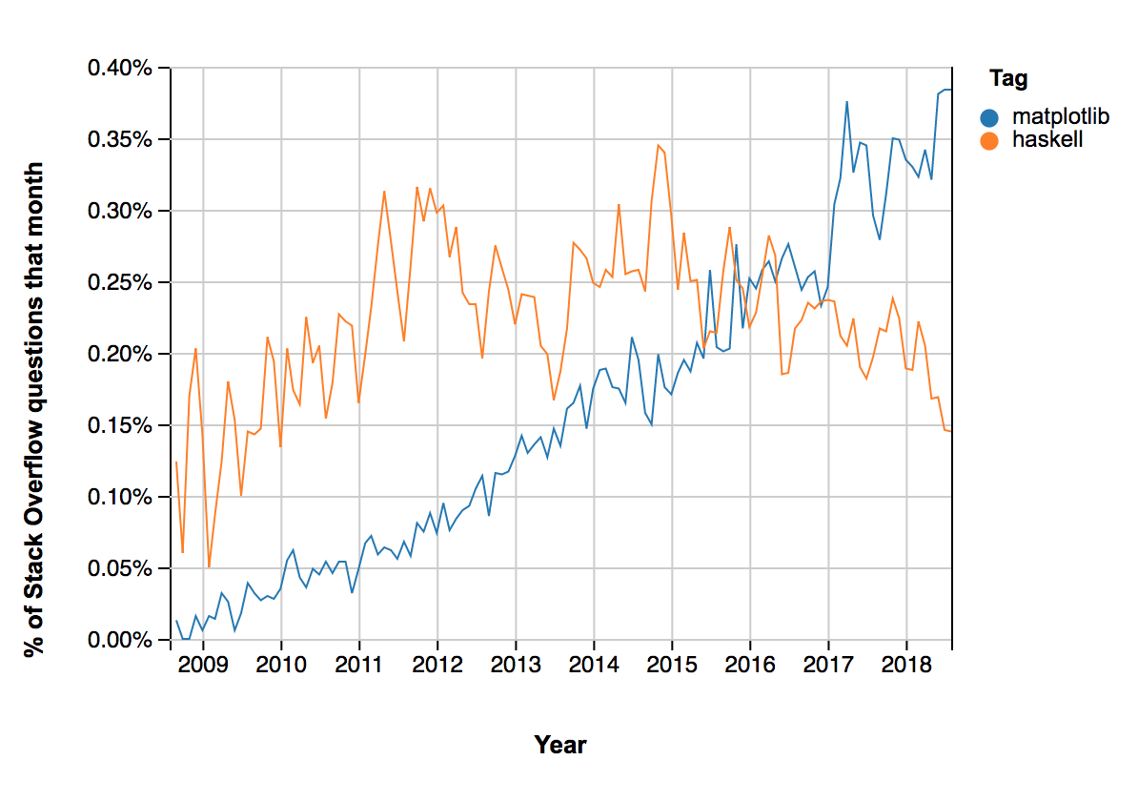

Slide 28
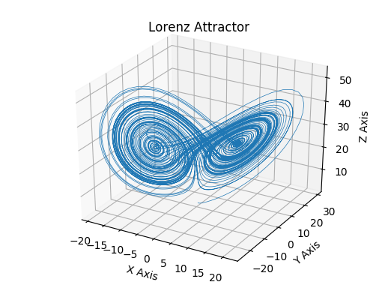

Slide 29
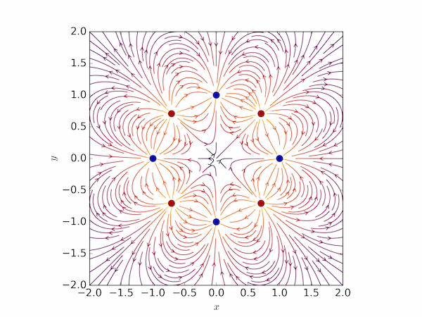

Slide 30
Sci-Kit Learn

Slide 31
Sci-Kit Learn
All-in-one machine learning package
Beginner-friendly and well-documented

Slide 32
Training a Model
model = LinearRegression()
columns = [‘crime_rate’, ‘tax_rate’]
model.fit(df[columns],df[‘price])

Slide 33
Using a Model
model.predict(df[columns])

Slide 34
