Slide 1
Programming
Intro to Python

Slide 2
Rob Carrington
4 years as a Python developer
Worked in FinTech (@Q2eBanking)

Slide 3



Q2

Slide 4
Why Python?

Slide 5
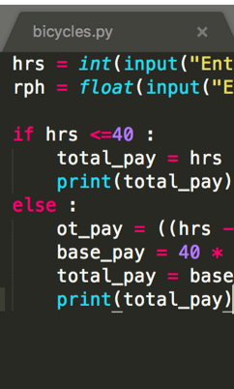
Code
Short, Readable

Slide 6
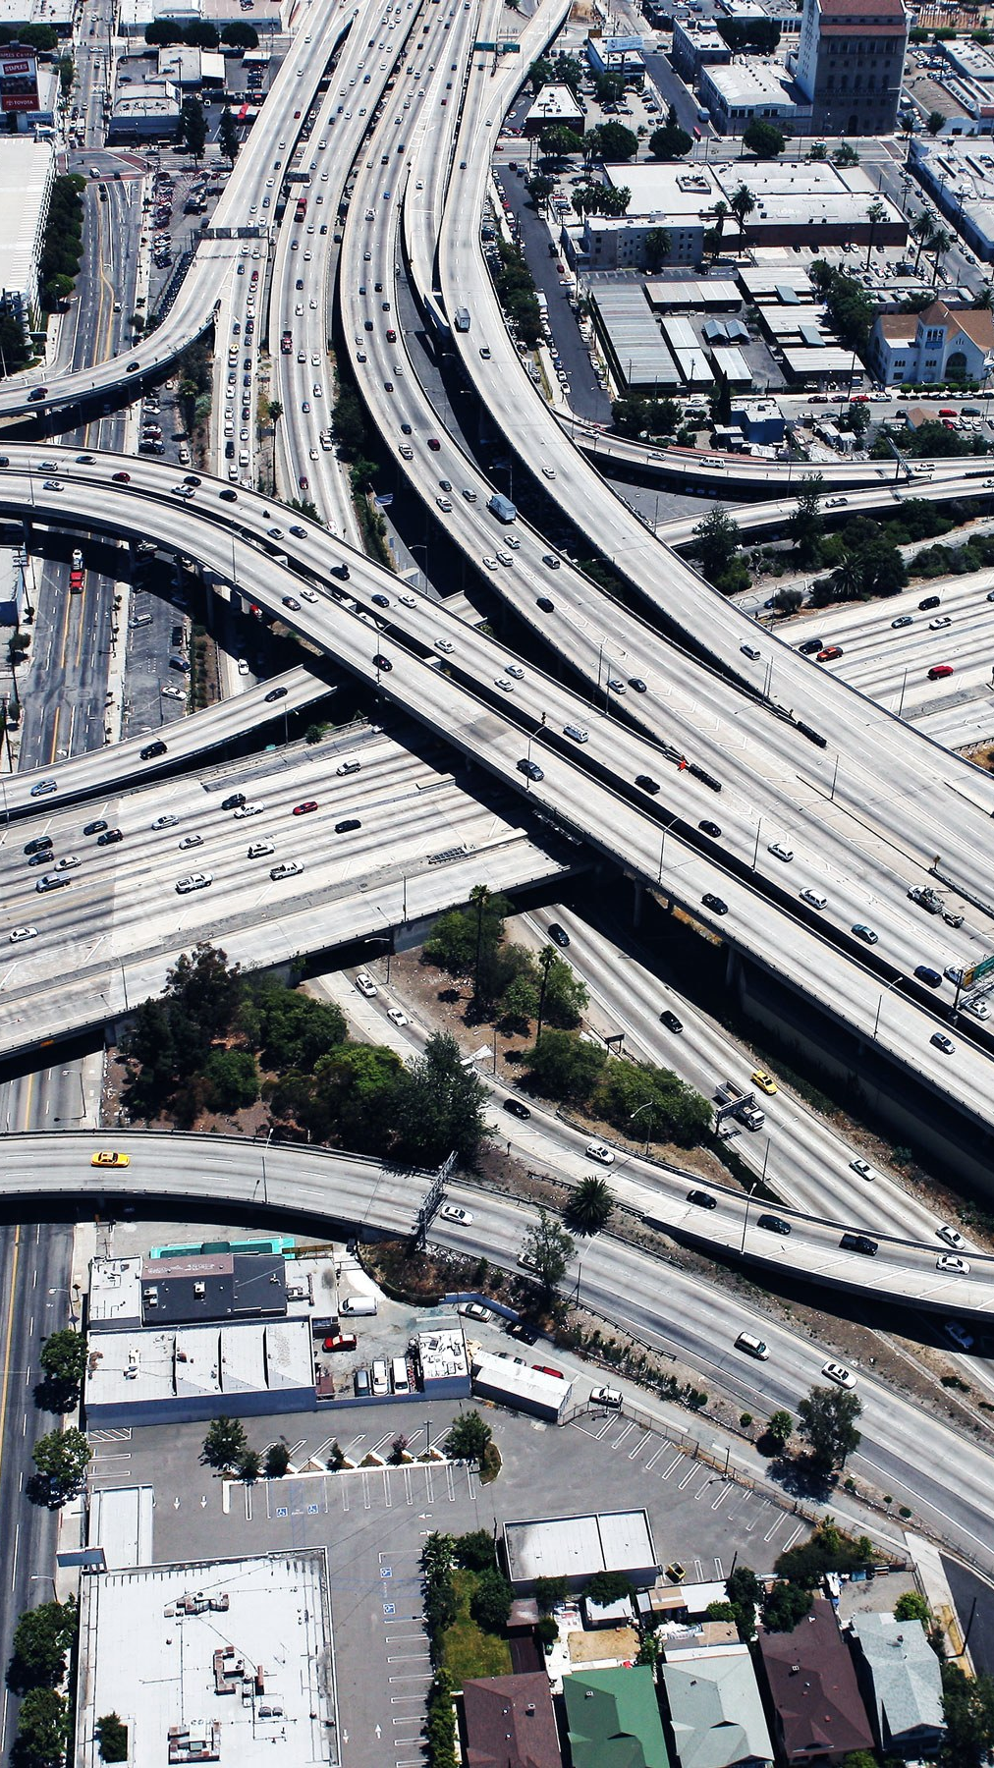
Infrastructure
Modern Software

Slide 7

Community
broad Open-Source

Slide 8

ME
What’s in it for

Slide 9
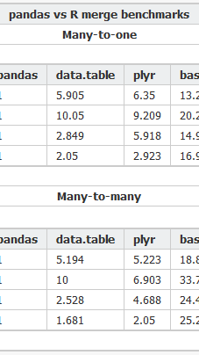
Csv
Analysis of a

Slide 10
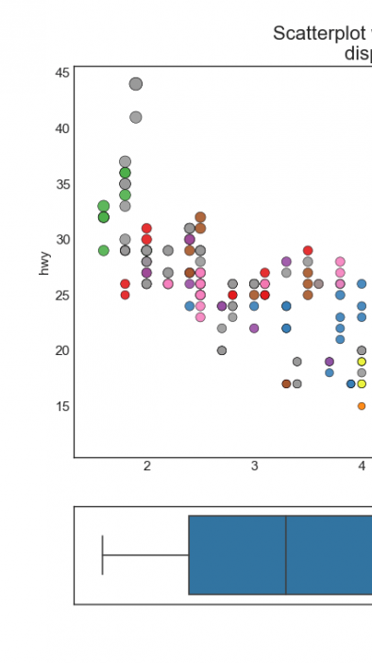
Visualizations
Creating Data

Slide 11
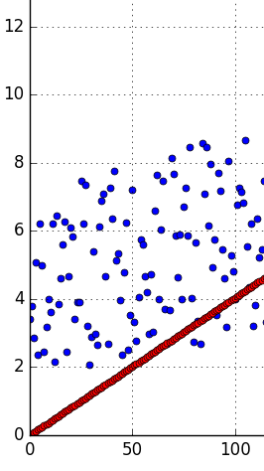
Regression
using Linear

Slide 12
Class format

Slide 13
Class format

Slide 14

Class format
10 minutes for lesson & demo
15 minutes for exercise
Pause to review & ask questions
Rinse and repeat

Slide 15
Fundamentals

Slide 16
How to think about Python
You are giving orders to your computer
Each order is called a “statement”

Slide 17
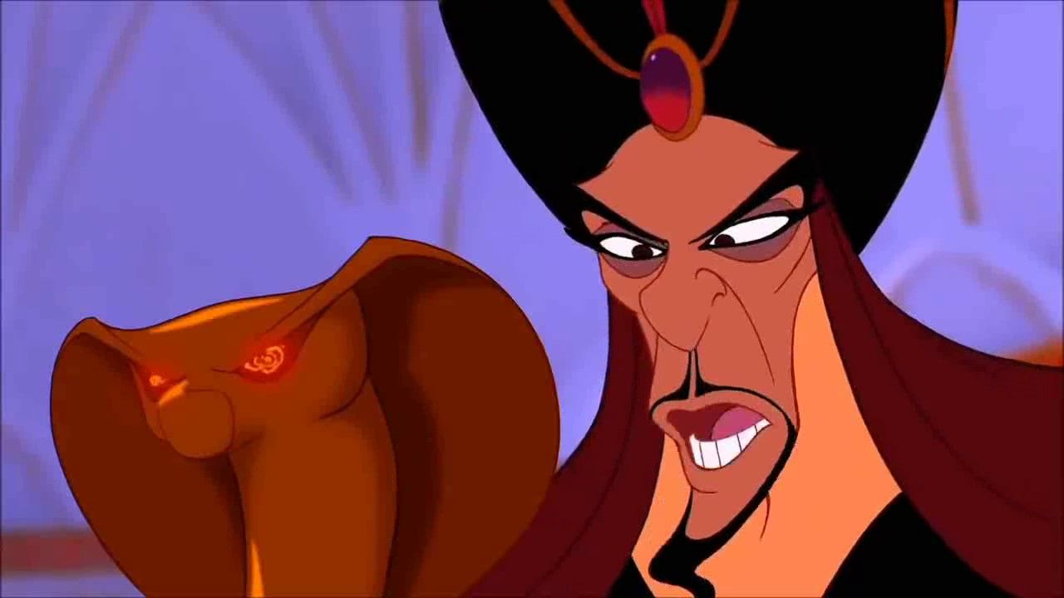
You
Python

Slide 18

Your Computer

Slide 19
ASSIgnment Statement
English:
remember “fav_number” means 3

Slide 20
ASSIgnment Statement
English:
remember “fav_number” means 3
arbitrary label

Slide 21
Assignment Statement
fav_number = 3

Slide 22
ASSIgnment Statement
fav_number = 3
variable

Slide 23
ASSIgnment Statement
fav_number = 3
value
variable

Slide 24
ASSIgnment Statement
fav_number = 3
variable
(integer literal)

Slide 25
Rules for Variables
Must start with a letter or underscore
Cannot start with a number
Only letters, numbers and underscores allowed
Variable names are case-sensitive

Slide 26
Variables
my_number

Slide 27
Variables
my_number

Slide 28
Variables
my_number
3amigos

Slide 29
Variables
my_number
3amigos

Slide 30
Variables
my_number
3amigos
left-handed

Slide 31
Variables
my_number
3amigos
left-handed

Slide 32
ExpressionS
An expression is part of a statement
Noun without a verb

Slide 33
Expression Examples
Variables (like fav_number)
Values (like 3)

Slide 34
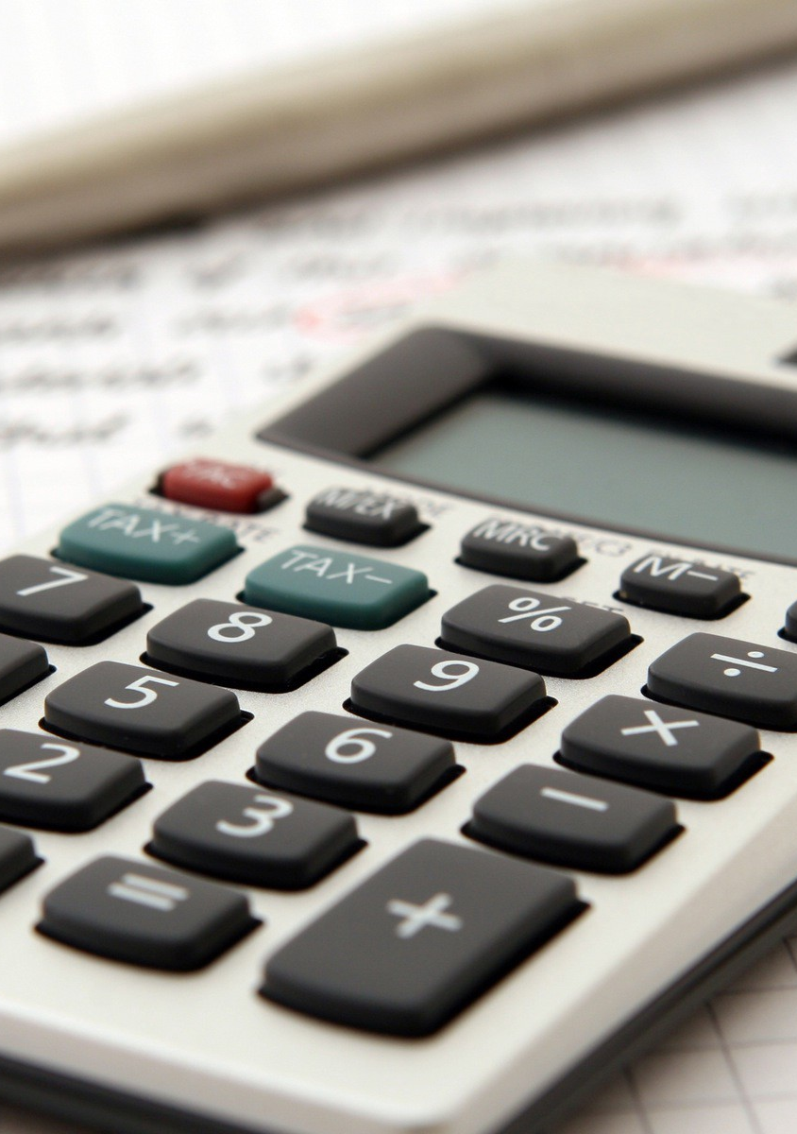
Python thinks like your calculator
If you enter 7 + 9, this is still an expression.
Equivalent to 16.

Slide 35
Expression Vs Statement
Equal to a single value —> expression

Slide 36
Expression Vs Statement
Equal to a single value —> expression
Important to know when you’re giving an order vs noun

Slide 37
Why Do I care about calculators?
Compare to Excel formulas
Find compound interest, etc

Slide 38
Old Friends
Integers (called “int”)
Decimals (called “float”)

Slide 39
Old Friends
Addition (+)
Multiplication (*)
Division (/)
Exponents (**)

Slide 40
A New Friend
Modulo (%)
Finds the remainder

Slide 41
Concepts covered so Far
Statement
Expression
Variable
Int, Float

Slide 42
Exercises

Slide 43
New Data Type: String
Text wrapped in quotes
Only meaningful to humans

Slide 44
String Example
greeting = “hello world!”

Slide 45
String Example
greeting = “hello world!”
value

Slide 46
String Example
greeting = “hello world!”
(string literal)

Slide 47
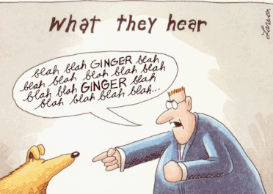

Slide 48
Indexing Syntax
English:
get the first letter in my_string

Slide 49
Indexing Syntax
my_string[0]

Slide 50
Indexing Syntax
English translation:
get the seventh letter in my_string

Slide 51
Indexing Syntax
my_string[6]

Slide 52
Indexing Syntax
English:
get the last letter in my_string

Slide 53
Indexing Syntax
my_string[-1]

Slide 54
Slice Syntax
English:
get the first four letters of my_string

Slide 55
SLICE Syntax
my_string[0:4]

Slide 56
SLICE Syntax
my_string[0:4]
not included!

Slide 57
Slice Syntax
English:
get all the letters up to the third

Slide 58
SLICE Syntax
my_string[:3]

Slide 59
Slice Syntax
English:
grab from the third element through until the end

Slide 60
SLICE Syntax
my_string[2:]

Slide 61
Slice: step
[start_index:end_index]

Slide 62
Slice: step
[start_index:end_index:step]

Slide 63
Slice: step
my_string[::2]

Slide 64
Slice: step
my_string[::2]
even # items in list

Slide 65
Slice: step
my_string[1::2]

Slide 66
Slice: step
my_string[1::2]
odd # items in list

Slide 67
Slice: step
my_string[::-1]

Slide 68
Slice: step
my_string[::-1]
reverse list

Slide 69
Exercises

Slide 70
Values: What kinds ARE THERE?
Int
Float
String

Slide 71
Mixing data types
1 + 7.0 = 8.0

Slide 72
Mixing data types
1 + 7.0 = 8.0
1 + “7.0” = error

Slide 73
Mixing data types
1 + 7.0 = 8
1 + int(“7.0”) = 8.0

Slide 74
F-Strings
Text with variables injected
Normal string but with an “f” before the quotes

Slide 75
F-strings
my_name = “rob”

Slide 76
F-strings
f“Hello, {my_name}!”

Slide 77
F-strings
f“Hello, {my_name}!”
“Hello, Rob”

Slide 78
Anatomy of a function call
int(“7.0”)

Slide 79
Anatomy of a function call
int(“7.0”)
function

Slide 80
Anatomy of a function call
int(“7.0”)
function
input (aka argument)

Slide 81
Function
Performs an action
Action in example: cast to integer

Slide 82
Function vs method
Same: performs an “action” with input
Different: where input comes from

Slide 83
method Example
“Rob”.replace(“R”,“B”)

Slide 84
method Example
“Rob”.replace(“R”,“B”)
“Bob”

Slide 85
method Example
“Rob”.replace(“R”,“B”)
method on string

Slide 86
Function vs method
Input between parentheses
int(“123”)
“Rob”.replace(“R”,“B”)

Slide 87
Function vs method
Input between parentheses
int(“123”)
Main input before dot
“Rob”.replace(“R”,“B”)

Slide 88
Casting between Data types
int()
float()
str()

Slide 89
Concepts covered so Far
Function
Method
Casting

Slide 90
Exercises

