Slide 1
Programming
INtro to Python

Slide 2

For-Loops
Repeats a chunk of code
Hands in different item each time

Slide 3
For-loops
pets = [“dog”, “cat”, “fish”]
for pet in pets:
print(pet)

Slide 4
For-loops
pets = [“dog”, “cat”, “fish”]
for pet in pets:
print(pet)

Slide 5
For-loops
pets = [“dog”, “cat”, “fish”]
for pet in pets:
print(“dog”)

Slide 6
For-loops
pets = [“dog”, “cat”, “fish”]
for pet in pets:
print(“cat”)

Slide 7
For-loops
pets = [“dog”, “cat”, “fish”]
for pet in pets:
print(“fish”)

Slide 8
For-loops
pets = [“dog”, “cat”, “fish”]
for pet in pets:
if pet == “dog”:
print(“Man’s best friend!”)
else:
print(“whatever”)

Slide 9
Range function
Generates range of numbers
Parameters match slice syntax

Slide 10
Range function
range(3)

Slide 11
Range function
range(3)
0, 1, 2

Slide 12
Range function
range(1,4)

Slide 13
Range function
range(1,4)
1, 2, 3

Slide 14
Range function
range(3,0,-1)
3, 2, 1

Slide 15
Range is Not A List
Returns a “lazy” list
Numbers are generated one-by-one to save memory

Slide 16
Convert Range to list
list(range(3))
[0, 1, 2]

Slide 17
For-Loops
Repeats a chunk of code
Hands in different item each time

Slide 18
Exercises

Slide 19
Values: what kinds are there?
data types: int, float, string, bool
lists of the above

Slide 20
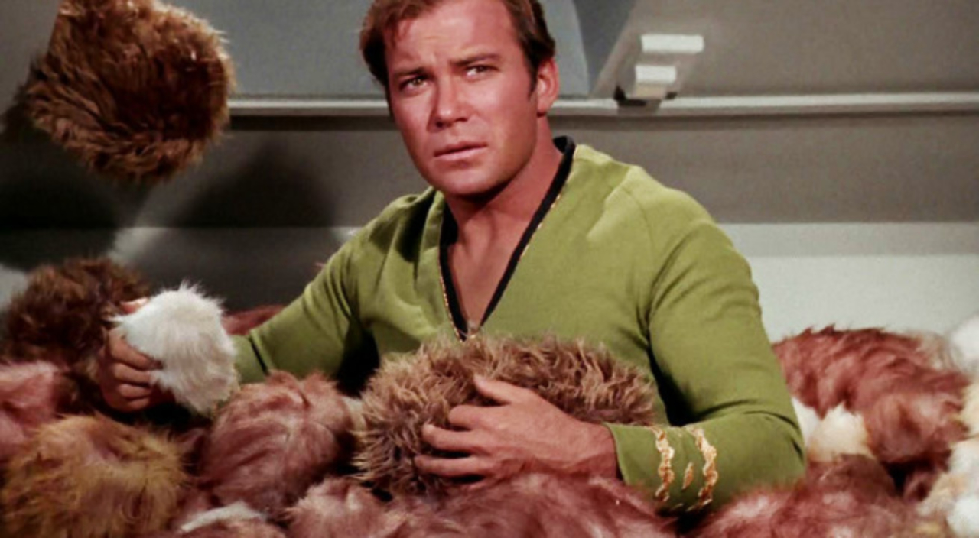
Trouble with Lists
Hard to manage lots of data

Slide 21
Trouble with Lists
Was it my_list[8] or my_list[9]?
Hard to manage lots of data

Slide 22


Slide 23
Dictionary
Store data under a label (“key”)
Fetch value later by key

Slide 24
Dictionary
my_dict = { “name”: “Rob” }

Slide 25
Dictionary
my_dict = { “name”: “Rob” }
dictionary
literal

Slide 26
Dictionary
my_dict = {“name”: “Rob”,
“hair”: “brown”}

Slide 27
Dictionary
my_dict[“hair”]
“brown”

Slide 28
Dictionary
my_dict[“hair”] = “blonde”

Slide 29
Dictionary
for key in my_dict:
print(“look at this”+ key)

Slide 30
Dictionary
for value in my_dict.values():
print(“look at this ”+value)

Slide 31
Dictionary
for key, value in my_dict.items():
print(“look at this ”+key)
print(“look at this ”+value)

Slide 32
Exercises

Slide 33

Classes and Objects

Slide 34
Class vs object
class is a “blueprint” with empty slots
object is one occurrence, slots filled

Slide 35
Why do we need classes?
Like dictionary with guaranteed keys
Can create methods

Slide 36
Using a Class
rob = Person(“Rob”)
rob.name
>>> “Rob”

Slide 37
Using a Class
rob = Person(“Rob”)
rob.say_name()
>>> “Hi I’m Rob”

Slide 38
Why do we need classes?
Store data and methods together
Can make code more intuitive

Slide 39
Class
class Person():
def __init__(self, name):
self.name = name

Slide 40
Class
class Person():
def __init__(self, name):
self.name = name

Slide 41
Class
class Person():
def __init__(self, name):
self.name = name

Slide 42
What is “self”??
Class is the cookie-cutter, self is the cookie
First argument in any method

Slide 43
Class
class Person():
def __init__(self, name):
self.name = name

Slide 44
Class
constructor
class Person():
def __init__(self, name):
self.name = name

Slide 45
Class
*magic*
class Person():
def __init__(self, name):
self.name = name

Slide 46
Class
instance
class Person():
def __init__(self, name):
self.name = name

Slide 47
Class
*magic*
class Person():
def __init__(self, name):
self.name = name

Slide 48
Class
class Person():
def __init__(self, name):
self.name = name

Slide 49
Class
class Person():
def __init__(self, name):
self.name = name
attribute

Slide 50
Class
class Person():
def __init__(self, name):
self.name = name
self[“name”] = name

Slide 51
Class
class Person():
…
def say_name(self):
print(self.name)

Slide 52
Class
rob = Person(“Rob”)
rob.name
>>> “Rob”

Slide 53
Class
rob = Person(“Rob”)
rob.name
>>> “Rob”
attribute

Slide 54
Class
rob = Person(“Rob”)
rob.say_name()
>>> “Rob”

Slide 55
Class
rob = Person(“Rob”)
rob.say_name()
>>> “Rob”
method

Slide 56
Exercises

Slide 57
Concepts covered so Far
For-loops
Dictionary
Class

Slide 58
Dictionary
my_dict = {“name”: “Rob”,
“hair”: “brown”}

Slide 59
Dictionary
my_dict[“hair”] = “blonde”

Slide 60
Dictionary
my_dict[“hair”]

Slide 61
Dictionary
my_dict[“hair”]
“brown”

Slide 62
Dictionary
for key in my_dict:
print(f“look at this {key}!”)

Slide 63
Dictionary
for key, value in my_dict.items():
print(f“look at this {key}!”)
print(f“look at this {value}”)

Slide 64
Class
class Person():
def __init__(self, name):
self.name = name

Slide 65
Class
rob = Person(“Rob”)
rob.name

Slide 66
Class
rob = Person(“Rob”)
rob.name
“Rob”

