Slide 1
SQL Bootcamp
Noble Desktop

Slide 2
Review

Slide 3
Select Statement with Limit
SELECT * FROM products
LIMIT 100;

Slide 4
Distinct
SELECT DISTINCT price FROM products

Slide 5
Numeric Filter: Less than or equal to
SELECT * FROM products
WHERE price <= 1000;

Slide 6
Numeric Filter: in
SELECT * FROM products
WHERE price in (9.99, 15.99);

Slide 7
Pattern matching: wildcard
SELECT * FROM products
WHERE name LIKE ‘B%’;

Slide 8
wildcard
SELECT * FROM products
WHERE name LIKE ‘B%’;
wildcard

Slide 9

Aggregation Functions
Boil down the resulting data
Commonly used: SUM(), MAX(), MIN(), AVG()

Slide 10
Count
SELECT COUNT(state)
FROM purchases WHERE state=‘FL’

Slide 11
Count
SELECT COUNT(state)
FROM purchases WHERE state=‘FL’
Counts ALL rows! (not just unique values)

Slide 12
Group by statements
SELECT COUNT(*)
FROM purchases GROUP BY user_id

Slide 13
Exercises

Slide 14
Subqueries

Slide 15
Subqueries
Inner query evaluated first
Substitutes in one or multiple values

Slide 16
Single Value subquery
select * from purchase_items where price =
(select max(price) from products)

Slide 17
Multiple Value subquery
select * from purchase_items where price in
(select price from products
where name like ‘% TV’)

Slide 18
Bad subquery
select * from purchase_items where price in
(select * from products)

Slide 19
Bad subquery
select * from purchase_items where price in
(select * from products)

Slide 20
Exists
SELECT * FROM users WHERE EXISTS (SELECT 1 FROM purchases WHERE users.id = purchases.user_id and purchases.name LIKE 'Bob%')

Slide 21
Exercises

Slide 22

Primary key
Column that is unique per row
Never changes, like a Social Security Number

Slide 23


Slide 24

Other columns can change
We can still refer to the exact same row with primary key

Slide 25
Foreign key
Reference to primary key in different table
Like a “link” to that row

Slide 26
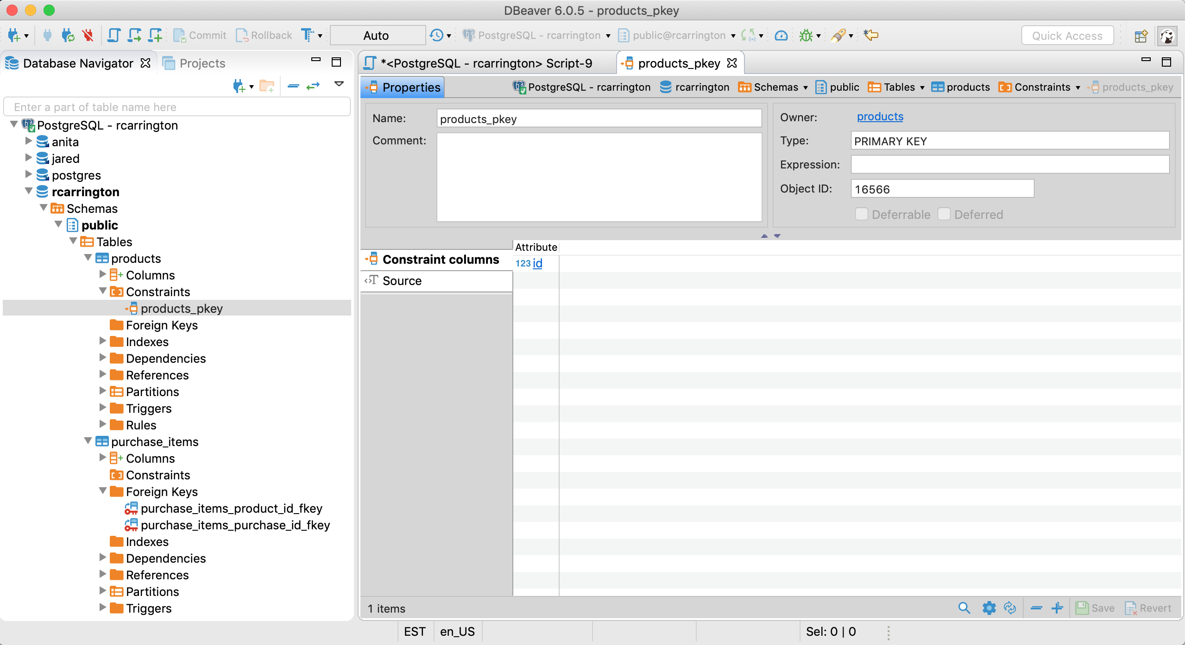
Text

Slide 27
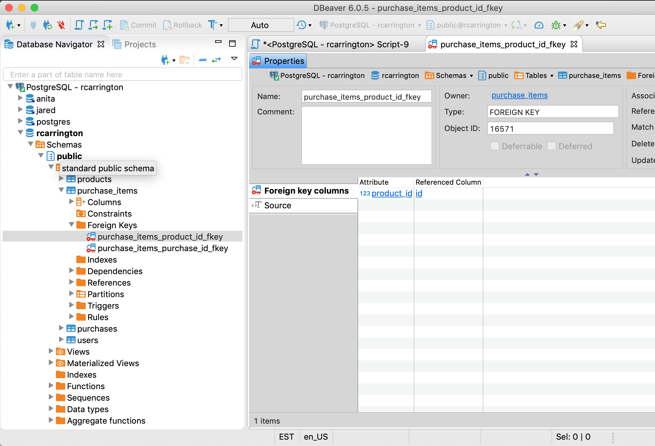
Text

Slide 28
Question #1
What e-mail address is associated with the latest purchase from Wyoming?

Slide 29
Question #2
The largest order from purchase_items was for what product?
Use both price and quantity

Slide 30
Question #3
What is the name of the person who made the largest return?
Use both price and quantity

