Slide 1
Status update
Robert Carver

Slide 2
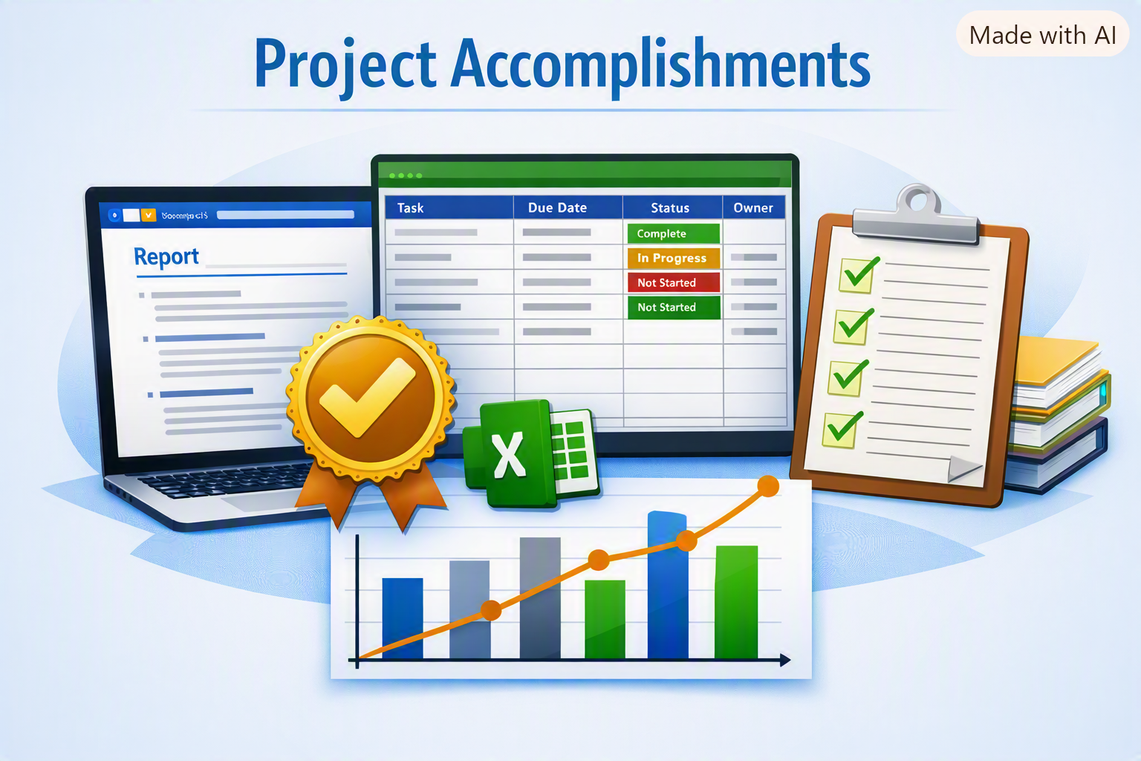
Key accomplishments
Completed the Word document with a polished, professional layout.
Built the Excel tracker and successfully implemented dropdown menus for status tracking.
Established a structured foundation for project monitoring and reporting.
Notes:
“Over the past week, I’ve made solid progress on the project. The Word document is complete and looks professional, and I’ve built the Excel tracker with dropdowns for status updates. These tools are helping us stay organized and visualize progress clearly.

Slide 3
Next steps & Challenges
Upcoming Tasks
Current Challenges
Create a progress chart in Excel to visualize status updates
Condense detailed information into PowerPoint slides without losing clarity
Draft a concise email to my manager to send the presentation and update
Clarify project dependencies to complete the project plan table effectively
Data visualization setup — determining the best chart type to clearly show progress
Information condensation — summarizing detailed updates into just a few slides without losing context
Dependency clarification — understanding how tasks rely on each other in the project plan
Communication alignment — crafting an email that effectively conveys progress and next steps to your manager
Time management — balancing document, tracker, and presentation work efficiently
Notes:
“My next focus is creating a chart from the tracker data to show progress visually, then condensing everything into a few PowerPoint slides for the final presentation. I’ll also prepare an email to my manager with the slides attached. The main challenges right now are summarizing all the details effectively and clarifying project dependencies, so the plan table is accurate

