Slide 1
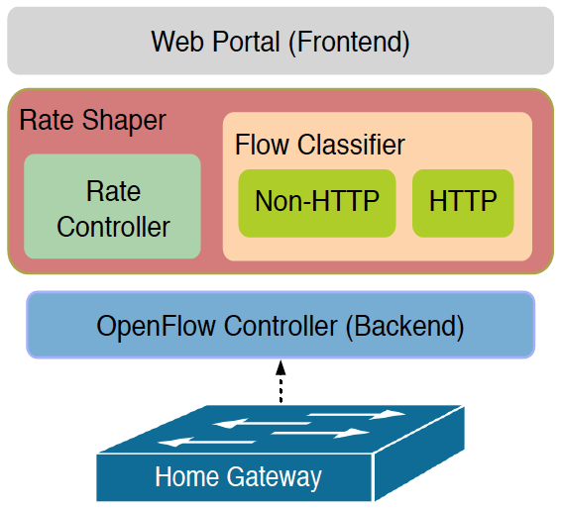
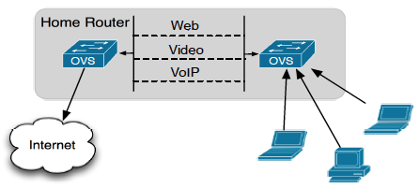
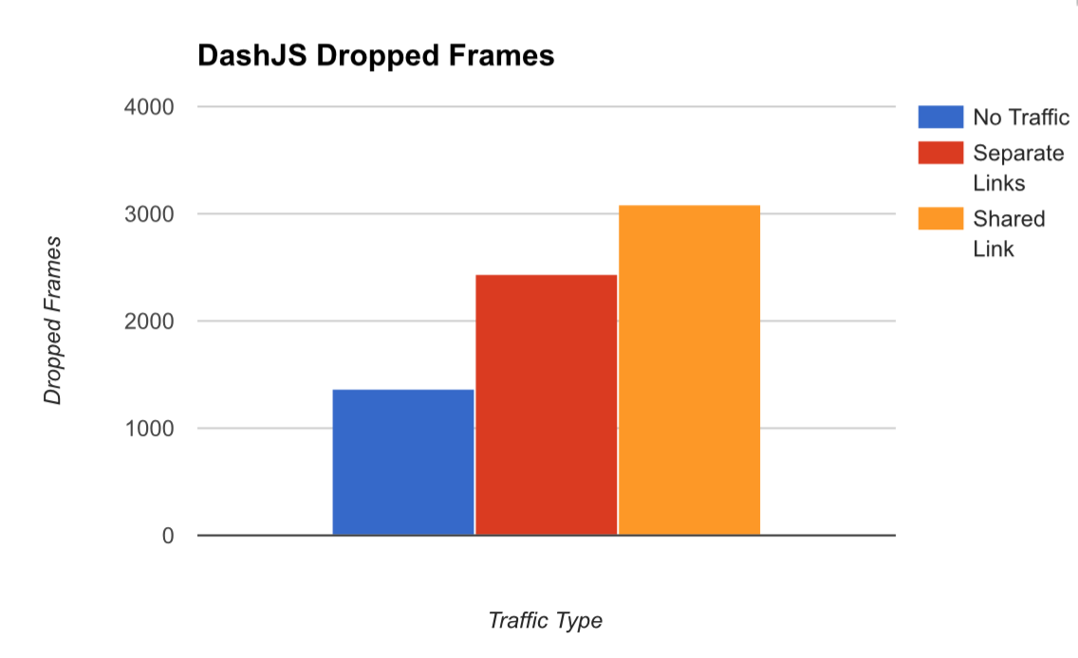
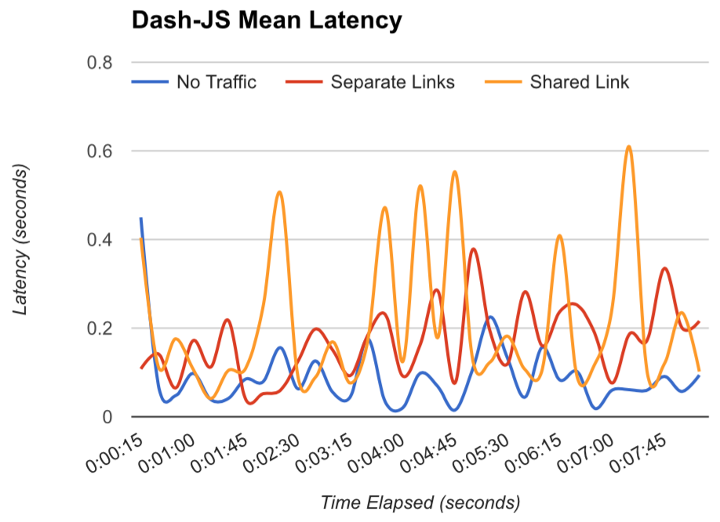
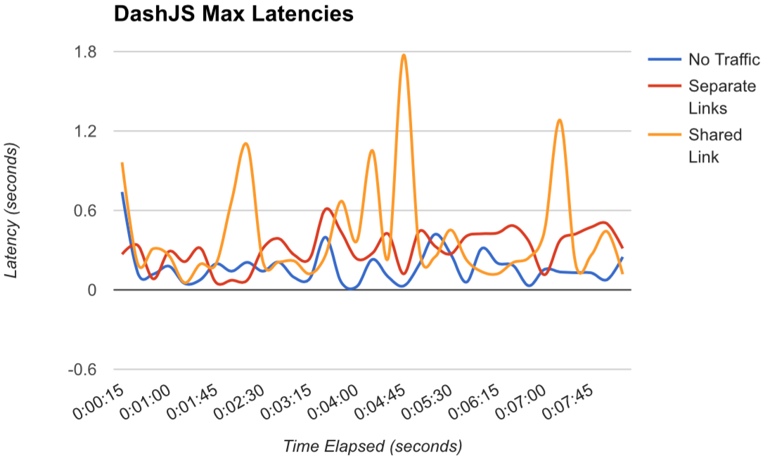
FlowQoS: Not every flow is the same
Dhruv Sharma, Robert Jenkins, Frederik Nygaard, Feichao Qian
dhsharma@ucsd.edu; rfjenkin@ucsd.edu; frederikny@gmail.com; feqian@ucsd.edu
Motivation
FlowQoS Architecture
SDN-Based Rate Controller
• Traffic from one application might not share the same characteristics as the traffic emerging from another application.
• Mechanisms to perform QoS functions are not based on specific application, devices, or users.
• Users configure priorities for specific high-level applications.
•The output from the portal is a configuration file that the rate shaper uses for shaping traffic.
•Enables per-flow QoS by instantiating a two-switch virtual topology.
• Each virtual link between the two switches corresponds to a different
application group.
• Each link has a traffic shaper that corresponds to the user‐specified rate.
Solution
• Isolate different traffic in separate queues/channels that put a hard rate limit on the either type of traffic
• Utilize the Linux's advanced routing and traffic control to overcome the limitation of under-utilization of available bandwidth
Flow Classifier
Linux traffic control structure
• Maintains a lookup table
• The key is a tuple consisting of the source IP address,
destination IP address, protocol, source port, and destination port.
Results
Improvements to application performance
Classifier delay

