Slide 1
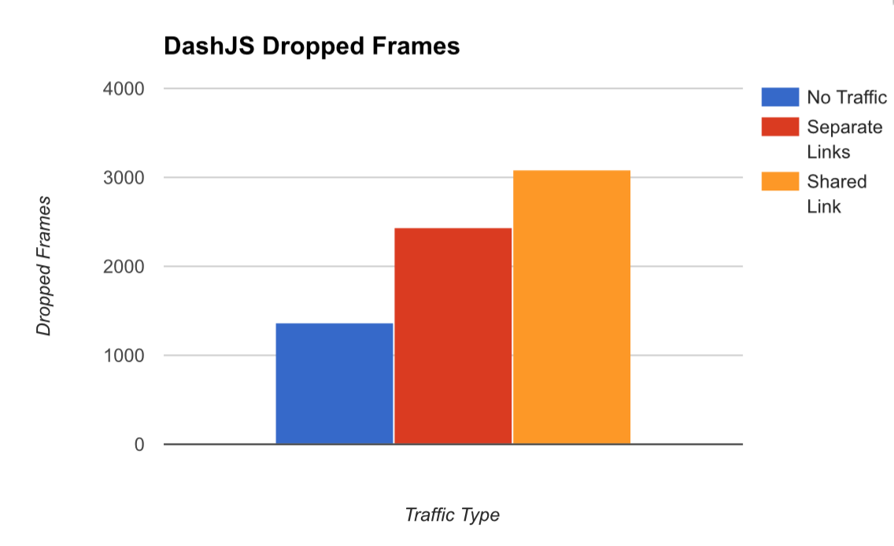
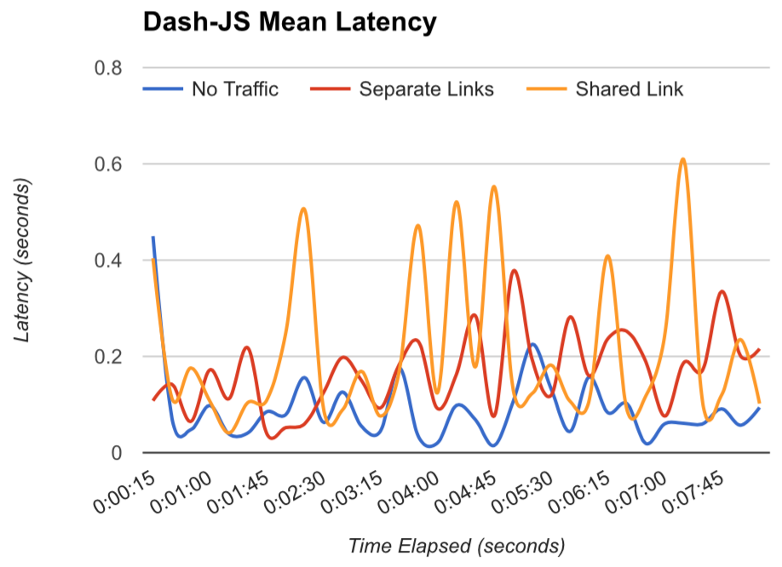
FlowQoS: Not Every Flow is Born the Same
Group 20: Dhruv Sharma, Robert Jenkins, Frederik Nygaard, Feichao Qian
Motivation
FlowQoS Classification & Rate Control
FlowQoS Architecture
• Traffic from one application might not share the same characteristics as the traffic from another.
• Mechanisms to perform QoS functions are not based on specific application, devices, or users.
• Modern devices only support DSCP-based QoS requiring applications to proactively set the right fields in IP header.
• Users configure priorities for specific high-level applications.
• The output from the portal is a configuration file that the rate shaper uses for shaping traffic.
• Enables per-class QoS by creating a two-switch virtual topology.
• Each link corresponds to a different traffic class and is rate-limited to the user‐specified rate.
• Classification uses DNS records for HTTP traffic and first 4 bytes of the flow in either direction.
Solution
Linux Traffic Control
Heirarchical Token Bucket (HTB) Traffic Flow
• Isolate different traffic in separate queues each having a hard rate limit on that traffic.
• Openflow-based isolation and OVS ingress policing for rate limiting traffic.
• Utilize the Linux's advanced routing and traffic control to overcome the limitation of under-utilization of available bandwidth.
• Provides a handle tc for Linux kernel’s network scheduler for low-level manipulation of network traffic flowing through it.
• Implements multiple queuing disciplines, traffic policers and shapers to provide QoS to matching traffic.
• HTB is classful queueing discipline that supports multi-level traffic classification and shaping on egress traffic at an interface.
Results
Improvements to Application Performance using OVS-Openflow Classification
Additional Gains from using Hierarchical Token Bucket (HTB) in Linux Traffic Control
Reduced Skype Call Jitter
Improved VLC Realtime Streaming Bitrate
Improved Worst-Case VLC Streaming Bitrate
OVS-OpenFlow Policing Bandwidth Utilization
Efficient Bandwidth Utilization
Reduced Frame Drops and Segment Latency in DASH (HTTP) Video Streaming
Reduced Latencies in DASH Video Streaming
HTB Traffic Shaping Bandwidth Utilization

