Slide 1
Adventures in moving to Service Broker
By Rob Koch

Slide 2
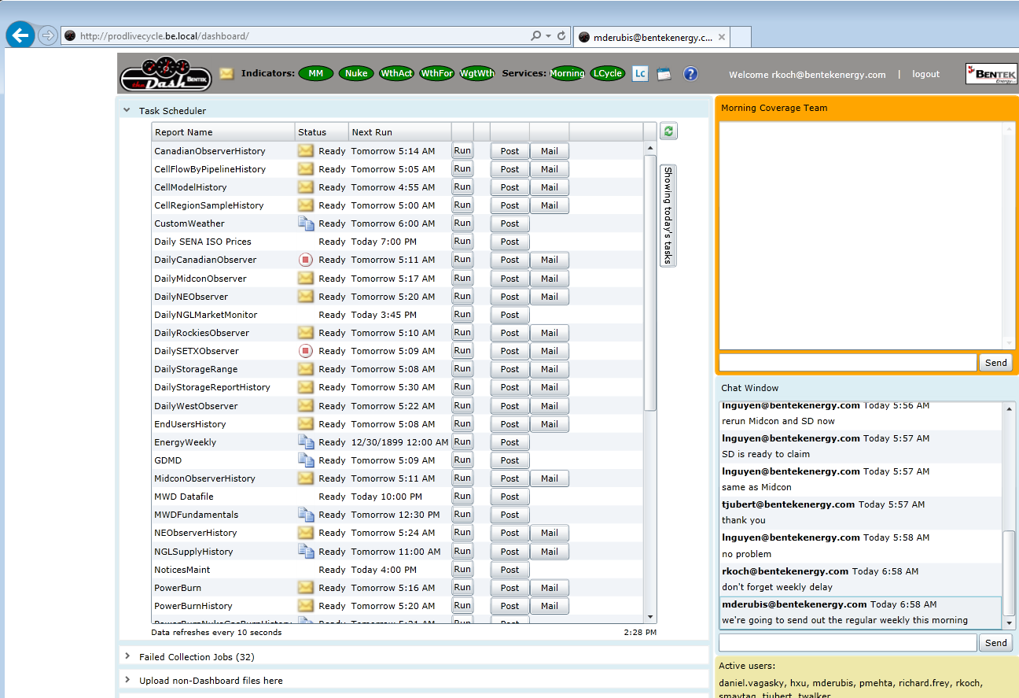
First iteration of the Dash

Slide 3
First iteration of the Dash
Better than Excel checklist and waiting for emails
Silverlight (rapid app development)
Rides on our WPF expertise (no CSS!)
SQL Server
Supported by all browsers
Very reliable: had an outage for a day or so over a year ago – combo bad build/config

Slide 4
Growing pains
Volume of products increased
Upgrades to 2008 R2 and then 2012 hurts performance
Performance issues using SMO
Server is more stressed than ever, polling doesn’t help matters.
Looking for reliable alternatives – Message Queueing

Slide 5
Enter Service Broker
Researched RabbitMQ, ZeroMQ, Akka.NET (F#) – prepped development
Enter Ryan Duffy, The DBAnswer: “Service Broker”
Looked into it – convinced this is the right approach:
No new server to maintain/troubleshoot
Managed by DBAs – they assume the blame ;-)
Secure, guaranteed, coupled, transactional, one connection for db & queues.

Slide 6
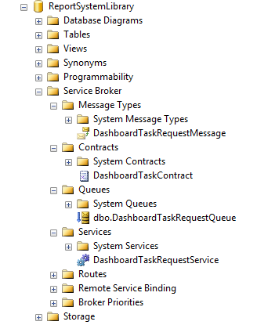
Overview from the UI
Service Broker is part of SQL Server. (since 2005)
All your data is stored on the server so why
Do we need YET ANOTHER server!? No, tell me.
4 parts to SBs:
Set up Contract
Message Type is a package style: XML or straight up string -- JSON if you want?
Queues are ordered transactions
Service processes Queues.
You can set up multiple SBs, even passing each other messages across servers.
One idea – during DataCollections, record gets inserted, queue passed around connected systems, action takes place.

Slide 7
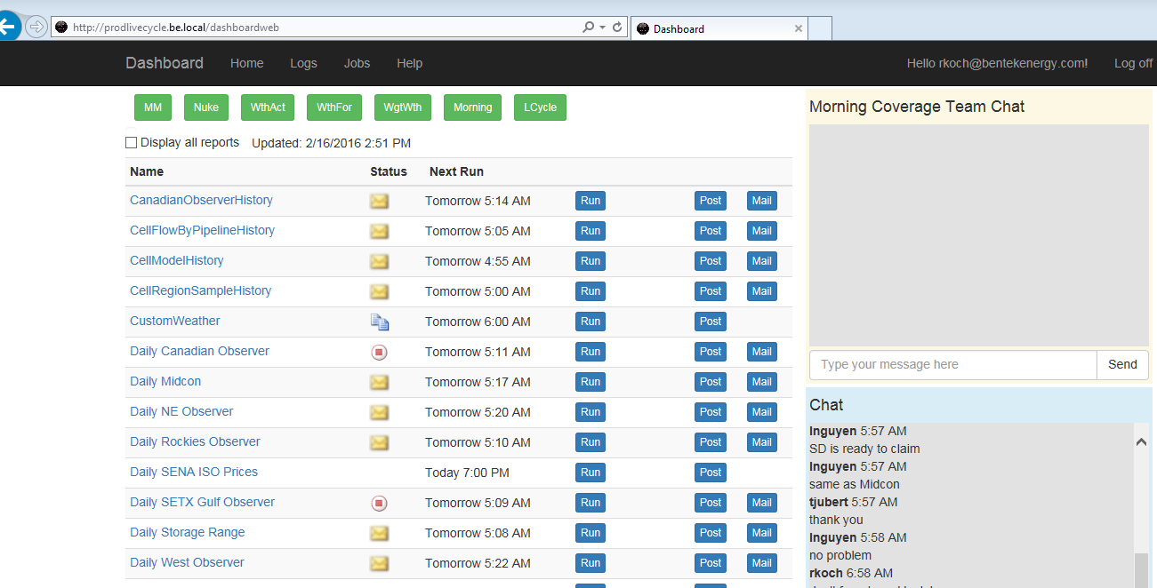
New Dashboard
Supports all browsers – HTML5
Bootstrap to avoid manipulating CSS as much as possible.
Responsive design, mobile devices ready.

Slide 8
New Dash
Only hits the DB for initial load
After than doesn’t hit the database for updates
Uses Service Broker and SignalR (WebSockets)
Let’s Demo!

Slide 9
CODE CODE CODE
Checklist of what to show:
Show SQL trigger code writing to queue
Show queue in Service Broker Queue
Run C# code consuming message
Show C# code sending message to website
Show C#/JavaScript code consuming message for SignalR

Slide 10
Conclusion
Very happy with Service Broker
Painful getting the concepts and definitions wrapped around my head.
Lots of reading. Learning curve to be expected.
Once I got the hang of it, it’s easy.

