Slide 1
AI AT WORK
Three meetings, live demos, and audience choices
A two-hour session led by Rob Koch, Deaf Professional
Slides will be shared publicly after this session either this evening or tomorrow.
Rob Koch, Deaf Professional
IDP Summit
Notes:
00:00–00:03
ROB: “I want to show you how an interpreter can arrive better prepared for a meeting with me. We will follow the research, challenge an answer, and end with a brief I can review.” Maya and Aisha are fictional. Rob is real; his client meeting is an example.
DELIVERY: Give 10–15 seconds to read before signing. Stop scrolling while explaining. For a choice, allow five seconds of silent thought, then optional hands. Repeat audience questions for the room.
OPENING ANNOUNCEMENT: Slides will be shared publicly after this session either this evening or tomorrow.

Slide 2
OPENING • OPTIONAL SHOW OF HANDS
Your experience with AI
I have never used it to prepare for an assignment.
I have tried it, but still question the answers.
I already use it and want a better process.
You can think, raise a hand, or simply watch.
IDP SUMMIT • ROB KOCH
02
Notes:
00:03–00:05
Invite a quick show of hands for each statement, with no round-robin. Acknowledge the range and continue. If no one responds, say that all three starting points fit this session.
DELIVERY: Give 10–15 seconds to read before signing. Stop scrolling while explaining. For a choice, allow five seconds of silent thought, then optional hands. Repeat audience questions for the room.

Slide 3
AI AT WORK
Our two hours
00:00–00:22 Sign-language AI, wider costs, and the prompt warm-up
00:22–01:05 Maya’s documents and Rob’s public research
01:05–01:15 Break
01:15–01:50 Aisha, the brief, and planning an interpreter’s day
01:50–02:00 Questions and closing
IDP SUMMIT • ROB KOCH
03
Notes:
00:05–00:07
A guided presentation with optional choices. No device, account, group work, or personal disclosure is required. The handout contains all prompts.
DELIVERY: Give 10–15 seconds to read before signing. Stop scrolling while explaining. For a choice, allow five seconds of silent thought, then optional hands. Repeat audience questions for the room.

Slide 4
OVERVIEW
The interpreter question in each meeting
01
02
03
Maya
Rob
Aisha
Launch decision
Technical client meeting
Confidential HR discussion
How do I prepare without taking over the decision?
How do I research terminology without profiling the person?
What information and tools stay outside my role?
AI changes preparation. It does not change who owns the conversation.
IDP SUMMIT • ROB KOCH
04
Notes:
00:07–00:08
Introduce Maya’s source material, Rob’s public research, and Aisha’s generic preparation. Keep the preview brief.
DELIVERY: Give 10–15 seconds to read before signing. Stop scrolling while explaining. For a choice, allow five seconds of silent thought, then optional hands. Repeat audience questions for the room.

Slide 5
ROLE CLARITY
Three roles in the meeting
1
2
3
Deaf professional
Interpreter
AI tool
Sets the purpose and language preferences. Makes decisions. Approves information and final use.
Prepares for the content. Renders meaning and intent. Clarifies and protects confidentiality.
Organizes approved material. Suggests terms or drafts. May be wrong and has no authority.
Interpreters take responsibility for interpretation. I direct my own participation.
IDP SUMMIT • ROB KOCH
05
Notes:
00:08–00:10
The interpreter is accountable for interpreting decisions and works with the Deaf professional on preferences and repair. Organizers and information owners may also need to authorize tools. Source: https://rid.org/wp-content/uploads/2023/03/NAD_RID-Code-of-Professional-Conduct-508-Accessible.pdf
DELIVERY: Give 10–15 seconds to read before signing. Stop scrolling while explaining. For a choice, allow five seconds of silent thought, then optional hands. Repeat audience questions for the room.

Slide 6
SIGN-LANGUAGE TECHNOLOGY
State of sign-language AI
A real, narrow use
Google DeepMind’s SL2T turns ASL into English text on Pixel 11 for dictation and brief exchanges.
No replacement for meeting interpreters
SL2T cannot interpret both ways or ask for clarification. Its impact report rules out formal workplace decisions.
What comes next
Sign-language generation is still in development. Deaf-led evaluation should guide where each tool helps.
Recognition, translation and generation are different tasks.
IDP SUMMIT • ROB KOCH
06
Notes:
00:10–00:12
ROB: “As a Deaf professional, I want to distinguish a useful new tool from a claim that a phone can replace an interpreter. Google’s SL2T gives ASL users a way to produce English text in specific situations. The person signing reviews what the model wrote before sharing it.”
Google DeepMind introduced SL2T 1.0 in August 2026 for ASL-to-English text in Gboard and Live Transcribe on Pixel 11. The Google DeepMind/AISLAC joint impact report names dictation, search, messages, and informal low-stakes one-to-one exchanges as intended uses. It explicitly excludes workplace decisions, healthcare, legal proceedings, academic assessment and classroom interpreter replacement. The report says the product does not translate spoken language into sign or ask for clarification, and warns against using it to evade human-interpreter obligations.
Recognition (SLR) identifies signed input; translation (SLT, including SL2T) maps meaning into another language; generation (SLG) produces signed output. These tasks should not be conflated. Google says it is working on sign-language generation; the current release is ASL-to-English text. There are already narrow use cases, so avoid saying the field has none. The open question is which additional uses Deaf people find valuable and safe.
Sources: https://deepmind.google/blog/putting-sign-language-ai-into-users-hands/ ; https://storage.googleapis.com/deepmind-media/DeepMind.com/Blog/putting-sign-language-ai-into-users-hands/aislac-joint-impact-report-for-sl2t-1-0.pdf
DELIVERY: Allow 10–15 seconds to read before signing. Keep this to two minutes. Transition: “Now let’s name the wider costs and claims that come with these tools.”

Slide 7
QUESTIONS WE SHOULD KEEP VISIBLE
The elephant in the room
Power and water
Data centers use electricity and cooling water, and release waste heat. Local emissions depend on the power source.
Financial ties
Chip and cloud suppliers may also invest in AI customers. Commitments are different from realized returns.
Security
Malicious content can redirect connected AI agents through the tools they are allowed to use.
AGI claims
There is no agreed definition of AGI. Predictions do not establish what today’s tools can do.
Useful tools can still carry real costs and limits.
IDP SUMMIT • ROB KOCH
07
Notes:
00:12–00:15
ROB: “I am interested in useful AI, and I also want us to see what supports it and what risks come with it. These concerns do not disappear just because a demo goes well.”
POWER AND WATER: Data centers require electricity and cooling. Cooling may consume water; servers generate heat that must be removed. The local environmental effect varies with cooling design, water source, geography and the electricity mix. Do not claim that every data center uses the same amount of water or has the same emissions. The IEA estimates 485 TWh of global data-center electricity use in 2025 and a central projection of 950 TWh in 2030; those figures cover all data centers, not AI alone. IEA 2025 reports cooling as about 7% to over 30% of data-center electricity use depending on facility type. LBNL reports US data-center water use and water-use effectiveness. Sources: https://www.iea.org/reports/key-questions-on-energy-and-ai/executive-summary ; https://www.iea.org/reports/energy-and-ai/energy-demand-from-ai ; https://seta.lbl.gov/publications/2024-lbnl-data-center-energy-usage-report
FINANCIAL TIES: OpenAI reported 2026 funding anchored by strategic partners including NVIDIA, Amazon and SoftBank, while its infrastructure strategy also buys compute and chips from industry partners. Intertwined investor-supplier relationships deserve scrutiny, but this evidence alone does not establish fraud or prove that any announced investment has been spent or earned back. Source: https://openai.com/index/accelerating-the-next-phase-ai/
SECURITY: By “breaches,” distinguish a documented risk from a claim that AI routinely breaks into other systems. NIST describes indirect prompt injection: malicious instructions in external material can hijack connected agents and lead them to misuse authorized tools or expose data. Source: https://www.nist.gov/blogs/caisi-research-blog/insights-ai-agent-security-large-scale-red-teaming-competition
AGI: Stanford HAI states that there is no universally accepted definition of artificial general intelligence. Avoid treating a forecast about AGI as proof of current capability or inevitable human replacement. Source: https://hai.stanford.edu/assets/files/hai_ai_index_report_2025.pdf
DELIVERY: Allow 10–15 seconds to read before signing. This is a three-minute presenter-led overview, not a debate or audience exercise. Transition: “With those limits in view, let’s see how a better prompt helps with a real preparation task.”

Slide 8
AUDIENCE CHOICE • A OR B
Which prompt gives useful direction?
A
B
“Tell me about Rob Koch.”
“I am preparing to interpret a data architecture meeting with Rob Koch. Find relevant public sources, explain terms, and link each fact.”
Take five seconds. Which answer would help you prepare?
IDP SUMMIT • ROB KOCH
08
Notes:
00:15–00:17
Make this a two-minute visual choice. Skip the optional live A; show B, then move to the short Search example on the next slide. Invite a silent choice or hands. Reveal B: it provides role, topic, task, and evidence requirement. A might yield useful facts but gives little basis for selecting relevant details.
DELIVERY: Give 10–15 seconds to read before signing. Stop scrolling while explaining. For a choice, allow five seconds of silent thought, then optional hands. Repeat audience questions for the room.

Slide 9
LIVE DEMO • PROMPT AND REVISION
The follow-up improves the draft
FIRST ANSWER MAY CONTAIN
FOLLOW-UP TO PASTE
A long biography
Interesting but irrelevant details
Terms with no explanation
“Keep only information relevant to this meeting. Explain unfamiliar terms. Cite factual claims. List what you could not verify.”
IDP SUMMIT • ROB KOCH
09
Notes:
00:17–00:22
Run one short Search example and its follow-up. Keep this to five minutes. Show one useful reduction and one unresolved question. The left column describes possible output, not a result already generated. Use the labeled sample if search is unavailable.
DELIVERY: Give 10–15 seconds to read before signing. Stop scrolling while explaining. For a choice, allow five seconds of silent thought, then optional hands. Repeat audience questions for the room.

Slide 10
MEETING 1
Maya's launch-date decision
MEETING
DECISION
Monday, 9:00 a.m.
30-minute project review
Ship October 15 or move the launch to November 1
PEOPLE
APPROVED MATERIAL
Maya Chen, Deaf product lead
Engineering lead
Marketing lead
ASL-English interpreters
Agenda and current risk log
Prior action list
Names, acronyms, and terminology
Public launch page
IDP SUMMIT • ROB KOCH
10
Notes:
00:22–00:24
Introduce fictional Maya and the launch choice. The interpreter prepares to understand the discussion. Maya and colleagues make the business decision.
DELIVERY: Give 10–15 seconds to read before signing. Stop scrolling while explaining. For a choice, allow five seconds of silent thought, then optional hands. Repeat audience questions for the room.

Slide 11
FICTIONAL DEMO • SAFE TO PASTE
Maya’s source material
FICTIONAL DEMO MATERIAL — MAYA
Purpose: choose October 15 or November 1 for launch.
Participants: Maya, engineering lead, marketing lead.
Agenda: readiness, open risks, launch decision.
Terms in the notes: UAT, rollback, CDC.
UAT sign-off is pending. A rollback drill is scheduled.
CDC appears without a definition.
No language or access preferences have been supplied.
IDP SUMMIT • ROB KOCH
11
Notes:
00:24–00:27
Copy the complete fictional source from the handout. This demo needs no private client file. Approval to read a document does not by itself establish approval to upload it.
DELIVERY: Give 10–15 seconds to read before signing. Stop scrolling while explaining. For a choice, allow five seconds of silent thought, then optional hands. Repeat audience questions for the room.

Slide 12
MEETING 1
Maya: interpreter preparation
MAYA PROVIDES
INTERPRETER PREPARES
Meeting purpose and decision
Agenda and approved documents
Names and preferred terminology
Language and access preferences
Review the launch options and risks
Clarify acronyms and technical terms
Confirm team, platform, and placement
Identify information still needed
AI may organize a term list when the material and tool are authorized.
IDP SUMMIT • ROB KOCH
12
Notes:
00:27–00:29
Coordinate relevant agenda, terms, and access preferences with Maya and the organizer. Check the specific tool and source authorization. The sample intentionally omits some information.
DELIVERY: Give 10–15 seconds to read before signing. Stop scrolling while explaining. For a choice, allow five seconds of silent thought, then optional hands. Repeat audience questions for the room.

Slide 13
LIVE DEMO • PASTE FROM THE HANDOUT
Maya’s preparation prompt
I am preparing to interpret Maya's project review. Using ONLY the fictional material below, make a brief with: meeting purpose, terms and plain-English meanings, uncertainties, and questions for Maya. Mark any term whose meaning the material does not establish. Do not choose the launch date or invent access preferences.
Then paste the fictional source material.
IDP SUMMIT • ROB KOCH
13
Notes:
00:29–00:33
Open a new chat and paste the complete Maya prompt. This supplied-material task does not need web search. Show what the resulting brief identifies as missing.
DELIVERY: Give 10–15 seconds to read before signing. Stop scrolling while explaining. For a choice, allow five seconds of silent thought, then optional hands. Repeat audience questions for the room.

Slide 14
AUDIENCE CHOICE • PLANTED AMBIGUITY
The AI expanded “CDC.” What next?
Sample AI answer: “CDC means change data capture.”
A Keep it because this is a technology meeting.
B Ask what CDC means in this specific agenda.
C Pick a different expansion from a web search.
IDP SUMMIT • ROB KOCH
14
Notes:
00:33–00:36
This is a deliberately planted example, not an actual response. Allow a silent choice and optional hands. If the live model already flags CDC, explain that its uncertainty is useful.
DELIVERY: Give 10–15 seconds to read before signing. Stop scrolling while explaining. For a choice, allow five seconds of silent thought, then optional hands. Repeat audience questions for the room.

Slide 15
REVEAL • THE SOURCE DOES NOT DEFINE IT
CDC remains an open question
The source gives us three letters, without a definition.
A common expansion does not establish this team’s meaning.
Follow-up: “Mark CDC as unresolved. Draft a question for Maya.”
“What does CDC refer to in this launch review?”
IDP SUMMIT • ROB KOCH
15
Notes:
00:36–00:39
Answer B. Paste the follow-up. Uncertainty becomes a direct question for the person with context. Avoid suggesting a sign for an unresolved concept.
DELIVERY: Give 10–15 seconds to read before signing. Stop scrolling while explaining. For a choice, allow five seconds of silent thought, then optional hands. Repeat audience questions for the room.

Slide 16
MEETING 1
Maya: during and after the meeting
DURING
AFTER
Render the discussion, risks, and commitments
Preserve Maya's register and intent
Request clarification when meaning is unclear
Do not decide, advise, or summarize for Maya
Follow the agreement for notes and records
If authorized, flag terminology or interpretation issues
Do not approve business facts or commitments
Maya approves the recap
The interpreter supports communication. Maya owns the decision and record.
IDP SUMMIT • ROB KOCH
16
Notes:
00:39–00:42
Review purpose, terminology, the missing definition, and questions. Interpretation includes both directions and all participants. Business judgments and official records stay with the relevant participants and owners.
DELIVERY: Give 10–15 seconds to read before signing. Stop scrolling while explaining. For a choice, allow five seconds of silent thought, then optional hands. Repeat audience questions for the room.

Slide 17
MEETING 2 — LIVE DEMO
The research task
MEETING
DEMO SOURCE BOUNDARY
Example assignment
45-minute client conversation
Public web only
No client documents
No personality assessment
No assumed access preferences
RESEARCH GOAL
Prepare the interpreter for a discussion with Rob about data and AI architecture.
Output: a sourced terminology and context brief for the interpreter.
IDP SUMMIT • ROB KOCH
17
Notes:
00:42–00:44
Rob is the real research subject, but this meeting is illustrative. No real client identity or engagement details are supplied. Research published context, then confirm the agenda.
DELIVERY: Give 10–15 seconds to read before signing. Stop scrolling while explaining. For a choice, allow five seconds of silent thought, then optional hands. Repeat audience questions for the room.

Slide 18
MEETING 2 — LIVE DEMO
Starting the ChatGPT research
1
Open chatgpt.com and sign in
BEFORE UPLOADING
2
Start a new chat
Confirm that the tool and the information are approved for this assignment.
3
Choose Deep research from the available tools
4
Or use Search for a shorter web lookup
For this demonstration, ChatGPT receives public sources only.
IDP SUMMIT • ROB KOCH
18
Notes:
00:44–00:46
Open chatgpt.com in the approved account. Show the controls actually present. Deep research may be in tools or the sidebar; /Deepresearch is also documented. Ordinary Search does not promise a plan or Start research button. Source: https://help.openai.com/en/articles/10500283-deep-research-in-chatgpt
DELIVERY: Give 10–15 seconds to read before signing. Stop scrolling while explaining. For a choice, allow five seconds of silent thought, then optional hands. Repeat audience questions for the room.

Slide 19
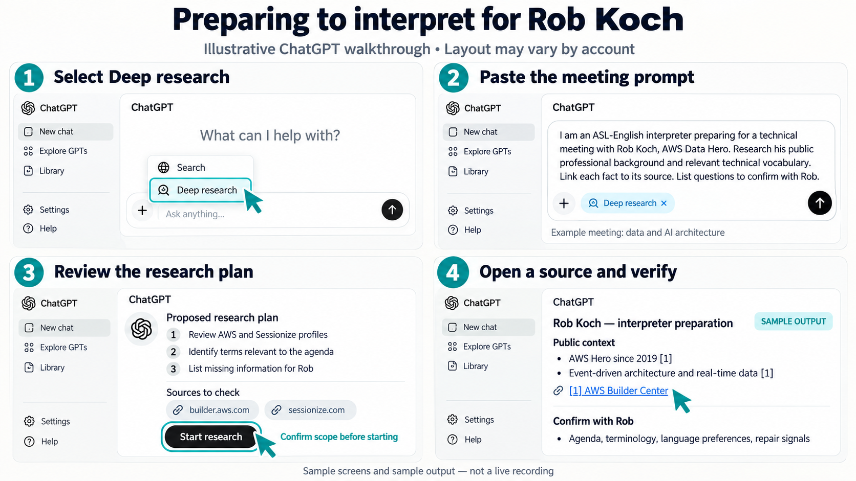
ILLUSTRATIVE INTERFACE • SAMPLE OUTPUT
The ChatGPT research sequence
IDP SUMMIT • ROB KOCH
19
Notes:
00:46–00:48
Show the audience-approved generated image as a roadmap, then switch to the real tool. It is not a current account screenshot. A blank chat can still use memory or personalization. Source: https://help.openai.com/en/articles/10500283-deep-research-in-chatgpt
DELIVERY: Give 10–15 seconds to read before signing. Stop scrolling while explaining. For a choice, allow five seconds of silent thought, then optional hands. Repeat audience questions for the room.

Slide 20
MEETING 2 — LIVE DEMO
First prompt: set the boundary
I am an ASL-English interpreter preparing for a 45-minute technical client meeting with Rob Koch. The topic is data and AI architecture.
Search public professional sources only. First list the sources you plan to use. Focus on terminology, proper names, organizations, and Rob's published technical topics. Cite every factual claim.
Do not infer personality, working style, language preferences, or access needs. Put missing information in a section called Questions for Rob.
Paste this prompt, then review the proposed research plan before starting.
IDP SUMMIT • ROB KOCH
20
Notes:
00:48–00:51
Paste the fuller Rob prompt from the handout, including URLs and the example-meeting label. In Deep research, review any clarifying questions or plan. In Search, proceed to its cited answer.
DELIVERY: Give 10–15 seconds to read before signing. Stop scrolling while explaining. For a choice, allow five seconds of silent thought, then optional hands. Repeat audience questions for the room.

Slide 21
MEETING 2 — LIVE DEMO
The proposed research plan
KEEP
EDIT OR REMOVE
AWS Builder Center
Rob's Sessionize profile
Rob's published talks and blog
CNCF sources relevant to the meeting
Unrelated personal sources
Research about Deaf people in general
Claims about personality or communication style
Sources that cannot be opened or verified
When the plan matches the assignment, select Start research.
IDP SUMMIT • ROB KOCH
21
Notes:
00:51–00:54
Review the Deep research scope and start it. In Search, this slide explains source selection rather than a required screen. If a run is slow, switch to the prepared sample and label it as authored illustration. Source: https://help.openai.com/en/articles/10500283-deep-research-in-chatgpt
DELIVERY: Give 10–15 seconds to read before signing. Stop scrolling while explaining. For a choice, allow five seconds of silent thought, then optional hands. Repeat audience questions for the room.

Slide 22
MEETING 2 — LIVE DEMO
Open the citations and check the claims
EXAMPLE CLAIMS TO VERIFY
FOR EACH CLAIM
AWS Data Hero since 2019
Published focus on event-driven architecture and real-time data
Talks about Kubernetes, AI workloads, databases, and accessibility
Select the citation
Open the original page
Check the name, date, and wording
Delete or label anything the source does not support
A citation is a route to the evidence. It is not proof until you open it.
IDP SUMMIT • ROB KOCH
22
Notes:
00:54–00:58
Open one claim from AWS and the title mismatch on Sessionize. Keep this to four minutes. Check identity, wording, relevance, and dates. AWS supports Hero since 2019 and event-driven architecture / real-time data expertise. If Sessionize heading and biography differ on title, flag the mismatch. Sources: https://builder.aws.com/community/heroes/RobKoch ; https://sessionize.com/robkoch/
DELIVERY: Give 10–15 seconds to read before signing. Stop scrolling while explaining. For a choice, allow five seconds of silent thought, then optional hands. Repeat audience questions for the room.

Slide 23
AUDIENCE CHOICE • INVENTED ERROR EXAMPLE
Would you keep this sentence?
Written for this presentation. No source or live AI response made this claim.
“Rob prefers fast, highly technical conversations and dislikes introductory explanations.”
Keep it, revise it, or remove it?
What would a source have to say to support this claim?
IDP SUMMIT • ROB KOCH
23
Notes:
00:58–01:01
Explicitly label this a planted example. After a brief silent choice, reveal: remove the claim and replace it with a direct question. Expertise and talk topics do not establish preferred pace. Ask the model to find other unsupported preferences.
DELIVERY: Give 10–15 seconds to read before signing. Stop scrolling while explaining. For a choice, allow five seconds of silent thought, then optional hands. Repeat audience questions for the room.
PROVENANCE: The assistant authored this sentence as a deliberately flawed teaching example. It was not quoted from Rob, a public profile, or a real ChatGPT result. Its invented reasoning leap is: technical subject expertise supposedly implies a preference for fast discussion and a dislike of introductory explanations. Public talk topics do not establish either preference.
ROB INTRODUCTION: “Here is an invented sentence to test. The research did not say this about me. Imagine it appeared in a preparation brief. Would you keep it?”
REVEAL: Remove the unsupported claim. Replace it with a direct question about preferred pacing and the level of context needed for this meeting.

Slide 24
MEETING 2 — LIVE DEMO
Creating the interpreter brief
1
Stay in the same research conversation
BEFORE USING THE BRIEF
2
Paste the second prompt from the handout
Keep only checked facts. Leave preferences as questions for Rob.
3
Review the brief and check its sources
4
Confirm open questions directly with Rob
Ask for a one-page brief. Keep citations and mark source gaps.
IDP SUMMIT • ROB KOCH
24
Notes:
01:01–01:03
ROB: “We have checked the research. Now I want a short brief the interpreter can use before the assignment. Stay in this conversation so the source material is available. Paste the follow-up from the handout. Review what it kept, keep the citations, and leave preferences as questions for me.”
Show where to paste the second prompt, then send it. The same conversation provides context but does not guarantee accuracy. Ask for one page containing the example meeting purpose, checked professional context, terminology, proper names, questions for Rob, and source gaps. Use only claims checked against original sources. Do not infer preferences or invent sign glosses.
DELIVERY: Give 10–15 seconds to read before signing. Stop scrolling while explaining. The next slide illustrates the same steps.

Slide 25
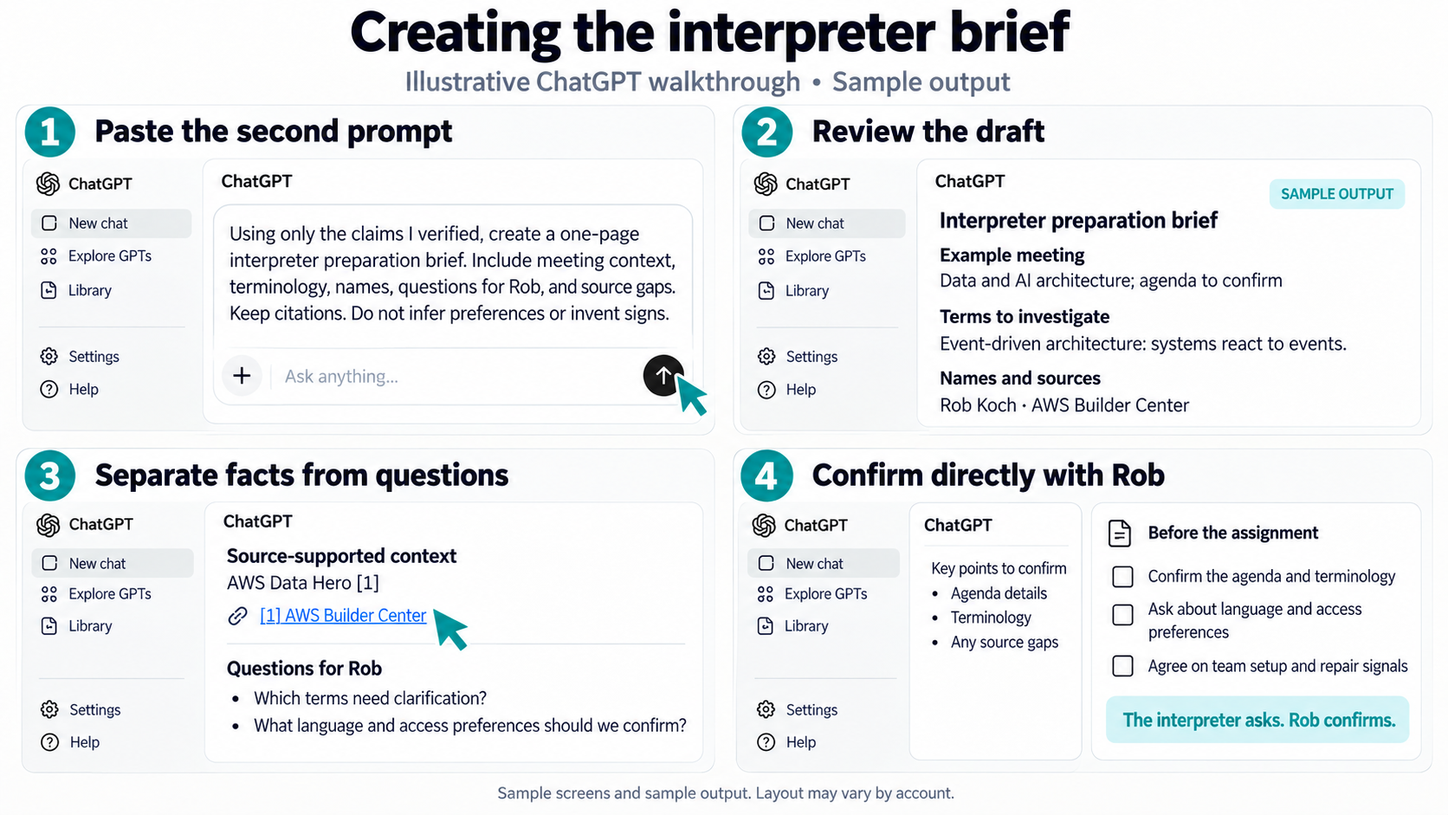
ILLUSTRATIVE INTERFACE • SAMPLE OUTPUT
Second prompt: the interpreter brief
IDP SUMMIT • ROB KOCH
25
Notes:
01:03–01:05
Paste the Rob follow-up. Only facts checked against original sources go under verified context. Draft questions for Rob; sending is a separate human step. Candidate research topics are not a confirmed agenda.
DELIVERY: Give 10–15 seconds to read before signing. Stop scrolling while explaining. For a choice, allow five seconds of silent thought, then optional hands. Repeat audience questions for the room.
The illustration is generated sample UI and output, matching the visual style of slide 18. Use the full follow-up prompt from the audience handout for the live demonstration. Ask Rob directly about preferences; this is a human step, not an automatic AI action.
FULL ORIGINAL SLIDE TEXT:
Using only the verified claims and sources from the report, create a one-page interpreter preparation brief.
Use these sections:
1. Meeting map
2. Terminology and short definitions
3. Proper names and organizations
4. Published topics likely to arise
5. Questions to confirm with Rob
6. Source gaps
Do not provide sign glosses or infer preferences.
FINAL HUMAN STEP
Send Rob the short list of questions.
Confirm terminology, names, modality, team setup, and repair signals directly with him.
Research prepares the assignment. Rob confirms how the assignment works.
Source for the example public-context claim: https://builder.aws.com/community/heroes/RobKoch
Visual: OpenAI built-in image generation, companion to the slide 18 illustration.
After the instruction slide, walk through the four panels and compare them with the live result. Pause for the audience to read before signing.

Slide 26
01:05–01:15
10-minute break
When we return: Aisha’s meeting and your finished preparation brief.
The handout includes all three prompts.
Following along is optional.
IDP SUMMIT • ROB KOCH
26
Notes:
01:05–01:15
Take the full break and announce the return time. Share the handout through the event’s approved channel. Public audience resources: https://robcube.github.io/interpreting-for-deaf-professionals-summit-2026/ . No QR code is embedded.
DELIVERY: Give 10–15 seconds to read before signing. Stop scrolling while explaining. For a choice, allow five seconds of silent thought, then optional hands. Repeat audience questions for the room.

Slide 27
MEETING 3
Aisha's confidential HR discussion
MEETING
PURPOSE
Friday, 3:00 p.m.
60-minute confidential meeting
Clarify performance expectations and confirm the accommodation process
PEOPLE
PREPARATION BOUNDARY
Aisha Patel, Deaf operations director
Aisha's manager
HR partner
ASL-English interpreters
Use the minimum authorized information
Keep personnel and medical details protected
Confirm policy before using any AI tool
IDP SUMMIT • ROB KOCH
27
Notes:
01:15–01:18
Aisha is fictional. Demonstrate useful generic preparation without private employment or medical records.
DELIVERY: Give 10–15 seconds to read before signing. Stop scrolling while explaining. For a choice, allow five seconds of silent thought, then optional hands. Repeat audience questions for the room.

Slide 28
AUDIENCE CHOICE • A, B, OR C
Which input would you use for this demo?
A A personnel file, with Aisha’s name removed
B A fully invented agenda with no personal facts
C A recording from an earlier interpreting assignment
Choose silently first. Optional hands follow.
IDP SUMMIT • ROB KOCH
28
Notes:
01:18–01:21
Wait for reading and a silent choice. Do not invite real assignment details from the audience.
DELIVERY: Give 10–15 seconds to read before signing. Stop scrolling while explaining. For a choice, allow five seconds of silent thought, then optional hands. Repeat audience questions for the room.

Slide 29
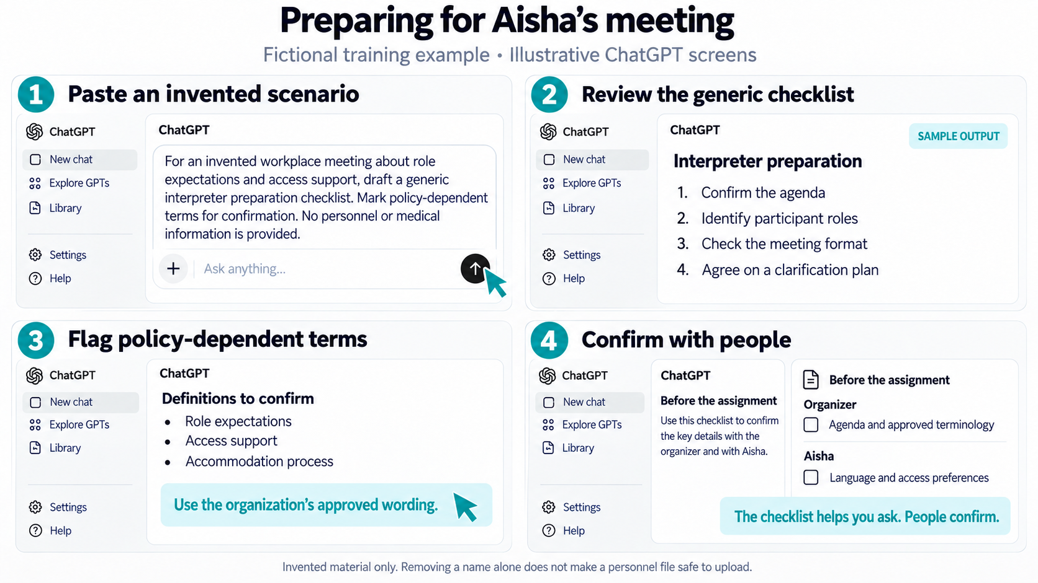
ANSWER B • FICTIONAL MATERIAL ONLY
Aisha: generic preparation in ChatGPT
IDP SUMMIT • ROB KOCH
29
Notes:
01:21–01:26
Answer B for this public demo. Paste the full Aisha prompt into a new chat. The sample output is authored illustration. Actual assignments require the organization’s approved policy and authorized sources.
DELIVERY: Give 10–15 seconds to read before signing. Stop scrolling while explaining. For a choice, allow five seconds of silent thought, then optional hands. Repeat audience questions for the room.
ILLUSTRATION WALKTHROUGH: Answer B is the fully invented agenda. Open a new chat and paste the full fictional Aisha prompt from the handout. Read the generic checklist, flag terms that need approved policy wording, and take questions to the organizer and Aisha. This illustration is a sample, not a live response. A new chat alone does not establish privacy or permission to upload information.
COPYABLE PROMPT AND ORIGINAL REVEAL:
Removing a name alone does not make a personnel file safe to reuse.
Prompt: “For an invented workplace meeting about role expectations and access support, draft a generic interpreter preparation checklist. Mark policy-dependent terms for confirmation.”
Sample output: confirm the agenda, participant roles, approved policy wording, meeting format, and clarification plan.
Visual: built-in image generation, matching the earlier ChatGPT illustrations.

Slide 30
MEETING 3
Aisha: interpreter boundaries before the meeting
INTERPRETER MAY RECEIVE
KEEP OUTSIDE GENERAL AI
Time, participants, and broad purpose
Approved policy glossary
Authorized meeting documents
Access preferences and team plan
Personnel or performance notes
Medical and accommodation details
Knowledge from prior assignments
Recordings or transcripts without approval
Confidentiality applies before, during, and after the assignment.
IDP SUMMIT • ROB KOCH
30
Notes:
01:26–01:29
Relate the checklist to real preparation. Documents an interpreter can access are not automatically permitted AI inputs. Source: https://rid.org/wp-content/uploads/2023/03/NAD_RID-Code-of-Professional-Conduct-508-Accessible.pdf
DELIVERY: Give 10–15 seconds to read before signing. Stop scrolling while explaining. For a choice, allow five seconds of silent thought, then optional hands. Repeat audience questions for the room.

Slide 31
MEETING 3
Aisha: during and after the meeting
DURING
AFTER
Render the full message and emotional content
Ask for clarification and repair
Avoid advice or policy interpretation
Follow the agreed team and turn-taking plan
Protect all assignment information
Manage or delete notes under agreement and policy
Report concerns only through authorized channels
Do not create an AI recap without approval
Aisha chooses disclosure. HR owns the official record.
Next: return to Rob’s brief for the final human review.
IDP SUMMIT • ROB KOCH
31
Notes:
01:29–01:31
Explain how preparation helps during the meeting and how notes follow agreement and policy afterward. AI output does not establish employment policy.
DELIVERY: Give 10–15 seconds to read before signing. Stop scrolling while explaining. For a choice, allow five seconds of silent thought, then optional hands. Repeat audience questions for the room.
TRANSITION TO SLIDE 32, IN ROB’S VOICE:
“Aisha’s example showed how to prepare without uploading private details. Across all three meetings, AI can help us organize questions, but the Deaf professional still needs to confirm what matters. Let’s return to the brief about me. I can show you what it got right, what I would correct, and what you still need to ask me directly.”
This closes the third scenario. The return to Rob demonstrates the final human review, rather than introducing another meeting.

Slide 32
FINAL DEMO • HUMAN REVIEW
Back to Rob: reviewing the brief
ROB KOCH / INTERPRETER PREPARATION BRIEF
Saved research • 26 September 2026 • Hypothetical data/AI meeting • Not yet reviewed by Rob
PUBLIC CONTEXT
SOURCE CHECK: ASK ROB
AWS Data Hero since 2019; public topics include event-driven architecture and real-time data. [1]
Speaker-page heading: “Senior Principal, Slalom.” Bio: “Principal at Slalom Build.” Which title should we use? [2]
TERMINOLOGY TO PREPARE
BEFORE INTERPRETING
EDA: services communicate through events such as an order being placed. [4]
Kubernetes / K8s: manages containerized applications and services. [5]
Ask for the agenda, diagrams and acronyms.
Confirm with Rob: his role, terminology, language and clarification preferences.
Working-style preferences: not established.
Sources: [1] AWS profile [2] Sessionize [4] AWS EDA guide [5] Kubernetes docs • Full links in notes
IDP SUMMIT • ROB KOCH
32
Notes:
01:31–01:35
This slide displays a condensed, source-linked version of our saved research brief—not an outline and not an invented ChatGPT response. Full saved result: Rob-Koch_Saved-Interpreter-Brief_2026-09-26.html (also available as Markdown).
PROVENANCE: Adapted from the existing Rob-Koch_Public-Professional-Meeting-Brief_Example.md and rechecked against the public sources below. Prepared with AI assistance in Codex; this is not a ChatGPT Deep Research export, screenshot, or transcript. The earlier working-style hypotheses have not been carried forward as facts.
DELIVERY: Give the audience 10–15 seconds to read before signing. Do not sign while scrolling the full brief. Walk through one public fact, one term, and the actual role-title mismatch. The proposed data/AI meeting is hypothetical. No communication preferences have been confirmed by Rob.
OPENING IN ROB’S VOICE: “Here is the saved research brief about me. It gives the interpreter some useful technical context. It also found two different job titles on the same speaker page. That is something to ask me—not something the AI should quietly guess.”
TRANSITION TO SLIDE 33: “Now I’ll review this as the person you would interpret for: what is right, what needs correcting, and what you still need to ask me.”
FULL SAVED BRIEF:
# Rob Koch: interpreter preparation brief
Saved public-source research, adapted for interpreter preparation • September 26, 2026 • Draft for Rob’s review
Adapted from the existing Rob-Koch_Public-Professional-Meeting-Brief_Example.md and rechecked against the public sources below. Prepared with AI assistance in Codex; this is not a ChatGPT Deep Research export, screenshot, or transcript. The earlier working-style hypotheses have not been carried forward as facts.
## Assignment boundary
- Hypothetical data/AI architecture meeting. No real agenda, participant list, client records, or confirmed communication preferences were supplied. Rob is the Deaf professional in this demonstration; the interpreter is preparing to support communication, not advise on architecture.
## Public professional context
- AWS lists Rob as a Data Hero since 2019 and describes work in event-driven architecture and real-time data. [1]
- His speaker page lists database, Kubernetes, analytics, and enterprise architecture experience. These topics are candidates for preparation, not a prediction of this meeting’s content. [2]
- In his 2022 “Data what??” post, Rob compares data terminology and revises initial assumptions against researched definitions. This is an observable writing example, not proof that he prefers a particular pace, technical depth, or interpreting approach. [3]
## A source issue to confirm with Rob
- The Sessionize heading says “Senior Principal, Slalom”; its biography says “Principal at Slalom Build.” Ask which title and affiliation to use. Do not silently resolve the mismatch or present either as personally confirmed. [2]
## Starter terminology — validate against the actual agenda
- EDA — event-driven architecture: services communicate through events representing changes, such as an order being placed. [4]
- Kubernetes / K8s — an open-source platform for managing containerized applications and services; K8s abbreviates Kubernetes. [5]
- These are preparation definitions, not prescribed signs. Confirm meeting-specific meanings, product names, acronyms, and agreed terminology with Rob and the interpreting team.
## Questions before the meeting
- Ask the organizer: What decision is being made, who is attending, and can we receive the agenda, slides, diagrams, and acronym list through an approved channel?
- Ask Rob: What is your role in this meeting, and which points or technical distinctions must come through accurately?
- Ask Rob and the interpreting team: Which language, terminology, fingerspelling, clarification signals, pacing, and turn-taking arrangements work for this meeting?
- Confirm the room or video layout, visibility of shared diagrams, and team-interpreter coordination. Do not infer access preferences from a biography.
## Human review status
- Not yet reviewed or approved by Rob. His replies remain blank until he provides them. On slide 33, Rob reviews this draft in his own words; on slide 34, add only the corrections he actually confirms and permits us to use.
## Sources and retrieval notes
1. [AWS Builder Center — Rob Koch](https://builder.aws.com/community/heroes/RobKoch) — Profile identifies a Data Hero since 2019 and describes event-driven architecture and real-time data work. Direct page extraction was empty; profile text was available through the search index.
2. [Sessionize — Rob Koch](https://sessionize.com/robkoch/) — Speaker-page heading and biography use different role titles. Public profile statements are not confirmation of a specific meeting assignment.
3. [Rob Koch — Data what?? (June 2, 2022)](https://robcube.github.io/discussion/2022/06/02/data-what.html) — A dated example of Rob comparing terminology, initial assumptions, and researched definitions. It is not evidence of fixed communication preferences.
4. [AWS — What is event-driven architecture?](https://aws.amazon.com/what-is/eda/) — Primary technical source for the EDA definition.
5. [Kubernetes — Overview](https://kubernetes.io/docs/concepts/overview/) — Primary technical source for Kubernetes and the K8s abbreviation.

Slide 33
FINAL DEMO • ROB REVIEWS THE DRAFT
My response as the Deaf professional
What does this brief get right about my work?
What would I correct or add for this meeting?
What do you still need to ask me directly?
IDP SUMMIT • ROB KOCH
33
Notes:
01:35–01:38
Rob answers in his own words. Choose a real correction or preference you want to share. Do not read invented personal preferences. If demonstrating a fictional preference, clearly label it.
DELIVERY: Give 10–15 seconds to read before signing. Stop scrolling while explaining. For a choice, allow five seconds of silent thought, then optional hands. Repeat audience questions for the room.
Connect each answer to the brief on the preceding slide. Give only a genuine correction or preference you choose to share. Then move to the follow-up prompt on slide 34 to show how direct confirmation improves the draft.

Slide 34
LIVE FOLLOW-UP • AFTER ROB RESPONDS
A correction becomes a better brief
“Rob has now confirmed: [paste only what he actually said and permits us to use].
Update the brief. Label this as directly confirmed information. Keep public facts linked to sources. Leave unanswered questions open.”
Check that the revision reflects Rob’s actual words.
IDP SUMMIT • ROB KOCH
34
Notes:
01:38–01:42
Run one revision with what Rob chooses to provide. Check that the output did not widen his statement. No sensitive client details are needed.
DELIVERY: Give 10–15 seconds to read before signing. Stop scrolling while explaining. For a choice, allow five seconds of silent thought, then optional hands. Repeat audience questions for the room.

Slide 35
COMPARISON
Three meetings from the interpreter's perspective
MEETING
INTERPRETER PREPARES
DURING THE MEETING
DEAF PROFESSIONAL OWNS
Maya
Launch decision
Agenda, risks, and terms
Render decision talk; clarify
Decision and recap
Rob
Technical client
Sourced terminology + confirmed preferences
Interpret the meeting itself
Communication and relationship
Aisha
Confidential HR
Minimum authorized information
Protect confidentiality and scope
Disclosure; HR owns record
Preparation supports access. It does not transfer authority to the interpreter or AI.
IDP SUMMIT • ROB KOCH
35
Notes:
01:42–01:44
Compare source types across the cases: supplied documents, public sources, generic scenario. Review the resulting preparation with the Deaf professional and interpreter team.
DELIVERY: Give 10–15 seconds to read before signing. Stop scrolling while explaining. For a choice, allow five seconds of silent thought, then optional hands. Repeat audience questions for the room.
TRANSITION IN ROB’S VOICE: “We have focused on preparing for the conversation. What about the rest of an interpreter’s working day? Here are a few other places AI could help you prepare.”

Slide 36
OTHER USES FOR AI
What else could AI help with?
Terminology practice
Turn approved material into a glossary or self-quiz. Verify meanings.
Assignment administration
Draft a preparation request or a reusable invoice template. Review it before use.
Fictional practice material
Create a practice dialogue without reusing a real client’s conversation.
The day between assignments
Check travel gaps, arrival time and food stops. Let’s see an example.
Which of these would be useful in your work?
IDP SUMMIT • ROB KOCH
36
Notes:
01:44–01:46
ROB: “Which of these would be useful in your work? Take a few seconds to choose privately. I’ll show the last example.” This remains a presenter-led session, not a group exercise. Do not invite client disclosures. If time permits, an optional show of hands can accompany the question.
These are proposed uses, not guarantees about any tool. Only use approved materials and protect assignment information. Review generated administrative content. Use fictional dialogues for practice. Do not treat generated sign descriptions as authoritative language models or as a replacement for qualified instruction and Deaf language expertise.
Pause for reading before signing.

Slide 37
HYPOTHETICAL SEATTLE DAY
Planning the day between assignments
THE ASSIGNMENTS
THE DEMONSTRATION
9:00–10:00 Ballard
11:15–12:15 First Hill
2:15–3:15 Georgetown
1
Open the day-planner webpage
2
Check driving and arrival buffers
3
Add a 20-minute traffic delay
A gluten-free lunch fits between
the second and third assignments.
4
Compare lunch plans and verify sources
Fictional sites. Assumed travel times. No live traffic feed.
IDP SUMMIT • ROB KOCH
37
Notes:
01:46–01:47
Open Interpreter-Day-Planner.html from the same folder as this deck. Keep it open in a browser before presenting. The file runs offline except for external source links.
ROB: “This interpreter has three assignments across Seattle and needs a gluten-free lunch. AI can help make the gaps visible. First, we need to separate fixed appointments from travel estimates and facts we still have to check.”
The example date is Wednesday, September 30, 2026. All locations are fictional sites identified only by neighborhood. The displayed driving durations are authored teaching assumptions, not navigation estimates. Do not type private client names or assignment details into a public AI demo.
The page includes a copyable, tool-neutral research prompt. It uses local calculations, not a live AI model.

Slide 38
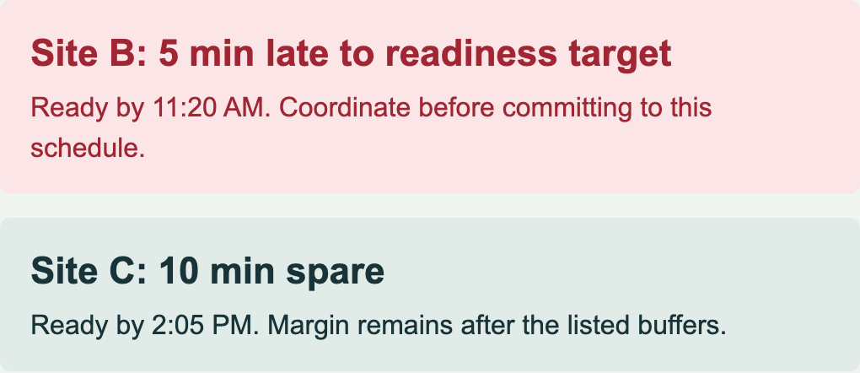
WEBPAGE DEMONSTRATION
A traffic delay changes the plan
RESULT FROM THE SAVED WEBPAGE
15 min spare
− 20 min delay
= 5 min short
A lunch change can help the afternoon.
The morning conflict still needs coordination.
Open the webpage for adjustable times, food options and the copyable AI prompt.
IDP SUMMIT • ROB KOCH
38
Notes:
01:47–01:50
This is a screenshot of the actual companion page, not a fabricated AI-tool response. Use the open webpage for the demonstration. If the browser fails, this slide is the saved fallback.
1. Base scenario: Site B has 15 minutes spare after driving, contingency and arrival preparation.
2. Click “Try a 20-minute traffic delay.” Readiness moves to 11:20 for an 11:15 booking, a five-minute conflict.
3. Select packed lunch. At the default 35-minute meal break, the afternoon margin increases from 10 to 35 minutes. The morning conflict stays.
4. Open an official restaurant source and WSDOT. The page does not fetch live traffic or claim that a gluten-free menu guarantees safety for every person. Verify current hours, food and preparation needs with staff.
5. Point to the copyable prompt for later use. Do not run another long AI search if it would consume Q&A time.
Sources checked September 26, 2026: https://ghostfishbrewing.com/taproom/ (dedicated gluten-free kitchen, 2942 1st Ave S, Wednesday noon opening); https://nuflours.com/pages/bakery (gluten-free claim and walk-ins, current address/hours not established in extracted text); https://wsdot.wa.gov/travel ; https://seattle.gov/transportation/projects-and-programs/programs/technology-program . All travel durations are assumptions.
Stop at 01:50 and move to questions. Give time to read before signing; stop scrolling while explaining.

Slide 39
CLOSING DISCUSSION • 8 MINUTES
Questions about the process
Which step would you want demonstrated again?
Where would this help you prepare?
What still needs a conversation with the Deaf professional?
IDP SUMMIT • ROB KOCH
39
Notes:
01:50–01:58
Use an agreed visible turn-taking cue and repeat each question for the room. Redirect identifying client details into generic examples. If no questions arrive, revisit CDC and opening a citation. Stop at 01:58.
DELIVERY: Give 10–15 seconds to read before signing. Stop scrolling while explaining. For a choice, allow five seconds of silent thought, then optional hands. Repeat audience questions for the room.

Slide 40
CLOSE
What I need from my interpreter
1
Prepare with approved materials
2
Verify the research and ask me about preferences
3
Interpret my meaning, tone, and decisions
4
Tell me when clarification or more support is needed
AI can support preparation. The working relationship remains between people.
© 2026 Rob Koch · CC BY 4.0 · creativecommons.org/licenses/by/4.0/
IDP SUMMIT • ROB KOCH
40
Notes:
01:58–02:00
ROB: “Preparation helps when I can see what you learned, correct what is wrong, and tell you what matters for this meeting.” Point to the handout and thank the audience and interpreter team.
DELIVERY: Give 10–15 seconds to read before signing. Stop scrolling while explaining. For a choice, allow five seconds of silent thought, then optional hands. Repeat audience questions for the room.
PUBLIC RELEASE: Original material © 2026 Rob Koch. Licensed under Creative Commons Attribution 4.0 International: https://creativecommons.org/licenses/by/4.0/ . Credit the named authors, link the license and indicate changes. Third-party material, trademarks and linked sources retain their existing rights. No endorsement is implied. Public resources: https://robcube.github.io/interpreting-for-deaf-professionals-summit-2026/

