Slide 1
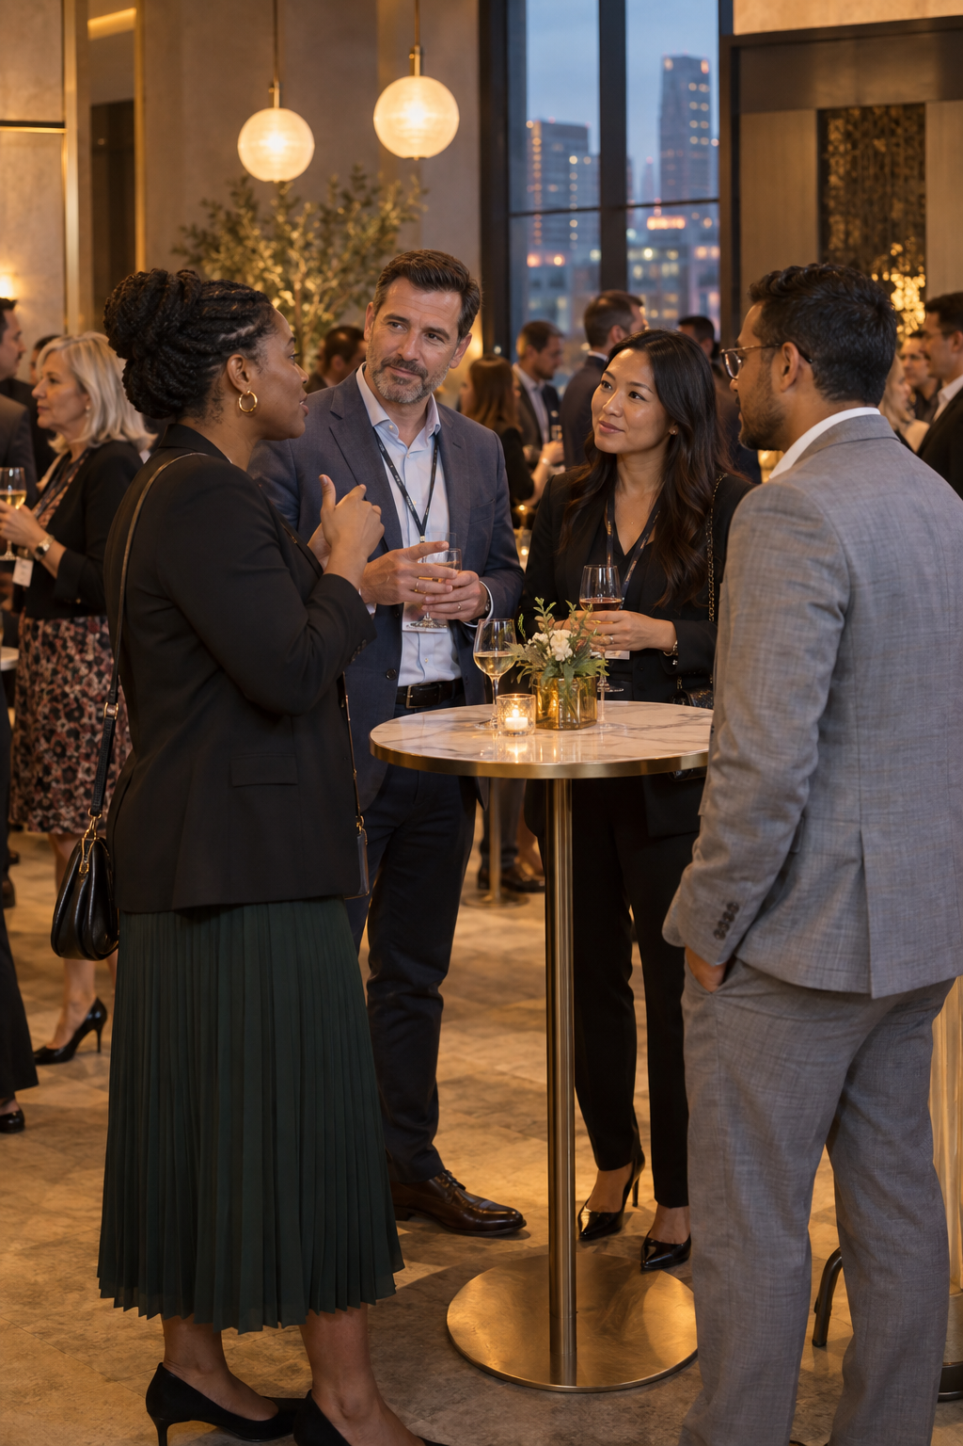
Networked
for Success
DEAF PROFESSIONAL + INTERPRETER WORKSHOP
Rob Koch + Jordann Hoelzel
IDP Summit
Notes:
0:00–0:02 | Rob opens with the purpose: help Deaf professionals build real professional relationships in informal settings. Jordann names the session as a set of adaptable agreements, not a universal script.
Cover image: AI-generated illustrative cocktail reception scene; it does not depict the summit or specific participants.

Slide 2
Professional relationships
begin in informal moments
MOST EXAMPLES BEGIN WITH ONE INTERPRETER
THEN WE ADD A TWO-INTERPRETER TEAM
Notes:
0:02–0:04 | Rob shares a brief lived example. Jordann clarifies the scope: most examples begin with one interpreter so ownership stays visible. Slides 7 and 17 show what changes with two interpreters.

Slide 3
Session outcomes
A usable playbook for the next networking event
Prepare as a Deaf professional and interpreter team
Each outcome becomes a specific choice participants can use right away.
Distinguish one-interpreter and two-interpreter roles
Navigate introductions and group conversations
Name who initiates, flags, decides, and follows up
Repair access while preserving relationship ownership
Notes:
0:04–0:06 | Jordann reviews the outcomes and previews the live demonstration. Participants may contribute from the Deaf professional, interpreter, or organizational perspective.

Slide 4
The professional relationship goal
PEER OR COLLEAGUE
Exchange expertise and stay connected.
MENTOR OR SPONSOR
Ask for context, guidance, or advocacy.
COLLABORATOR, CLIENT, OR HIRING CONTACT
Explore a project, service, committee, or role.
Notes:
0:06–0:08 | Rob clarifies the relationship goal. It is the relationship between the Deaf professional and a peer, mentor, sponsor, collaborator, client, recruiter, or community leader. It is not the interpreter-client working relationship.

Slide 5
Why networking access matters
MENTORSHIP
Informal conversation can reveal who is willing to share context and gain a friend.
VISIBILITY
Direct interaction lets people recognize the professional’s expertise and personality.
OPPORTUNITY
Specific follow-through can lead to collaboration, service, or future roles.
Notes:
0:08–0:11 | Rob names the stakes: direct recognition of expertise and personality. Jordann adds that networking may support opportunity, but no single exchange promises a result.

Slide 6
The team agreement
DEAF PROFESSIONAL
Chooses the relationship goal, what to share, and how directly to respond when the interaction drifts.
INTERPRETER TEAM
Brings access expertise and follows the agreed plan for social presence, tracking, repair, capture, and switching.
Notes:
0:11–0:14 | Jordann explains the team agreement. Rob names one preference about social presence or repair. The Deaf professional chooses the relationship goal and response. The interpreter team brings access expertise and follows the agreement.

Slide 7
One interpreter and two-interpreter teams
ONE INTERPRETER
Handles interpreting, tracking, and agreed repair. Captures details only when practical and agreed.
TWO INTERPRETERS
Name the active and off roles. The off interpreter can feed context and capture details. Switch at a natural boundary.
Notes:
0:14–0:18 | Jordann contrasts one and two interpreters. With two, agree on active and off roles, feed signals, capture, correction, and transitions. A natural team rhythm cannot be assumed.

Slide 8
Five-minute huddle
ACCESS AND CAPTURE
Where will the team stand and how will group pace work? Who records the name, organization, conversation thread, and promised next step?
PURPOSE
Which relationship matters today, and what would make the exchange worthwhile?
INTRODUCTION
How does the professional want to enter and introduce themself?
RESET
What signal means pause, recap, redirect, or exit?
Notes:
0:18–0:21 | Jordann defines capture: name and pronunciation, organization, conversation thread, promised next step, and who records it. Rob names what he would and would not want recorded.

Slide 9
Pre-event huddle
Scenario
You are entering a professional association reception to meet a hiring manager, reconnect with a colleague, and learn about a committee.
PURPOSE
Choose one person or conversation that matters most.
ACCESS
Where will the team stand, and how will they handle group pace?
TEAMING
If two interpreters are present, name active, off, feed, and switch cues.
CAPTURE
Name exactly what gets recorded and by whom.
Notes:
0:21–0:28 | Walk through the huddle using the scenario on screen. Model how the Deaf professional and interpreter name the purpose, access preferences, capture plan, and any two-interpreter cues. Invite brief observations.

Slide 10
Social presence within the team
ROLE PLAY
A volunteer interpreter (deaf or hearing) to come on camera please.
Notes:
0:28–0:33 | Rob tells the story of an interpreter instructed not to participate. Jordann models a natural greeting and a brief bridge back to Maya. Ask how the response helped the hearing contact engage directly without making the interpreter the relationship owner.

Slide 11
Social presence within the team
Illustrative moment
A contact greets the interpreter first. The interpreter acknowledges the greeting, interprets it, and says: “Maya can tell you more about the accessibility work her team is leading.”
SOCIAL ABSENCE STANDS OUT
The interpreter avoids greetings and brief reactions. The silence draws more attention to the interpreter.
TRANSPARENT PRESENCE CONNECTS
Within the agreement, the interpreter responds naturally and returns substantive attention to Maya.
The exchange feels rigid
The contact becomes unsure
Maya remains the relationship owner
Shared attention becomes easier
Notes:
0:28–0:33 | Rob tells the story of an interpreter instructed not to participate. Jordann models a natural greeting and a brief bridge back to Maya. Ask how the response helped the hearing contact engage directly without making the interpreter the relationship owner.

Slide 12
Group conversation moves and owners
JOIN: DEAF PROFESSIONAL
Chooses when to enter and asks to join. The interpreter may quietly orient only if agreed.
TRACK: INTERPRETER
Names the active speaker and gives brief context needed for access.
REPAIR: SHARED PLAN
The interpreter flags the breakdown. The professional chooses the relational response.
EXIT: DEAF PROFESSIONAL
Closes the conversation and names the next step. The interpreter supports communication and logistics.
Notes:
0:33–0:37 | Jordann names the owner of each move. The Deaf professional joins and exits. The interpreter tracks. During repair, the interpreter flags the breakdown and the professional chooses the relational response. A preauthorized interpreter pause can handle a mechanical access need.

Slide 13
Repair language with the speaker named
INT: TRACK
“Alex is speaking now.”
DP: REPAIR
“Please take one at a time so I can stay with the conversation.”
INT: FLAG TO DP
“There is overlap. Would you like me to pause the group?”
DP: REDIRECT
“Please speak to me directly.”
DP: JOIN
“Could someone catch us up before we join?”
INT: PREAUTHORIZED PAUSE
“Please pause for interpretation.”
INT: HAND BACK
“Rob, would you like to respond?”
DP: EXIT
“I want to follow up about the committee. May I connect with you?”
Notes:
0:37–0:41 | Rob and Jordann read the examples with the speaker labels. Distinguish flagging overlap to the Deaf professional from independently policing the group. Invite participants to revise one line so it sounds natural.

Slide 14
Bridge, name, assert, or exit
The Deaf professional chooses the response based on the relationship goal, power, energy, and safety.
BRIDGE
Interpreter, if agreed: “Let’s wait on Maya who would be the better person to answer.”
NAME
Deaf professional: “You may speak to me as in a normal conversation as the interpreter is there to facilitate us.”
ASSERT
Deaf professional needs to be tactfully-minded: “Sorry, you were saying?” “Do you mind if we move to another area?” Do NOT be demanding.
EXIT
Deaf professional: “Thank you for your time appreciate working with me and the interpreter. We can follow up by email.”
Notes:
0:41–0:44 | Rob asks: “It is a hearing world. What are you going to do about it?” Participants choose bridge, name, assert, or exit. Jordann closes with the boundary that the Deaf professional chooses the tactic.

Slide 15
Live demonstration: redirect without shutting down
Rob steps away. Jordann keeps talking. The volunteer interpreter decides what to do.
ROB / DEAF PROFESSIONAL
Steps away during the conversation.
VOLUNTEER INTERPRETER
Decides how to handle the conversation while Rob is away.
JORDANN / HEARING PERSON
Keeps talking to the interpreter after Rob steps away.
AUDIENCE
Offers feedback in chat or comes on camera to share an observation.
Notes:
0:44–0:52 | Run the live demonstration. Rob, the Deaf professional, steps away. Jordann plays an overly verbose hearing person and keeps talking directly to the volunteer interpreter. The volunteer decides how to respond while Rob is absent and how to reconnect the conversation when he returns. Pause for audience feedback in chat or invite people to come on camera. Run a second attempt if useful.

Slide 16
Audience coaching lens
Look for relationship quality and clear ownership
Who initiated the exchange?
Did the interpreter bridge briefly and return attention?
Offer one observation: “I noticed ___. It affected the connection by ___.”
Could Rob choose whether to name, assert, or continue?
Did the hearing contact receive a clear path back to Rob?
What should the volunteer try on the second attempt?
Notes:
0:52–0:55 | Audience members respond in chat or come on camera. Use the frame: I noticed ___; it affected the connection by ___. Ask what the volunteer should keep or change on the second attempt.

Slide 17
Access support and relationship ownership
DEAF PROFESSIONAL
Chooses the topic, what to disclose, whom to pursue, and the next step. Professional follow-up belongs to the Deaf professional.
INTERPRETER TEAM
Supports social mechanics, access, and agreed capture. The team does not pursue the contact or own the professional relationship.
Notes:
0:55–0:58 | Jordann separates access support from relationship ownership. The interpreter may contribute agreed capture details such as, “That was Jean, who wanted to meet again.” The Deaf professional decides whether and how to follow up.

Slide 18
Two interpreters: active, off, and the switch
ACTIVE
OFF
SWITCH
STAY WITH THE CONVERSATIONAL UNIT
Handle the current exchange and signal access problems according to the plan.
SUPPORT WITHOUT A PARALLEL CONVERSATION
Feed names or context discreetly, monitor chat and sightlines, and capture agreed details.
FOLLOW MEANING, NOT THE CLOCK
Switch at a topic transition, clear pause, or end of conversation. Do not switch mid-thought.
Notes:
0:58–1:03 | Jordann explains two-interpreter teaming. The off interpreter feeds context, monitors chat and sightlines, and captures agreed details. A twenty-minute interval is a planning cue, not permission to interrupt a thought or introduction. Switch at a natural boundary.

Slide 19
Attire, access, and the occasion
SETTING
VISUAL ACCESS
INDIVIDUAL NEED
DRESS FOR THE OCCASION
Match the professional level of the event instead of treating black as an automatic uniform.
PLAN CONTRAST TOGETHER
Use solid, contrasting clothing when the professional requests it or the environment calls for it.
HONOR SPECIFIC ACCESS NEEDS
DeafBlind and low-vision contexts may make dark, nonreflective clothing essential.
Notes:
1:03–1:06 | Rob tells the business-casual story about a worn black shirt. Ask what access problem the clothing was solving and who decided. State that black can be an access tool without becoming a universal uniform. Name DeafBlind and low-vision exceptions.

Slide 20
Capture that supports professional follow-up
IDENTIFY
Record the person’s name, pronunciation, role, and organization.
THREAD
Note the idea, shared interest, or promised resource that made the exchange specific.
NEXT STEP
Record what the Deaf professional agreed to do and by when.
WHAT IS NEEDED
WHO RECORDS
WHEN TO REVIEW
Notes:
1:06–1:09 | Jordann shows what capture includes and who may do it. With one interpreter, capture may be limited. With two, the off interpreter can record agreed details. Avoid retaining unnecessary personal information.

Slide 21
Two follow-ups with different owners
Professional relationship follow-up and interpreter-team debrief serve different purposes.
DP
TEAM
BOUNDARY
The Deaf professional chooses whom to contact, what to say, and the next professional step.
The working team reviews access, feeds, positioning, and switching for the next event.
The interpreter does not intentionally pursue the professional contact.
Notes:
1:09–1:12 | Rob distinguishes professional follow-up from the team debrief. The Deaf professional owns contact with the person they met. The working team reviews access, feeds, positioning, and switching.

Slide 22
What new approach would you bring for the next event?
ROB KOCH + JORDANN HOELZEL
Name the relationship goal
Clarify who leads each move
Agree how the team will capture, repair, and switch
© 2026 Rob Koch + Jordann Hoelzel · CC BY 4.0 · creativecommons.org/licenses/by/4.0/
Notes:
1:12–1:15 | Rob closes by asking participants to identify one agreement they will make with their interpreter team before the next event. Jordann reinforces that access supports the relationship, then thanks the group.
PUBLIC RELEASE: Original material © 2026 Rob Koch + Jordann Hoelzel. Licensed under Creative Commons Attribution 4.0 International: https://creativecommons.org/licenses/by/4.0/ . Credit the named authors, link the license and indicate changes. Third-party material, trademarks and linked sources retain their existing rights. No endorsement is implied. Public resources: https://robcube.github.io/interpreting-for-deaf-professionals-summit-2026/

