Slide 1

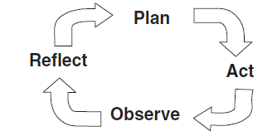
Action Research: For Both Teacher and Student
Dr. Rob Danin
English Language Specialist
www.robdanin.com

Slide 2
What is Action Research? “Learning by doing”
Action research is used to describe an approach to purposeful classroom research
Takes place in an actual/natural setting (the classroom)
Involves “actions” or strategies to determine results
Allows teacher and student to utilize creative problem solving approaches to learning; to become researchers
Gives structure to the process of reflection and inquiry
Being reflective is a prerequisite for this form of instruction
These reflective and inquiry practices can lead to improvement in both teacher and student achievement
Is not writing a research paper

Slide 3

Action Research: Accountability & Sustainability
Look
Think
Act
Think
Look
Act
Notes:
Long and respected history – can be traced back to mid 1870’s

Slide 4

Obstacles to Action Research
These may include:
professional isolation (teacher)
vague research ideas
lack of available resources
lack of time

Slide 5
Benefits of Action Research
Focus on educational issues, problems or concerns
Potential to impact program change
A form of teacher professional development
Collegial/peer interaction
Reflection on own teaching/learning
Improved communication

Slide 6

Types of Action Research
Individual teacher action research
Collaborative (team) action research
Department / School-wide action research
Student action research

Slide 7
Stages of Action Research
Identify an issue or problem
Planning an action (to solve the problem)
Implementation of the action
Observation of the action
Reflection on the observations

Slide 8
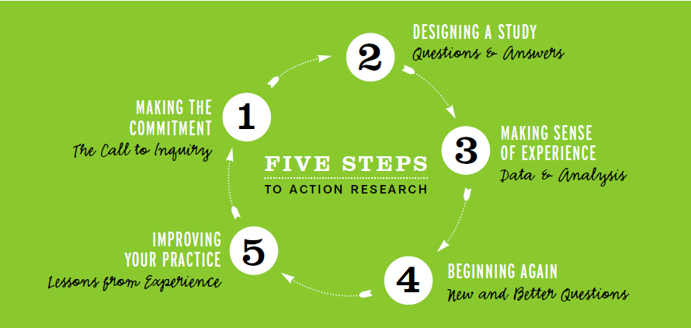
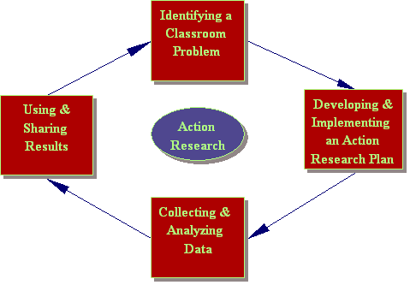
Action Research: Graphic Representations

Slide 9
ACTION RESEARCH PLAN (adapted from R. Allwright, 1993)
Identifying the problem
Decide on a specific focus for your classroom research
Find appropriate research procedures
Data collection techniques
Collect the data and analyze it
Reflect on your findings
Involves “shuttling back and forth between thinking and action”
Share your findings with others

Slide 10
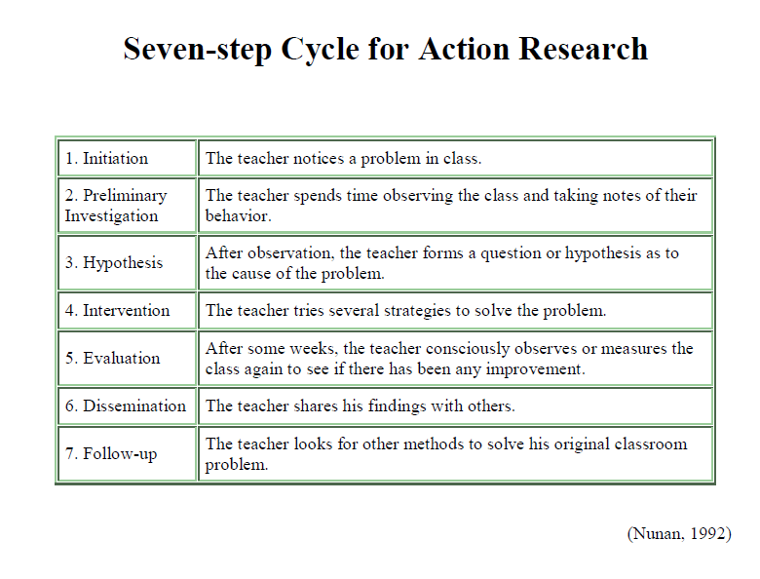

Slide 11
DATA COLLECTION TECHNIQUES:
1. | JOURNALS / DIARIES | Regular dated accounts of teaching/learning Includes personal feelings, reflections, philosophy, observations, thoughts, and feelings
2. | LEARNINNG LOGS | To include a variety of data, such as observations, analyses, diagrams, sketches, quotes, student comments, scores
3. | DOCUMENTS | Written or printed information on a related topic
4. | OBSERVATION | To write down what is actually occurring Don’t interpret what is being observed Use of a checklist typically works well
5. | FIELD NOTES | Involves writing / taking notes while the research is taking place
6. | RECORDING | To document in writing or other permanent form (e.g., audio)
7. | TRANSCRIPTION | A written or printed version of something spoken
8. | SURVEY / QUESTIONNAIRE | Research instruments consisting of a series of questions or other prompts for the purpose of gathering information
9. | INTERVIEW / DISCUSSION | A meeting at which information is obtained Talking in order to reach a decision or to exchange ideas

Slide 12
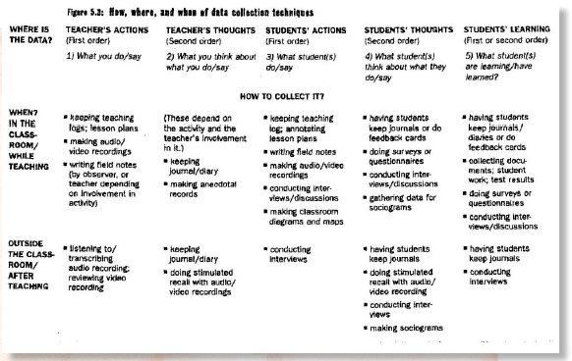
DATA COLLECTION SAMPLE:

Slide 13
Classroom Research Starters
1. I would like to improve... 2. I am perplexed by... 3. Some people are unhappy about... 4. I'm really curious about... 5. I want to learn more about... 6. An idea I would like to try out in my class is... 7. Something I think would make a difference is... 8. Something I would like to change is... 9. Some areas I'm particularly interested in are..

Slide 14
Action Research Student Activity
Students take a minute to write down a question
Share with the student next to them
Have these students discuss the steps on how to this answer
Now have these students respond to the other partner’s question
Sample question: Why are oral presentation
activities important in learning a foreign language?

Slide 15

Action Plan

Slide 16
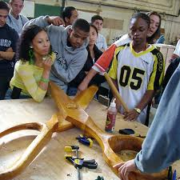
Assessing the Research
Students to exchange their work with another classmate
Make suggestions for improving their classmates’ work
Use of the student conference (individual and small group) with the teacher

Slide 17
Individual Student Conferences
Students should always do the majority of the talking and lead the conversation
This exchange is open-ended, and can last anywhere from 2-15 minutes
When conferencing the teacher should take anecdotal notes (not a verbatim transcript)
Note only those items you feel are important, such as strengths, weaknesses, skills learned, etc.
The teacher may want to design some kind of a checklist to use during this conference

Slide 18
Small Group Conferences
Meet with 3-8 students at one time
Teacher will be able to see a number of students fairly quickly and watch their interaction
Students can also hear and respond to other students’ thoughts
Each group can use a checklist to report their progress

Slide 19
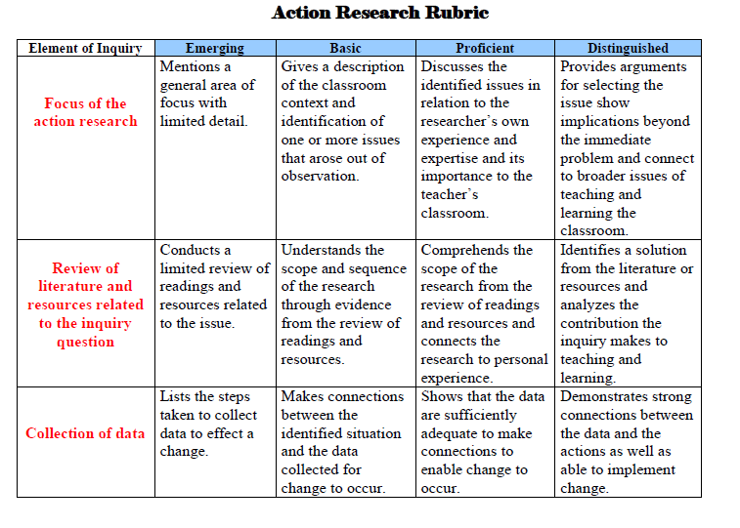
Sample Action Research Rubric: Page 1

Slide 20
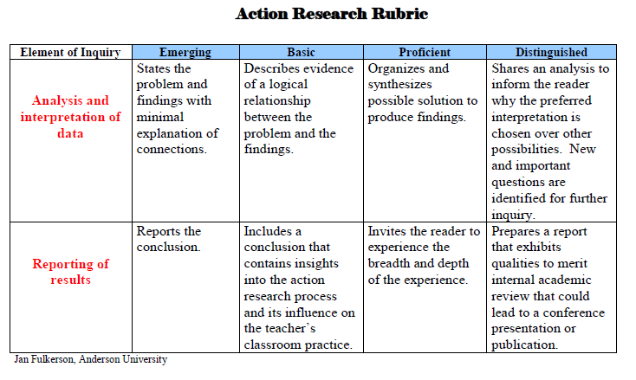
Sample Action Research Rubric: Page 2

Slide 21
Why Should Teachers Conduct Their Own Action Research?
To improve teaching practices and student achievement
To address educational concerns closest to them
with the intent that the research will inform and improve daily practice
To systematically analyze the effects of teaching on the students and/or educational programs
To document student progress toward educational goals
To serve as a role model of being a “lifelong learner” for their students

Slide 22
When Selecting a Topic
Consider:
Importance – will the information gained address a key determined issue?
Relevance – is the problem widespread? Will solving the problem have an impact on a broad number of students?
Interest – is this an issue that has a high degree of interest?
Feasibility – is this topic really researchable? Is information accessible to answer the research question(s)?

Slide 23
Action Research Topics for the Teacher
Team of teachers
focusing on a department level topic
Teacher and district, educational agency, or university personnel
learning and studying a particular instructional practice or program
Group of teachers
in the same school/university studying the same instructional concern
Action Research Topic Examples
•Technology Use & EFL Students •Effects of Cursive Writing on SLL •Peer and Cross-Age Tutoring •Bridging the Gap Between Families and School •Room Organization & EFL Instruction
Online Resources (more on website)
http://edchange.org/multicultural/tar.html
http://www.drawntoscience.org/educators/action-research/

Slide 24
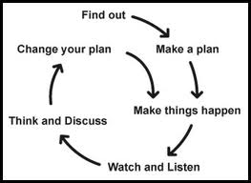
Approaches to Action Research
For example…
Interviews
Descriptive observations
Examination of written (or other media) materials
Research partners
Other forms of data collection…

Slide 25
Data Collection
…involves the collection of both informal, anecdotal data as well as formal, objective data
…provides the foundation for the researcher (both teacher and student) to examine, critique and better understand their teaching/learning

Slide 26

anecdotal data...
…information received from people
- statements
- behaviors
- interactions
- other observations

Slide 27
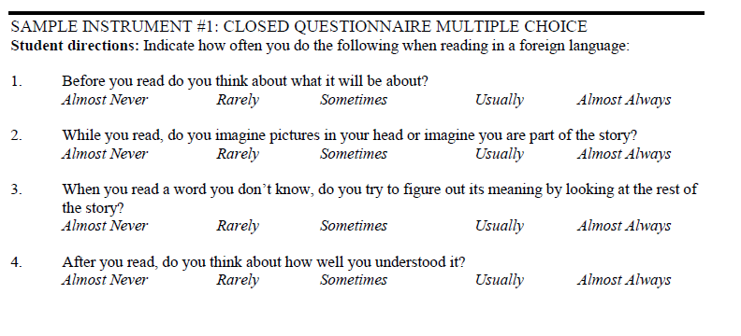
Action Research for the EFL Teacher: Data Collection Sample Research Instruments

Slide 28
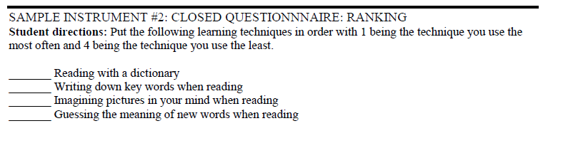
Action Research for the EFL Teacher: Data Collection Sample Research Instruments

Slide 29
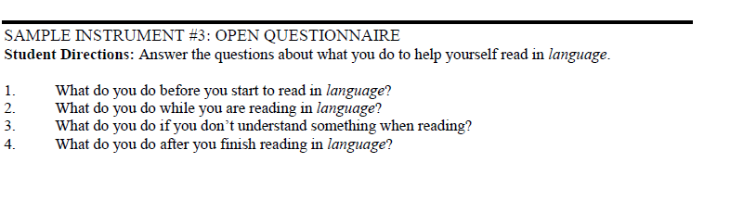
Action Research for the EFL Teacher: Data Collection Sample Research Instruments

Slide 30
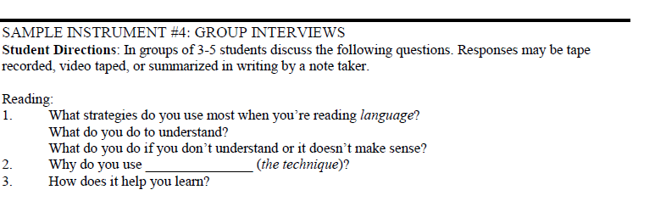
Action Research for the EFL Teacher: Data Collection Sample Research Instruments

Slide 31
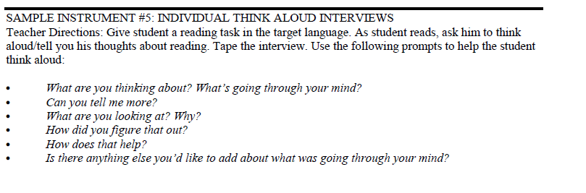
Action Research for the EFL Teacher: Data Collection Sample Research Instruments

Slide 32
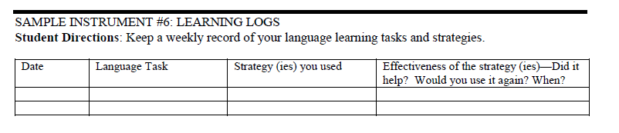
Action Research for the EFL Teacher: Data Collection Sample Research Instruments

Slide 33
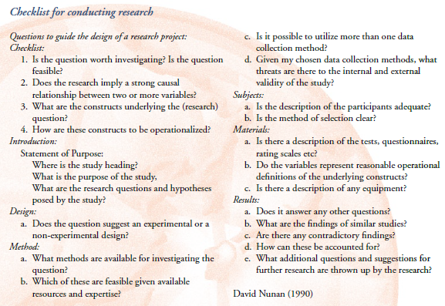
Action Research Checklist

Slide 34
Action Research Overview (2:01) http://www.youtube.com/watch?v=H5ytp5AcPRs

Slide 35
Action Research Brainstorming Session
Consider the following questions:
I would like to improve…..
Learning in my classroom would improve if….
A student behavior in my classroom that makes me angry is….
A teaching strategy that I would like to try in my classroom is…..
Students always have a difficult time with….
Other…
Please turn to your neighbor and discuss how you might approach solving this question

Slide 36

www.robdanin.com
Taking action with
Action Research

