Slide 1
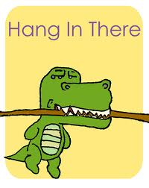
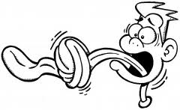
American Slang & Tongue Twisters

Slide 2
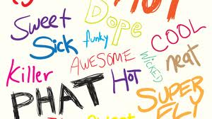
What Is Slang?
Definition: Slang is the use of informal words and expressions that are not considered standard in the speaker’s language.
Proper grammar is not always used.

Slide 3
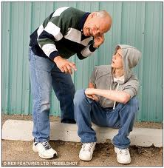
Why Teach /Learn Slang?
Rationale: EFL learners have difficulty understanding and interacting with native speakers because the nature of native speakers language differ from the “academic language” that is used in the classroom.

Slide 4

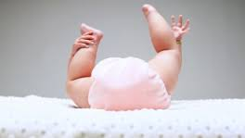
Please Consider…
Brainstorm the reasons why you may have difficulty fully understanding a native speaker’s language.
Give examples of slang language.
Ask yourself whether you have problems understanding conversations in American (or other English-speaking) movies. If so, why?
Is this what “bottoms up” means?

Slide 5
Quiz: What Do These Mean?
What an awesome sunset today.
The whole idea was a bust.
More than twenty companies went bust.
My new car is a lemon.
This is a really cool place to work.
I need more time to cram for the test.
She has a really cushy job.
I’m psyched!
I’m broke.
Others?
http://www.vocabulary.co.il/idioms/

Slide 6
What’s The Difference Between Slang & Idioms (Jargon)?
Slang: words and phrases associated with a particular group of people (e.g., young people)
Emo My bad
Idioms: words and phrases recognized by the public-at-large.
Every cloud has a silver lining / Spreading myself too thin
Slang and idioms are similar in meaning

Slide 7

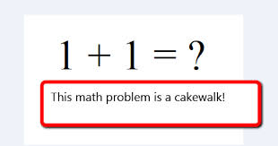
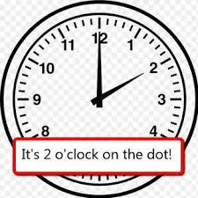
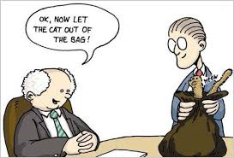
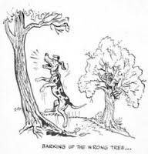
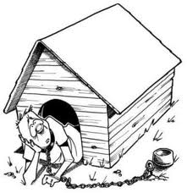
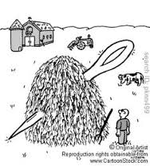
Can You Explain These Idioms?

Slide 8
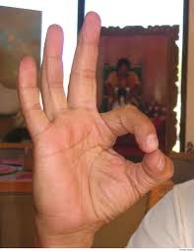
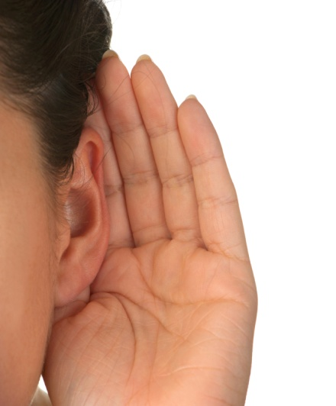
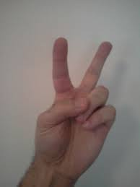




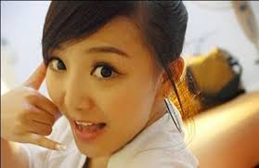
Can You Guess These Non-Verbal Gestures?

Slide 9
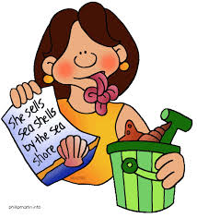
What Are Tongue Twisters?
Definition: Tongue twisters are phrases that are difficult to say because they have many same sounding words.
She sells sea shells by the seashore.

Slide 10
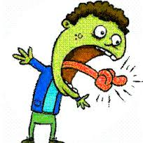
Why Teach Tongue Twisters?
Rationale:
Tongue Twisters help in practicing pronunciation.
May help ELL students to improve their English language accent.

Slide 11
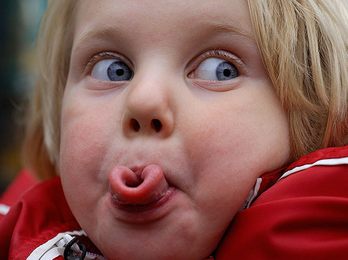
Try These Tongue Twisters!
Toy boat. Toy boat. Toy boat.
Good blood, bad blood.
Peter Piper picked a peck of pickled peppers.
World Wide Web
Fuzzy Wuzzy was a bear. Fuzzy Wuzzy had no hair. Fuzzy Wuzzy wasn't fuzzy, was he?
How much wood would a woodchuck chuck
if a woodchuck could chuck wood?
http://www.uebersetzung.at/twister/en.htm
"Stop it! Stop it! That's enough, sir. I can't say such silly stuff, sir." (Dr. Seuss, Fox in Socks. 1965)

Slide 12
More Tongue Twisters http://www.youtube.com/watch?v=6I54boqTe2g (2:00)

Slide 13
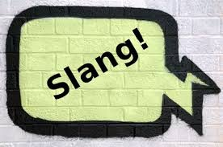

www.robdanin.com
Thanks for trying
&

