Slide 1

EFL Teaching and Assessment
Dr. Rob Danin
English Language Specialist www.robdanin.com

Slide 2
Tests vs. Assessments
Tests
“Too many tests we give as a school/district/state/county are not meant to assess, they are meant to provide data and too often that data is useless to teachers because it comes too late or is too confusing or isn’t related to that course.” (Blog Posting)
Such as…
Assessments
“Assessment goes beyond the test. Yes, testing is one way to assess, but only if the results of the test make sense and are given back in time to do something with. Assessments are the tools I use to see whether or not my students have mastered the skill at hand and the tools I use to adjust my teaching accordingly.” (Blog Posting)
Such as…

Slide 3
“Teaching to the Test”
Is it proper to teach to the test?
Should the teacher teach the material that would be on a test?
Therefore, is it okay to then teach TO the test rather than teach THE test?
Is there a difference? Why or why not?
Tests can have an influence on choices about how and what ELLs are taught, which can undermine years of research in the areas of bilingual education.
High-stakes tests are not developed to meet the specific educational needs of ELLs.

Slide 4
Assessing Students’ Needs
Assessment Types
Placement
Helps determine language proficiency level
Diagnostic (Pre/Post)
Modifies instruction to meet the needs of the student
Formative (Ongoing)
Informal assessment (non-graded)
For example: teacher observation
Can help in the planning and necessary adjustment of instruction
Summative (Final)
Formal assessment (graded)
Monitors student progress

Slide 5
Assessment for Learning
Inform students of lesson outcomes in terms they understand (lesson goals and objectives)
Articulate lesson outcomes in advance of teaching (rubric)
Develop assessment activities and scoring that accurately reflect student achievement (authentic)
Use assessments to build student confidence in their successes and help them take responsibility for their own learning (self-regulated learner)
Engage students in regular self assessment (reflection)
Share assessment results with specific feedback on how to improve
Quickly adjust instruction based on assessment results

Slide 6
Rubrics
“Art” of Rubric Design
The use of a rubric provide[s] effective feedback (washback) to students (Bresciani, et al., 2009).
Rubric performance levels need to have descriptors that are understood by both rater and student
Multiple raters are necessary especially when an objective score is vital (i.e., high-stakes tests)
Subjectivity in scoring may develop due to
Difficulty of assessment task (appropriate use of a rubric?)
Number of tasks to be assessed
Raters level of rubric training
Research studies support the use of rubrics in assessing educational content areas including
Fine arts, music, movement, sports
Performance-based activities

Slide 7
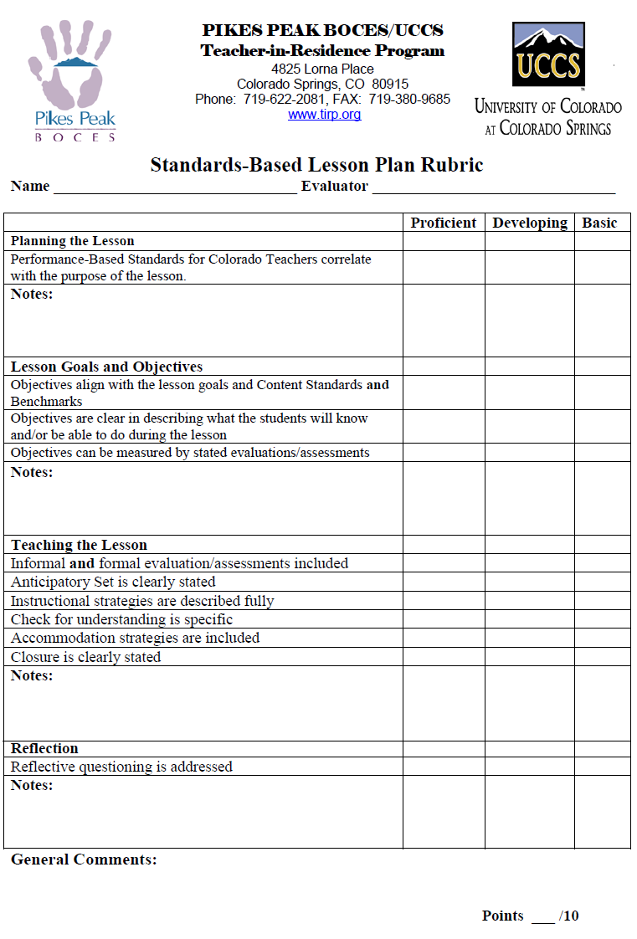
Rubric Sample: Standards-Based Lesson Plan

Slide 8
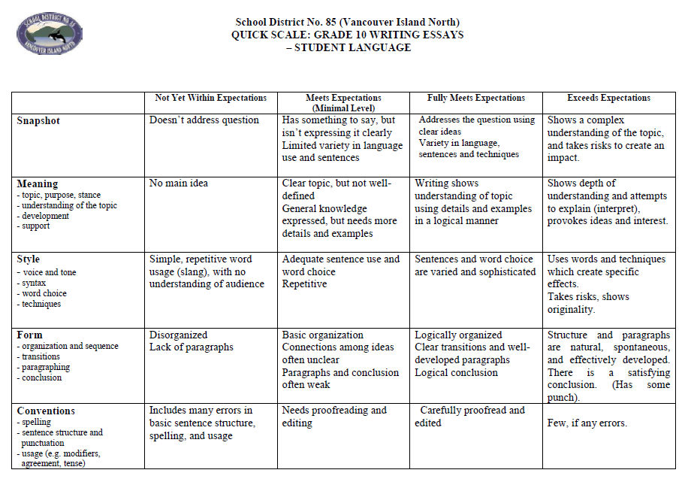
Rubric Sample: Student-Friendly

Slide 9
Reality Check
Is the use of rubrics…
something you see the value in (as a teacher and/or teacher trainer)?
Why or why not (e.g., teaching style, cultural hindrance)?
If yes, what is one way you could implement this assessment?
able to be utilized in the current educational environment?

Slide 10
Authentic Assessments
Assesses the student abilities by measuring how well students perform under “real-world” learning environments. It is likely that some mix of “traditional” and “authentic” testing will best meet the teacher’s needs in determining student achievement.
Anecdotal records (e.g., student observation)
Inventories (needs assessment, checklist, survey, etc.)
Learning logs and journals (reflective)
written entries in which students reflect on what they have learned and how they have learned it
Portfolios (e.g., collection of student’s original work)
Performance-based (activity that can be created or performed, such as science experiment, art and music/dance)
Use of realia (real life objects): cooking utensils , tools, clothing, items from work and nature, etc.
Other:

Slide 11
Reflective Practices: Self-Regulation
The ability for both teacher and student to question and explore their own practice of teaching and learning (Underhill, 2001).
The teacher/student learns about their own teaching/learning to better understand how to improve
rubrics and self-assessments are effective measurement tools
Through self-analysis of one’s own work greater retention of learned concepts takes place
meta-cognition: thinking about thinking
Teachers and students can then set individual goals that focus on areas in need of improvement

Slide 12
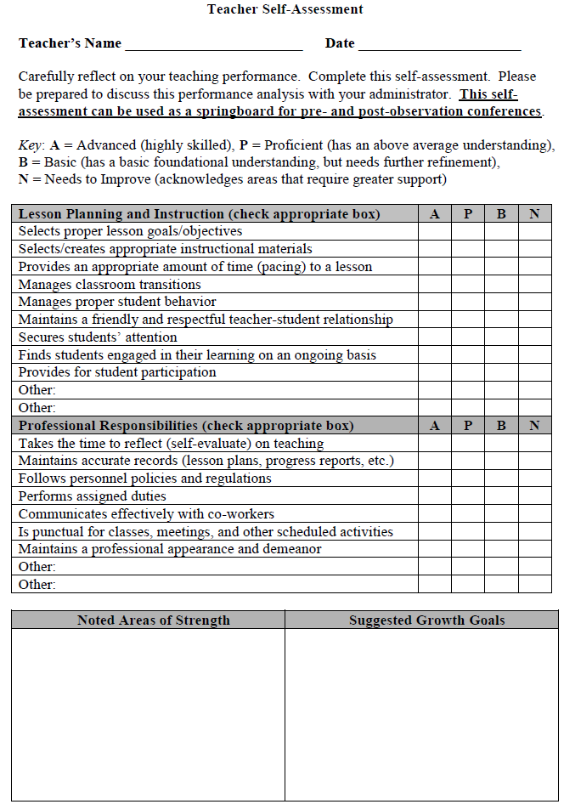
The Reflective Teacher: Self-Assessment

Slide 13
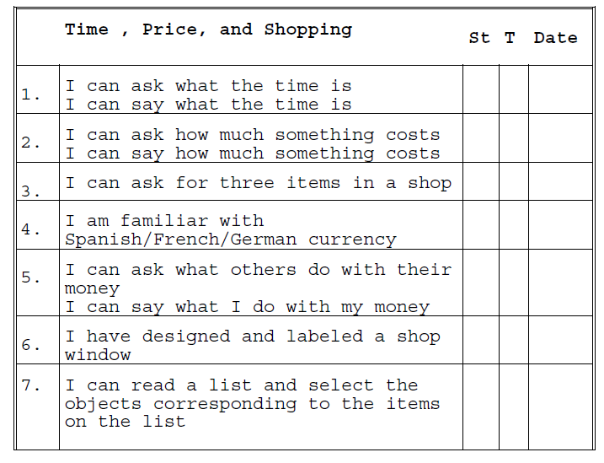
Self-Assessment Sample: Student-Friendly Student(St)/Teacher(T) checklist with follow-up conference

Slide 14
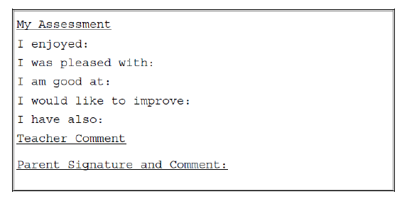
Self-Assessment Sample: Student-Friendly (cont.)

Slide 15
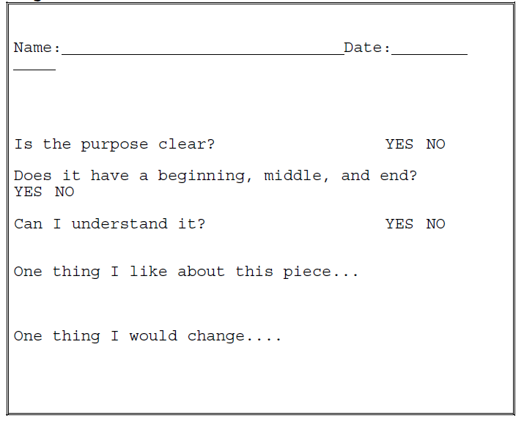
Peer Observations Peer assessments involve students in the evaluation of each other's work according to a set of criteria.

Slide 16
Reality Check
Is the use of authentic assessments…
something you see the value in (as a teacher and/or teacher trainer)?
Why or why not (e.g., teaching style, cultural hindrance)?
If yes, what is one way you could implement this assessment?
able to be utilized in the current educational environment?

Slide 17
ENGLISH LEARNER ORAL ASSESSMENT -- EFL Proficiency Assessment --
The Oral Assessment (OA) assesses a student’s oral/aural abilities in English. This includes the student’s listening comprehension of English sounds, sequence, intonation, vocabulary, and grammar, as well as the student’s ability to respond orally in those areas. Both aspects—listening comprehension and speaking—determine scoring.
For additional assessments please go to my website
www.robdanin.com

Slide 18
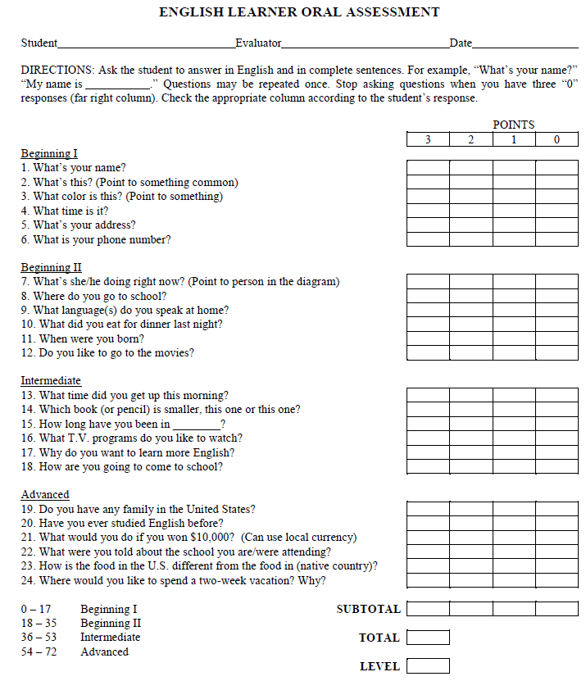
ENGLISH LEARNER ORAL ASSESSMENT: Protocol

Slide 19
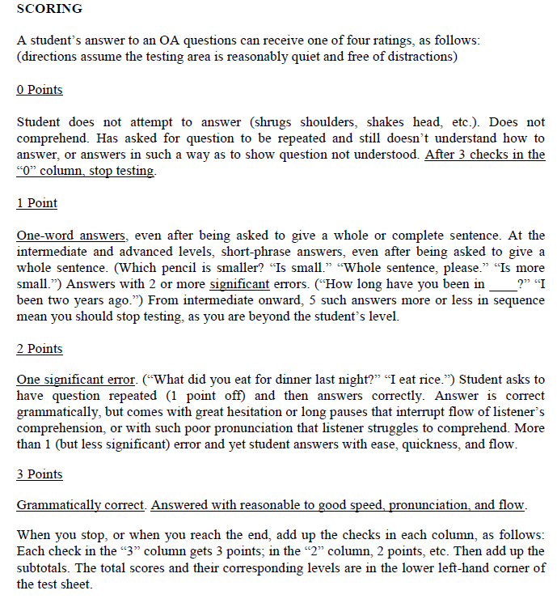
ENGLISH LEARNER ORAL ASSESSMENT: Scoring

Slide 20
Home Language Surveys (HLS)
HLS can be a important part of the battery of assessments in helping to determine the level of English proficiency and corresponding placement in EFL) programs for ELLs (Bailey and Kelly, 2010).
This protocol is generally considered an initial step in the identification of students needing support services in learning English.
The HLS can serve as an important first step towards an accurate portrayal of those needing EFL support services (Goldenberg and Quach, 2010).
For many schools, the HLS is the only source of information used to determine the EFL needs of the ELL student.

Slide 21
Home Language Surveys (HLS)
Word of caution…
Some HLS may have too few items to be meaningful for decision-making purposes.
Researchers have raised a concern regarding the lack of valid results generated by the current use of HLS (Bailey and Kelly, 2010; Zehr, 2010).
Therefore, the ELL student can very well be under or over identified for proper EFL services.
This survey can and should be used as part of a set of multiple criteria in diagnosing and rating ELL students’ level of English proficiency (Abedi, 2004).

Slide 22
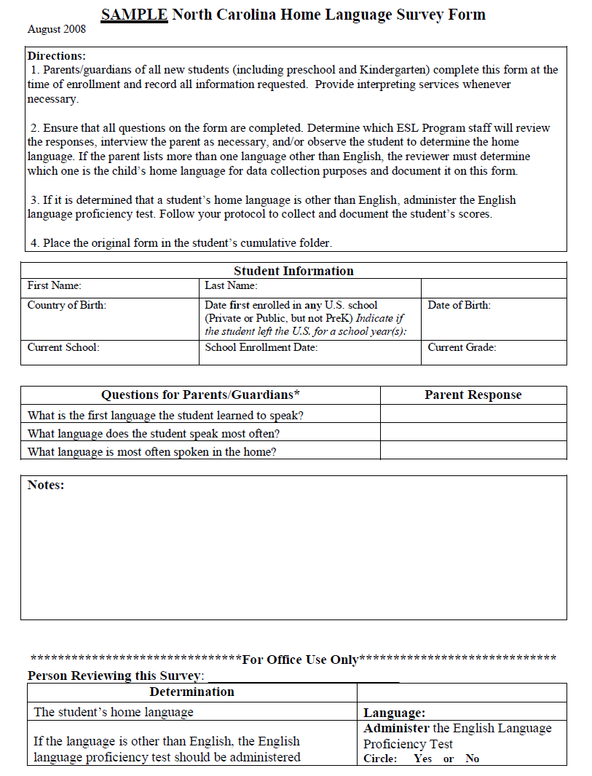
Sample: Home Language Survey (HLS)

Slide 23
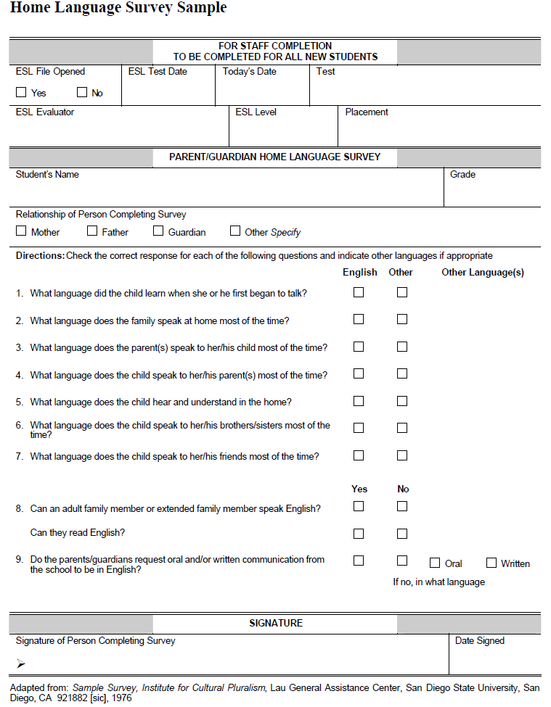
Sample: Home Language Survey (HLS)

Slide 24
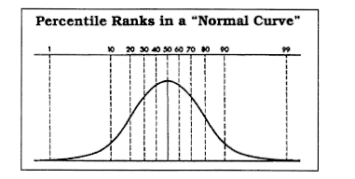
Standardized Tests: Norm-Referenced “Norm-referenced” tests that compare a person's score against the scores of a group of people who have already taken the same exam, called the norming group. Renorming of tests occurs about every 7 years. Otherwise the “bell-shaped curve” would be skewed to the high end. Students are getting smarter!
Types of Norm-Referenced Standardized Tests TOEFL Graduating Exams TOEIC IQ Tests
Language Proficiency Tests (some)

Slide 25
Standardized Tests: Norm-Referenced
Appropriate Uses of Standardized Achievement Tests
Informing parents about their children’s relative achievements
Informing teachers about their students’ relative achievements
Selecting students for special programs (comparative needs with limited resources)
Inappropriate Uses of Standardized Achievement Tests
Evaluating schools (high-stakes)
Evaluating teachers (high-stakes)
Promoting or grading students (high-stakes)
Making classroom instructional decisions

Slide 26
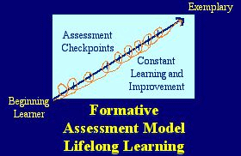
Standardized Tests: Criterion-Referenced

Slide 27
Standardized Tests: Criterion-Referenced
A criterion-referenced test is one that provides scores of an individual based on their level of understanding of a specified subject matter.
Scores on criterion-referenced tests indicate what individuals can do — not how they have scored in relation to the scores of particular groups of persons, as in norm-referenced tests.
Most tests and quizzes written by school teachers are criterion-referenced tests.
CRT should be based on relevant, high-quality standards , curriculum and instruction.

Slide 28
Standardized Tests: Criterion-Referenced
Appropriate Uses of Criterion-Referenced Tests
Criterion-referenced tests are more suitable than norm-referenced tests for tracking the progress of students within a curriculum.
Criterion-referenced tests can be developed at the classroom level.
Test items can be designed to match specific program objectives.
The scores on a criterion referenced test indicate how well the individual can correctly answer questions on the material being studied.
If the standards are not met, teachers can specifically diagnose the deficiencies.
Test results can be quickly obtained to give students effective feedback on their performance.

Slide 29
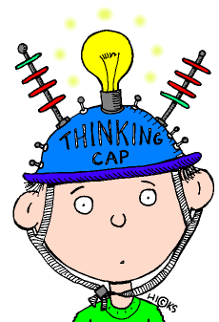
Standardized Tests: Criterion-Referenced
Inappropriate Uses of Criterion-Referenced Tests
Creating tests that are not both valid and reliable.
Test results cannot be generalized beyond the specific course or program.
Criterion-referenced tests are specific to a program and cannot be used to measure the performance of large groups.

Slide 30
Standardized Tests Comparisons
Norm-Referenced
Criterion-Referenced
Cultural/socio-economic status bias
Focus on one 'right answer'
Judgment without suggestions for improvement
Pressures teachers to narrow teaching to what is tested
Focus on lower-order knowledge and skills
Does not allow students to interact
More culturally fair
Possibility of several perspectives
Useful information for improving/guiding learning
Allows teachers to develop meaningful curricula
Emphasis on higher-order learning outcomes and thinking skills
Encourages collaborative learning

Slide 31
Reality Check
In what educational settings should a teacher use norm-referenced standardized tests to measure their students’ understanding?
In what educational settings should a teacher use criterion-referenced tests to measure their students’ understanding?

Slide 32
Implications for Educators
When using any assessment approach to instruction, the need for greater understanding on how to properly assess student progress is vital.
When utilizing multiple assessments within their instructional setting, educators need to accept the responsibility of fully comprehending both the varied content areas and which assessment(s) are the most appropriate to gauge the learner’s understanding.
A central consideration of proper assessment practices should focus on the improvement of teaching and student learning.

Slide 33

Website www.robdanin.com
Thank you

