Slide 1
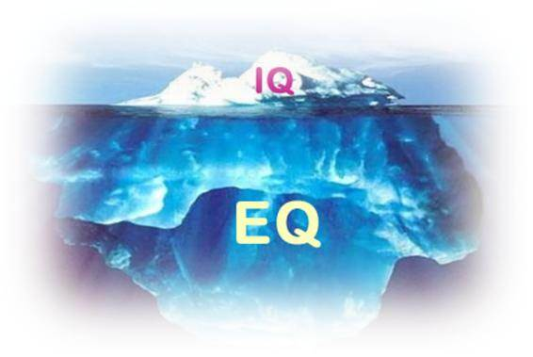
Emotional Intelligence (EI/EQ) in the Learning Environment
Dr. Rob Danin
English Language Specialist
www.robdanin.com

Slide 2
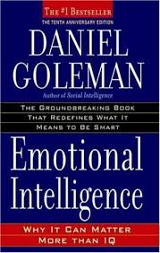
Emotional Intelligence (EI)
“The capacity for recognizing our own feelings and those of others, for motivating ourselves, for managing emotions well in ourselves and in our relationships.”
(Goleman, 1995)
Notes:
Different definitions of EI exist and can be found within the psychological literature. One widely used definition above is derived from the work of Goleman (1995).
EI is the ability to understand your own emotions and those of people around you. The concept of EI means you have a self-awareness that enables you to recognise feelings and helps you manage your emotions. A person with a high EI is also capable of understanding the feelings of others and, therefore, is better at handling relationships of all kinds.
If a person is 'intellectually' intelligent, it does not necessarily follow they are emotionally intelligent. Having a good memory, or good problem-solving abilities, does not mean a person is capable of dealing with emotions or of motivating themselves.

Slide 3

EI Definition
A form of social intelligence that involves the ability to monitor one’s own and others’ feelings and emotions, and to use this information to guide one’s thinking and action.
“All learning has an emotional base.”
(Plato)

Slide 4
Emotional Intelligence (EI/EQ): Daniel Goleman (1995)
Affective Education: Emotions and feelings of inadequacy tend to be stronger when students learn a foreign language. (Genesee, et al., 2006)
Teachers need to create a learning environment that promotes emotional security
Intelligent use of one’s emotions
Teachers set the emotional tone of the classroom
Based on brain research: passion, motivation, commitment
Self-directed learning
The ability to be self-aware
The ability to manage oneself
Encourages motivation to develop one’s abilities by celebrating one’s strengths rather than focusing on weaknesses
Provides an intrinsic motivation to learn

Slide 5
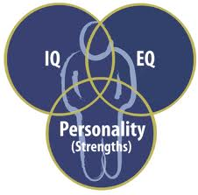

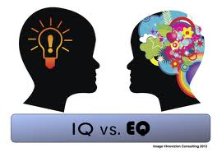
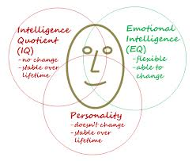
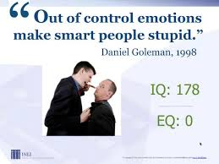
IQ EQ
EQ is a more reliable predictor of academic achievement than is IQ. (Goleman, 1995)

Slide 6
What is Emotional Intelligence (EI)?
EI is the ability to...
perceive emotions by both teacher and student.
understand complex emotions and emotional knowledge.
access and generate emotions so as it assist thought.
reflectively regulate emotions so as to promote emotional and intellectual growth.
Notes:
EI is viewed in two separate ways.
Trait EI reports on one’s beliefs about EI skills. Trait EI is measured using personality-type self-report measures which provides us with information about how people THINK they are at EI skills.
Ability EI views EI as a global ability, which joins together specific and individual abilities and is measured using traditional general ability-type measures, similar to IQ tests. An individual’s responses are compared to those provided by an expert in the field – so there are right and wrong answers.
The abilities involved in EI include the ability:
to perceive emotions (so, the ability to recognise how you and those around you are feeling)
to access and generate emotions so as to assist thought (this will include also the ability to reason with the emotion that is generated)
to understand complex emotions and emotional knowledge (this includes the ability to understand emotional ‘chains’ , so how emotions move
from one stage to another)
to reflectively regulate emotions so as to promote emotional and intellectual growth (here we are talking about the ability to manage emotions
in yourself and in others).

Slide 7
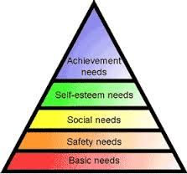
EI/EQ & Maslow’s Hierarchy of Needs

Slide 8
Four Basic Components of EI
Self -
awareness
Empathy
Motivation
Social Skills
Notes:
Looking now in more detail about EI and using a Four-Branch Model of EI (Boyatzis & Goleman, 2005), EI comprises four clusters of competencies that work together: our self-awareness underpins our self-management and social awareness, which in turn underpin our capabilities in relationship management – our positive impact on others.
Therefore, each of the EI competencies is important. The competencies in the self-awareness cluster are particularly important as the foundation for developing and sustaining EI in the long-term.
Examples of competencies that may fall within each cluster:
Self-awareness: self-confidence, accurate self-assessment, emotional self-awareness
Social awareness: empathy, responsiveness to others, organizational awareness
Self-management: adaptability, emotional self-control, positive outlook, initiative
Relationship management: conflict management, inspirational leadership, influence, teamwork

Slide 9
Components of Emotional Intelligence
 | Definition | Attributes
Self Awareness | The ability to recognize and understand your moods and emotions well as their effects on others | -- Self-confidence -- Realistic personal growth -- Comfort with ambiguity -- Openness to change -- Sense of humor
Motivation | A passion to work for reasons that go beyond money or status The propensity to suspend judgment – to think before acting | Strong drive to achieve Optimism, even in the face of failure
Empathy | The ability to understand the emotional makeup of other people Skill in treating people according to their emotional reactions | Expertise in building ones’ learning abilities Cross-cultural sensitivity
Social Skills | Proficiency in managing relationships An ability to find common group & build rapport | Effectiveness in working with others Developing influence and confidence by others

Slide 10
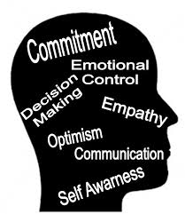
Education and EI
Creates a “relationship-centered” [student-centered] approach to education
Has the potential to be considerably more motivating for students
Students cope better with transitions
Lower drop out from secondary
school and university
Higher academic qualifications
Better career prospects
When students perceive that their teachers are competent and caring, then they are less likely to cheat in those classrooms.
Notes:
When looking specifically at EI and education.
Literature to support these statements are provided in other areas on the website.
These slides provide a basic overview of EI. Further detail is available within the website if required.

Slide 11
How Can Teachers Use Emotional Intelligence?
Pay attention to self and other’s body language
Listen more; speak less - develops empathy
Get curious, not furious - Watch what you say especially when frustrated or annoyed. Reframe negative emotions can be replaced with, "Do you see something in this that I must have missed?”
Elicit pride in others – Reason for working together
Remember that emotions are contagious - A person's emotions (negative or positive) always influences others. Teachers should be careful to show only those emotions, which they want to see in others (The Golden Rule).

Slide 12
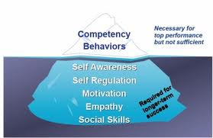
What educators can do to stimulate EI skills in their students
CLEAR COMMUNICATION
EMPATHY
SELF AWARENESS
DECISION MAKING
PROBLEM SOLVING
SHARING
PATIENCE
LISTENING
CARING
GETTING ALONG WITH OTHERS
GENTLENESS
PERSEVERANCE
SELF MOTIVATION
SELF CONTROL

Slide 13
EI = Social-Emotional Learning
Social-emotional learning helps students build resiliency and learn from failure. It helps them make the best choices in life.
Social-emotional Competencies are: • Self-awareness - the ability to recognize one's own feelings, interests and strengths • Self-management - skills allow individuals to handle daily stresses and control their emotions under difficult situations • Social awareness - allows individuals to take other perspectives into account and to empathize with others • Relationship Management - allows students to develop and maintain healthy relationships with others and seek help when needed • Responsible decision making - enables students to keep in mind respect and safety concerns when making decisions

Slide 14

EI & EFL
Emotional intelligence is a factor in second language learning.
Enhance the integration of cognition with affect
EI involves "knowing what one’s feelings are and using that knowledge to make good decisions." (Goleman, 1995)
This includes the ability to maintain hope and an optimistic outlook in the face of disappointments and difficulties [a common occurrence for many SLLs].

Slide 15
EI Educational Practices
• Student-Centered Discipline • Responsibility and Choice • Warmth and Support (Teacher and Peer) • Cooperative Learning • Classroom Discussions • Self-Reflection and Self-Assessment • Balanced [Varied] Instruction • Realistic Academic Expectations • Modeling, Practicing, Feedback, Coaching
There are valuable lessons in “failing”.
Mistakes can teach us that it is not that we are bad at something, just that we have to try a different method to find success. It teaches “resilience”.

Slide 16
EI Educational Techniques
Ice breakers (to enable students to get to know each other)
Warm ups/Sponge Activities (to generate interest in/review of the lesson)
Providing varied learning activities (this maintains interest and also allows for different learning styles)
Brainstorming and discussion - encourages the sharing of knowledge and opinions

Slide 17
EI Educational Techniques
Role-playing and simulations that are related to the real world
Promoting group/project work that encourages cooperation (e.g., Cooperative Learning)
Providing feedback (use of continuous assessments to help determine students' academic progress in the subject area)
Managing expectations (relates to giving feedback and making students aware of what is expected)

Slide 18
EI Educational Techniques
Introduce journal writing. This familiar educational tool can be an effective way to help students develop self-awareness along with developing writing skills.
Emphasize responsibility. Helps to encourage a sense of responsibility (e.g., organized classroom tasks).
Encourage creativity. Creativity is most necessary in times of emotional hardship, such as when we're frustrated or angry. Provide students with ongoing opportunities to express their creativity.
Institute classroom meetings. This can provide numerous opportunities to support social and emotional learning. It helps build a sense of community, creates a climate of trust, and encourages respectful communication.
See next “Responsive Classroom Methods“ slide

Slide 19
Emotional Intelligence (EQ/EI): Responsive Classroom Methods A Sense of Community
The goal is to help create a culture where students care about each other, their school/classroom and their learning.
Designed to improve the ways teachers interact with students and the way the students interact with each other.
Classroom Meetings can be used to build “classroom community”
Gets students ready for the lesson
goals/objectives/outcomes
Helps in providing ‘calm and smooth’ classroom transitions
Reinforces the proper use of social skills among the students
Learn the students' names, ask about their lives outside of class, offer to help with assignments, offer more opportunities for student choice and voice in the classroom.
Students' perceptions of their school can also affect cheating behavior.
When students perceive feel like they belong in the school community they are less likely to cheat.

Slide 20
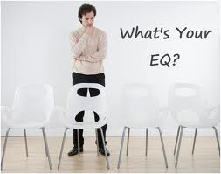
EI/EQ Quiz (Body Language)
http://greatergood.berkeley.edu/ei_quiz/

Slide 21
How to Improve Our EI
Observe how we react to people.
Try to put ourself in their place, and be more open and accepting of their perspectives and needs.
Do continuous self-evaluation. What are our weaknesses? Strengths?
Examine how we react to stressful situations.
Take responsibility for our actions.
Examine how our actions will affect others. Would we want to experience those actions?

Slide 22
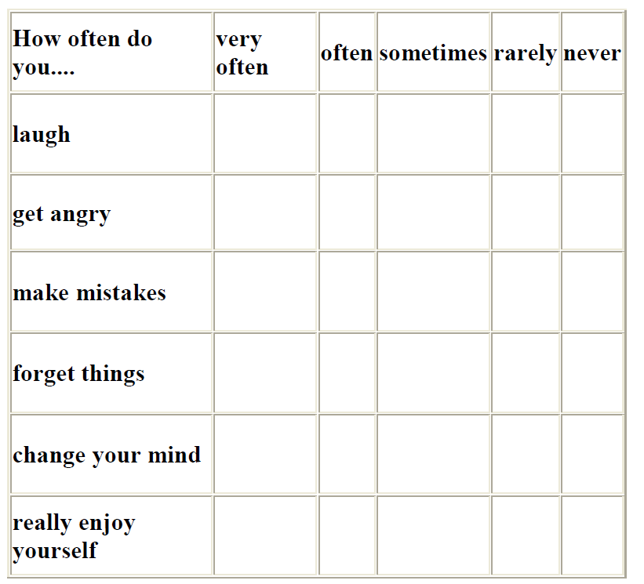
EI Classroom Survey
Can be used to promote self-awareness and open communication

Slide 23
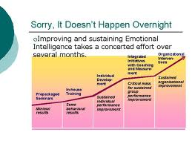
EI Growth Over Time

Slide 24

EI Can Be Developed at Any Age
Age and maturity are positively correlated with EI
Children develop emotional intelligence during the first 15 years of life as they mature. (Goleman, 1995)
Emotional intelligence skills allows us to be more effective both professionally and personally.

Slide 25
EI/EQ Group Discussions
Group 1
What approaches do you use to build a safe and caring learning environment?
Group 2
What instructional strategies do you use to improve the learner’s ability to express emotions appropriately. Make responsible decisions, and solve problems effectively?
Group 3
How can you integrate social-emotional learning with traditional academics to enhance learning?

Slide 26

In Summary…
Emotional Intelligence is the ability to:
recognize your emotions, understand what they're telling you, and realize how your emotions affect people around you.
understand your perception of others: when you understand how they feel, this allows you to manage relationships more effectively.

Slide 27
In Closing…
How would you like students to relate to one another within your classroom/behavior management system?
How much choice will you give students within your classroom/behavior management system?
“Top 10 Qualities of an Effective Teacher” (2:33)
https://www.youtube.com/watch?v=kQORgscVLcs

Slide 28

Enjoy having…
www.robdanin.com

