Slide 1
Essay Writing
&
Personal Statements
Tips
Dr. Rob Danin
English Language Specialist
www.robdanin.com

Slide 2
Creating a Writing Environment
Writing occurs when…
Writing is valued
By both teacher and student
Students write frequently and authentically
Meaningful and purposeful to the student
The learning environment is language/literature rich
Examples of good writing, exposure to books and other literature contexts
Students use various writing styles
Personal narratives, reports, informative pieces, poems, etc.

Slide 3
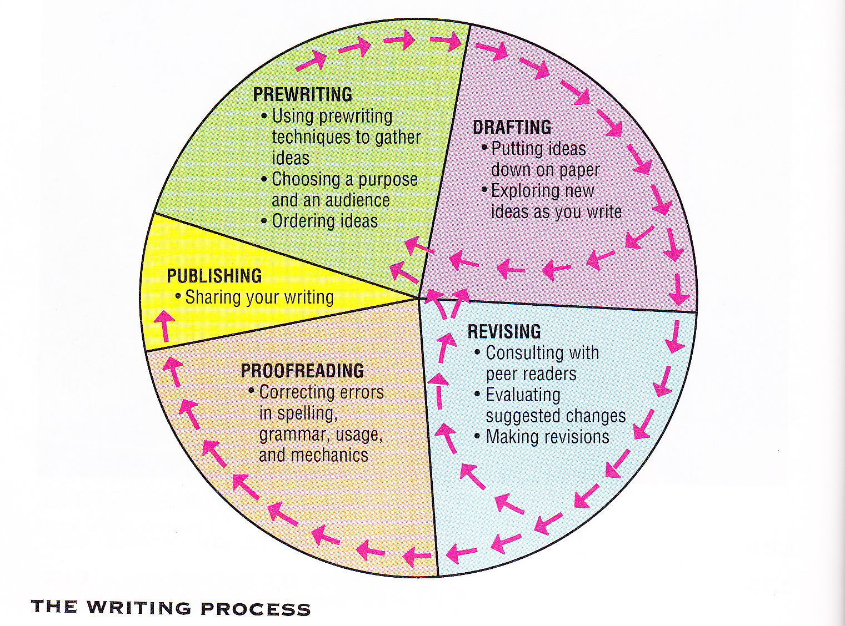
The Writing Process

Slide 4
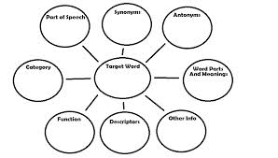
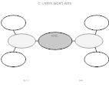
The Writing Process: Prewriting Tips
Teachers need to provide…
Talking and listening time
Including language experience activities
Exposure to literature
Age and language proficiency appropriate (to include predictable and illustration-based reading materials)
Drama activities
Role playing, storytelling, puppetry, etc.
Tapping into pre-existing (background) knowledge
Brainstorming, word webbing

Slide 5
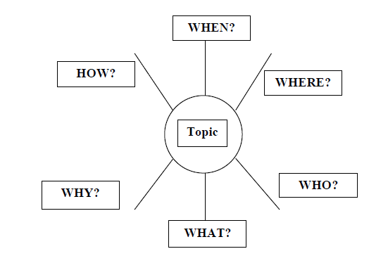
The Writing Process: Drafting Tips
Students writing quickly to get their ideas down on paper…
Model writing for your students
Teacher writes while students write
Encourage students to “spell as best they can”
Worry about the mechanics of writing (grammar, punctuation) later
Provide daily writing experiences
Keeping journals and learning logs
Teach and encourage the use of outlining strategies
Sunshine Outline

Slide 6
The Writing Process: Revising/Proofreading Tips
Suggested activities…
Share and discuss samples of various levels of writing abilities
Use anonymous samples of your or students’ writing
Use conference groups to help in the revision process
Positive feedback, Questions to clarify meaning, suggestions to “Polish” writing (PQP)
Have students read their writing aloud
Helps students to evaluate their own writing (thinking out loud)
Teacher-led demonstration of revision techniques
“Mini-lessons” that stresses the varied qualities that make up good writing (conventions, voice, word choice, transitions, etc.)

Slide 7

The Writing Process: Publishing Tips
Publishing students’ writing provides an authentic reason to write. Here are some ways of publishing…
Displaying writing on wall and halls
Reading students’ writing aloud
Making a video of students reading their pieces of their work
Binding writing into individual books; have students create their own book covers
Making class books to be checked-out library fashion

Slide 8
Other Writing Considerations
Devote time to write on a regularly scheduled basis.
Give permission to the students to write about whatever they want.
Writing without being graded allows greater freedom of expression.
Writing without fear of consequences helps the students develop their own writer’s “voice”. Play with language!
Encourage students to incorporate art in their writing to enhance visual thinking.
Writing and reading go together. If students write well, they will be more excited about reading.
Recognize varied forms of writing:
Academic, creative, journalistic, digital (e-mail, Twitter, SMS)

Slide 9
Anecdotal Comments on Writing Foreign language teachers from the RFE
What do teachers struggle with in the teaching of writing?
Writing skills should be stressed more through the teaching of reading.
Teacher training programs need to continue to teach writing as a subject that stresses both the process and product.
Need to have students write on a daily basis. This also helps in preparing for the Unified State Exams.
Writing is the “Cinderella” skill (“step-child”) of the 4 skills (speaking, reading, listening, writing). Is used as a means for the other 3 skills. Speaking skills stressed more than writing.
Russia is based on an oral tradition (Tolstoy emphasized this).

Slide 10

Writing Resources www.robdanin.com
Writing Process Diagram
Academic Writing Tips and Checklist
Language Experience Approach (LEA) to Basic Writing
Low-Stakes Writing Exercises - 3 Tips to Get Started
Writing Online Resources

