Slide 1
Homework Reasons and Rationale
Dr. Rob Danin
English Language Specialist
www.robdanin.com

Slide 2
Why Give Homework?
To enhance what a student has learned in the classroom though practice
To provide the opportunity to deepen understanding and skills relative to what was previously learned
Extends learning beyond the class session
Note: It has been found that students typically need 24 study practices (not only homework, however) before they reach an 80% academic competency level.

Slide 3
Purpose of Homework
The purpose of homework should be identified as:
Focused Practice: targets particular skills that are familiar to the student
Writing skills
Sentence forming
Preparation: to begin thought process on a subject matter & Elaboration: clarify a topic introduced
The study of idioms

Slide 4
Here’s a test of your short-term memory
Read (please do not write) the following sequence silently, pausing at each dash:
IC-EDV-DC-ATD-OGL-OW
Write down any letters from this sequence that you can remember.

Slide 5
Now read the following sequence silently (again, please do not write), pausing at each dash:
ICE-DVD-CAT-DOG-LOW
Now write down any letters from this sequence that you can remember.

Slide 6
Take another look at the two sequences:
IC-EDV-DC-ATD-OGL-OW
ICE-DVD-CAT-DOG-LOW
Notice anything?
The letters are the same in each sequence.
Yet, you most likely found it a lot easier
to remember the second sequence. Why?

Slide 7
Most people can hold up to 7 meaningful pieces of information in their short-term memory. Meaningful pieces of information could be numbers, words, faces, objects, or any other “chunks” of information. While short-term memory is important, it is long-term memory that really matters when it comes to learning. How does short-term memory become long-term memory?

Slide 8
Practice (including homework) of information is required to convert short-term memory into long-term memory. Without practice, short and therefore long-term memory are forgotten.
new information
usually lost
short-term memory
rapid retrieval
practice
forgetting
remembering
slower retrieval
long-term memory

Slide 9
Teacher Feedback
Effects of homework depend greatly on teacher feedback:
Homework not commented on = 28% effective
Homework verbally commented on = 78% effective
Homework with written comments = 83% effective
Therefore, if homework is assigned it should be commented on by the teacher.

Slide 10
Assigning Homework
Design homework assignments that are purposeful and with an expected outcome
Give homework for a reason
Plan for it as you would any other part of your lesson
Provide homework based on skills and concepts already taught in class, not new material
Vary the approaches to provide feedback
For example: verbal, written, peer, rubric
Determine the weight of the grade for out-of-classroom assignments
Establish and communicate a homework policy

Slide 11
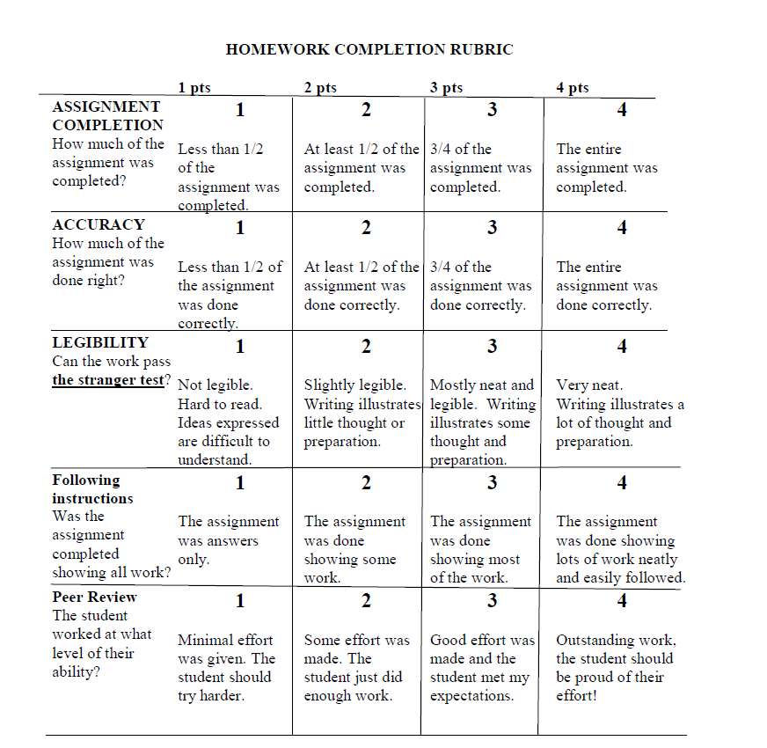

Slide 12
Homework Policy
States the purpose of the homework
Amount of homework that will be assigned
Consequences for not completing the homework
Description of the types of outside involvement that are acceptable
Having a policy will increase the likely-hood that the homework will have more of an impact and will enhance the student’s learning.

Slide 13
Homework Tips
Make it relevant
Don't assign homework at the end of class
Provide feedback
Correct it on your own as the teacher
Go over it as a class
Students can check their own or exchange papers
Teachers assign up to 10 minutes per night per
grade

Slide 14
EFL Homework Suggestions
Learning vocabulary words:
Find out what part of speech they are.
Find the translation of these words into their native language.
Write a simple definition, without copying from the dictionary.
Write a sentence using each one.
Read their sentences aloud to someone.
Read and record their sentences. Listen to that recording.
Write a story using all the vocabulary words.
Read their story aloud to someone.
Read and record their story. Listen to this story.

Slide 15
EFL Homework Suggestions
Relevant homework assignments:
Creating a study schedule
Listing their personal goals
Making predictions about their after-school future
Asking students to read an (online, newspaper, magazine) article, then tell the class about it and give their opinion on what they read.
Asking students to watch something(news, movies, interviews, YouTube, etc.) then share with the class what they remember or what their opinion is.

Slide 16
What’s Being Said About Homework…
Vigorous scrutiny of the research, they argue, fails to demonstrate tangible benefits of homework, particularly for elementary students. What it does instead, they contend, is rob children of childhood, play havoc with family life and asphyxiate their natural curiosity. Learning becomes a mind-numbing grind rather than an engaging adventure.
"Researchers have been far from unanimous in their assessments of the strengths and weaknesses of homework as an instructional technique”, summarized the Journal of Educational Psychology. Their assessments ranged from homework having positive effects, no effects, or complex effects to the suggestion that the research was too sparse or poorly conducted.

Slide 17
What’s Being Said About Homework…
Proponents cite evidence suggesting that homework instills responsibility, and they note that learning would proceed at a sluggish pace if class time were consumed with students reading novels, memorizing vocabulary or writing research papers -- assignments better accomplished at home. [“Flipped Teaching”: see more on this at www.robdanin.com]
Opponents counter with evidence that homework’s' dictatorial nature undercuts responsibility, generates family conflict, and takes away time for creative play and natural learning.
But at a tipping point, too much homework actually seemed to have a negative effect. SFGate.com

Slide 18
Try these two on-line tests...
Want to test your short-term again?
http://faculty.washington.edu/chudler/puzmatch.html
http://faculty.washington.edu/chudler/stm0.html

Slide 19

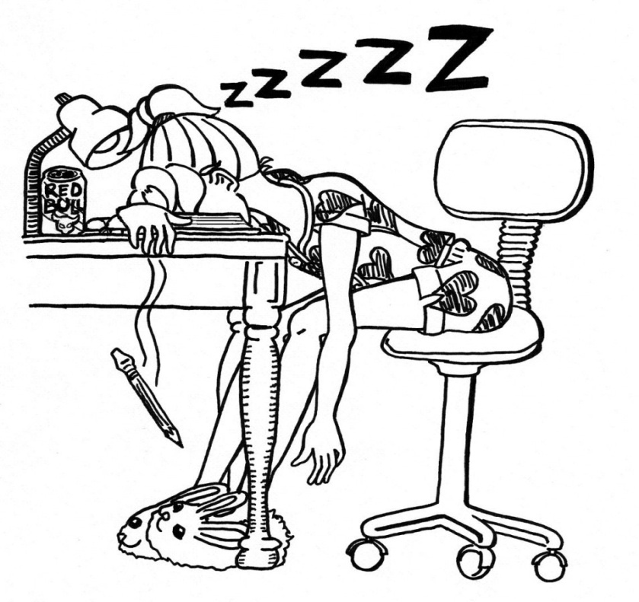
Let’s hope homework doesn’t come to this?!?! www.robdanin.com

