Slide 1
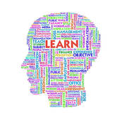
Dr. Rob Danin English Language Specialist www.robdanin.com
Learning Styles:
It’s In All of Us

Slide 2

The Bottom line…

Slide 3
By the Numbers
Rief (1993) says that students retain:
10% of what they read
20% of what they hear
30% of what they see
50% of what they see and hear
70% of what they say
90% of what they say and do

Slide 4
Student Learning
Cognitive – visual, auditory, or psychomotor learning
Affective – a personal approach to learning (socio-emotional)
Physiological – individual learning preferences (e.g., “Quiet” deep thought, reflection)
Students vary dramatically in the way they process and understand information.
These differences, called “learning styles”, refer to students’ preferences for some types of learning activities over others.
A student’s learning style has to do with the way he or she processes information in order to learn and apply it.
Students who understand their own styles are likely to be better learners.

Slide 5
Learning Styles
Teachers who understand their students’ learning styles are better able to adapt their teaching methods appropriately.
Most people exhibit some combination of learning style or prefer one style to another depending on the type of learning task they are undertaking.
Visual learners—prefer to study graphs, look at models and pictures, and take notes to review later
Auditory learners—prefer to listen closely in class, read aloud when studying during lectures in class, or confer with peers in class to confirm information
Verbal learners—likely to absorb reading materials and lectures easily, prefer written materials over visual materials such as graphs and illustrations
Tactile learners—learns through moving, doing, touching (hands-on methods), manipulating materials and objects (realia)

Slide 6
Learning Styles: A Quick Review
Personalized Instruction: The effort to organize the learning environment to take into account individual student characteristics and needs and to make use of flexible instructional practices.
To help students to recognize their cognitive strengths and weaknesses
To adapt the learning environment and instruction to learner’s needs and interests
Cultural differences: Learning occurs in social/cultural environments. Therefore, access to varied instructional resources to ensure multiple perspectives is vital.
Gender differences: Cognitively “wired” to learn differently
Can be measured by a variety of assessments (e.g., “Learning Styles Inventory”)

Slide 7
Learning styles approaches
Multiple Intelligences (MI): Howard Gardner Frames of Mind (1983)
Linguistic intelligence: sensitivity to spoken and written language, the ability to learn languages. For example:
Logical-mathematical intelligence: capacity to analyze problems logically, carry out mathematical operations, and investigate issues scientifically. For example:
Musical intelligence: involves skill in the performance, composition, and appreciation of musical patterns. For example:
Bodily-kinesthetic intelligence: potential of using one's whole body or parts of the body to solve problems. For example:
Spatial intelligence: potential to recognize and use patterns.
For example:
Interpersonal intelligence: capacity to understand the intentions, motivations and desires of other people. For example:
Intrapersonal intelligence: capacity to understand oneself.
For example:

Slide 8
Learning styles approaches
Multiple Intelligences (MI): Other possible intelligences
Naturalist intelligence: enables human beings to recognize, categorize and draw upon certain features of the environment.
For example:
Existential intelligence (spiritual intelligence): concern with 'ultimate issues‘. For example:
Moral intelligence: adoption of any specific moral code regarding personality, individuality, will, character and the realization of human nature. For example:
MI Professional Development Considerations
Create lessons that cultivate MI in the classroom.
Do you have an inclination towards any particular MI attribute(s)? If so, notice whether these influence your instructional approach. The same goes for Learning Styles. If so, in what ways?

Slide 9
Learning Styles: Teaching Methodologies
Provide a balance of concrete information (facts, data, and experimental results) and abstracts concepts (principles, theories, and models.). Teaching as a science.
Balance materials that emphasize practical problem-solving methods with materials than emphasizes fundamental understanding.
Use pictures, graphs, and other visual cues before, during and after the presentation of verbal material.
For the auditory learner, paraphrasing is a powerful strategy for making material meaningful.
For the tactile learner, role playing is a useful comprehension strategy.
Bottom line: Only meaningful information is transferred to long term memory.

Slide 10
Advice for Visual Learners
Use visual materials such as pictures, charts, and maps
Use color to highlight texts and own notes
Take notes or use handouts; look carefully at headings and patterns of topics
Brainstorm using illustrations, mind maps and models
Use multi-media where possible (computers; mind maps)
Study in a quiet place away from visual disturbances
Visualize information as a picture
Skim-read to get an overview before reading in detail

Slide 11
Advice for Auditory Learners
Participate frequently in discussions and debates
Make speeches and presentations
Use a tape recorder if possible instead of (or as well as) making notes
Read text aloud
Discuss your ideas verbally
Dictate to someone else while they write your ideas down
Speak onto an audio-tape and listen to your own ideas played back.
Create musical jingles and mnemonics* to aid memory
* One example is the Russian word for cow (корова, pronounced roughly karova): think and visualize "I ran my car over a cow."

Slide 12
Advice for Tactile Learners
Take frequent study breaks
Move around to learn new things (e.g., read while you are using an exercise bike; model in clay to learn a new concept)
Stand up to work
Use bright colors to highlight reading material and turn it into posters or models
Skim-read before reading in detail

Slide 13
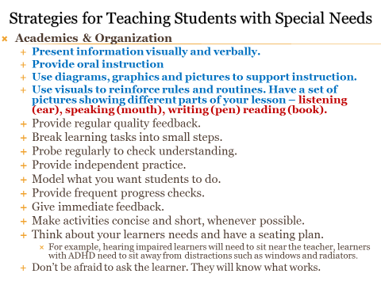

Slide 14
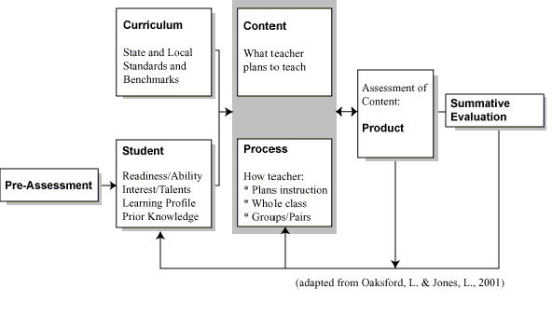
Learning Styles: Curriculum Development

Slide 15
Learning Styles: Materials Development
How to?
Examples:
Determine the ability level of your students
Align tasks and objectives to learning goals
Survey student interests/learning styles
Interest Inventories, Interview/Conference, respond to Open-Ended Questionnaire
What are your student’s preferences and motivators?
Brain-based research
Know YOUR students
Use instructional materials at varying readiness levels
Put text materials on tape
Use Study Buddies
Meet with small groups to re-teach a concept or skill for struggling learners or to extend learning

Slide 16
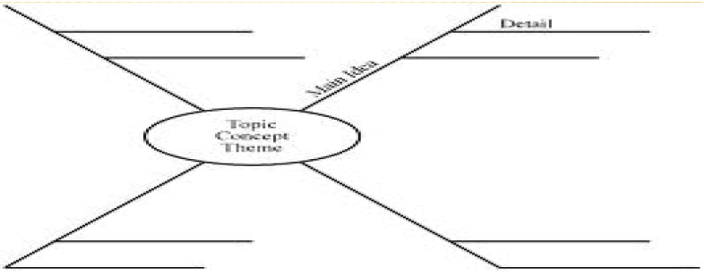
Learning Styles: Differentiated Instruction
Customized lessons in order to meet students’ varied learning needs
Tiered Activities
Develop Personal Agendas for Completion of Work
Self Talk-”Here’s my plan for how to complete this project.”
Manipulatives (or) Hands on Supports
Varying the Length of Time (Pacing)
Memorization
KWL
Reciprocal Teaching
Creating dioramas
Constructing mathematical models
Developing photos
Debating
Semantic Webbing/Graphic Organizers

Slide 17
Understanding your Learning Style
Partner Activity
It is unlikely that your style of learning will be the same as everyone else.
Take turns with your partner to memorize and share these two groups of letters:
aaysa
smjptc
Now ask each other how you went about the task.
aaysa
smjptc
Did you make the letters into words, and memorize the sounds ‘ay-sir’ and ‘smidge-ptk’?
Did you memorize the visual pattern made by the letters?
Did you make a mnemonic, like ‘anarchists annoy your sour aunt’ or ‘smart mice jump past the cat’?
Did you use some other strategy?

Slide 18
Understanding your Learning Style
Each of us has our own strategies for such mental tasks.
Does this tell you anything about ways of approaching learning?
If you read the two groups of letters (starting with the bottom right letter and zig-zagging as you read towards the left) it spells ‘cats pyjamas’.
aaysa
smjptc

Slide 19
Understanding your Learning Style
Group Activity
Try and spot the pattern in this group of letters:
acegijlnprtvxz
If you see the pattern, please do not share right away.
Every second letter has been omitted until ‘i’ which is immediately followed by ‘j’, then the pattern resumes from there.
How did you go about spotting this pattern?
We are all likely to have a preference in solving cognitive activities (learning style).

Slide 20
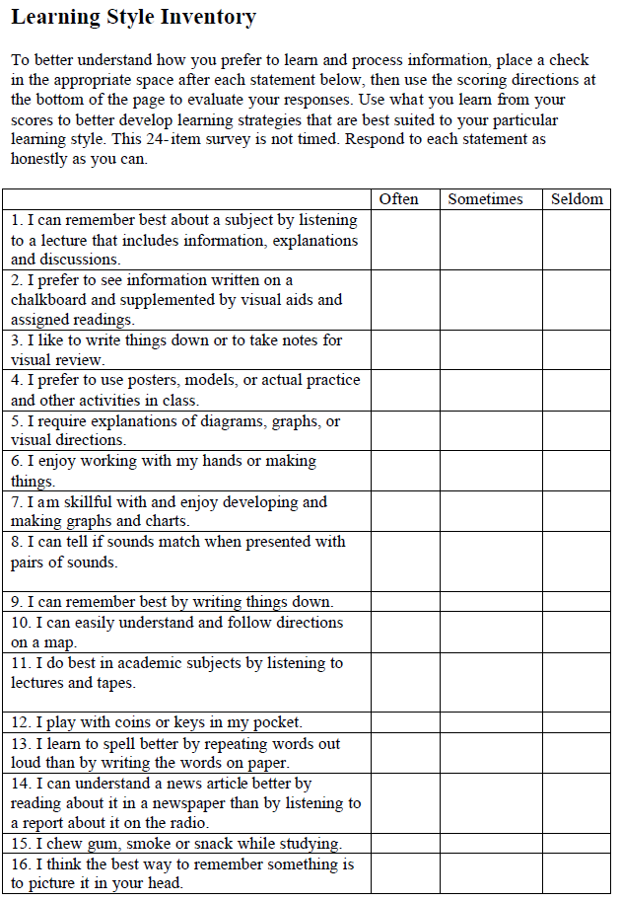
Learning Styles Inventory A great “ice-breaker” activity

Slide 21
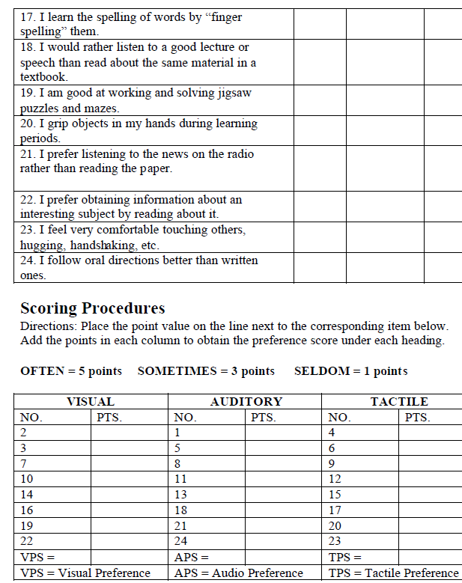
Learning Styles Inventory (cont.)

Slide 22
Understanding your Learning Style
Learning Style Inventory
Take a few minutes to complete and score the learning style inventory you have received.
Take another few minutes to reflect on the results of this inventory.
Does the results match what you thought was your learning style preference?
If not, what do these results mean to you?
Will it change your style of learning?
Will it have an impact on your teaching style?

Slide 23

Learning Styles: It’s In All of Us
I hope that this time together helped you to better understand
the concepts related to learning styles
your own learning style and how you may utilize it in the future

Slide 24

Thank You!!
Online Resources:
Learning Styles & MI Inventories
&
Personality Test
@
www.robdanin.com

