Slide 1

Lesson Development:
Planning and Delivery
Dr. Rob Danin
English Language Specialist
www.robdanin.com

Slide 2
Lesson Purpose:
Student Perspective
Why is this important to learn?
In what ways am I challenged to think?
How will I apply, assess, or communicate
what I’ve learned?
How will I know how good my work is and
can I improve it?

Slide 3



“Why are we learning this?”
“Learners benefit when the learning goals [and objectives]…are explicit. As research has shown, students who do best in school are often those most adept at figuring out what the teacher wants.” (McCombs & Whisler, 1997)

Slide 4
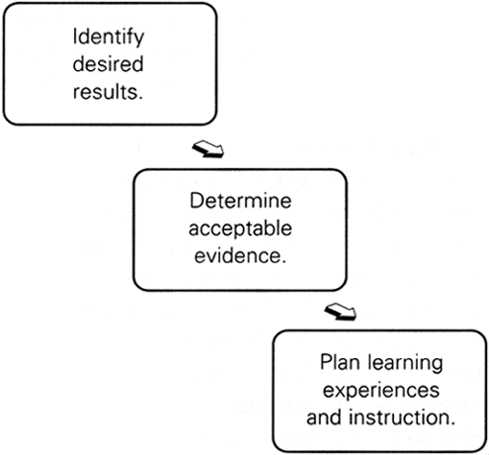
Lesson Planning:
Backward Design

Slide 5
Instructional Strategies Descriptors:
Direct Instruction
What is Direct Instruction?
  The direct instruction strategy is highly teacher-directed and is among the most commonly used. This strategy is effective for providing information or developing step-by-step skills. It also works well for introducing other teaching methods, or actively involving students in knowledge construction.
Examples
  Teaching relevant vocabulary in order to read a story during class
  Others?

Slide 6
Instructional Strategies Descriptors:
Inquiry
What is Inquiry?
  Inquiry learning provides opportunities for students to experience and acquire processes through which they can gather information about the world. Questioning is the heart of inquiry learning.
Examples
  Students are asked to support their opinion with:
    facts
    statistics
    examples
  Others?

Slide 7
Instructional Strategies Descriptors:
Inquiry (cont.)
Students become actively involved in the learning process as they:
  act upon their curiosity and interests
  develop questions
  think their way through controversies or dilemmas
  look at problems analytically
  inquire into their preconceptions and what they already know
  develop, clarify and test hypotheses
  draw inferences and generate possible solutions
Use of a KWL Chart is an effective inquiry-based instructional tool

Slide 8
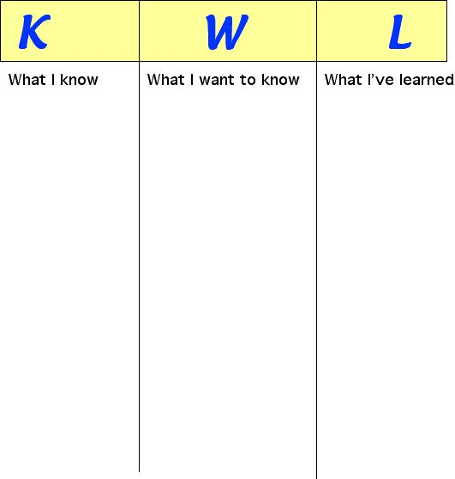
KWL Chart

Slide 9
Instructional Strategies Descriptors:
Guided Practice
What is Guided Practice?
  After a skill or concept has been introduced through direct instruction, the teacher provides guided support (scaffolding) for the students as they learn. This strategy helps the teacher to assess, either informally or formally, if the students are ready for independent practice. A means of “checking for understanding”.
Examples
  Students, individually or in pairs, work on drawing a picture incorporating characteristics they learned about in the lesson
  Others?

Slide 10
Instructional Strategies Descriptors:
Independent Practice
What is Independent Practice?
  Independent practice refers to the range of instructional methods which are purposefully provided to foster the development of individual student initiative, self-reliance and self-improvement.
  Independent practice may be initiated by student or teacher, the focus here will be on planned independent practice by students with very little, if at all, guidance or supervision by the teacher.
  Independent practice can include learning in partnership with another individual or as part of a small group. Independent practice can be used as a formal assessment.
Examples:
  Students will complete the Venn Diagram (in English) categorizing the characteristics of plants and animals studied in class.
  Others?

Slide 11
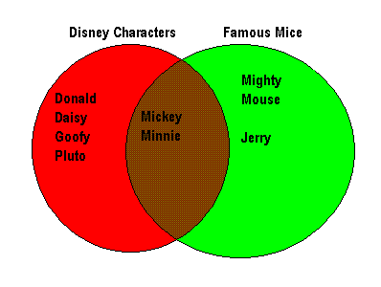
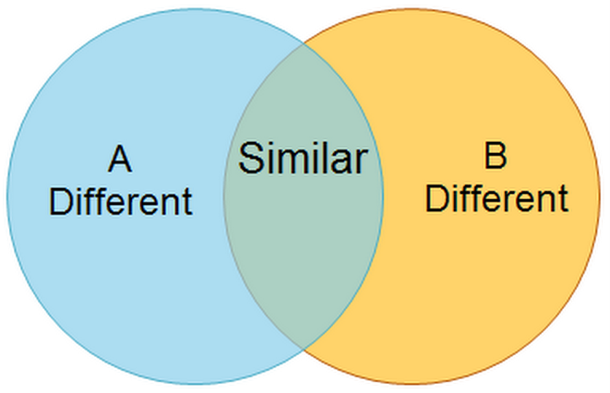
Venn Diagram

Slide 12
Instructional Strategies Overview
Direct Instruction (DI): Intro to New Material
↓
Guided Practice (GP): Scaffolding
↓
Independent Practice (IP): Formal Assessment
MODEL > COACH > FADE

Slide 13

Lesson Delivery:
Pacing
Lesson Pacing: knowing when to move through instruction from slowly to quickly
  Slower Pace When Presenting for New Information: Instructional pacing should be slowed when the information is new or complex
  Relatively Brisk Pace: With well understood instructional materials (as it can be tolerated by the student)
Academic learning time – amount of time students spend actually learning the material (wait time)
Pacing and structuring of a lesson is a particularly challenging aspect of instruction
  Gets better with practice!

Slide 14
Lesson Delivery:
Pacing (cont.)
Factors that can change the pace and structure of a lesson as it unfolds:
  Students’ not understanding how the lesson is important to them
  Misjudgments by the teachers about readiness
  Students’ not being able to comprehend the material or becoming confused
  Remaining questions by the students
  Students’ lack of interest (motivation and engagement)
  Interruptions from student misbehavior/disruptive students

Slide 15

Lesson Delivery:
Pacing (cont.)
  Student’s attention (“time on task”) does not remain constant throughout the day
  Schedule interactive exercises when students’ energy levels are low
  Pace activities to allow for logical breaks at different times during the class
  Always plan more than you think is necessary!
    It is better to have extra lesson activities then too little!

Slide 16
Lesson Delivery:
Transitions
Transitions should be quick, orderly and systematic
Link units of instruction to provide continuity
Both the teacher and the student should know instructionally where they have been and where they are going at the end of each lesson
Avoid jumping from topic to topic - “smoothness”
Before a transition students must be certain about what they are about to do
Develop procedures for passing out materials quickly with a minimum of movement and disruption
Have materials ready for the next lesson
Plan transitions same way you’d plan a lesson

Slide 17
Start of the Lesson
ANTICIPATORY SET - includes the motivation and introduction (purpose) of your lesson; it is the attention getter for the lesson.
“Sponge activities” are created by teachers to take advantage of innovative non-graded activities that are both educational and enjoyable and serve as review or introduction of instruction. Some sponge activity themes are:
  Dictionary Sponge Activity
  Writing Sponge Activity
  Spelling Sponge Activity
  Math Sponge Activity

Slide 18
End of the Lesson
Include a proper “lesson closure” to the day’s tasks. The wrap-up at the end of the lesson.
A form of review of what the students were taught.
Allows the teacher to see where the students are to assist in the planning for the next lesson.
Some lesson closure activities are:
  Reviewing the key points of the lesson
  Asking students to draw conclusions from the lesson
  Asking students how they can use this new information
  Previewing future lessons

Slide 19
Lesson Plan:
Key Elements
Lesson Planning: involves the ability to organize and sequence instruction in a logical manner (a script)
Proper lesson delivery begins with proper lesson planning
The teacher organizes and collects needed materials when developing the lesson (don’t wait)
The teacher links students' personal experiences and prior knowledge to instruction
Instruction should be directly relevant to the lesson goals and objectives
Different students will have different abilities to learn the same material (accommodations)
Approximate how long each segment of the lesson will take (pacing)

Slide 20
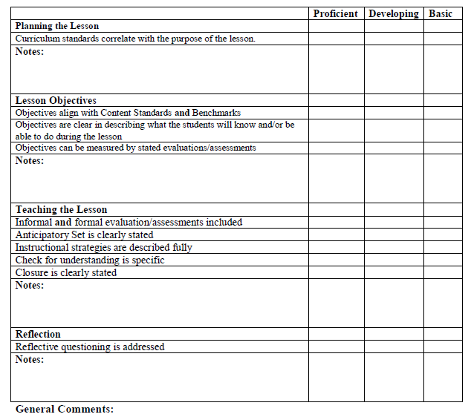
Lesson Plan:
Rubric

Slide 21
Best/Worst Lesson Activity:
Think/Pair/Share
This oral discussion will provide a meta-cognitive (reflective) analysis as to why this lesson went well or not
“Best” Lesson:
(1) Give a brief description
(2) Why was this a “best” lesson?
“Worst” Lesson:
(1) Give a brief description
(2) Why was this a “worst” lesson?
(3) How would you make this lesson better

Slide 22
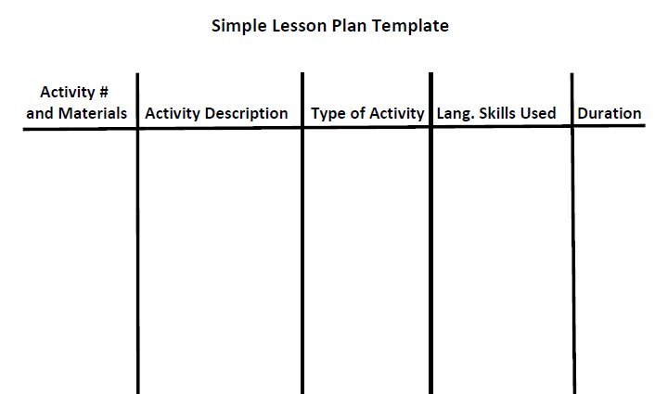
Lesson Plan Template #1

Slide 23
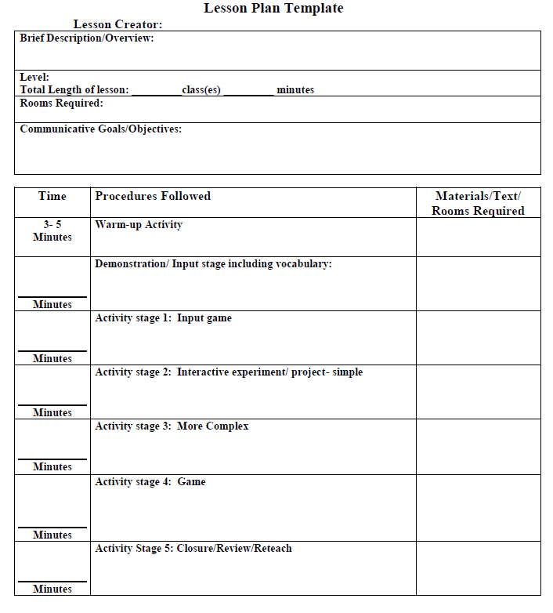
Lesson Plan Template #2

Slide 24
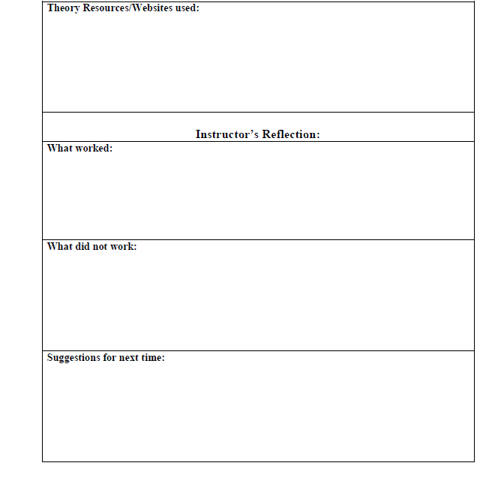
Lesson Plan Template #2 (cont.)

Slide 25
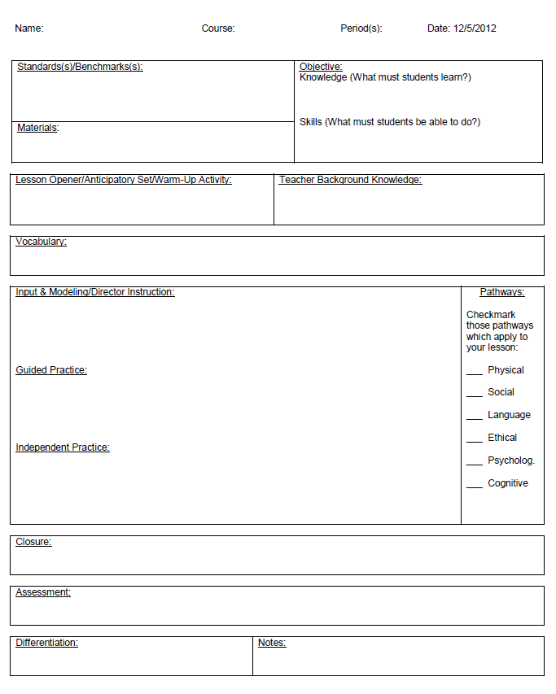
Lesson Plan Template #3

Slide 26
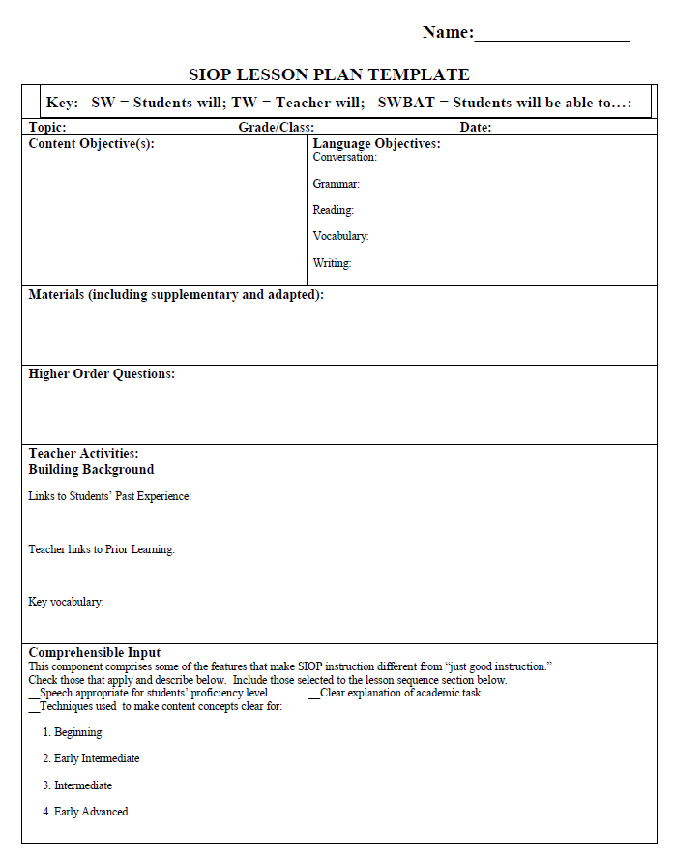
Lesson Plan Template #4

Slide 27
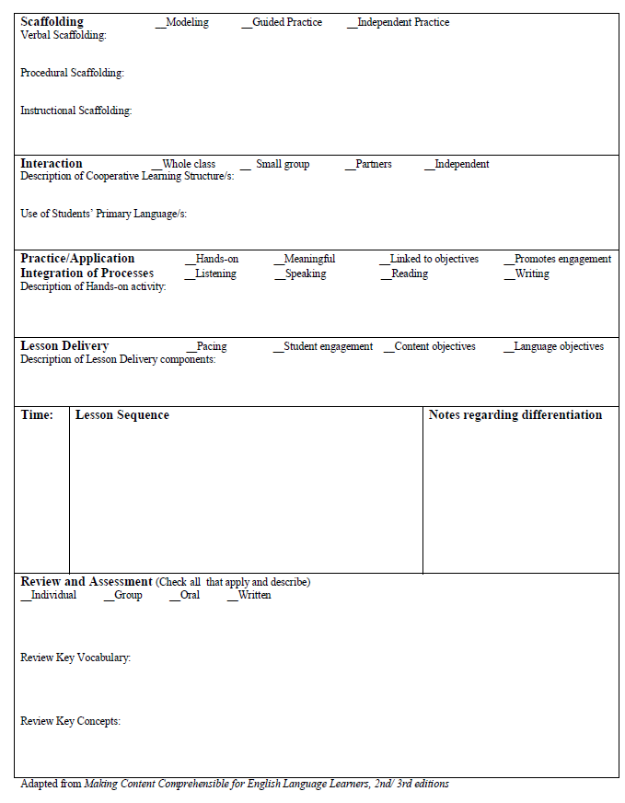
Lesson Plan Template #4 (cont.)

Slide 28

Any questions/comments?
www.robdanin.com

