Slide 1
Project-Based Learning: PBL for EFL
Dr. Rob Danin
English Language Specialist
www.robdanin.com

Slide 2
What is Project-Based Learning?
PBL focuses on real-world problems (authentic) and encourages students to explore issues outside the classroom
“Learning by doing” educational process
Encourages student motivation and collaboration
Students show pride in a project they have designed themselves and shared with others
Supports ELLs to discover new vocabulary, actively engage others in non-rehearsed dialogue, and generally improve cognitive skills
plan, organize, summarize, ask questions, interpret results

Slide 3
PBL is Skill-Based
To learn collaboration –
work in teams
To learn critical thinking –
take on complex problems
To learn oral communication –
present ideas
To learn written communication –
reflective writing

Slide 4

Important Elements of PBL
Standards Based
Assessment
Student Centered
Collaboration
Real World Connection
Extended Time Frame
Multimedia

Slide 5
Therefore, Project Based Learning is
A systematic teaching method

Slide 6
Therefore, Project Based Learning is
that engages learners in acquiring knowledge and skills
Notes:
Difference between knowledge and skills.
Knowledge: What is a doorknob?
Skill: Opening a door.

Slide 7
Therefore, Project Based Learning is
extended inquiry process
Notes:
Inquiry-based learning honors learners’ drive to create meaning from their world. It assumes that people want to learn and naturally have questions about their world.

Slide 8
Therefore, Project Based Learning is
structured around complex, relevant questions
Notes:
PBL is designed to acknowledge the importance of standards and evaluation of student learning. Essential questions or Curriculum Framing Questions keep the focus of the project on the learning objectives and assessment standards.
Avoid dull questions such as “What is the water cycle?”
The project should highlight provocative issues or questions that lead students to in-depth exploration of authentic and important topics.

Slide 9
Therefore, Project Based Learning is
structured around carefully designed products
Notes:
Project based learning specifies products that solve problems, explain dilemmas, or present information generated through investigation, research, or reasoning.

Slide 10
Therefore, Project Based Learning is
and authentic tasks.
Notes:
Authentic, real-world tasks create a need to know the material being studied. That NEED pulls the learners towards information.
Better than teachers PUSHING learners in a direction.
Learners are more engaged and interested in authentic tasks.

Slide 11
Therefore, Project Based Learning is
A systematic teaching method that engages learners in acquiring knowledge and skills through an extended inquiry process structured around complex, relevant questions, carefully designed products, and authentic tasks.
From Introduction to Project Based Learning Handbook, Buck Institute for Education.
Notes:
Students learn more deeply when they can apply classroom-gathered knowledge to real-world problems, and when they take part in projects that require sustained engagement and collaboration.
Active-learning practices have a more significant impact on student performance than any other variable, including student background and prior achievement.
Students are most successful when they are taught how to learn as well as what to learn.

Slide 12

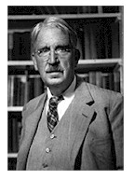
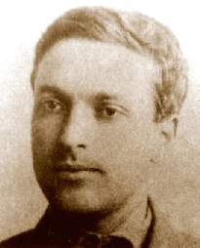
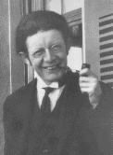
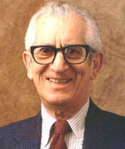
PBL is NOT New
JOHN DEWEY
SOCRATES
LEV VYGOTSKY
JEAN PIAGET
BENJAMIN BLOOM

Slide 13
Not to Be Confused With
Problem-Based Learning
Product emphasis
Project-Based
Process emphasis
Problem-Based
Notes:
What is problem-based learning?
Though many people use the terms project-based learning and problem-based learning interchangeably, a distinction can be made based on whether the focus is on the product or on the process. Typically, with project-based learning the focus is on the outcome, the product. In problem-based learning the focus is on inquiry and the problem-solving process itself rather than on fashioning a product. The difference lies in the goal of the learning experience.
We consider problem-based learning a subset of project-based learning, a particular type of project-based learning with the distinguishing feature of initiating learning with a problem, one that is open-ended, ill-structured, intricate, and then focusing on the complex process of solving it.

Slide 14
PBL Considerations
It’s different!
Student driven
It’s hard!
Developing a “good” problem
Teacher giving up control
It’s time-consuming!
Planning
Implementing
It’s wonderful!
High engagement/motivation
Self-directed learning
Stretch learning abilities
Notes:
How do we feel about using PBL in teacher education?
It’s different, hard, time-consuming, and wonderful
*Note: What is a “good” problem?
One that:
is embedded in significant content of the discipline(s)
is complex and open-ended
involves conceptual reasoning
necessitates critical thinking
encourages collaborative research
provides one or more strong stakeholders

Slide 15

Questions to be Answered by PBL Inquiry Approach to Instruction
Teacher and students brainstorm activities that support inquiry:
“What’s going on?”
“Why is this happening?”
“What does this mean?”
“What will happen in the future?”

Slide 16
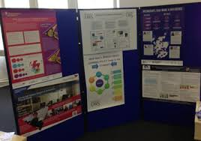
Examples of PBL
interviews: either translated or in English
a PowerPoint presentation
a play
a script
a simulation
a cartoon
an adaptation of a
previous project
a video
an original idea

Slide 17


How Does Research Support PBL?
Increases student motivation and engagement in learning
Is more effective than traditional instruction in increasing academic achievement
Improves student retention of knowledge over time
Is especially effective with lower-achieving students
Improves mastery of 21st century skills

Slide 18
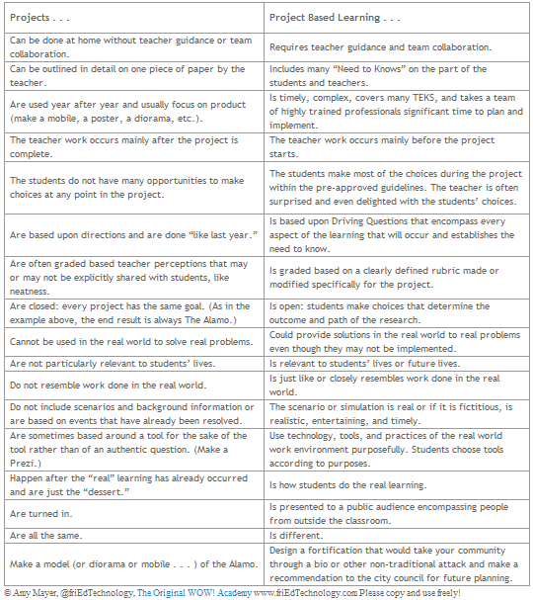
The Difference: PBL and Traditional Projects

Slide 19

The Teacher’s Role
Serve as facilitator
Model thinking and problem-solving strategies effectively
Structure meaningful tasks
Work with students to frame worthwhile questions
Manage the structure of multiple day-to-day activities to produce high quality outcomes
Teach students to set goals
Notes:
From this list, which items did your group discuss? Is there anything listed here that your group did not notice? Have the group share their findings from the Think-Pair-Share on the previous slide. Make sure each bulleted item is said aloud—either by the presenter—or the group participants.
Are there additional items we could add?

Slide 20
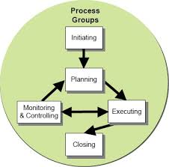
PBL Questions to be Considered
Has the teacher adequately prepared the students (e.g., foundational skills)?
Does the teacher solicit student input?
Do the teacher and student negotiate learning outcomes?
Who selects the topic?
Who defines the products and activities?
Who controls the timeline and pace of the project?

Slide 21

The Student’s Role
Set goals
Begin with the end in mind
Explore and ask questions
In order to answer
Essential Questions
Work well with peers
Stay accountable to self, peers, and teacher for project outcomes
Notes:
What about the student’s role in the video segments? Which items from this list did your group discuss? Is there anything listed here that your group did not notice? Have the group share their findings from the Think-Pair-Share. Again, make sure each bulleted item is listed is spoken aloud—either by the presenter or the group participants.
Is there anything else we should add?

Slide 22
Developing Essential Questions
Essential Questions are…
stimulating.
open-ended.
aligned to the project topic.
challenging.
Essential Questions should relate to
real-world (authentic) situations that
students find interesting.

Slide 23

Students Develop Needed Skills
Information Searching & Researching
Critical Analysis
Summarizing and Synthesizing
Inquiry, Questioning and Exploratory Investigations
Design and Problem-solving

Slide 24
Student Planning Phase
Identify a topic
Work on project
Ask questions that clarify topic
Respond to questions raised

Slide 25
EFL Project Examples
Are Cell Phones Dangerous? (Introduction to Non-Fiction) (intermediate high) The student designed a survey, conducted interviews among friends and strangers, examined research on the topic, and prepared a 12-page paper. In the paper, the student compared available data from cell phone use and research in the United States and Russia; she also summarized the results of the survey she conducted and showed video on the topic.
Mind Playground: A Mad Podcast (Introduction to Fiction) (intermediate high) The student designed a series of interviews and profiles using different electronic voices based on characters from the novels and short stories read during the course. One of the questions asked by the student was, “how can technology be integrated into the study of fiction and English for nonnative speakers?”
The USA and the USSR: The Truth in the Arts and Cinema of the Sixties (The Sixties: a Decade of Change) (advanced level) The student doing this project asked questions about U.S. and Soviet relations at a dark period in their history. The project contained original video footage from the two countries, a survey of people who lived during the time as well as some humorous anecdotes and movie footage connected to the topic.

Slide 26
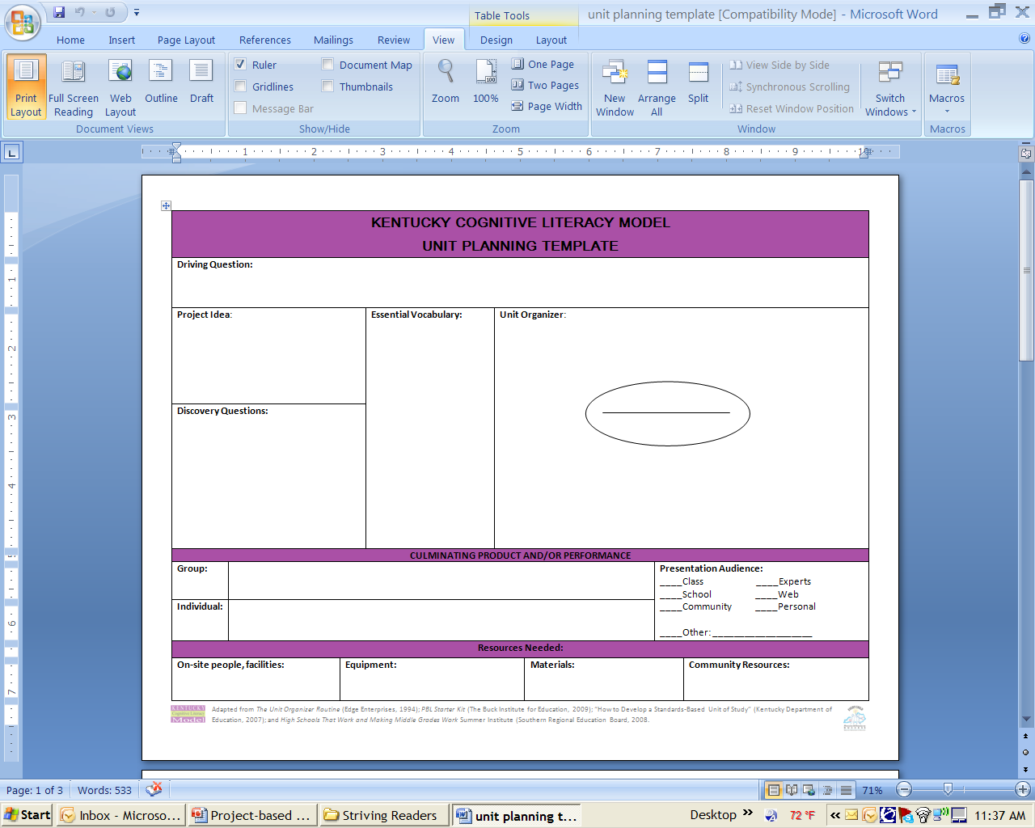
How are PBL Units Designed? PBL Planning Template

Slide 27
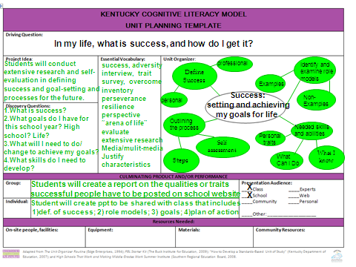
PBL Planning Template Example

Slide 28

PBL Planning Log

Slide 29
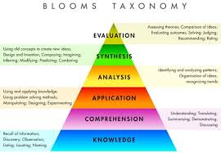
PBL Assessment
One way of creating proficiency levels for PBL is to use Bloom’s Taxonomy, which consists of six levels, from lowest to highest: knowledge, comprehension, application, analysis, synthesis, and evaluation.
The lower level involves rote memorization. At this level, students might develop a poster or PowerPoint presentation with facts. At the higher levels, students are encouraged to produce more complicated projects (i.e., community-based). This can promote differentiation of instruction based on students’ abilities and needs.

Slide 30
Project Evaluative Measures
Does the project
Meet standards?
Engage students?
Focus on essential understanding?
Encourage higher-level thinking?
Teach literacy and reinforce basic skills?
Allow all students to succeed?
Use clear, precise assessments?
Require the sensible use of technology?
Address “authentic” issues?

Slide 31

Project Evaluation (Self and Peer Assessment)
Take time to reflect individually and as a group
Share feelings and experiences
Discuss what worked well
Discuss what needs to be changed/revised
Share ideas that will lead to new inquiries and projects
Notes:
In the busy schedule of the school day, there is often little time for reflection. Yet, reflection is a very important part of the learning process.
How do we expect our students to be able to synthesize their new knowledge if they are not given time to reflect upon what they have discovered?
Too often, we teachers do not allow ourselves the time to reflect, as well.
Set a time that is designated for reflection upon the daily activities. Allow for individual reflection, such as journaling, as well as group reflection and discussion.

Slide 32
Reflective Evaluation
What did I/we learn?
Did I/we collaborate effectively?
What skills did I/we learn?
What skills do I/we need to practice?
What was the quality of my/our work?
Where can I/we improve?

Slide 33
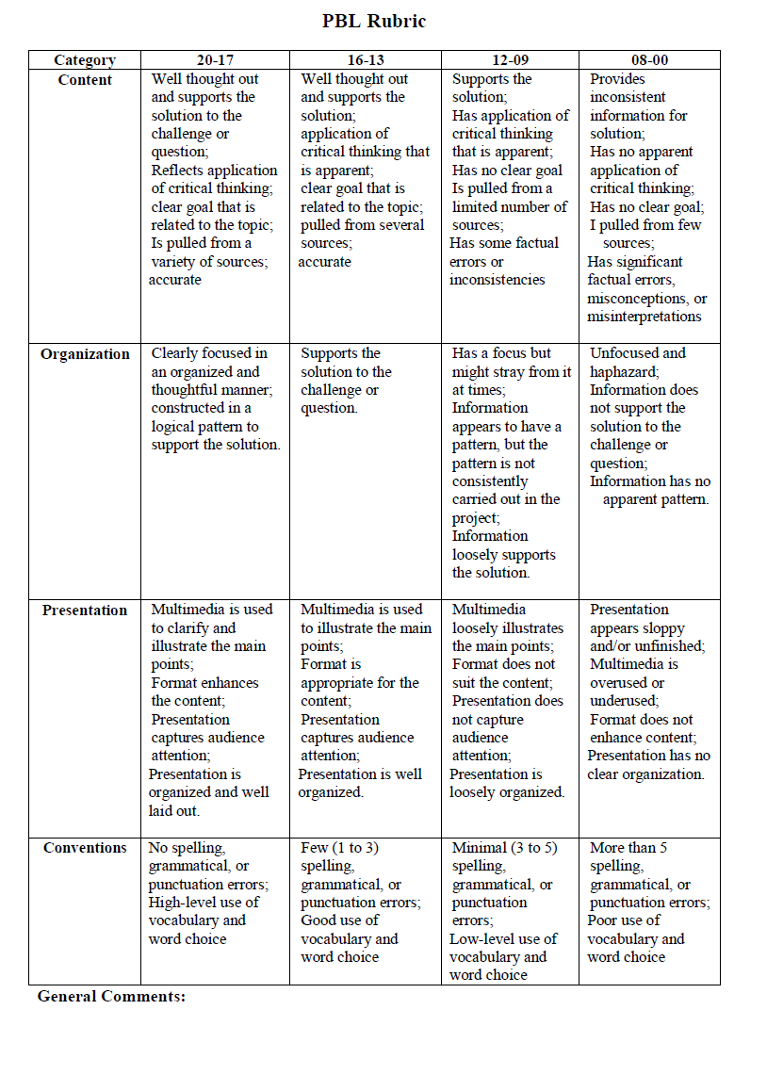
PBL Rubric

Slide 34
PBL In Action (3:50) http://www.youtube.com/watch?feature=player_embedded&v=LMCZvGesRz8

Slide 35
PBL: Think/Pair/Share
What ideas do you have for a project?
What question will you ask your students?
Write down possible questions that will “launch” a project-based learning activity.
Choose one of your questions. Brainstorm with your colleague sitting next to you. Take notes (concept map).
What subjects can be “woven” into this PBL activity?

Slide 36
Project-Based Learning Resources
http://www.bie.org/
http://pbl-online.org/ (BIE sponsored)
https://www.edutopia.org/article/planning-pbl-implementation
http://21centuryedtech.wordpress.com/2010/01/16/free-project-based-learning-resources-that-will-place-students-at-the-center-of-learning/
http://www.lullah.com/pblwebquest/
(PBL teacher training WebQuest)
Notes:
Here are some links to online resources that may be beneficial as you begin to plan projects for your students.

Slide 37








Let’s Begin PBL!
Think BIG!
The Question is the Answer!
What is the Question?
www.robdanin.com
Notes:
Now that you’ve been introduced to Project-Based Learning, do these activities to build on your understanding.

