Slide 1

“Reciprocal Teaching (RT)” Reading Strategies
Dr. Rob Danin
English Language Specialist
www.robdanin.com

Slide 2
Definition Of Terms
Reciprocal Teaching-an instructional technique in which the teacher and students take turns leading discussion, guided by four cognitive strategies: predicting, question generating, clarifying and summarizing.
Meta-Cognition-awareness or analysis of one's own learning or thinking processes.
Oral Communication-communication by word of mouth.
Speaking/Listening Skills-effective speaking and listening are highly valued communication skills.
Receptive Language-the comprehension of language - listening and understanding what is communicated (e.g., reading and communication).
Interactive Lesson-a two-way system of instruction which individuals can learn from one another.

Slide 3
Definition Of Terms
Cooperative Learning-a method of instruction that has students working together in groups, usually with the goal of completing a specific task (Scaffolding - active, meaningful support and feedback).
Constructivist Learning-learners actively create (construct) their own knowledge by trying to make sense out of the material that is presented.
Expository Text-a type of writing where the purpose is to inform, describe, explain.
Productive Learning-learning process can be measured from its starting point.
Performance-based Assessment (Authentic)-evaluating a learner’s “real world” performance with a hands-on task.

Slide 4

Definition Of Terms
Rubric-prescribed assessment guide for conduct or action.
Likert Scale-means to determine the 'distance' between assessment items (e.g., 1 –4, fail-exceptional)
Washback-the influence a test has on teaching and learning.
SIOP- Sheltered Instruction Observation Protocol (e.g., lesson plan template)

Slide 5
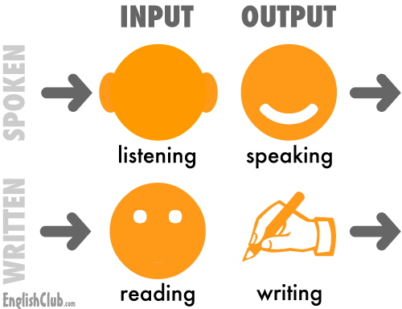
EFL Factors: RT ALI SAID AL-ISSA & REDHA AL-QUBTAN (2010)
EFL teachers strive to make their classes more communicatively dynamic.
An important feature of the EFL classroom in different parts of the world today is oral presentations.
Speaking is one of the least practiced and most neglected skills in almost any EFL classroom.
Oral presentations facilitate the 4 Skills (all used in RT)
Listening, Speaking, Reading, Writing
The 4 Skills have…“in fact have so much in common with each other, that it makes much more sense to treat them holistically” (Wray & Medwell 1991)

Slide 6
Educational Theory: RT ALI SAID AL-ISSA & REDHA AL-QUBTAN (2010)
“Reciprocal Teaching” (RT) strategies include both proper speaking and listening skills.
Providing public speaking experiences in an EFL classroom can be integral in promoting greater oral communication among the students.
The use of RT strengthens reading comprehension.
An effective method in strengthening reading comprehension is through the teaching of others.
This meta-cognitive approach helps students to understand the reading content through explanation of this content to other students.

Slide 7
Educational Theory: RT
RT is described as “reciprocal” because each student converses with others (classmates as well as teacher) typically within a structured learning environment. (Palincsar, Brown and Campione, 1989).
Literacy needs to include both proper speaking and listening skills.
RT helps promote public speaking since it can be a practical oral approach within an interactive EFL lesson.
RT encourages the use of receptive language which typically is an easier process to acquire for SLLs.
RT strategies encourage thinking aloud (meta-cognitive approach, Higher Order Thinking Skills [HOTS]).
Helps with content comprehension, such as reading. (Hurley & Tinajero, 2001)

Slide 8

Key Elements: RT
Instructional Goals: SWBAT
use RT strategies such as predicting, questioning, clarifying and summarizing.
develop cooperative strategies and skills for information gathering and problem solving.
develop a greater level of understanding and retention of the materials taught through classroom instruction and reading.
draw their own meanings from what they read (Constructivist Learning).

Slide 9
Key Elements: RT
Instructional Objectives: SWBAT
read an appropriate level of expository text
use RT strategies such as predicting, questioning, clarifying and summarizing in the retention of selected reading material
participate in small-group discussion
use cooperative strategies and skills for information gathering and problem solving

Slide 10

Expected Outcomes: RT
Upon completion of the RT lesson the students will have a greater level of understanding and retention of the materials taught through classroom instruction and reading.
All members of the group have a shared responsibility for leading and taking part in communicating their thoughts during this structured learning experience (leadership skills).

Slide 11

Instructional Materials: RT
Lesson plan
Rubric
KWL chart
Copies of reading passage
Written “Teacher” prompts

Slide 12
Lesson Plan: RT
Instructional Procedures
The classroom teacher will:
review the goals and objectives of the lesson
Use of KWL chart (the “K” section)
explain the nature and scope of the RT process
explain the specific “Teacher” responsibilities (Prompts) for each small group participant
model the RT process
The teacher models the role of the RT “Teacher” to clarify the RT process and to encourage participation
The “Teacher” role should be role-played with a volunteer from the small group
Example statement by the RT “Teacher”: I am going to ask you to summarize what you are learning. Who can tell me what you remember about what we have just read?”

Slide 13
Lesson Plan: RT
review and clarify the rubric as the student assessment for this activity (will be assessed on both group and individual basis)
The teacher will observe and individually assess via a rubric each “Teacher” during the RT process
The teacher will individually conference with each student in review of their rubric assessment (at a time as close as possible to the completion of this lesson)
Prepare the students to participate in reciprocal teaching by previewing the passage to be read
Distribute and briefly review the reading passage with the students
Discuss important vocabulary and terms

Slide 14
Lesson Plan: RT
Tell the students that they will be individually reading the selected passage
The students become the subsequent leaders with assistance from the teacher
Each “Teacher” will then take turns participating in their particular role (“Predictor, “Questioner” “Clarifier” and “Summarizer”)
Distribute and review RT “Teacher” prompts with the students
Small Group “Teacher” Discussions

Slide 15
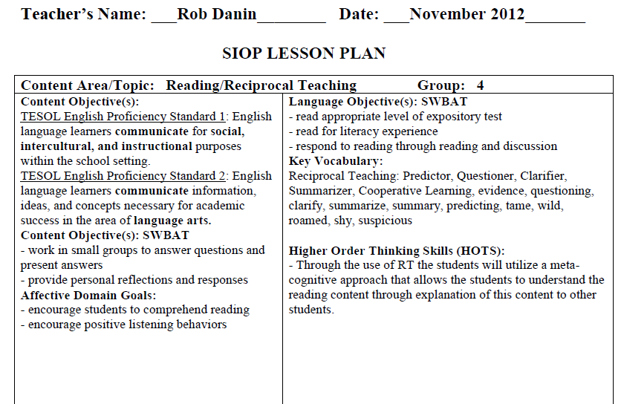
Lesson Plan: RT

Slide 16
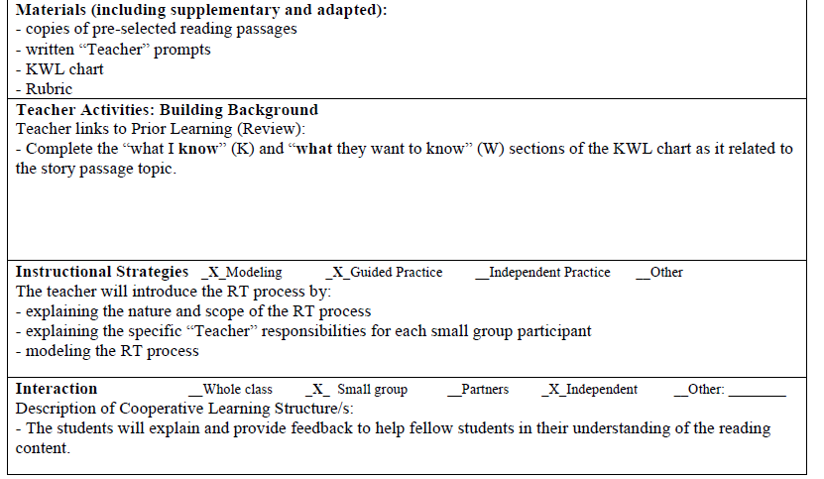
Lesson Plan: RT

Slide 17
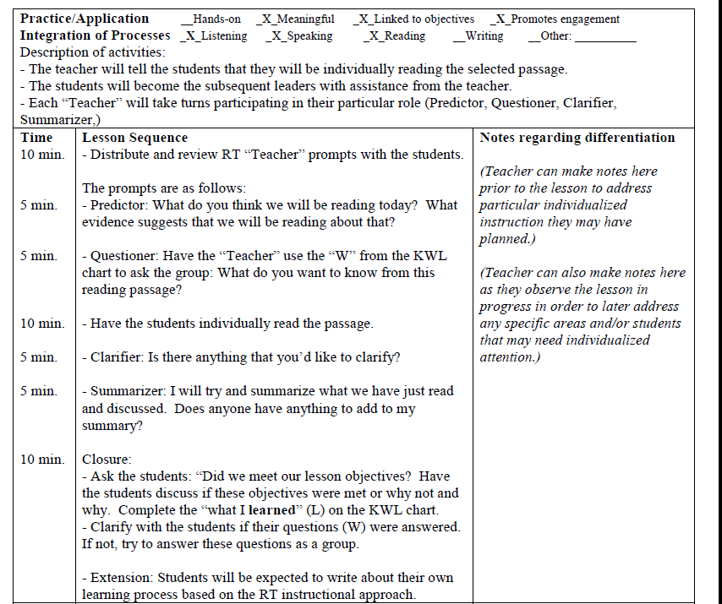
Lesson Plan: RT

Slide 18
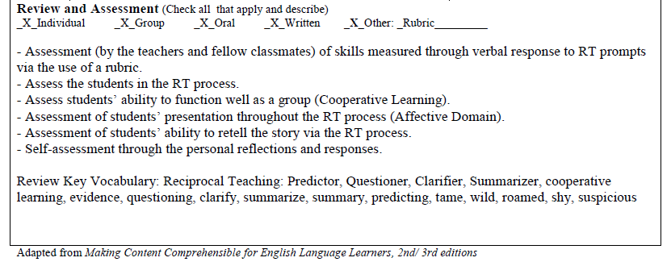
Lesson Plan: RT

Slide 19
Rubric: RT
An authentic approach to assessing
“Real world” means of listening and speaking (typical conversational practice)
Stresses observable and integrative skills
Discuss expectations and accompanying rubric elements prior to instruction (part of “expected outcomes”)
Immediate feedback after lesson
would still be relevant and provide the greatest amount of “washback” for the students
A subjective assessment (e.g., performance-based) can be more difficult to grade than an objective assessment (e.g., written test)
Peer evaluation fosters their confidence and intrinsic motivation (Otoshi & Heffernen, 2008)
has positive implications for developing a reflective and critical sense

Slide 21
Reading Passage: RT
“The History of Dogs”
Many years ago, in the days when people lived outdoors or in caves, there were no tame dogs. In fact, all the animals of the world were wild. One of those wild animals was the wolf. Wolves roamed through the fields and forests shy and suspicious of humans. Yet from these wild wolves have come all the different dogs that are pets today.

Slide 22
“Teacher” Prompts: RT
Predictor: What do you think we will be reading about today? What evidence suggests that we will be reading about that?
Questioner: Have the student use the “W” from the KWL chart to ask the group: What do you want to know from this reading passage? Have the Questioner write these statements on the board
Clarifier: Is there anything that you’d like to clarify? Any words or anything else you’re not sure about?
Summarizer: I will try and summarize what we have just read and discussed. Does anyone have anything to add to my summary?

Slide 23
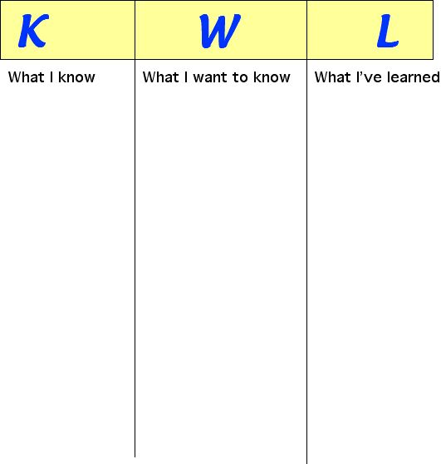
KWL Chart

Slide 24
Lesson Closure: RT
At the end of the lesson, revisit their predictions to see how close they were to the actual text (“K”).
Clarify with the students if their questions (“W”) were answered. If not, try to answer these questions as a group (if there is not adequate time to currently complete this, use as a “springboard” activity for a follow-up lesson).
To close out the lesson, fill in the What I’ve Learned section of the KWL chart (“L”).
Ask if the students have any final questions or comments.

Slide 25
Word of Caution: RT
Use of the RT method can be difficult to implement by certain teachers, such as those not philosophically inclined to this approach to instruction and those teachers who teach a single subject content area.
Novice teachers that should not take on this complex teaching methodology.
Should be placed on the “back burner”.
The introverted student: “They listen more than they talk, think before they speak, and often feel as if they express themselves better in writing than in conversation.”
Quiet: The Power of Introverts in a World That Can't Stop Talking
by Susan Cain (2012)
These students can have a harder time working in groups

Slide 26
Susan Cain YouTube Video: http://www.youtube.com/watch?v=c0KYU2j0TM4 (16:48-17:32)

Slide 27
Website www.robdanin.com
Спасибо

Slide 28
Reciprocal Teaching: Action Plan
Review Part 1 and Part 2 of RT video clips (approx. 15 minutes)
Take reflective notes using the “RT Lesson Development Chart” provided
Based on your viewing of these clips and notes taken discuss in small and/or whole group next steps in the development of a RT lesson
Use this professional development opportunity to consider using the RT reading approach with your students
Additional resources on web site: www.robdanin.com
RT Teacher Reference Sheet
RT Student Guide Sheet
RT Lesson Development Chart

Slide 29
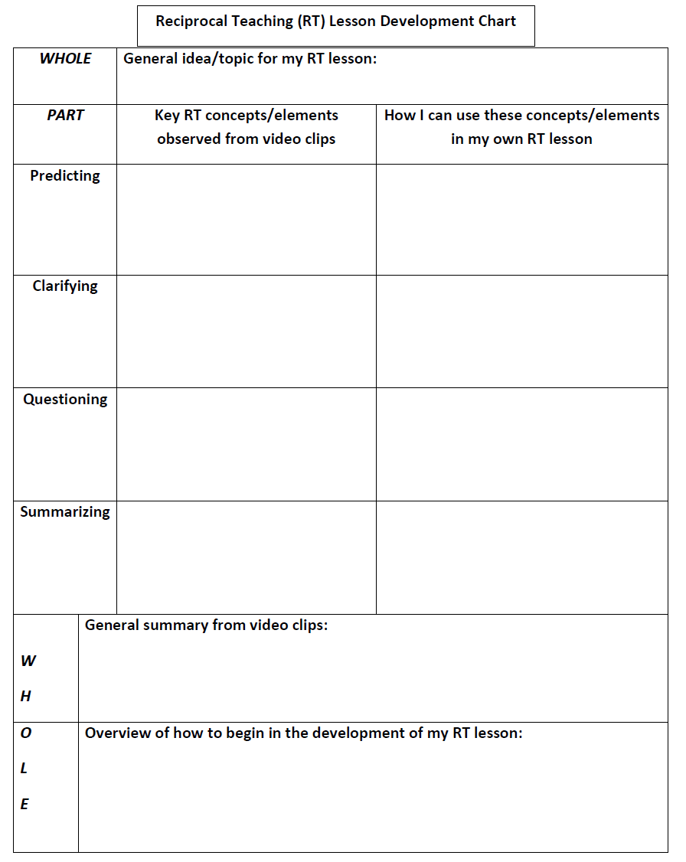
Reciprocal Teaching Lesson Development Chart

Slide 30
RT Video Clip: Part 1 (7:22) http://www.youtube.com/watch?v=8oXskcnb4RA

Slide 31
RT Video Clip: Part 2 (7:42) http://www.youtube.com/watch?feature=endscreen&v=e8gSIcSyypk&NR=1

