Slide 1
Rubric Design
Dr. Rob Danin
English Language Specialist
www.robdanin.com

Slide 2
What is a Rubric?
An “authentic” method of assessing the learner
Provides a transparent assessment process
A guideline for rating student performance (Asmus, 1999).
Defines the range (continuum) of possible performance levels.
An evaluative tool that assesses specific areas of instruction
Clear and relevant
Age appropriate (student-friendly)

Slide 3
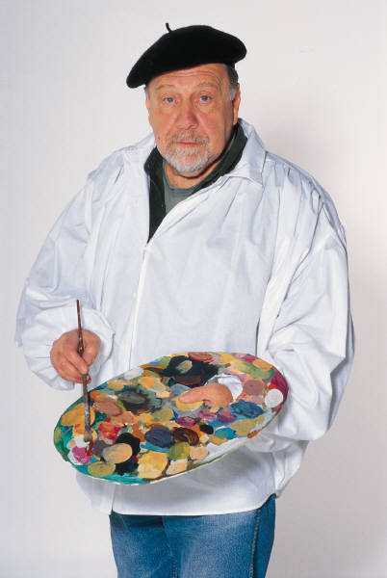
“Art” of Rubric Design
Experts agree:
Rubrics are hard to design
Rubrics are time-consuming to design
“A rubric is only as useful as it is good. Using a bad rubric is a waste of time…”
--Michael Simkins in “Designing Great Rubrics”

Slide 4
What makes up a rubric?
Rubrics provide a criteria and scale which differentiates among the descriptors (these two elements usually go together)
Rubrics include descriptors for each targeted category
The core of the rubric
Each level of performance should have descriptors which clearly indicate what is necessary to achieve that level of performance.
Example
Exceeds Expectation (4-points): “Work is clearly organized and includes a diagram or step-by-step analysis.”
scale
descriptor
criteria

Slide 5
The Rubric: A Cookie!
Criteria Scale | Delicious 4 | Tasty 3 | Edible 2 | Not yet edible 1
Category # chips | Descriptor Chips in every bite | 75% chips | 50% chips | Less than 50% chips
texture | Consistently chewy | Chewy middle, crispy edges | Crunchy | Like a dog biscuit
color | Even golden brown | Brown with pale center | All brown Or all pale | Burned
richness | Buttery, high fat | Medium fat | Low-fat flavor | Nonfat flavor

Slide 6
Why a Rubric?
The purpose of using rubrics is to provide a more systematic way of describing/evaluating a performance that is more qualitative than quantitative in nature. (Greer and Kale, n.d.)
To clearly show students how their work is being evaluated
To communicate detailed explanations of what constitutes excellence
To serve as a means for clarifying expectations for assignments and experiences
Usually with a relatively complex assignment, such as a long-term project, essay or research-based product

Slide 7
Benefits of a Rubric
Improve student performance
Encourage students to “check progress” using a rubric (formative assessment)
Allow for multiple correct answers
Encourage / require self-assessment and/or peer assessment (formative assessment)
Detailed evaluations of final projects (summative assessment)
Provide those who have been assessed with clear information about how well they performed
Provide those who have been assessed with a clear indication of what they need to accomplish in the future to better their performance

Slide 8
How to Use a Rubric
Expect to revise…and revise…
Adjust the rubric after, not during the assessment
Make changes soon after grading
Keep track of strengths and weaknesses of rubric as you use it to assess student work
Were the criteria, scale and descriptors easy to follow?
Did the overall grade reflect performance?
When you’ve got a good one, SHARE IT!
Share rubrics with students at the start of the project - criteria helps students understand teacher expectations
Model proper rubric usage – when and how
Provide examples (models) of student work showing varied performance levels for learners

Slide 9
Rubric Design: Getting Started
If you use generic or online rubrics make sure to carefully consider their quality to see if this rubric is appropriate for your project
If you use a previously developed rubric:
Find a rubric that most closely matches your performance task
Evaluate and adjust to reflect your instruction, language, expectations, content, students
Criteria
Scale
Descriptors
If you make your own rubric: An easy way is to set up tables in Word (the number of columns will depend upon how many levels of proficiency [criteria/scale] you want to show

Slide 10
Rubric Design: Criteria & Scale “Nuts & Bolts”
Aim for an even number of levels
Create a continuum between least and most
Define extremes and work inward
Describe proficient levels of quality
No evidence, minimal evidence, partial evidence, complete evidence
Emerging, developing, achieving
Below average, average, excellent
Unacceptable, acceptable, competent, proficient

Slide 11
The Rubric: A Cookie!
Criteria Scale | Delicious 4 | Tasty 3 | Edible 2 | Not yet edible 1
Category # chips | Descriptor Chips in every bite | 75% chips | 50% chips | Less than 50% chips
texture | Consistently chewy | Chewy middle, crispy edges | Crunchy | Like a dog biscuit
color | Even golden brown | Brown with pale center | All brown Or all pale | Burned
richness | Buttery, high fat | Medium fat | Low-fat flavor | Nonfat flavor

Slide 12
Rubric Design: Descriptor “Nuts & Bolts”
Know the specific skills or knowledge you want to measure
Align the assignment with the rubric. Use same language.
Aim for concise, clear, jargon-free language
Avoid wordiness, and negativity
Limit the number of descriptors
Separate key descriptors
Use realistic, teachable descriptors

Slide 13
Rubric Design: Descriptor “Nuts & Bolts”
Use concrete versus abstract and positives rather than negatives
List skills and traits consistently across levels
Use measurable/observable (identifiable) descriptors
Someone else should be able to use your rubric and score your assignments as you would
Reliable and Valid
Leave space for specific comments during grading
Match written comments to phrases in rubric
Include all non-negotiable items
On time
Formatted correctly
Follows standard conventions…
Etc.

Slide 14
The Rubric: A Cookie!
Criteria Scale | Delicious 4 | Tasty 3 | Edible 2 | Not yet edible 1
Category # chips | Descriptor Chips in every bite | 75% chips | 50% chips | Less than 50% chips
texture | Consistently chewy | Chewy middle, crispy edges | Crunchy | Like a dog biscuit
color | Even golden brown | Brown with pale center | All brown Or all pale | Burned
richness | Buttery, high fat | Medium fat | Low-fat flavor | Nonfat flavor

Slide 15
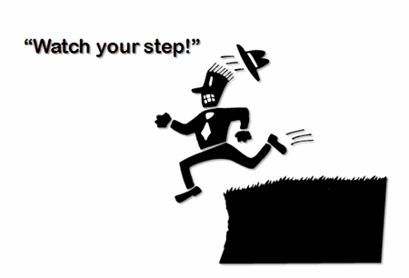
CAUTION: Common Rubric Pitfalls
Rubric does not correspond with class or program outcomes
Scale does not have enough levels
Too broad, not enough content described
Too long/too complicated

Slide 16
Review: Rubric Design
Clear, observable and essential criteria
Realistic number of criteria
Explicit, observable indicators
Align the assignment with the rubric
Include all non-negotiable items
An even number of standards of excellence
Create a continuum between least and most
Define extremes and work inward
Deliberate sequence of criteria
Must be clear to students upfront
High reliability and validity
Provide varied samples of student work
Pilot with students – adjust accordingly
Notes:
We need to teach the kids to use the rubrics as a TOOL (not only as an evaluation).
Create a habit of mind = self-assess.

Slide 17
Next Steps: Mini-Rubric
Rubrics that are quick to use
Fewer criteria and shorter descriptions of quality
Yes/no checklists
Describe proficient level of quality and leave other boxes for commentary during grading
Use for small products or processes
Poster
Outline
Journal entry
Class activity

Slide 18
Sample: Mini-rubric
Vocabulary Poster Purpose: to inform
Content criterion (50%) 4 3 2 1
____written explanation of denotation—accuracy/thoroughness
____examples in action—accuracy/variety
____visual symbol or cartoon conveys word meaning-- accuracy/clarity
____wordplay---weighs synonyms for subtleties of meaning--accuracy/thoroughness
Presentation criterion (50%)
4,3,2,1--neat
4,3,2,1--clear organizational pattern
4,3,2,1--no error in Conventions
4,3,2,1--uses visual space to catch and hold attention
Score= Content___ + Presentation___ = ______GRADE
Comments:
Notes:
Content criteria repeats phrasing on assignment sheet.
Comments allows teacher to “justify” any score not a “4.”

Slide 19
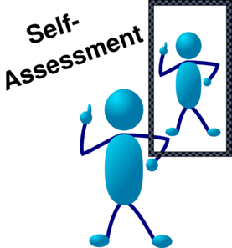
Next Steps: Student Created Rubrics
Include students in creating or adapting rubrics
This form of self-assessment helps with providing the learner a greater understanding and appreciation of what they are being evaluated on.
Consider using “I” in the descriptors
I followed…
I did not follow…

Slide 20
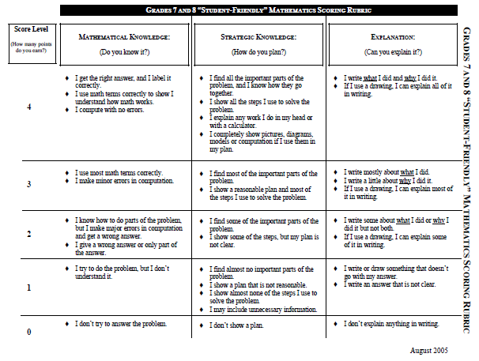
Sample: Student-Friendly Rubric

Slide 21
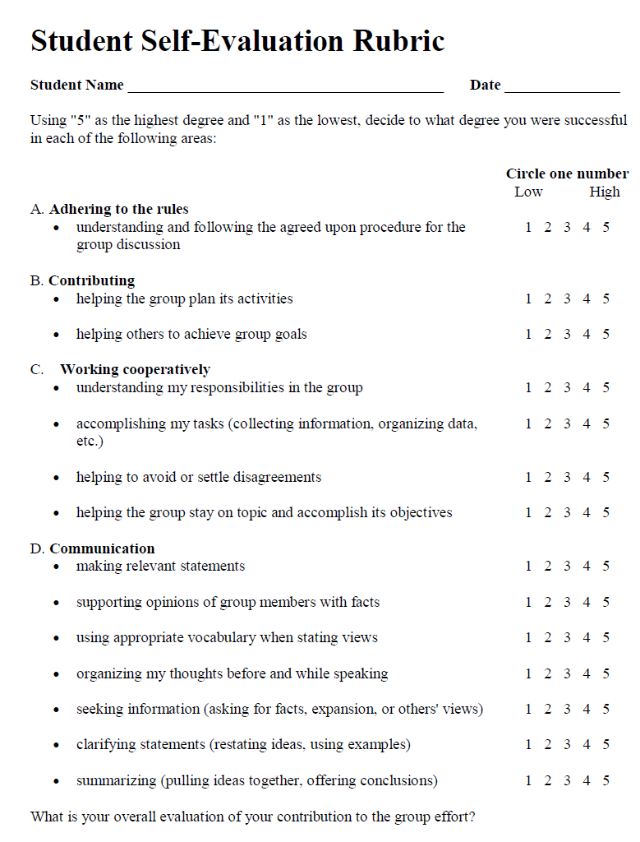
Sample: Student Self-Assessment Rubric

Slide 22
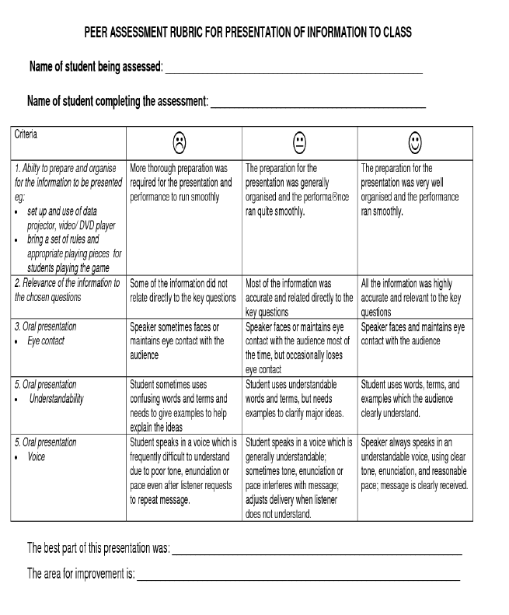
Sample: PEER Assessment Rubric

Slide 23
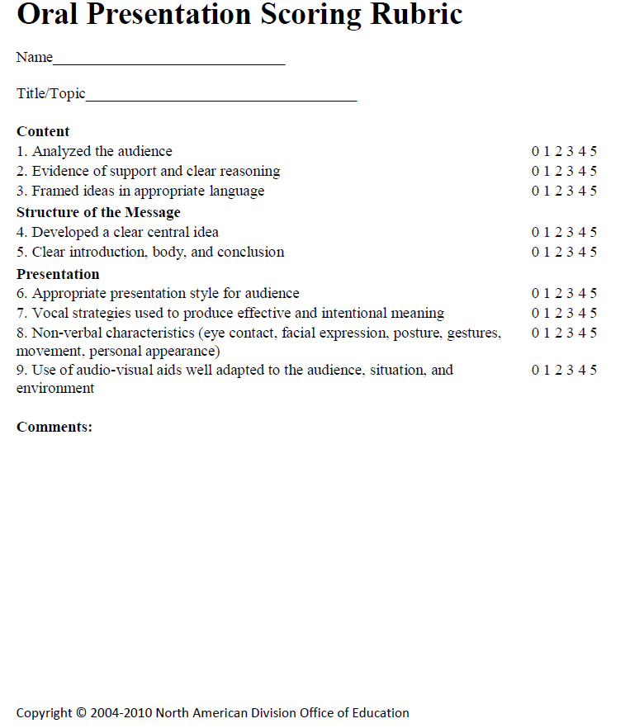
Other Rubric Samples: Oral Presentations

Slide 24
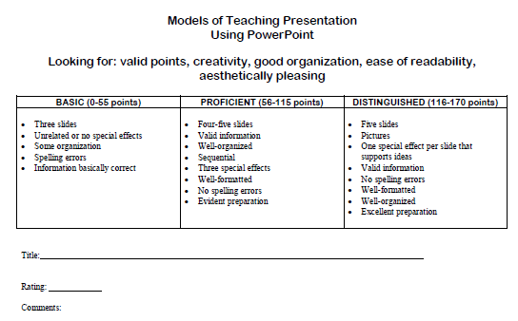
Other Rubric Samples: PowerPoint Presentations

Slide 25
Rubric Design Activity
Develop a new or revise an existing rubric (using the rubric template provided to you) that can be used with your students in a particular content area.
When creating this rubric, please take into consideration those elements of effective rubric design that were discussed (please see rubric review sheet from this presentation).
Feel free to evaluate your rubric using the “Rubric Design Rubric” provided to you.
If there is time and the desire, feel free to break into small groups to constructively critique the rubrics you have created.

Slide 26
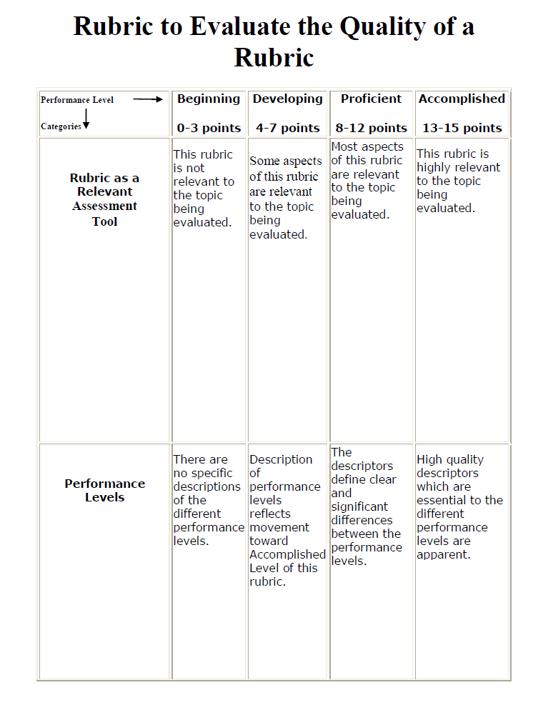
Rubric Design Rubric

Slide 27
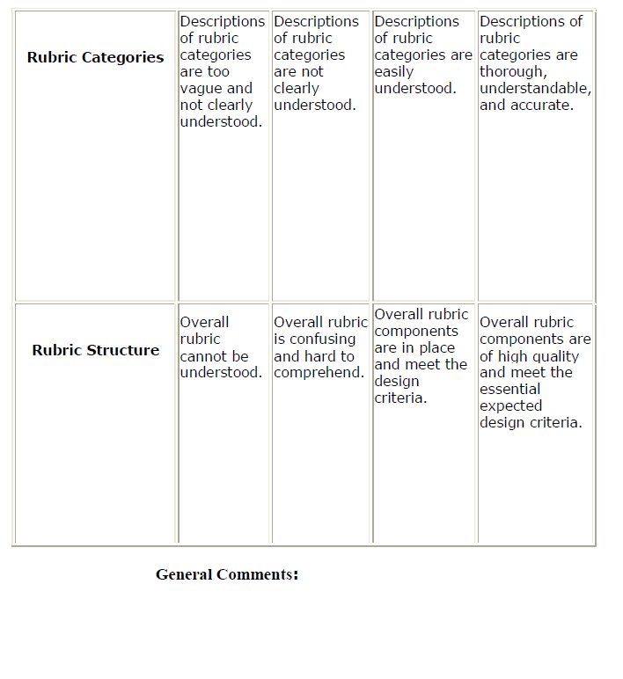
Rubric Design Rubric
_______/15 Points

Slide 28
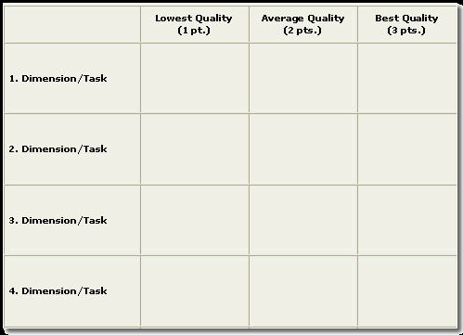
Rubric Template

Slide 29
Rubrics On Line
http://rubistar.4teachers.org/ (create your own)
http://www.teach-nology.com/web_tools/rubrics/
http://www.rubrician.com/language.htm
http://www.rubrics4teachers.com/
http://www.rubrics4teachers.com/powerpoint.php (PPT rubrics)
http://www.nadasisland.com/rubrics.html (EFL/ESL)
http://www.rcampus.com/rubricshowc.cfm?code=L24W4A&sp=yes (EFL speaking)

Slide 30
Rubric Design www.robdanin.com
ENJOY THE
ART OF
RUBRIC DESIGN!!

