Slide 1

Scaffolding for the EFL Classroom
Dr. Rob Danin
English Language Specialist
www.robdanin.com

Slide 2
Scaffolding… What does this mean?
Analogy to teaching and learning: Construction workers lay the foundation, and build support columns little by little, using scaffolding to keep them held in place and standing. As the columns are ready to stand on their own, the scaffolding is removed.
Scaffolding refers to the support systems and instructional techniques teachers employ to help take students from where they are to higher levels of academic achievement.
Teachers need to provide scaffolding for students to reach each skill or concept and achieve at higher levels.
Scaffolding should be integrated into each lesson.
Written as well as oral instructions

Slide 3
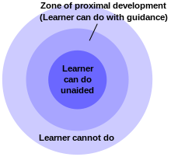
Scaffolding… Its origins
Lev Vygotsky (1932)
Zone of Proximal Development (ZPD)
[зона ближайшего развития]
What students' can do alone versus what they can accomplish with the help of a more capable peer or teacher.
Note:
Vygotsky never used the term “scaffolding”

Slide 4

Putting scaffolding into practice
Please be willing to share your prior knowledge (more on this later) regarding scaffolding techniques and suggestions at any time during this presentation.
This will help provide additional support for all of us in our efforts to provide support to our students.

Slide 5

Scaffolding The gradual release of responsibility
Instruction should move from teacher-led (I do it), to guided practice with students (we do it), to independent student practice (you do it)
“Goldilocks Principle” when using scaffolding:
Not too much, not too little, just the right amount
Too much scaffolding for students:
Not moving towards independence of skills
Not enough scaffolding for students:
Giving up on the lesson and not putting in the effort
Right amount of scaffolding for students:

Slide 6
Before we discuss this lesson planning and instructional process…
Let’s determine the students’
Background Knowledge or Prior Knowledge
The existing knowledge and experiences students have about a particular subject.
Determine students’ prior knowledge at the beginning of a lesson or unit.
Is there a need to review or reteach key vocabulary, academic language and concepts related to the lesson?
Knowing the students’ prior content knowledge and skills, vocabulary knowledge and language proficiency levels influences how much scaffolding will be required.
Enhances instruction and comprehension and helps students stay engaged (motivated).

Slide 7
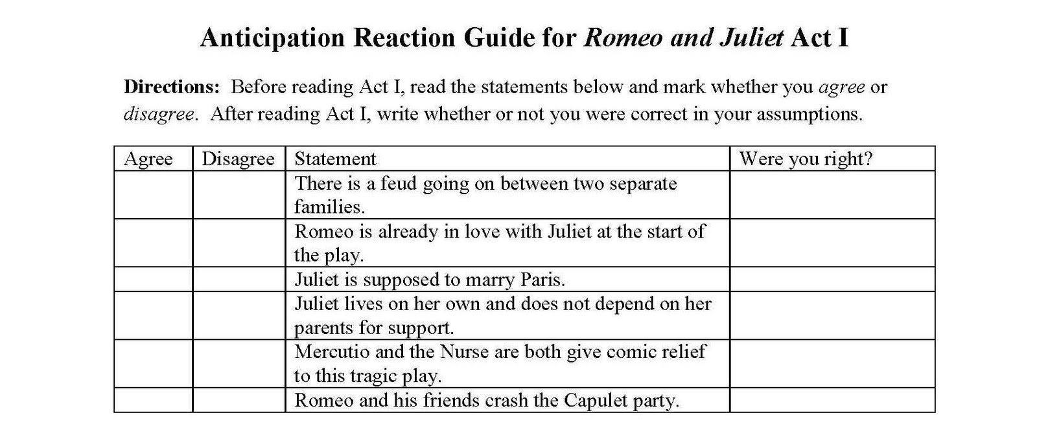
Determining Background (Prior) Knowledge
Methods that can be used in the classroom:
Analogies and storytelling - how content relates to student’s life and experiences
Discussion and questioning
Anticipation guides

Slide 8
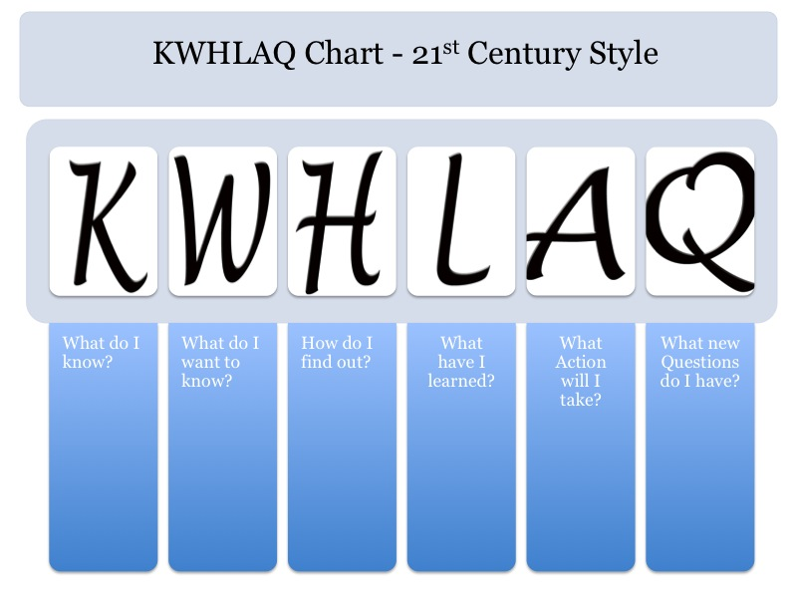
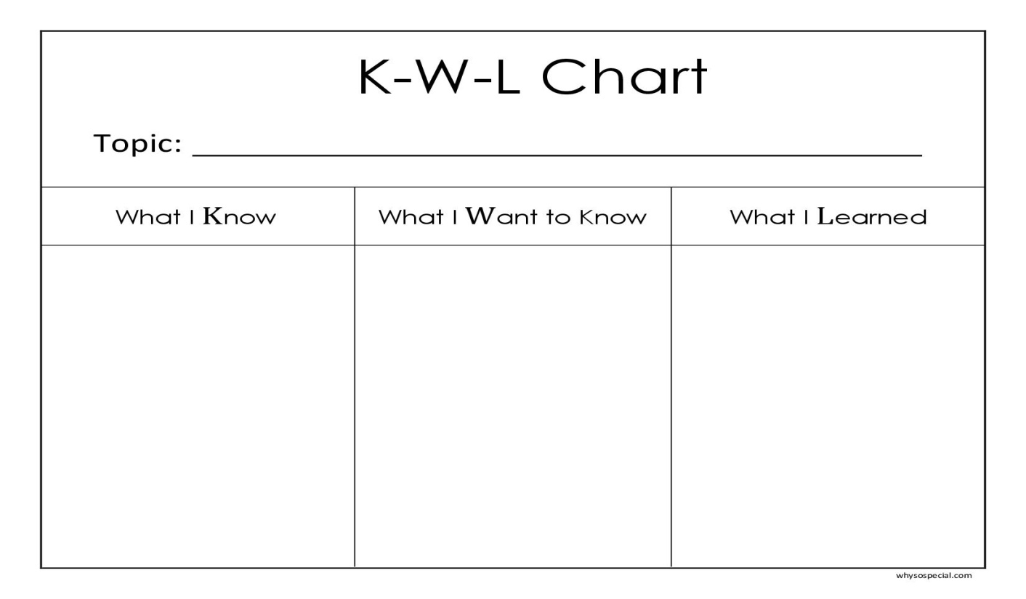
Determining Background (Prior) Knowledge
Review and quizzes on previously taught concepts and skills
Students sketch a picture that represents a topic
KWL Chart

Slide 9
Determining Background (Prior) Knowledge: EFL Style
Language proficiency levels:
Diagnostic pre-testing (post-testing comes later)
Students responses to "what" and "where" questions
Student retelling stories (sequencing: first, next, last)
Brainstorming (e.g., use of a KWL Chart)
Vocabulary knowledge:
Word card sort - match words and definitions
Refer back to a word wall where previously learned words are posted
Students will provide their own descriptions, explanations or examples (e.g., use of photos)

Slide 10
And now back to scaffolding during the lesson planning and instructional process Steps in supporting language fluency
Direct Instruction / Modeling (I do)
Explaining tasks and lead students step-by-step through the processes they will be using
Think-Alouds (Vygotsky)
share with students what goes on in the mind of a proficient reader, writer of a foreign language learner
Changing the color of the pen/marker you are using during each step (visual learner)
Teachers have students orally recite key vocabulary words
Discuss predictions / Drawing conclusions
Summary “quick write” (of previously taught concept)

Slide 11
Steps in supporting language fluency
Guided practice (we do together)
Calling on students (in this order)
Selecting students intentionally who have a clear understanding of concepts taught
Selecting students randomly - holds all students to be accountable
Selecting volunteers - may have something additional to add
If a student needs help in answering a question
"phone-a-friend“ (try this first)
Students chorally providing help or the answer

Slide 12
Steps in supporting language fluency
Collaborative guided practice (students do together)
Students work together in small groups to practice the skill or concept
Students seated in pairs, triads, or small groups
Cooperative Learning model with roles and responsibilities
Use of a “talking stick”
Teacher walks around monitoring student practice and assisting students as needed (“student watching”)
Speak to the entire class when you hear the same questions from more than one group
Teacher can pull together a small group of students that may need additional direct instruction (ability groups)

Slide 13
Steps in supporting language fluency
Independent practice (students do independently)
The last stage requires students to practice and apply the instructional task independently.
Students independently work on activities such as:
projects (Project-Based Learning)
portfolios
reflective journaling
written reports / essays
oral presentations (including skits and videos)
meeting with other language learners
only speak in that language
find a free EFL internet site and do online exercises

Slide 14

Instructional Scaffolding Strategies
Pictures / Photos
Helps make abstract concepts more concrete
Can be sorted and classified
Used as writing prompts
Labeled with key vocabulary words
Used to “spark” conversation

Slide 15

Instructional Scaffolding Strategies
Sketches
When pictures/photos are not available use sketches to help demonstrate the vocabulary or concept
Sketches differ from drawings
a quick representation and not necessarily artistic or well-drawn
A sketch can help get a message across quickly

Slide 16
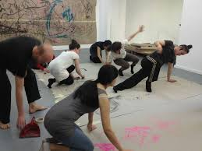
Instructional Scaffolding Strategies
Gestures
Incorporate movement to demonstrate the meaning of words and concepts
Students move their arms or bodies to show the meaning of a word
Physical actions help students to remember key vocabulary, content topics or concepts
Kinesthetic Learner (Learning Styles)
Total Physical Response (TPR)

Slide 17
Instructional Scaffolding Strategies
Context Clues
Words that give you information about words you don’t understand
Students may have to use what they have read before and after to determine a word’s meaning.
When students are reading and see a word they don’t know, they should reread the sentence.
He wears trousers and a shirt.
Students should look for words they know, and these words might give the learner information about the unknown word.
He wears trousers and a shirt.
Substitute a synonym the students know, and see if the sentence makes sense.
He wears pants and a shirt.

Slide 18

When to begin to remove the scaffolds
As you see that students are experiencing success
Begin to remove scaffolds relatively slowly
Utilize the gradual release of responsibility until the scaffolding is removed all together
Monitor and adjust: through formative assessment, observation and discussion with students

Slide 19
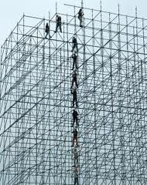
What have we missed?
What other scaffolding principles do you use in your classroom?
www.robdanin.com

