Slide 1

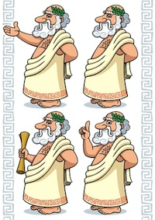
Socratic Seminar
Dr. Rob Danin
English Language Specialist
www.robdanin.com

Slide 2
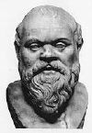
What does Socratic mean?
Socratic comes from the name
Socrates
Classical Greek philosopher who developed a “Theory of Knowledge”.
Based on a form of inquiry and discussion between individuals, based on asking and answering questions to stimulate critical thinking.
The Socratic Seminar serves as a
discussion, not a lecture.

Slide 3

What is a Socratic Seminar?
A highly motivating form of intellectual and scholarly and focused discussion between participants with the goal of informing those involved

Slide 4
Why do we have Socratic Seminars?
Participants seek a
deeper understanding
of complex ideas through thoughtful
Dialogue / Conversation
rather than by memorizing information.

Slide 5

Advantages of Socratic Seminars
Provides opportunities for critical readings of texts
Teaches respect for diverse ideas
Enhances students' knowledge
Creates a community of inquiry
Develops critical thinking, problem solving, speaking, and listening skills
Maximizes student participation

Slide 6
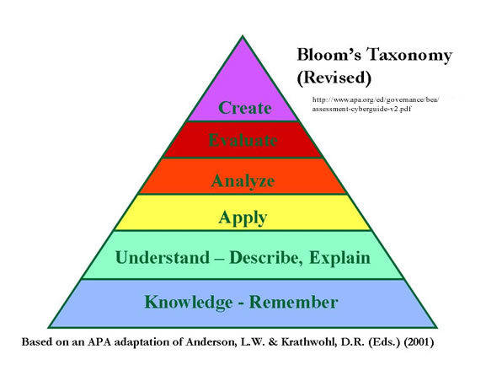
Expected Outcomes
Students determine the flow of the classroom discussion by applying the inquiry process
Ability to critically think (Bloom’s Taxonomy)
Use prior knowledge to pose or identify problems
Determine the reliability and importance of information using multiple sources

Slide 7

Four Essential Elements
An effective Socratic Seminar consists of four basic elements:
1. the text being considered
- varied text formats including readings from
the Internet
2. the questions raised
3. the seminar leader, and
4. the participants

Slide 8
The Text
Seminar text can be drawn from readings in literature, history, science, math, health, and philosophy or from works of art or music
A good text raises important
questions
- There are no right or wrong answers
- At the end of a successful Socratic Seminar, participants often leave with more questions than they brought with them

Slide 9
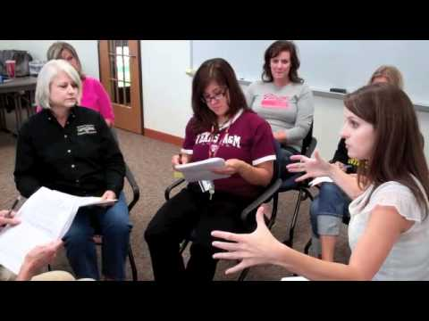
When Examining the Text…
Use thoughtful and polite comments such as:
“I agree with… but would like to add…”
“I disagree with…because…”
“I am confused by…”

Slide 10
The Questions
A Socratic Seminar opens with a
question
posed by the teacher,
the leader,
or participant
Responses to the opening question generates new ideas and leads to new responses
-- Avoid using YES/NO questions --

Slide 11
The Leader
serves a dual role as
leader and participant
Keeps the discussion focused on the text by
asking opening and follow-up questions
helping clarify positions when arguments become confused
involving reluctant (quiet) participants
Considerations for both teacher and leader:
How do you make sure that all students get to participate?
What do you do if no one talks?

Slide 12

Sample Questions
Here is my view and how I arrived at it. How does it sound to you?
Do you see “gaps” in my reasoning?
Do you have different conclusions?
How did you arrive at your opinion?
What would change your mind?

Slide 13

The Participants
Share responsibility for the quality of the seminar
Most effective when participants:
study the text closely in advance
listen actively
enthusiastically participate
share their ideas and questions
search for evidence in the text to support their ideas

Slide 14
8 Strategies for Participants in a Socratic Seminar
Refer to the text during the discussion.
Ask for clarification.
Stick to the point.
Don't raise hands; take turns speaking.
Listen carefully and speak up so that all can hear you.
Talk to each other, not just to the leader.
Discuss ideas rather than each other's opinions.
Take risks in making mistakes in order to learn.

Slide 15
Expectations of Participants
Did I…..
speak loudly and clearly?
cite reasons and evidence for my statements?
use the text to find support?
listen to others respectfully?
avoid angry responses?
question others in a polite manner?
avoid inappropriate language?
stick to the subject?
talk to others, not just to the leader?
paraphrase accurately?
ask questions to clear up confusion?
support others?
seem prepared?

Slide 16
Expected Outcomes
An atmosphere of intellectual engagement, cooperation, and conversation is encouraged
The goal is not only to answer questions, but to generate more questions (inquiry)
The teacher serves as a facilitator
initiate well thought out, open-ended questions
gives no response, negative or positive, to the students’ discussion
pose questions to “move” discussion
Students learn the difference between DEBATE and DIALOGUE

Slide 17
Debate Dialogue
Is oppositional
One listens to counter arguments
Affirms participant's points of view
Defends assumptions as truth
Creates a close-minded attitude
Is collaborative
One listens in order to find common ground
Enlarges points of view
Reveals assumptions for re-evaluation
Creates an open-minded attitude

Slide 18
Debate Dialogue
Expects other’s reflections will improve their own thinking
Temporarily suspending one's beliefs
Searches for strengths
Respects others and seeks not to alienate
Assumes that cooperation can lead to greater understanding
Remains open-ended
Defends thinking to show that it is right
Calls for investing one's beliefs
One searches for weaknesses
Rebuts contrary positions and may belittle others
Debate assumes a single right answer
Demands a conclusion

Slide 19
Socratic Seminar Learning Objectives
Student will be able to (SWBAT):
participate in the decision-making process.
actively synthesize information (making connections) from multiple sources.
demonstrate how to effectively communicate through group discussion.
Others?

Slide 20
Socratic Seminar Rules (“Norms”)

Slide 21
Tips for Introducing Socratic Seminars
Stress the importance the Socratic Seminar (expected outcomes)
Don’t rush into the discussions without establishing your expectations for each role (teacher, leader, participant)
Explain the process fully
Clarify terms on the rubric, observation checklist and guided notes
Remind students to use appropriate vocabulary and academic language
Make sure note-takers understand what good notes look like
Show them models
The observers’ job is to provide positive feedback
After you’ve trained the students in effective CONSTRUCTIVE feedback, then you can encourage a more “critical friend” form of response.
To ease students’ nerves the first time around, make the first time a “dry run” for feedback, not a grade.
Start with shorter sessions (e.g., six minutes) and questions on familiar topics (how they feel about various holidays , which movies they like the best, etc.)
You might also use this opportunity to prompt personal reflection, such as “What are your plans after university?”

Slide 22
Tips for Teachers
Read the text carefully before the seminar
Focus on possible stimulating questions
Select short passages for special attention
Identify tough vocabulary words
Choose an introductory question in advance
Broad, open-ended, thought-provoking
Allow for pauses during discussion
Silent moments for deep thinking

Slide 23
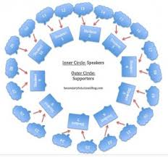
SET UP:
Desks arranged in a circle
Text given in advance
Students must read the text and prepare important questions and references if they intend on participating.
Rules posted
Allow 45-50 minutes
30 minutes for first time
Teacher or Leader is ready with an opening question
Participants respond with textual evidence for support
Participants respond with questions
Students do not raise hands
Students reflect and debrief
Accountability through rubric assessments and student
reflection

Slide 24

Evaluation Considerations
Evaluating student participation during a Socratic Seminar can be challenging.
It would be a mistake to assume that the most talkative students are necessarily the most active participants or that the quiet students are not actively participating.
It may be important to provide the more quiet student with time to reflect on the dialogue and consider how it has shaped their thinking.

Slide 25
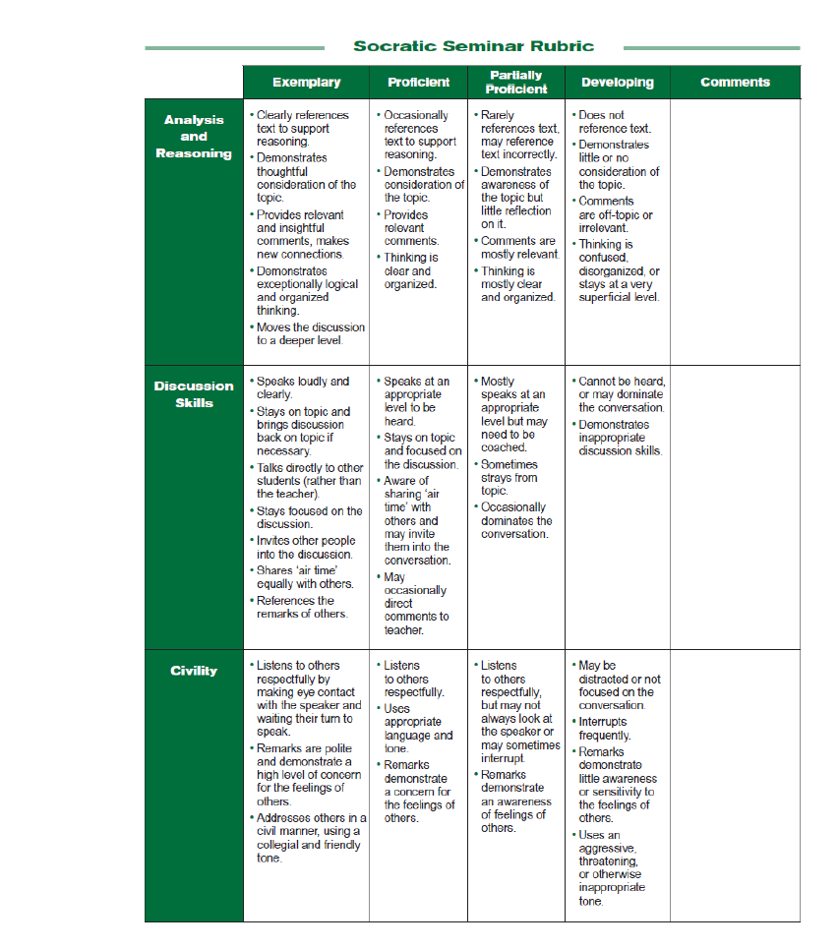
Socratic Seminar Rubric: Page 1

Slide 26
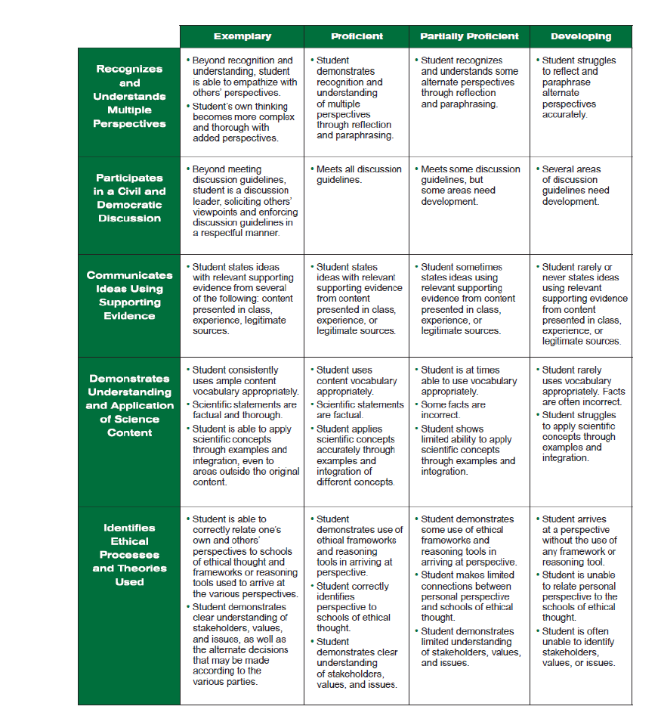
Socratic Seminar Rubric: Page 2

Slide 27
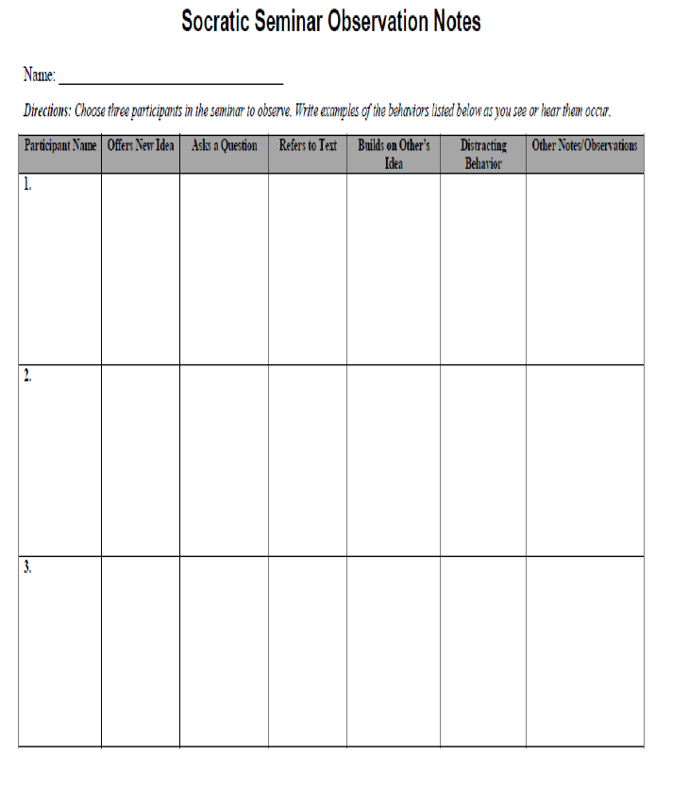
Socratic Seminar Peer Evaluation

Slide 28
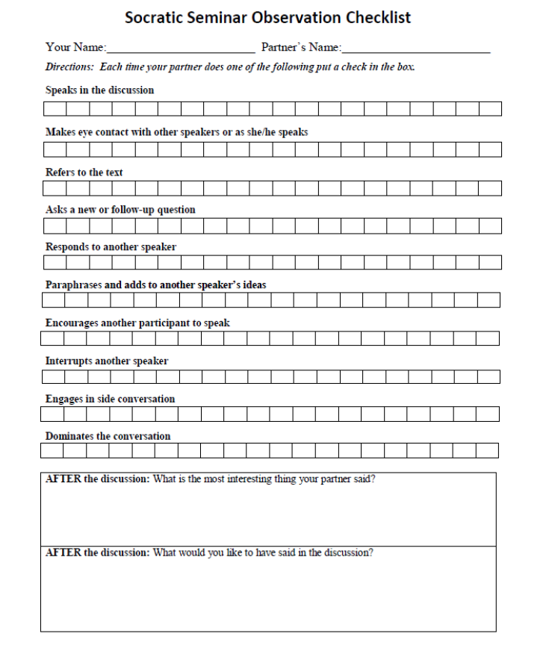
Socratic Seminar Partner Evaluation

Slide 29
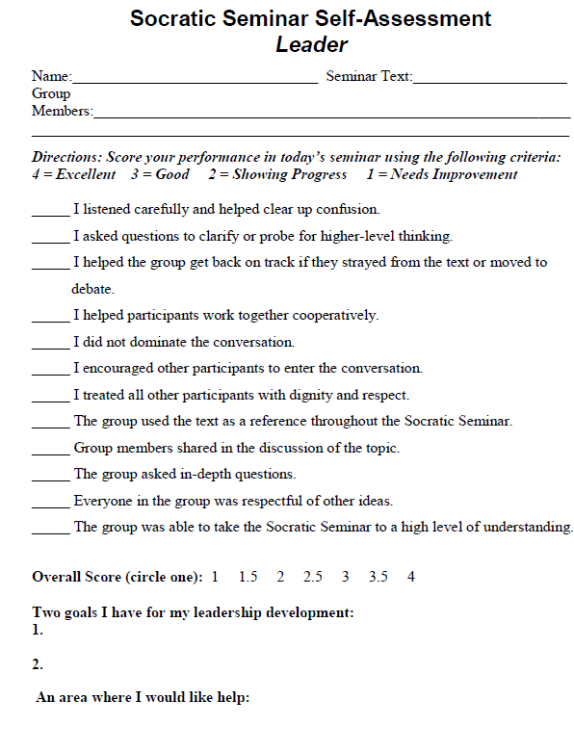
Socratic Seminar Self Assessment: Leader

Slide 30
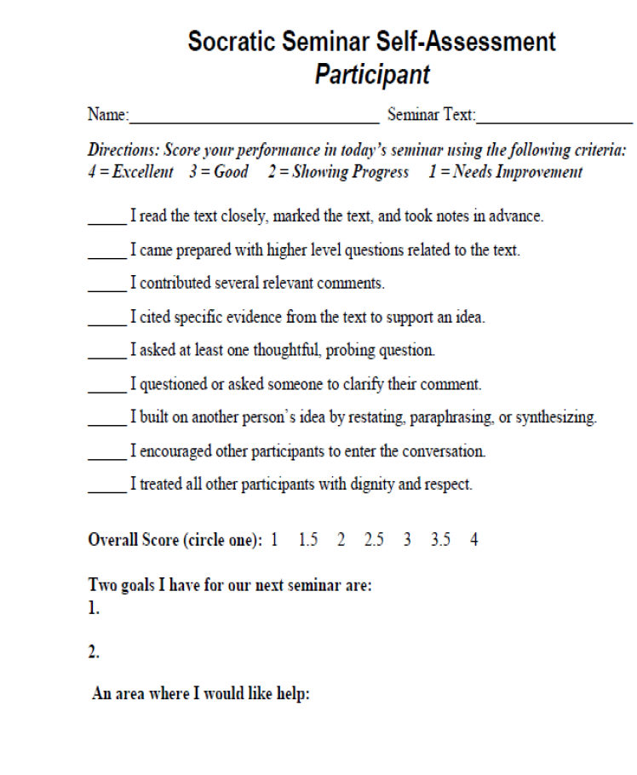
Socratic Seminar Self Assessment: Participant

Slide 31
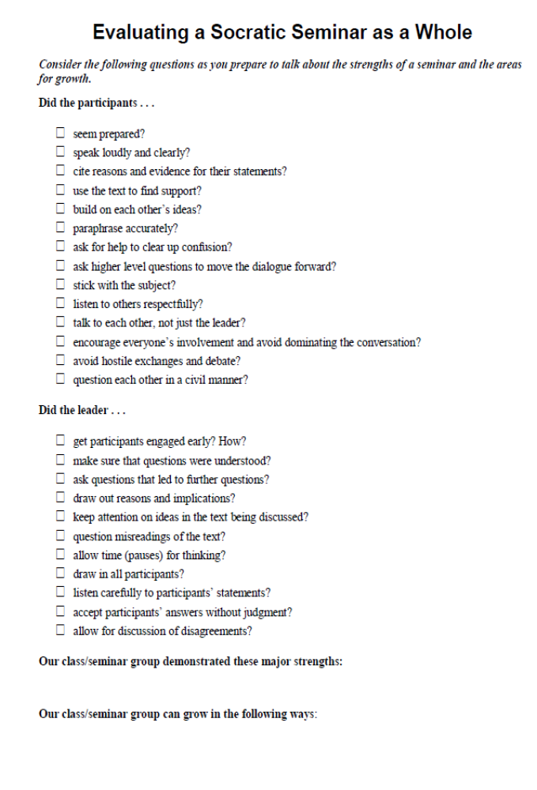
Socratic Seminar Checklist: Teacher Reflection

Slide 32
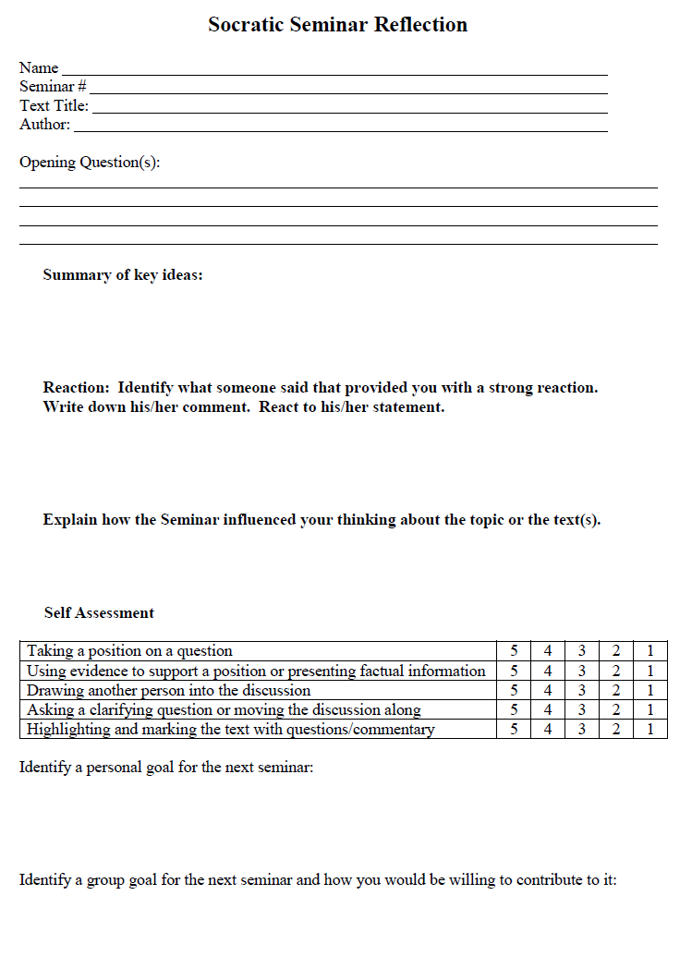
Socratic Seminar: Student Reflection

Slide 33
Socratic Seminar: Student Reflections
Use of “Reflective Questioning”
Questions to consider:
Were we courteous to one another?
Were our comments to the point? Easy to understand?
Did anyone dominate the discussion?
Did we follow our established group norms and process?
Conduct a debriefing:
Have students write a reflection (journal writing)
Debrief on the Socratic Seminar TOPIC
“If you have changed your mind about a particular point or issue, what made you change it?”
Debrief on the PROCESS
What seminar guidelines where observed?
What social skills did the group exhibit?
What might the group goal be for the NEXT seminar?

Slide 34
Socratic Seminar Demonstration (4:31) http://www.youtube.com/watch?v=6pGVR6ZF_2M

Slide 35
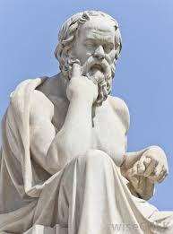

Socratic Seminar Demonstration: “Patience and Practice” (7:25)
http://www.edweek.org/tm/section/teaching-channel/index.html?cmp=ENL-TU-NEWS2

Slide 36
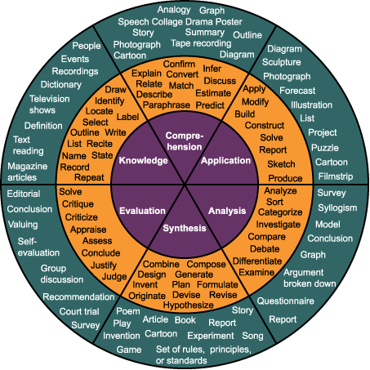
www.robdanin.com
Socratic Seminar
According to Bloom

