Slide 1
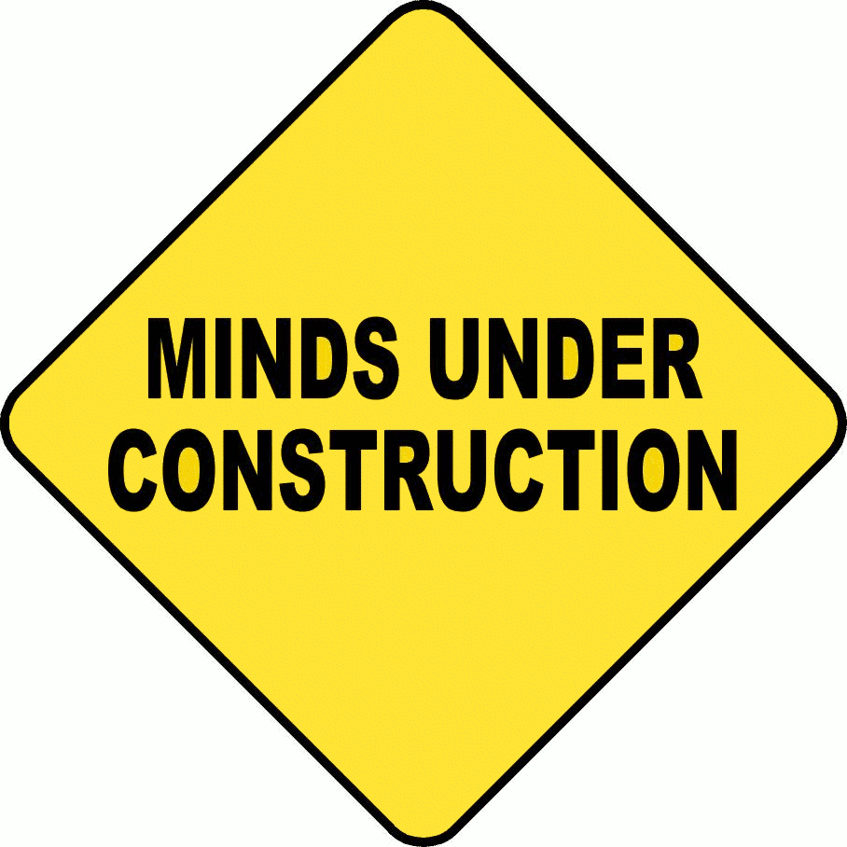
Dr. Rob Danin English Language Specialist www.robdanin.com
Student-Centered Instruction
&
Learning Styles

Slide 2
Student-Centered Instruction: What does this mean?
A ‘student-centered’ focus should be at the heart of our educational efforts.
Supported by solid research and strong pedagogical theory.
Focus of instruction allows for “teacher-as-coach”.
The content and delivery of instruction is culturally responsive which respects and builds on the diverse resources and experiences of learners in the classroom.
The student is central to the learning experience.
Students consistently develop their own reasoning around concepts.
Students work in flexible, cooperative groupings to solve problems.

Slide 3
Student-Centered Instruction: the research & theory
“The ultimate goal for student-centered classrooms is for students to gain independent minds and the capacity to make decisions about their life-long learning .” (Brown, 2008)
Flexible, cooperative groups becomes important when working with students with a variety of language abilities. Grouping gives students the opportunity to clarify key concepts with their native speaking peers. (Echevarria and Graves, 2011)
SCI offers the best means to optimize student learning in college. Current brain research on cognition and learning research shows that if the student is actively engaged in their learning concept attainment is greater. (Doyle, 2011)
To truly effect change, the curriculum needs to be examined and aligned with learner-centered practices. (Cullen, Harris and Hill, 2012)

Slide 4

Student-Centered Instruction: important considerations
Discipline
Class size
Subject within the discipline
Room layout
Classroom dynamic (between students)
Teacher personality
Continuous academic and professional development is paramount

Slide 5
Student-Centered Instruction: a comparison
Teacher-centered
Student-centered
Teachers serve as the center of knowledge
“Sage on the stage”
Less instructional differentiation
Students progress at the “same rate”
Teaching to the middle (the norm)
Lower order thinking skills stressed
Memorization, recall, identify, define
At times very appropriate
Assessment takes the form of traditional exams
Direct instruction
At times very appropriate
Teacher acts as facilitator to help students access and process information
“Guide on the side”
Focus on effective learning strategies
Recognition that students learn in different ways and have different learning styles
Learning is recognized as an active and dynamic process
Students construct their own meaning of what they are learning
Higher order/critical thinking skills
Practical and continuous feedback through authentic assessments
Self and peer assessments

Slide 6
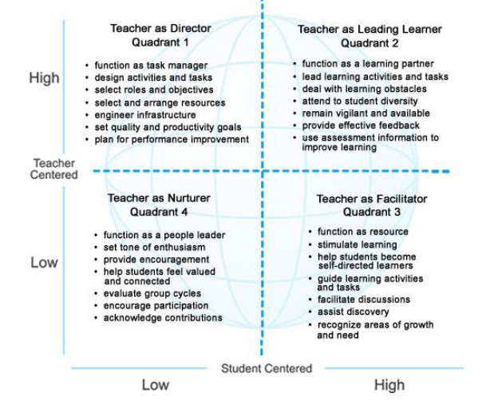
Student-Centered Instruction: What it may look like
The Four Quadrants of Teacher Directiveness (Moss, 2002)

Slide 7
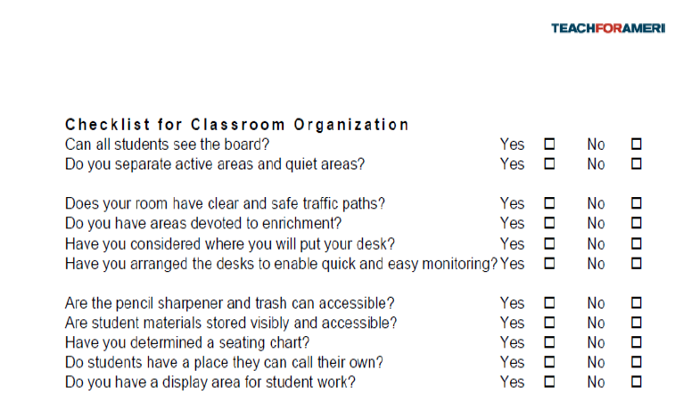
Student-Centered Instruction: Classroom organization

Slide 8
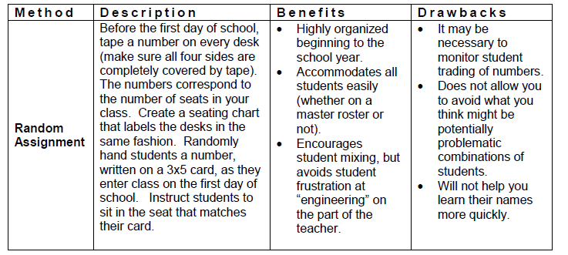
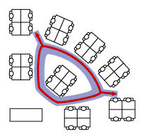
Student-Centered Instruction: MANAGING CLASSROOM SPACE
Possible Classroom Configuration with Corresponding “Traffic Flow”

Slide 9
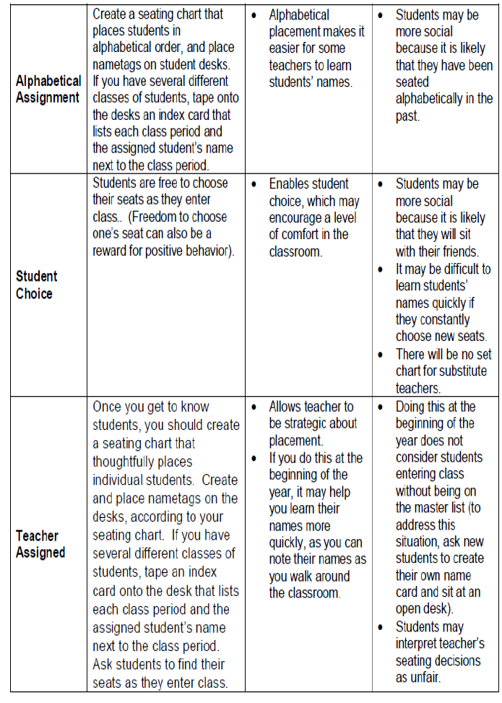
Student-Centered Instruction: MANAGING CLASSROOM SPACE

Slide 10
Student-Centered Instruction: your thoughts
Now it’s your turn:
What is your willingness and ability to:
implement these types of activities
train teachers
based on this theoretical/pedagogical method for learning?
Under what educational context(s) would this instructional framework be appropriate? When is it not?

Slide 11
“democratic” Instructional approaches: A shared responsibility
“Pupils should be treated as reasoning and reasonable beings.” (Tolstoy, 1862)
Methods of instruction that place an emphasis on “co-operative social organization.” (John Dewey's Democracy and Education, 1916)
Learners of all ages need to have some power and responsibility in the institutions of learning where they spend so much of their lives.
Students need to experience and practice meaningful participation within a school’s social framework.
“The relationships teachers and students develop during the learning process aligns with a greater recognition of individual student differences. As with collaboration between students, a more equal relationship between teachers and students may facilitate differentiated instruction.” (Rallis, 1995)

Slide 12
Student-Centered Learning & Learning styles
“Learning is not about passivity and order; it is about the messy process of discovery and construction of knowledge.” (Johnston, 2004)
Essential attributes of the student-centered learning environment:
Educator/student partnerships
teachers and students work together in a cooperative learning environment
Metacognition
Construction of learning
Collaborative learning
These considerations help to determine and define the curriculum development, materials development and instructional methodologies used by the educator.

Slide 13
Metacognition: Thinking About Thinking
Students need to be taught how to create higher-level questions and how to answer them. (Peirce, 2004)
Cognitive strategies help students “learn how to learn”:
to identify the task on which one is currently working
to check on current progress of that work
to evaluate that progress
to predict what the outcome of that progress will be
Through this cognitive process a person learns about his or her own style of learning.

Slide 14
Metacognition: The Four Principles
Principle 1: The nature of the learning process
Principle 2: Goals of the learning process
Principle 3: Higher-order thinking
Principle 4: The construction of knowledge

Slide 15
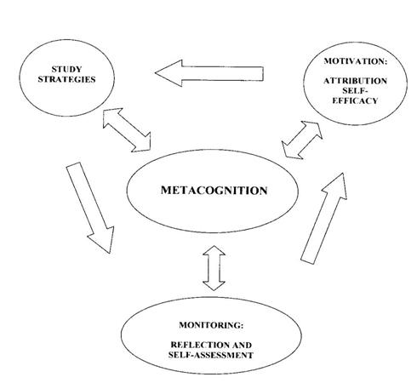
Metacognition: What it looks like
“Autonomous Learning” is when students take responsibility for their own learning. (Holec, 1981)

Slide 16
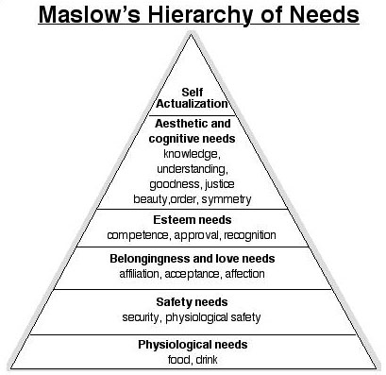
Higher Level Thinking Skills: HOTS

Slide 17
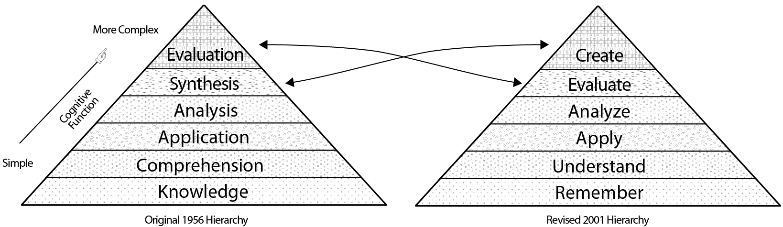
Bloom’s Taxonomy: Another Look

Slide 18
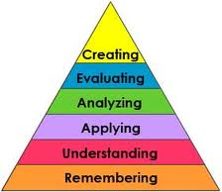
Higher Level Thinking Skills: HOTS
Bloom's Taxonomy

Slide 19
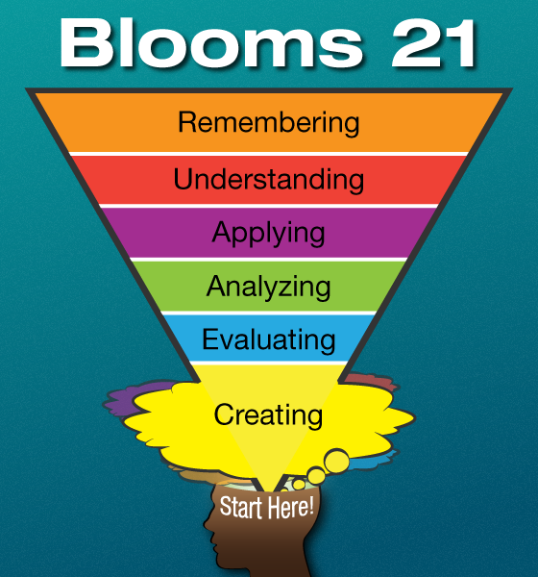
Higher Level Thinking Skills: HOTS
Bloom's Taxonomy Inverted
(for the 21st Century)

Slide 20
Learning styles: how does it all fit?
Personalized Instruction: The effort to organize the learning environment to take into account individual student characteristics and needs and to make use of flexible instructional practices.
To help students to recognize their cognitive strengths and weaknesses
To adapt the learning environment and instruction to learner’s needs and interests
Can be measured by a variety of assessments (e.g., “Learning Styles Inventory”)
Cultural differences: Learning occurs in social/cultural environments. Therefore, access to varied instructional resources to ensure multiple perspectives is vital.
Gender differences: Cognitively “wired” to learn differently

Slide 21
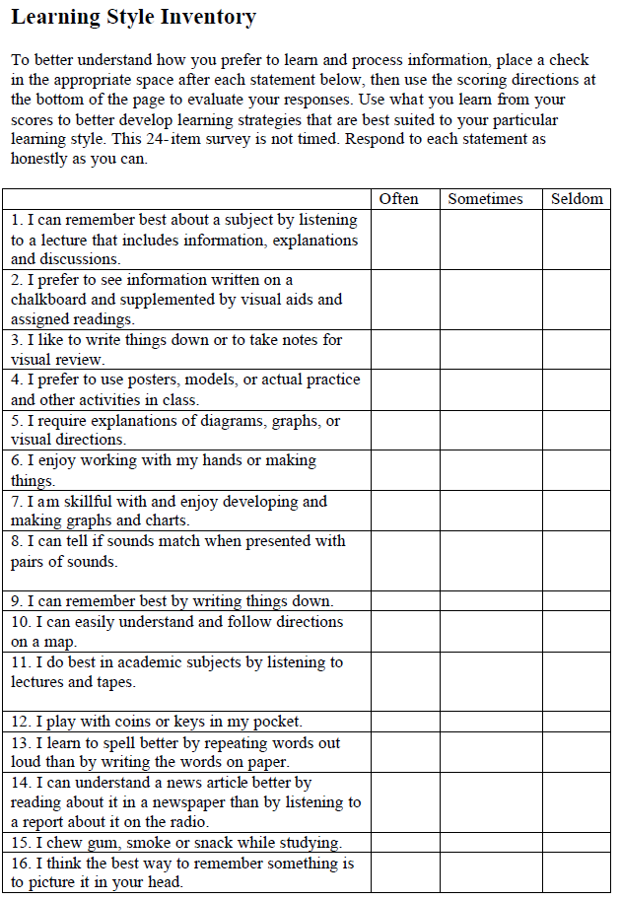
Learning Styles Inventory Try it! http://www.personal.psu.edu/bxb11/LSI/LSI.htm

Slide 22
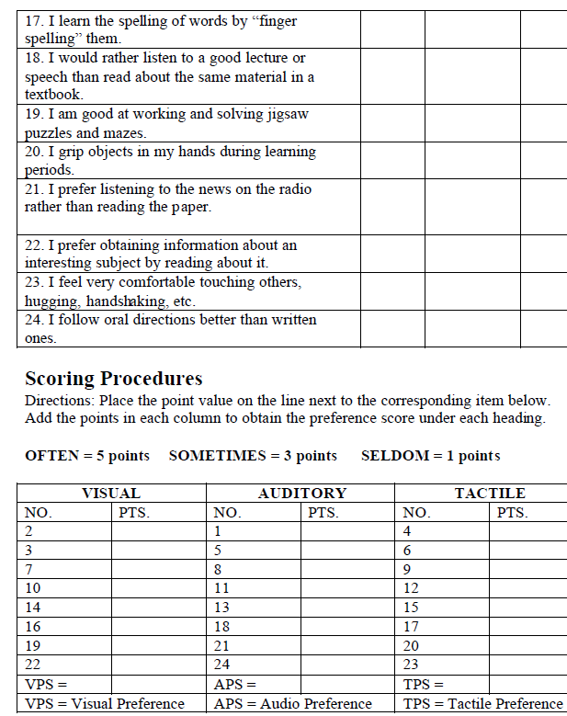
Learning Styles Inventory (con’t.) Great “ice-breaker” classroom activity!

Slide 23
Learning Styles
Teachers who understand their students’ learning styles are better able to adapt their teaching methods appropriately.
Most people exhibit some combination of learning style or prefer one style to another depending on the type of learning task they are undertaking.
Visual learners—prefer to study graphs, look at models and pictures, and take notes to review later
Auditory learners—prefer to listen closely in class, read aloud when studying during lectures in class, or confer with peers in class to confirm information
Verbal learners—likely to absorb reading materials and lectures easily, prefer written materials over visual materials such as graphs and illustrations
Tactile learners—learns through moving, doing, touching (hands-on methods), manipulating materials and objects (realia)
Interesting note: Most teachers are verbal learners and find it easier to relate to and teach students who are verbal learners.

Slide 24
Student learning
Cognitive – visual, auditory, or psychomotor learning
Affective – a personal approach to learning (socio-emotional)
Physiological – individual learning preferences (e.g., “Quiet” deep thought, reflection)
Students vary dramatically in the way they process and understand information.
These differences, called “learning styles”, refer to students’ preferences for some types of learning activities over others.
A student’s learning style has to do with the way he or she processes information in order to learn and apply it.
Students who understand their own styles are likely to be better learners.

Slide 25
Student-Centered/Learning styles approaches
Multiple Intelligences (MI): Howard Gardner Frames of Mind (1983)
Linguistic intelligence: sensitivity to spoken and written language, the ability to learn languages. For example:
Logical-mathematical intelligence: capacity to analyze problems logically, carry out mathematical operations, and investigate issues scientifically. For example:
Musical intelligence: involves skill in the performance, composition, and appreciation of musical patterns. For example:
Bodily-kinesthetic intelligence: potential of using one's whole body or parts of the body to solve problems. For example:
Spatial intelligence: potential to recognize and use patterns.
For example:
Interpersonal intelligence: capacity to understand the intentions, motivations and desires of other people. For example:
Intrapersonal intelligence: capacity to understand oneself.
For example:

Slide 26
Student-Centered/Learning styles approaches
Multiple Intelligences (MI): Other possible intelligences
Naturalist intelligence: enables human beings to recognize, categorize and draw upon certain features of the environment.
For example:
Existential intelligence (spiritual intelligence): concern with 'ultimate issues‘. For example:
Moral intelligence: adoption of any specific moral code regarding personality, individuality, will, character and the realization of human nature. For example:
MI Professional Development Considerations
Create lessons that cultivate MI in the classroom.
Do you have an inclination towards any particular MI attribute(s)? If so, notice whether these influence your instructional approach. The same goes for Learning Styles. If so, in what ways?
MI Inventory: http://surfaquarium.com/MI/inventory.htm,

Slide 27
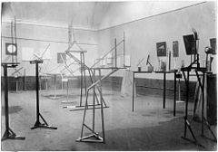
Student-Centered/Learning styles approaches
Constructivism: Vygotsky, Piaget, Dewey, Vico, Rorty, Bruner
Interesting note: Constructivism was an artistic and architectural philosophy that originated in Russia beginning in 1919. The movement was in favor of art as a practice for social purposes.
(From Wikipedia)
[Educational] Constructivism is founded on the premise that by reflecting on our experiences we develop our own understanding of the world we live in.
Comprehension is constructed from background knowledge (prior knowledge).
Reflection: What type of learning experiences have you had (as a teacher or student) that reflect a Constructivist approach to learning?

Slide 28
Student-Centered/Learning styles approaches
Constructivism: Some misconceptions
Adopting a constructivist theory implies that all learning is “discovery learning” (student-centered).
“Direct instruction” of basic skills (background knowledge) is not incorporated into the classroom.
Reflection: What types of learning would Constructivist approaches would most likely be appropriate? Inappropriate?
Reflection: How can MI strategies be incorporated in a Constructivistic activity?

Slide 29
Student-Centered/Learning styles approaches
Cooperative Learning: Johnson & Johnson, Slavin
Collaborative Learning: method of teaching and learning in which students team together to further explore concepts learned, create a meaningful projects, and the like. Typically less teacher structured.
Cooperative Learning: a form of collaborative learning. Student work cooperatively in small groups on more teacher structured activities.
Encourages collaborative behaviors among groups of individuals.
Learning is highly social and influences the development of the brain. (Vygotsky, 1978)
Students are individually accountable for their work. Also, whole group cooperation is assessed. (Gifted students generally do not like this style of instruction. Some cultural groups also do not like this type of methodology. Why do you think?)

Slide 30
Student-Centered/Learning styles approaches
Emotional Intelligence (EQ/EI): Daniel Goleman (1995)
Affective Education: Emotions and feelings of inadequacy tend to be stronger when students learn a foreign language. (Genesee, et al., 2006)
Teachers need to create a learning environment that promotes emotional security
Intelligent use of one’s emotions
Teachers set the emotional tone of the classroom
Based on brain research: passion, motivation, commitment
Self-directed learning
The ability to be self-aware
The ability to manage oneself
Encourages motivation to develop one’s abilities by celebrating one’s strengths rather than focusing on weaknesses
Intrinsic motivation to learn

Slide 31
Emotional Intelligence (EQ/EI): Responsive Classroom Methods
The goal is to help create a culture where students care about each other, their school/classroom and their learning.
Designed to improve the ways teachers interact with students and the way the students interact with each other.
Morning meetings can be used to build “classroom community”
Gets students ready for the lesson
goals/objectives/outcomes
Helps in providing ‘calm and smooth’ classroom transitions
Reinforces the proper use of social skills among the students
Students' perceptions of their teachers can also affect cheating behavior.
When students perceive that their teachers are competent and caring, they are less likely to cheat in those classrooms
Learn the students' names, ask about their lives outside of class, offer to help with assignments, offer more opportunities for student choice and voice in the classroom

Slide 32
Student-Centered/Learning styles approaches
Socratic Seminar : Socrates (c. 469 BC – 399 BC)
Helps to achieve a deeper understanding about the ideas and values in a text.
Participants systematically question and examine issues and principles related to a particular content as well as articulate different points-of-view.
Group conversation assists participants in constructing meaning through disciplined analysis, interpretation, listening, and participation.
The participants carry the burden of responsibility for the quality of the discussion.
Key elements:
Text: All participants read the text in advance
Classroom Environment: Room arrangement and group norms
Questions: Open-ended. Both teacher and student generated

Slide 33
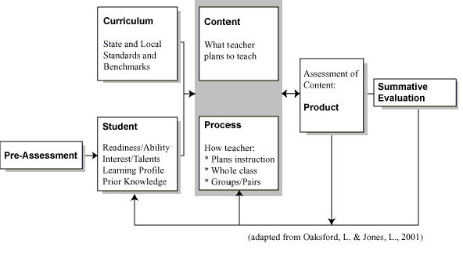
Learning Styles: Curriculum Development

Slide 34
Learning Styles: Teaching Methodologies
Provide a balance of concrete information (facts, data, and experimental results) and abstracts concepts (principles, theories, and models.). Teaching as a science.
Balance materials that emphasize practical problem-solving methods with materials than emphasizes fundamental understanding.
Use pictures, graphs, and other visual cues before, during and after the presentation of verbal material.
For the auditory learner, paraphrasing is a powerful strategy for making material meaningful.
Bottom line: Only meaningful information is transferred to long term memory.

Slide 35
Learning Styles: Differentiated Instruction
Customized lessons in order to meet students’ varied learning needs
Tiered Activities
Develop Personal Agendas for Completion of Work
Self Talk-”Here’s my plan for how to complete this project.”
Manipulatives (or) Hands on Supports
Varying the Length of Time (Pacing)
Memorization
KWL
Reciprocal Teaching
Creating dioramas
Constructing mathematical models
Developing photos
Debating
Semantic Webbing/Graphic Organizers

Slide 36
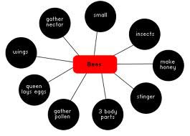
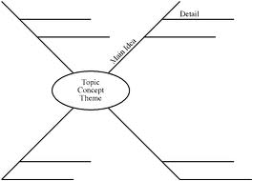
Differentiated Instruction: Semantic Webbing/Graphic Organizer

Slide 37
Learning Styles: Materials Development
How to?
Examples:
Determine the ability level of your students
Align tasks and objectives to learning goals
Survey student interests/Learning Styles
Interest Inventories, Interview/Conference, respond to Open-Ended Questionnaire
What are your student’s preferences and motivators?
Brain-based research
Know YOUR students
Use instructional materials at varying readiness levels
Put text materials on tape
Use Study Buddies
Meet with small groups to re-teach a concept or skill for struggling learners or to extend learning

Slide 38
Student-Centered/Learning styles: The role of the teacher
Focus on careful and strategic planning.
Establish high expectations: Let students know that you are challenging them because you recognize they have the ability to meet those expectations.
Create a risk-tolerant learning zone: Make it clear that mistakes are to be expected and that we can all learn from them.
Give feedback that focuses on process: Including students’ effort, persistence and proper cognitive strategies. Avoid “empty praises” for their ‘smartness’.
Introduce students to the concept of having an open mind to new forms of learning.
Have fun learning alongside your students!

Slide 39
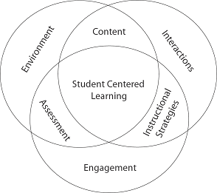
The Essence of Student-Centered Learning
Please consider the following question:
“What are you doing in your classroom now that you could turn over to your students to do themselves?”

