Slide 1

Syllabus Design
Dr. Rob Danin
English Language Specialist
www.robdanin.com

Slide 2
Things to consider When developing your syllabus
A well-designed syllabus includes:
a contract
syllabus design is concerned with the selection, sequencing and justification of the content of the curriculum (Nunan, 2001)
strong and achievable learning objectives
an outline indicating what students are expected to know and be able to do as a result of having participated in the course
subject matter, assignments, readings, and activities
Syllabus design should offer sufficient flexibility in order to change the course sequence, if necessary (e.g., snow day)
Assessment: Continuous assessment is suggested for the course: oral presentation; written organization; collaboration

Slide 3

Purpose of the Syllabus
A syllabus serves to provide a “road map” for a course
both for the instructor and the students
Most of the students feel discontent with the syllabus [if] it doesn’t meet their needs (AbdulMahmoud, 2010).

Slide 4
Student-Centered Focus: Learner Autonomy
Student-centered focus - the ability to take charge of one's learning (Holec, 1981).
The teacher should be very much involved in assisting learners with their learning (Schwienhorst, 2003).
Learners can choose to be more or less independent at different points in their learning process (Dickinson, 1987).
Learners should be encouraged to reflect on their learning and ways to improve it (Little, 1997).
When a syllabus is designed to promote learner autonomy, the focus of the syllabus is clearly on a student-centered approach (Gardner & Miller, 1994).
The development of learner autonomy should have strong coordinated elements between teacher and learner (Little, 1995).

Slide 5

Syllabus Design from Natalia Kasatkina, Svetlana Dandanova (Yaroslavl State University)
Content: First, reflect on the course you plan to teach. A syllabus cannot be built prior to course design.
Student Input: Next, consider the amount of student sharing (collaboration) you'd like to embrace in your course.
Policies: You will want to develop a set of policies that are based on your prior experiences with similar groups of students.
Schedule: This should include the topics to explore, presentations, guest speakers and assignments.
Setting the Tone: Once the basics of your syllabus are in place, consider the tone you are setting with your students.
To emphasize policies or deadlines, use italics, bold or underlining to draw student attention.
Keep in mind that ALL CAPS IS LIKE SHOUTING.

Slide 6
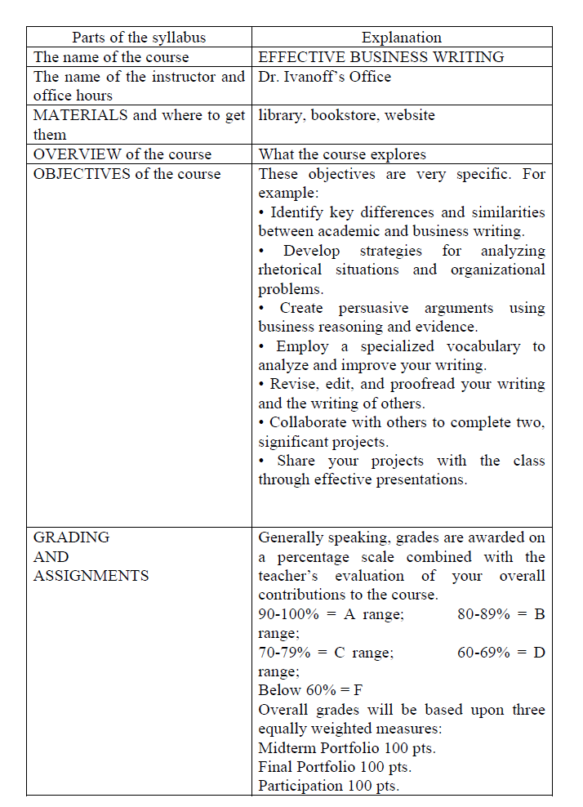
Sample Syllabi 1

Slide 7
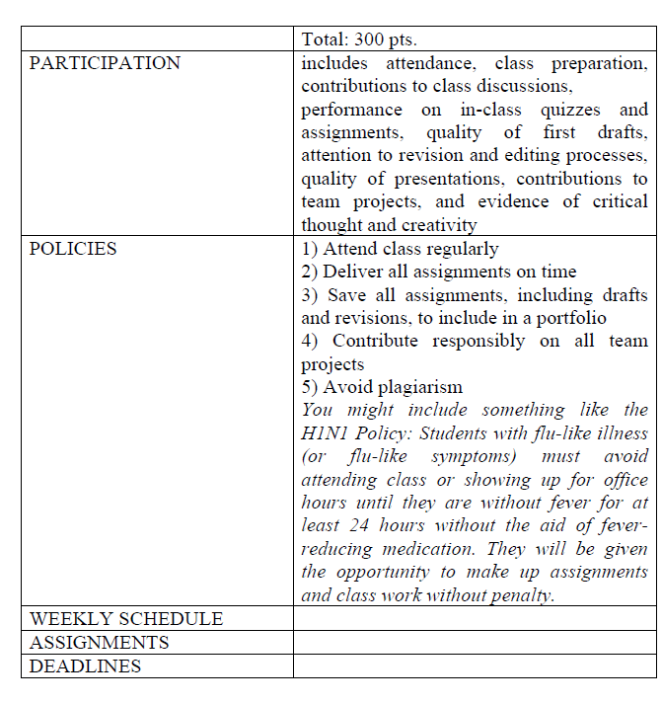
Sample Syllabi 1

Slide 8
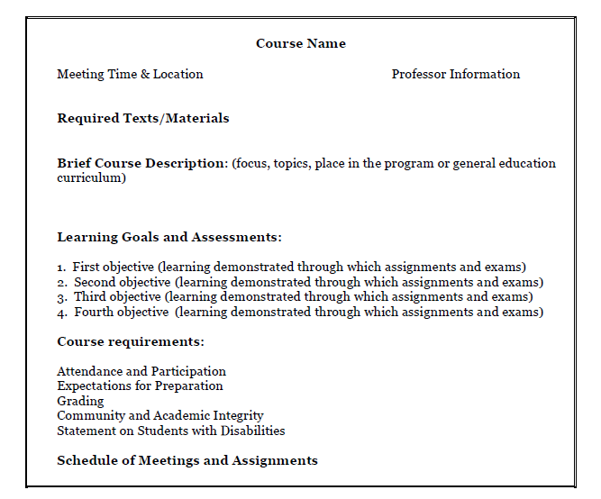
Sample Syllabi 2

Slide 9
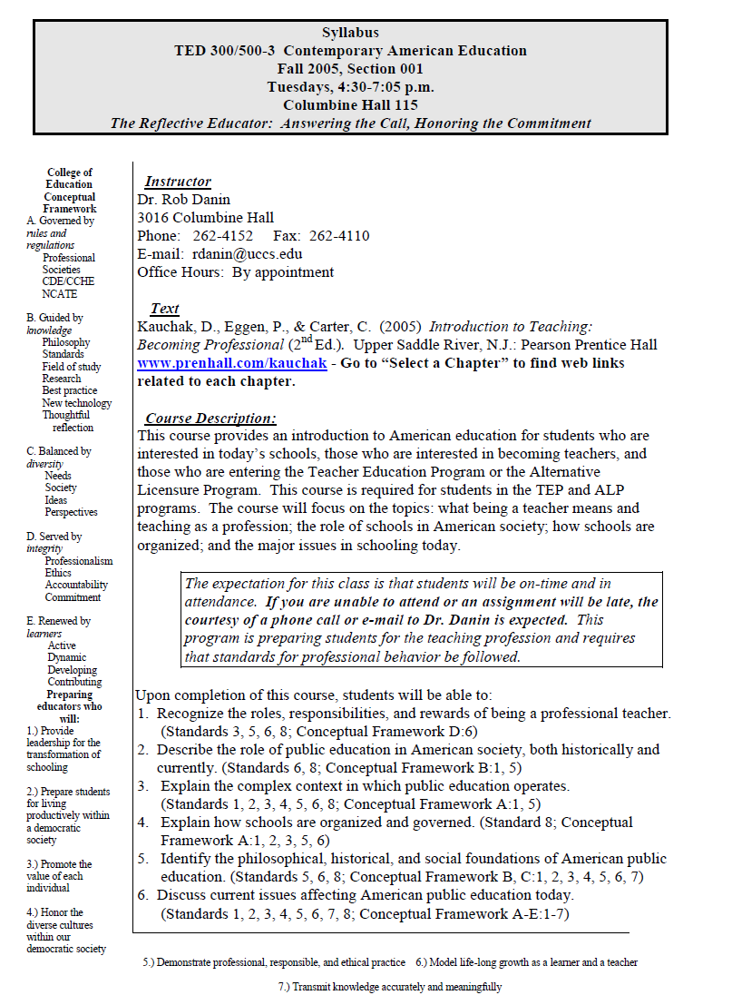
Sample Syllabi 3 (Abridged) from 7 pages!

Slide 10
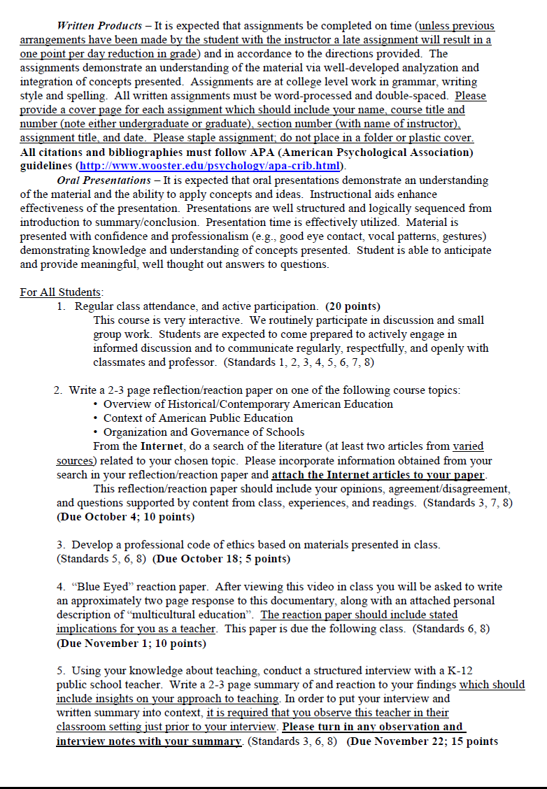
Sample Syllabi 3 (Abridged)

Slide 11
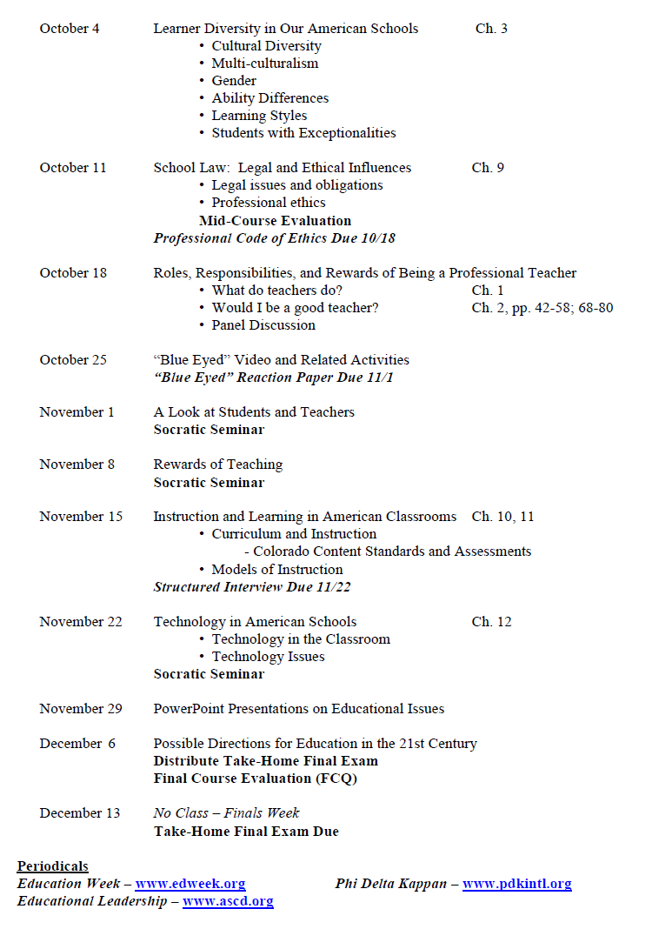
Sample Syllabi 3 (Abridged)

Slide 12
Syllabus Attendance policies
Responsibility for class attendance rests with the student.
Regular and punctual attendance at all scheduled classes is expected.
Instructors should set an attendance policy for each course they teach.
Instructors should state clearly in their syllabi their policy regarding student absences and how absences affect grades.

Slide 13
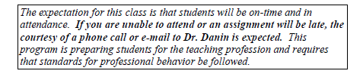
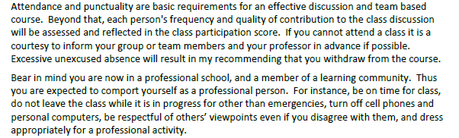

Syllabus Attendance policies More examples at www.robdanin.com
Attendance statement from previous syllabus sample
Some other sample attendance policies

Slide 14

Syllabus Design Work Sessions
With the template that follows and provided to you in hardcopy, please take the time to update, revise or create a new course syllabus.
Feel free to work with a partner or in groups.
Please be willing to share the progress you have made in the designing of your syllabus.
share your suggestions and experiences!
Syllabus Design www.robdanin.com

Slide 15
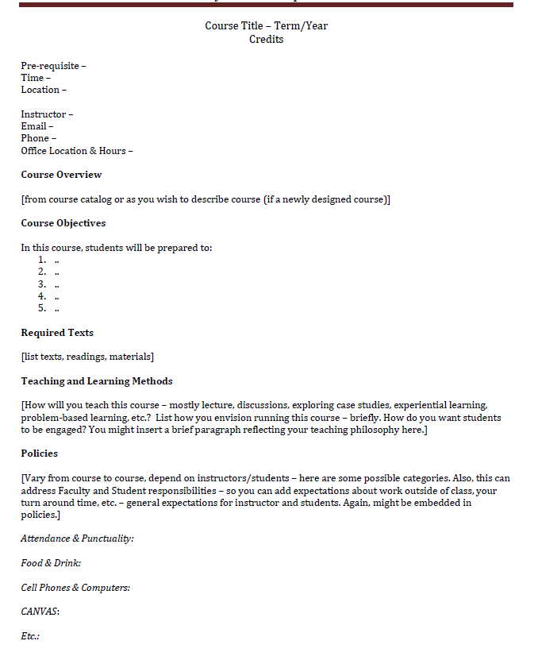
Syllabus template – Page 1

Slide 16
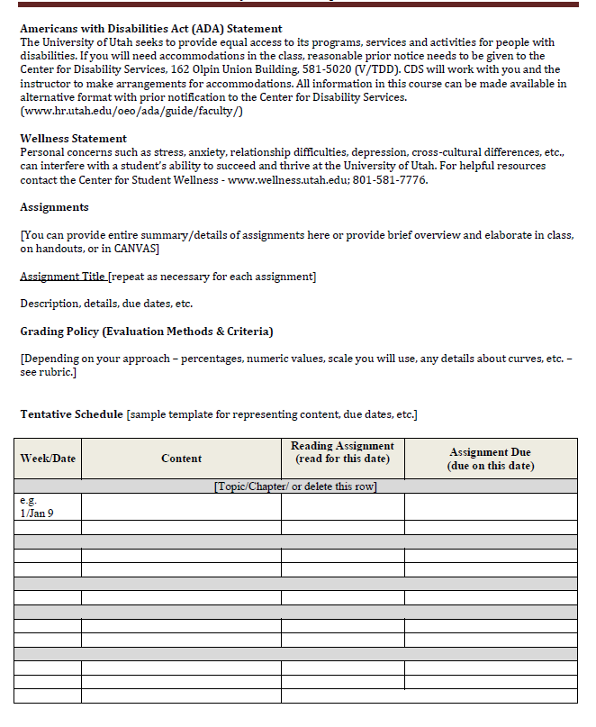
Syllabus template – Page 2

