Slide 1
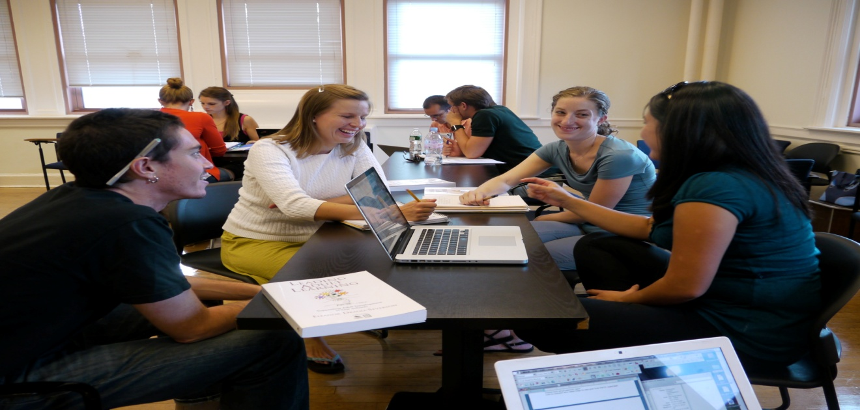
Working In Groups: An Overview
Dr. Rob Danin
English Language Specialist
www.robdanin.com

Slide 2
Student-Centered Approach
Cooperative Learning: Johnson & Johnson, Slavin
A form of collaborative learning. Student work cooperatively in small groups on more teacher structured activities.
Learning is highly social and influences brain development. (Vygotsky, 1978)
Encourages collaborative behaviors among groups of individuals.
Students are individually accountable for their work. Whole group cooperation is also assessed.
Gifted students generally do not like this style of instruction. Some cultural groups also do not like this type of methodology.
Why do you think?

Slide 3
Benefits of Cooperative Small Groups
Provides a good opportunity for students to share information and ideas with each other.
Effective in developing students’ critical thinking and higher-order skills.
Has a positive effect on students’ interpersonal relationships.
students of different races, ethnicities and academic abilities work together

Slide 4
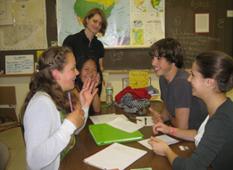
The Teacher’s Role
Cooperative small groups in the classroom represents a shift from direct to guided instruction and supervision on the part of the teacher.
Be prepared to let go. Ask questions rather
than direct behavior.
The students must learn to solve problems for themselves.

Slide 5

Student Participation
Some studies have found that low-achieving students spend less time off-task in cooperative small groups.
Tasks: Consider the type of instructional activities based on the level of proficiency by your students.
Motivation: Cooperative group work increases students’ motivation to help one another.

Slide 6
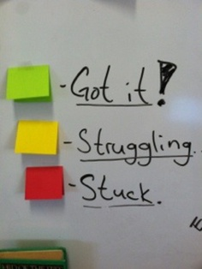
Feedback
It is essential for students working in cooperative small groups to receive feedback from the teacher on their group products and on the quality of the group process.
Students working in groups also give and receive peer feedback and need to be taught how to respond constructively to one another.

Slide 7
Tips for Working in Groups
Give students training on how to work in a group.
Group Norms: Developing rules for cooperative
behavior.
Group Responsibility: Creating roles within groups to enforce the norms and increase equal participation.
Group Composition: Don’t plan groups on the basis of friendships. Use a mixture of group members (community of learners).
academic achievement
gender
ethnicity
socioeconomic status

Slide 8

Tips for Working in Groups
Accountability: Can be established in a variety of ways. For example:
Each group member is responsible for a specific part of the task.
Each group member produces an individual product using the group to help.

Slide 9
Examples of Group Norms
See to it that everyone participates (roles).
Keep the group moving forward on the task to meet the deadline (on-task).
Make sure that students consider each other’s
opinions and listen to each other (speaking/listening).
Make sure that students give reasons and justify their arguments (reflection).

Slide 10
Suggestions for Small Group Tasks
Pick an interesting and intellectually challenging task.
Pick a task that is real-world (authentic) than ordinary classroom work.
Pick a task that involves a variety of skills and activities.
group discussion
interviewing
role playing
manipulating
creating a model building
observing
reasoning

Slide 11
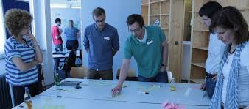
Wrap-Up
Bring the class back together after tasks are completed for a performance or report by each group.
Be sure to provide feedback on how well groups operated, and how each individual made contributions to the task.
teacher
student
classmates

Slide 12
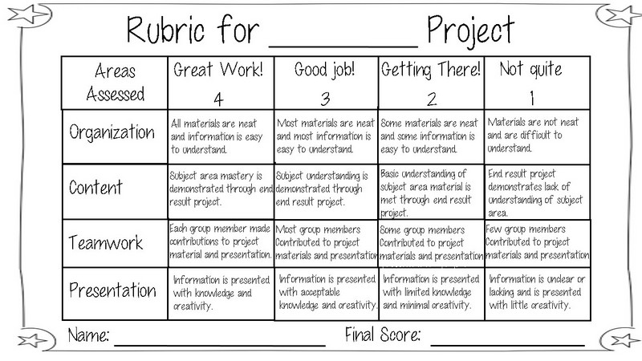
Group Work Rubric

Slide 13
Thanks for having your students work in groups!! www.robdanin.com

