Slide 1


Thanks to: Diane Moore (2007), Katie Alexander (2009)

Slide 2
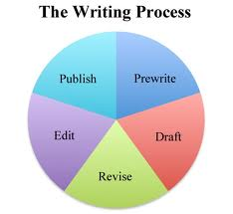

Slide 3


Slide 4
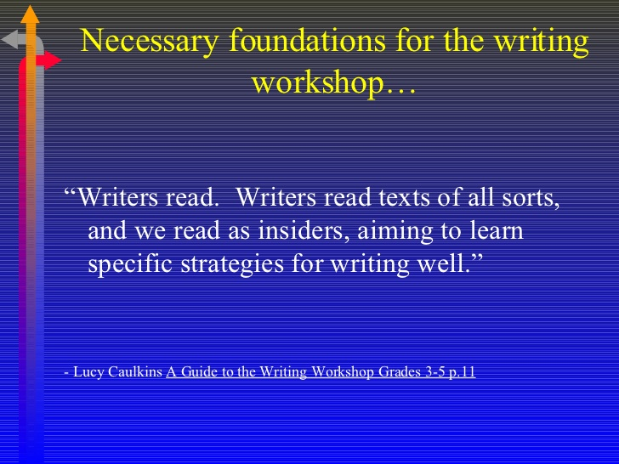

Slide 5


Slide 6
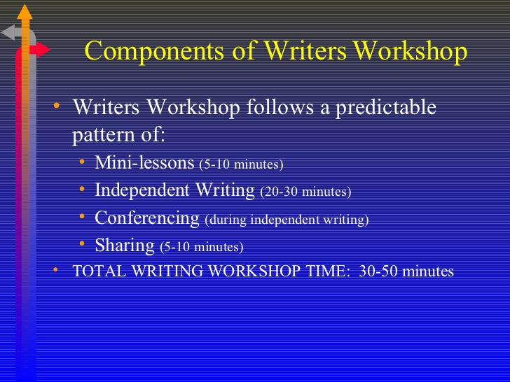

Slide 7
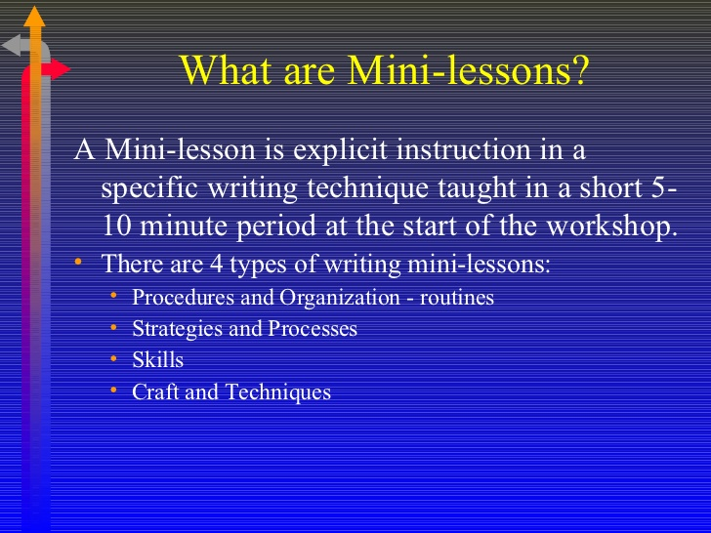

Slide 8
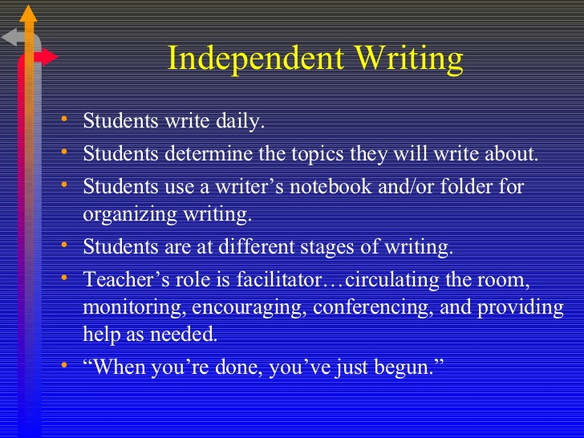

Slide 9
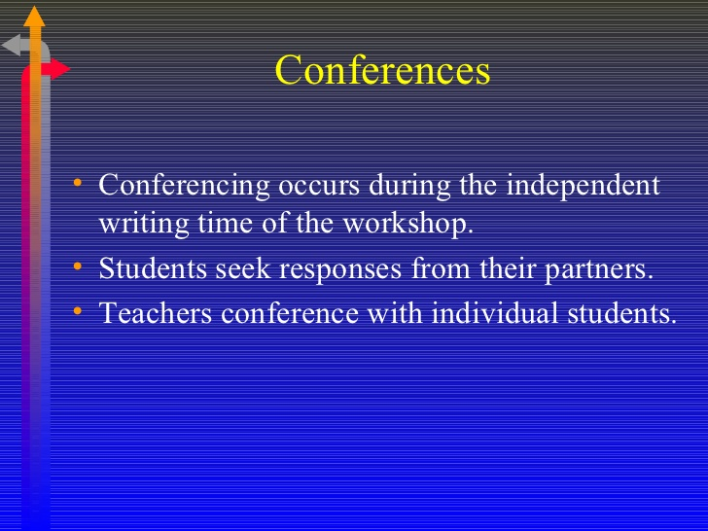

Slide 10


Slide 11
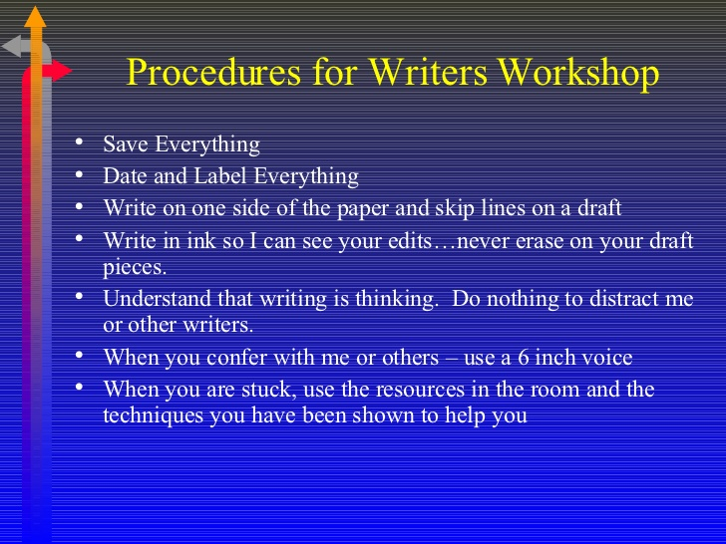

Slide 12


Slide 13
Writing Models
Re-Evaluate once finished
reread their previous entries
share their writing with a classmate
Author's Chair
students get to orally share their writing entry
student in the author's chair then gets to ask three students to either ask a question about their entry or to share a comment on what they thought about their writing
focusing on meaning and content (also supports speaking and listening skills)

Slide 14
Modes of Creative Writing
Creative writing: to entertain the reader
Descriptive writing: to describe a person, place, or event so that the topic can be clearly seen in the reader's mind. The writer must use vivid details that paint a picture for the reader
Expository writing: to provide information such as an explanation or directions
Narrative writing: narrative writing is to describe an experience, event, or sequence of events in the form of a story
Persuasive writing: to give an opinion and try to influence the reader's way of thinking with supporting evidence

Slide 15
Writing Prompts
What would you do if you suddenly woke up in another country and no one could understand a word you said!
What would you do if you could fly?
What would you do if you were the last person on earth?
Write a poem about your favorite person, animal, or place.
What is your dream vacation? Why?
Write a story from the perspective of a rabbit going down a hole. What does the rabbit experience, see and feel?
What would you eat if you were on a deserted island? How would you catch your food?
Imagine you are a mountain and you are sitting and watching the world. What have you seen in your lifetime?

Slide 16
Journaling Techniques
Summarize your day in 20 words or less.
Write one word across the journal page that best describes your day.
Write out the lyrics to your favorite song.
Compose a song.
Write a poem. Draw a picture that relates to this poem.
Write in your journal using colorful markers or colored pencils.

Slide 17


Slide 18
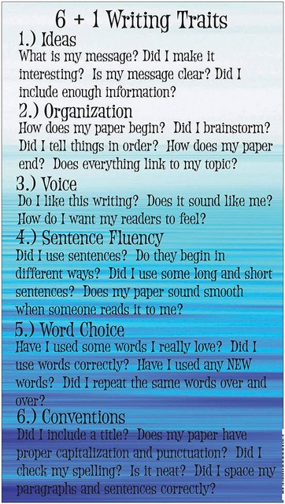

Slide 19
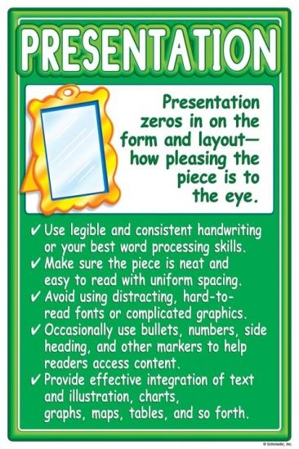

Slide 20
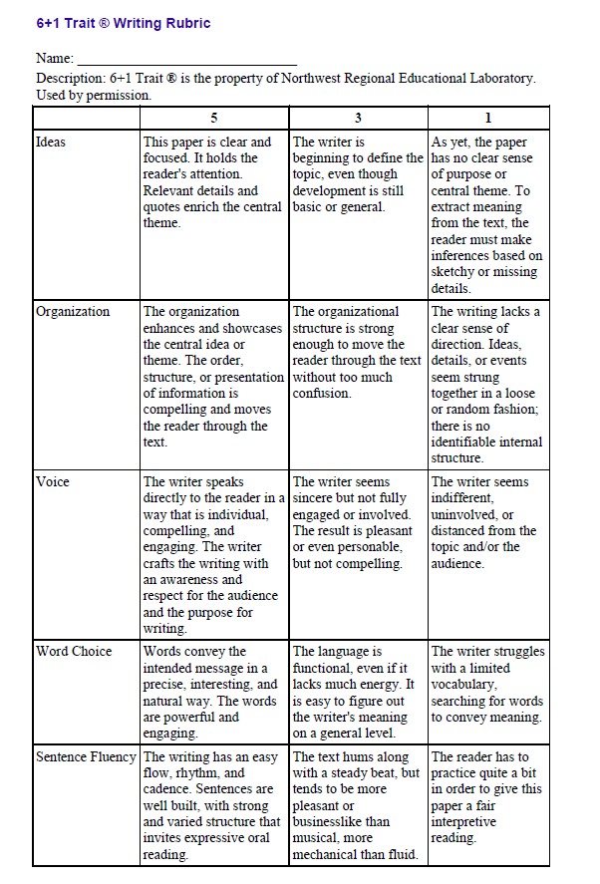

Slide 21
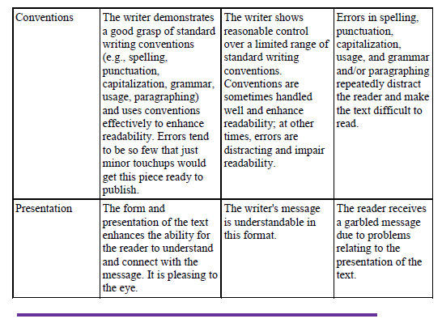

Slide 22
Useful Links
Writer’s Workshop: Overview (YouTube)
http://www.youtube.com/watch?v=ttlKQAoWBKk
Writer’s Workshop: Mini-lessons & Conferencing (YouTube)
http://www.youtube.com/watch?v=b-x7GMsYkD8
6+1 Trait Writing: Ideas (YouTube)
http://www.youtube.com/watch?v=qsER_iTmtBs
Write More, Grade Less by Mike Schmoker
http://mikeschmoker.com/write-more.html

