Slide 1

WRITING A RESEARCH ARTICLE
Dr. Rob Danin
English Language Specialist
www.robdanin.com

Slide 2
FORMAT FOR THE PAPER
TITLE
Make your title specific enough to describe the contents of the paper. The title should be appropriate for the intended audience.
The title usually describes the subject matter of the article: “Towards an Understanding of Culture in L2/FL Education”
Sometimes a title that summarizes the results is more effective: “How Native English Speakers Can Be Better English Teachers in Russia”

Slide 3
FORMAT FOR THE PAPER
AUTHORS
The person who did the work and wrote the paper is generally listed as the first author of a research paper.
For published articles, other people who made substantial contributions to the work are also listed as authors.

Slide 4
FORMAT FOR THE PAPER
ABSTRACT (Summary)
The abstract should be a little less technical than the article itself.
Your abstract should be one paragraph, of 100-250 words, which summarizes the purpose, methods, results and conclusions of the paper.
Start by writing a summary that includes whatever you think is important and then edit.
Don't use abbreviations or citations in the abstract. It should be able to stand alone without any footnotes.

Slide 5
FORMAT FOR THE PAPER
INTRODUCTION
The introduction summarizes the relevant literature (lit review) so that the reader will understand why you were interested in this particular topic.
What is the focus of your article?
Why is it interesting?
Questions for further review
One to four paragraphs should be enough.
Make sure you address all the questions you posed in this section of the paper.

Slide 6
FORMAT FOR THE PAPER
MATERIALS AND METHODS
How did you answer the questions in your introduction?
Look at other research papers that have been published in your field to get some idea of what is included in this section.
Do not put results in this section.
Mention relevant ethical/cultural considerations.
Various cultures view certain ethical practices differently (e.g., confidentiality)

Slide 7
FORMAT FOR THE PAPER
RESULTS
Summarize your main findings in the text.
Do not discuss the results or speculate as to why something happened; that goes in the Discussion section of your paper.
This is where you present the results of your research.
Use diagrams, charts/tables or flowcharts to help clarify key points in your article if appropriate.
Don't use these just to be "fancy". If you can summarize the information in one sentence, then a visual representation is not necessary.

Slide 8
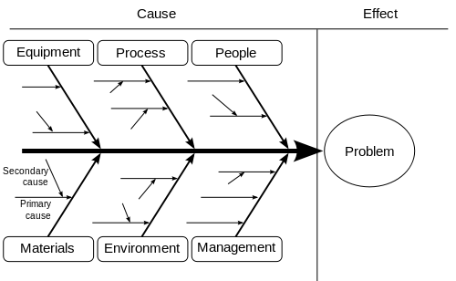
DIAGRAM

Slide 9
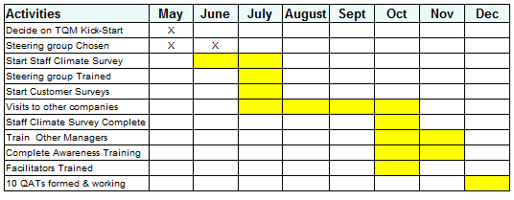
Table / Chart

Slide 10
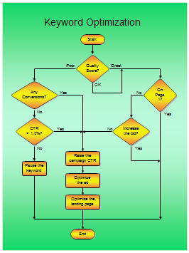
FLOWCHART

Slide 11
FORMAT FOR THE PAPER
DISCUSSION
Highlight the most significant results, but don't just repeat what you've written in the Results section.
How do these results relate to the original question(s)?
If your results were unexpected, try to explain why.
End with a one-sentence summary of your conclusion, emphasizing why it is relevant.

Slide 12
FORMAT FOR THE PAPER
ACKNOWLEDGMENTS
This section is optional. You can thank those who either helped with your study or made other important contributions.
REFERENCES (LITERATURE CITED)
Credit use of somebody else's words or ideas (Citations)
There are several possible ways to organize this section.
APA, MLA, Chicago http://myweb.wssu.edu/wallr/ms_form_comparison.htm
USEFUL BOOK
William Strunk, Jr. and E. B. White, The Elements of Style, 3rd ed. Macmillan, New York, 1987.
http://www.bartleby.com/141/ (online)
http://faculty.washington.edu/heagerty/Courses/b572/public/StrunkWhite.pdf (PDF)

Slide 13
Other Considerations
EDIT YOUR PAPER
"In my writing, I average about ten pages a day. Unfortunately, they're all the same page." Michael Alley, The Craft of Scientific Writing (1996)
Write accurately
Although writing instructors may tell you not to use the same word twice in a sentence, it's okay for scientific writing.
Make sure you say what you mean
Use past tense except when referring to established
facts
The paper will be submitted after all of the work is completed.
Be careful with commonly confused words
Culture has an effect on language learning.
Culture affects language learning.

Slide 14
Other Considerations
Write clearly
Write at a level that's appropriate for your audience.
Use the first person
Instead of: It is thought Write: I think
Use short sentences
A sentence made of more than 40 words should probably be rewritten as two sentences.
Check your grammar, spelling and punctuation
Use a spellchecker, but be aware that they don't catch all mmistakees.
Don't, use, unnecessary, commas.
Proofread carefully to see if you any words out.
Proof your paper by reading it from bottom to top

Slide 15
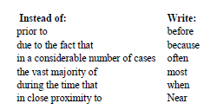
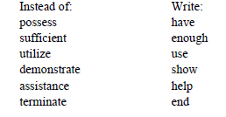
Other Considerations
Write succinctly
Use concise terms

Slide 16
Other Considerations
The top ten overused phrases:
1 - At the end of the day
2 - Fairly unique
3 - I personally
4 - At this moment in time
5 - It's not rocket science
6 - Absolutely
7 - It's a nightmare
8 - Shouldn't of
9 - 24/7
10 - With all due respect

Slide 17
Other Considerations
Careful Using Clichés
Avoid it like the plague
Dead as a doornail
Take the tiger by the tail
Low hanging fruit
If only walls could talk
The pot calling the kettle black
Think outside the box
Thick as thieves
But at the end of the day
Plenty of fish in the sea
Every dog has its day
Like a kid in a candy store

Slide 18
Other Considerations Article Publication
Non-Juried
Any source that is not in a peer-reviewed research journal
Non-peer reviewed/non-juried/non-refereed (all of those words mean the same thing)
Such sources include newspapers, magazines, websites, non-academic books, etc.
Juried
The peer review process ensures that the information in an article is reliable
Submission to a professional research journal
Article is reviewed anonymously by a panel of other researchers in the same field
If approved by the reviewers, then article is published

Slide 19
Creating an Outline for Your Article
Title (and Authors)
Make this as catchy as possible
Your reader will read this first then decide if he or she will continue reading the rest of the article
Introduction
Introduce the problem you will be discussing or write a short story of your experience with the problem
Body: this includes
Materials and methods
Results (use of visual graphics?)
Discussion
Acknowledgments and references
Abstract (and title)
Consider writing this after the completion of the article
This may help more accurately align the abstract/title to the central theme of the article

Slide 20
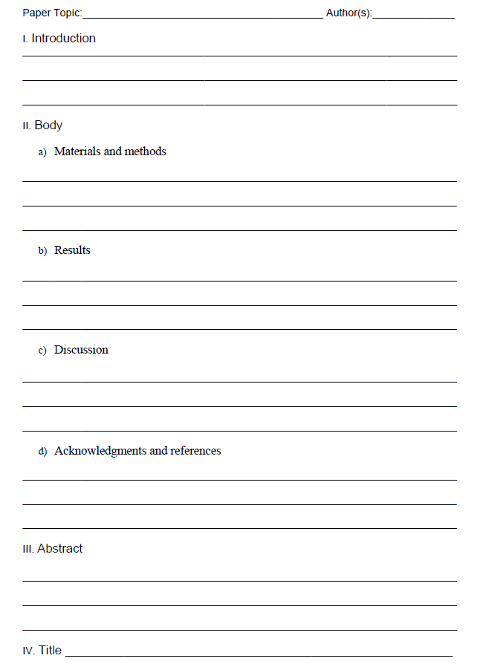

Slide 21
Writer’s Workshop
In small groups, please do the following:
Generate possible article ideas
You may already have one!
Collect writing ideas from the group
Choose “seed ideas” that work for you
Plan and begin an article draft
With the article outline provided (or using another outline method), please take time to begin a draft of a possible article you may decide to write.

Slide 22
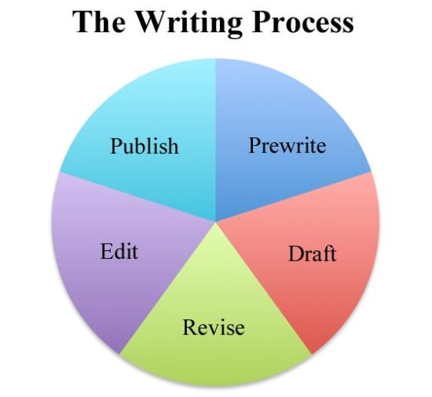
Best of luck! www.robdanin.com

