Slide 1



Writing Effective Instructional Goals and Objectives
Dr. Rob Danin
English Language Specialist
www.robdanin.com

Slide 2
Goals and Objectives Why bother?
When developing a lesson plan the teacher has to determine what they want the student to learn.
“Student will be able to” (SWBAT)
G&O’s help the teacher to determine if the students have learned what is taught.
Learning objectives are also called instructional objectives or behavioral objectives. They are necessary for the high-quality development of instruction (lesson planning).
There is a difference between G&O’s!

Slide 3
Instructional Goals
Goals are
broad, generalized statements about what is to be learned.
Think of them as a target to be reached.

Slide 4
Examples of Instructional Goals
Students will understand how to identify a compound word.
Students will know appropriate language variety, register and genre.
Students will learn grammatically correct phrases.
Students will use English to participate in social interactions
by ________________.
Students will identify a specific letter, word, or picture [by pointing to or circling it].

Slide 5
Instructional Objectives
Specific actions the teacher takes during their
“instructional delivery”.
Actual teaching of the lesson
Align directly to instructional assessments.
Confirms the teacher has met their overall lesson goals (Backward Design)
They are specific and measurable, rather than broad and intangible.
Actions (use of verbs in writing objectives) that clearly answer the question
What is the student doing?
Tip: Never use words such as understand, appreciate, etc. in an objective. They are too vague, and do not measure a specific behavior. These are okay to use in lesson goals.

Slide 6
The “Student Will Be Able To” (SWBAT)
Here are some objectives that relate to actual student performance (SWBAT). These examples relate to specific, measurable student outcomes:
SWBAT:
write a resume.
state three types of verbs.
add two words together to make a compound word.
Explain what the problem is with this example of an objective
Students will be taught three types of verbs.
This objective is too broad, and is concerned with the teaching process, not the learning process (SWBAT).

Slide 7
How To Write Instructional Objectives The ABCD's of Learning Objectives
Instructional objectives should specify:
Audience - Who? Who is the instruction aimed at?
Behavior - What? What do you expect the students to be able to do? This should be an observable behavior. If you can't observe it, you can't be sure your students really learned it.
Condition - How? Under what circumstances will the learning occur? What will the student be given or already be expected to know to accomplish the learning?
SWBAT prepare a four to six minute extemporaneous speech, given a maximum of six references.
Degree - How much? Must a specific set of criteria be met? Do you want total mastery (100%), do you want them to respond correctly 80% of the time, etc. A common (and totally non-scientific) setting is 80% of the time.

Slide 8

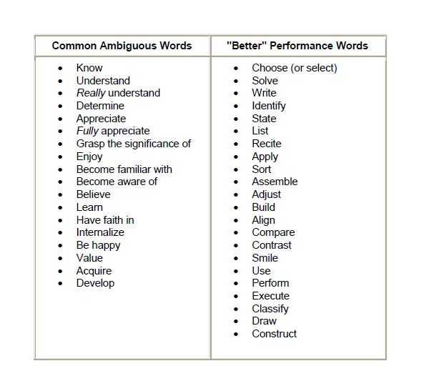
The Wording of Objectives

Slide 9
Instructional Objectives: Poor Examples
Why are these poor examples:
Students will understand English.
“understand” is not specific and measurable
Students will develop an appreciation of music.
“appreciation” is not specific and measurable
The teacher will conduct a lecture on proper noun usage.
Focuses on the teacher, not the students
Remember: SWBAT!

Slide 10
Instructional Objectives: Good Examples
Why are these good examples:
SWBAT:
act out verbal phrases.
i.e., Igor appears happy.
write a letter.
correctly solve at least 8 out of 10 true/false questions.
Act out, write and correctly solve [8/10] are observable and measurable behaviors.

Slide 11
A Quiz!
Analyze this objective using the
ABCD's of Learning Objectives
The student will be able to write the noun and verb, within a standard English sentence, without error.
Audience?
Student
Behavior?
Write
Condition?
A standard English sentence
Degree?
Without error

Slide 12

The Objective of this Presentation?
The participant will be able to write proper lesson goals and objectives without error.
Good Luck!!
www.robdanin.com

